Slide 1
Atomic Structure

Slide 2
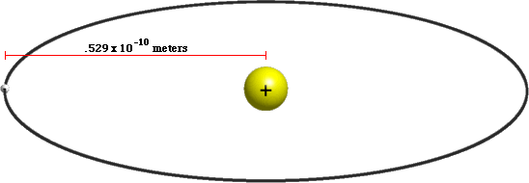
Why don’t you hit the ground?
0.0000000000004%
a hydrogen atom is 99.9999999999996%
percent empty

Slide 3
What is an Atom
An atom is the smallest particle of a substance that can exist by itself.
An atom consists of a central nucleus surrounded by a cloud of negatively charged electrons.
The nucleus is made up of positively charged protons and neutrally charged neutrons.

Slide 4
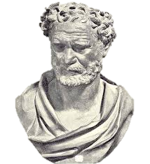
That which can’t be cut
The word atom means that which can’t be cut.
It was coined by a Greek scientist named Democritus who lived from 460 BC to 370 BC.
He asked a simple question. If I cut a stick in half is it still a stick?

Slide 5
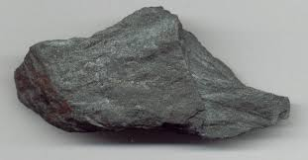
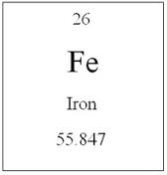
A Model of the Atom
Eventually scientists found out that certain substances could not be broken down into simpler parts.
An element is a substance made of atoms of only one kind. For example iron (Fe) is made of only iron atoms.

Slide 6
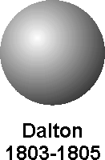
Daltons Concept
John Dalton was an English schoolteacher who came up with the following concepts.
All matter is made of atoms
Atoms cannot be divided into smaller pieces
All the atoms of an element are exactly alike
Different elements are made of different kinds of atoms

Slide 7
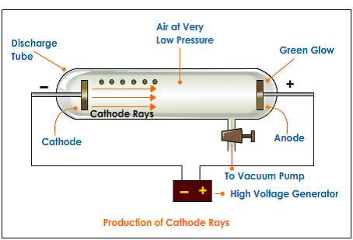
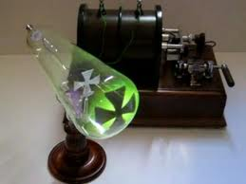
Scientific Evidence
William Crookes attempted to test Dalton’s theories in 1870.
He used a glass tube with almost all the air removed from it.
Crooke’s Cathode-ray Tube CRT

Slide 8
The glass tube had two pieces of metal called electrodes which were connected to a battery wire.
One electrode was called an anode and produced a positive charge the other was called a cathode and produced a negative charge.
Crooke’s Cathode-ray Tube CRT

Slide 9
In the center of the glass tube was a cross shaped object.
When the cathode and the anode were connected to the battery the tube lit up with a green glow.
A shadow of the cross was visible on the far side.
Crooke’s Cathode-ray Tube CRT

Slide 10
This showed that something was travelling in a straight line from the cathode.
Crooks proposed that these were called cathode rays as they were produced by the cathode.
Crooke’s Cathode-ray Tube CRT

Slide 11
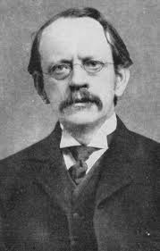
Discovering Charged Particles
Scientists were not convinced that the experiment was proof that cathode rays were streams of charged particles.
J.J. Thompson, an English physicist, conducted the same experiment but this time included a magnet in the glass tube.

Slide 12
Discovering Charged Particles
The beam of light was bent in the direction of the magnet.
As light cannot be bent by a magnet this was proof that the beam was made up from matter coming from the cathode.

Slide 13
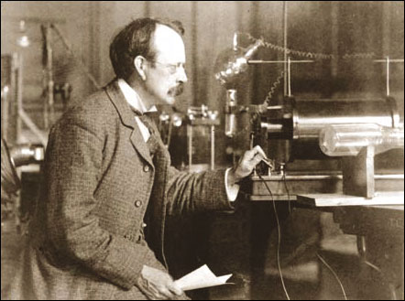
The Electron
Thomson repeated this experiment using different metals and different gasses in the tube.
He found that charged particles were always produced.

Slide 14
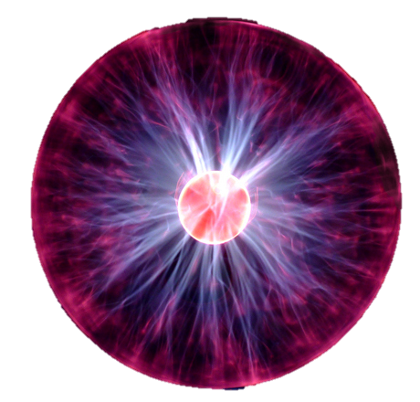
The Electron
Since the anode was positively charged and the particles were attracted to it he concluded that these particles must be negatively charged (since opposite charges attract).
We now call these negative charges electrons. From Thomson's experiments we know that they are in every type of atom.

Slide 15
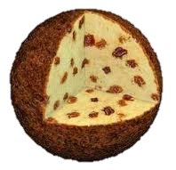
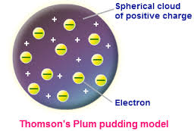
Thomson’s Atomic Model
Thomson concluded that since all atoms contained negatively charged particles they must also contain positively charged particles as not all matter is negatively charged.
Thomson revised Daltons model and produced a model that was positive throughout but has negatively charged electrons spread evenly among the positive charge.

Slide 16
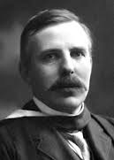
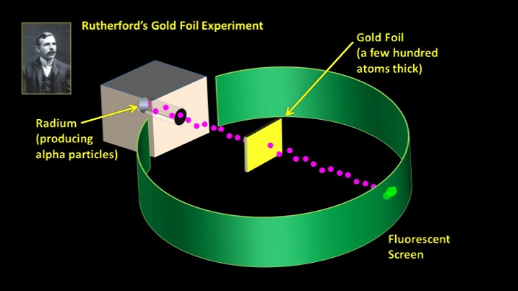
Rutherford’s Experiments
In 1906 Ernest Rutherford attempted to verify the Thomson model.
He fired fast moving positive particles called alpha particles at a piece of gold foil.
The gold foil was surrounded by a fluorescent screen that would flash when hit by an alpha particle.

Slide 17
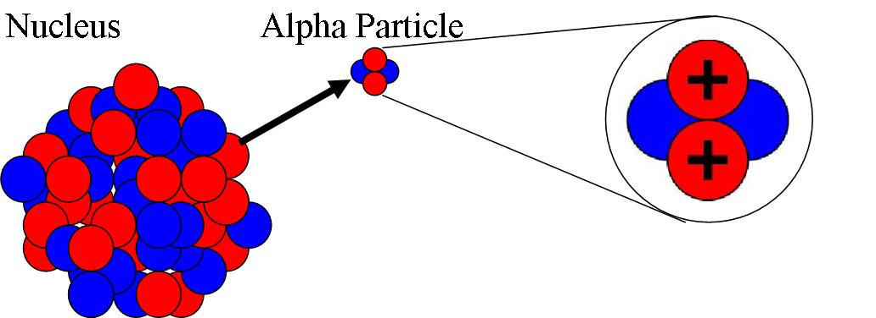
Rutherford expected that the alpha particles would pass through the gold with only a few deflections.

Slide 18
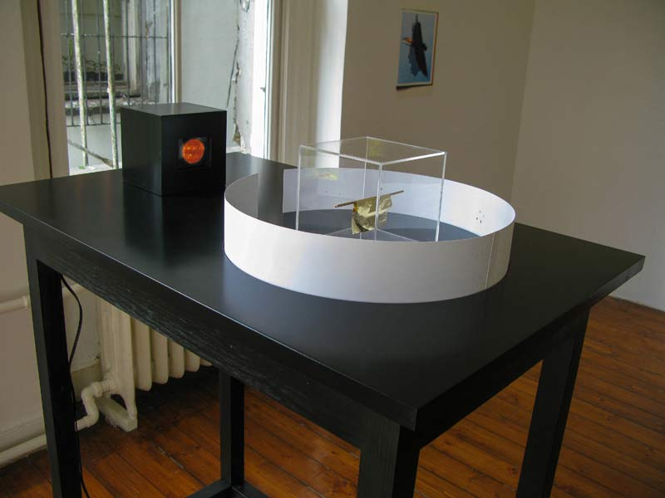
Rutherford’s Experiments
Rutherford was shocked when he learned that some particles were veering off at large angles.
It would take a large positive charge to cause the alpha particles to bounce back.
Thomson’s model with its uniform mix of negative and positive charges did not allow this to happen.

Slide 20
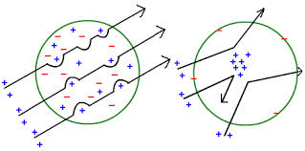
A Model with a Nucleus
The first diagram shows what Thomson expected to happen in his experiment.
The second diagram shows what actually happened.
Thomson proposed that almost all of the mass of an atom and all of its positive charge are crammed into an incredibly small area.
In 1920 scientists identified these positively charged particles as protons.

Slide 21
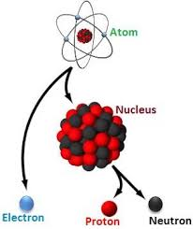
The Neutron
Rutherford’s work was applauded but it raised many questions.
The scientific process continued and new discoveries were made.
Rutherford had discovered the proton but most atoms contained around twice as much mass as was accounted for from the protons alone.

Slide 22
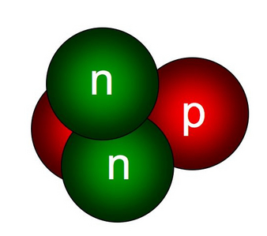
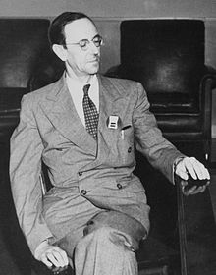
Neutrons
This lead to James Chadwick proposing the neutron. A neutron would have the same mass as a proton but be electrically neutral.
James Chadwick
1891-1974

Slide 23
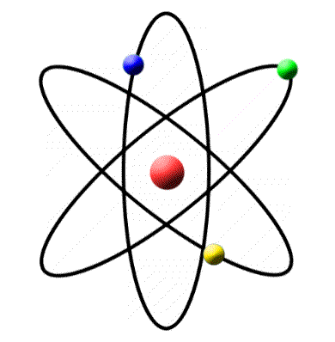
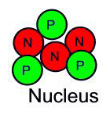
Rutherford's Model
Diagrams like this one do not give an accurate representation of the extreme smallness of the nucleus.
For example if the nucleus were the size of a table tennis ball the atom would have a diameter of more than 2.4 km (about 1.5 miles).

Slide 24
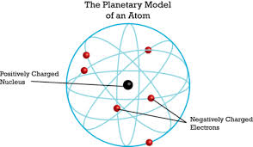
Rutherford's Model
This helps to explain why in Rutherford’s experiments most of the alpha particles passed right through the gold and when a nucleus was hit there were such large deflections.
Most of an atom is empty space.
But there are problems with this type of model.

Slide 25
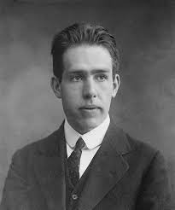
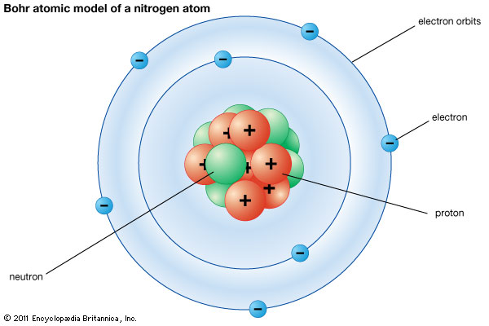
Further Developments
Niels Bohr calculated the orbits of electrons and what their energy levels would be.
Classic physics predicts that electrons should crash into the nucleus of an atom. Obviously this doesn’t happen.

Slide 26
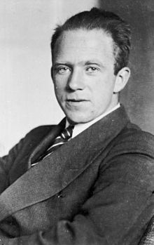
Standing on the shoulders of giants.
Other scientists soon discovered that it was impossible to know the precise location of an electron.
Scientists then produced models that considered electrons as waves rather than orbiting particles.
Werner Heisenberg put forward some of the first research to this effect.
Werner Heisenberg
1901-1976

Slide 27
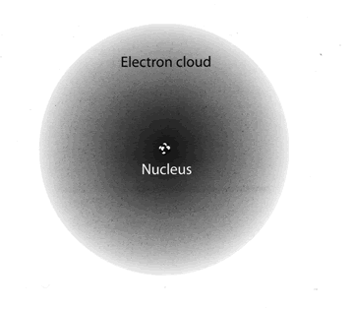
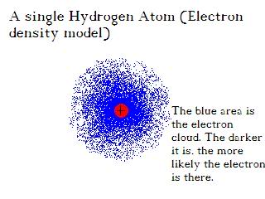
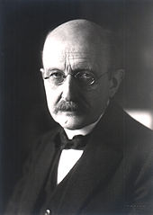
The Electron Cloud model
This lead to the creation of the electron cloud model that defines a region where an electron is most likely to be found. This is known as quantum mechanics.
Max Planck

Slide 28
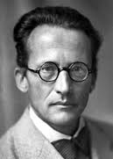
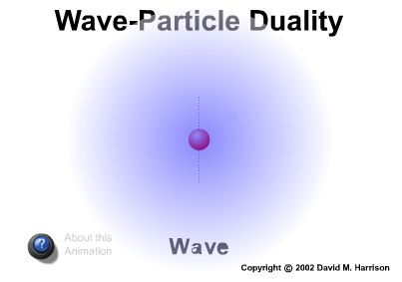
An electron is more like a wave
Quantum theory deals with the fact that an electron is not really like a particle.
It behaves more like a wave. Rather than a set orbit it has a zone of probability where it is likely to be found.
Erwin Shrodinger 1887-1961

Slide 29
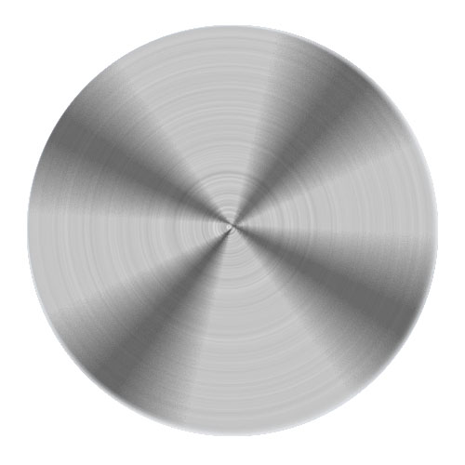
What is Quantum Mechanics?
Perhaps the easiest way to think about this is to think of the blades of a helicopter.
If you were to put a stick in the blades you would hit one. If you threw a ball into the blades at a really high velocity would you still hit one?

Slide 30
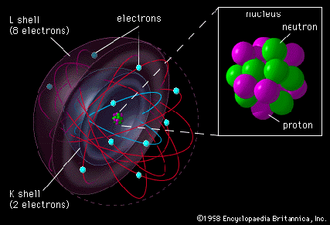
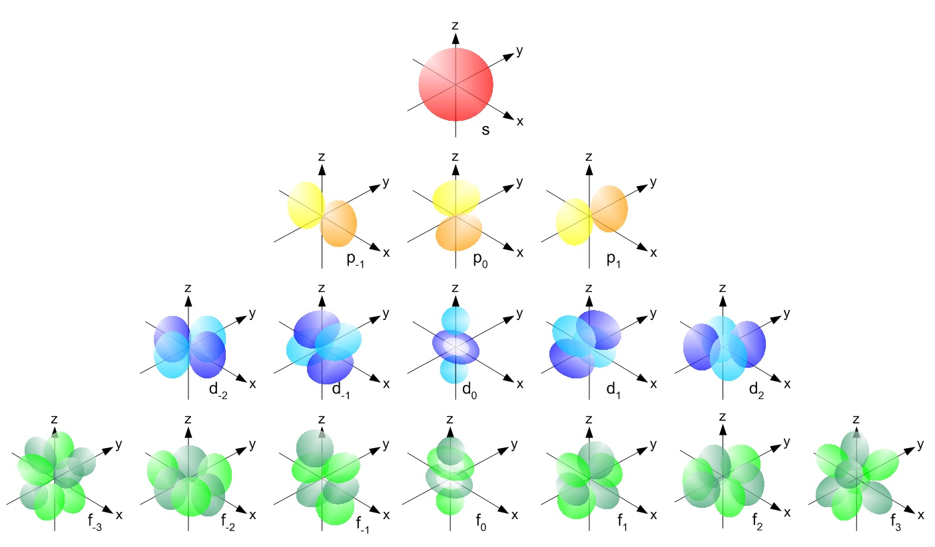
What is Quantum Mechanics?
The different electron shells are really an area of probability.
They represent the likely area in which an electron can be found.
Not only this but these shells are 3 dimensional

Slide 31
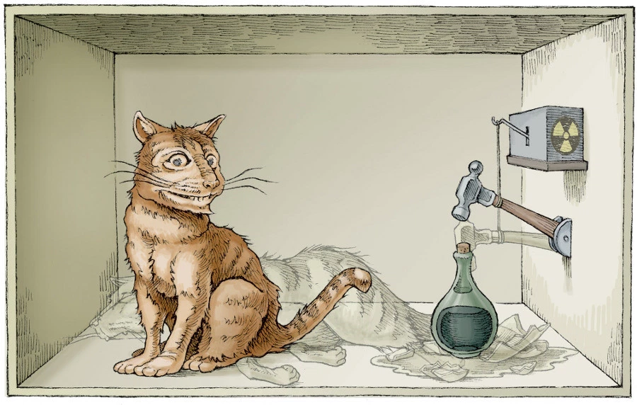

Slide 32
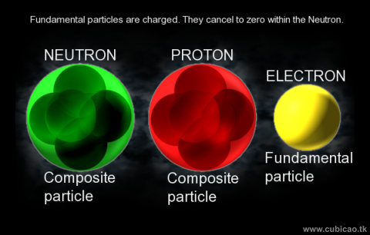
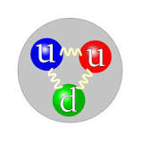
What’s smaller than a subatomic particle?
Protons and neutrons are made up of smaller particles called quarks.
A quark is an elementary particle and a fundamental constituent of matter.
Quarks combine to form composite particles called hadrons, the most stable of which are protons and neutrons, the components of atomic nuclei

Slide 35
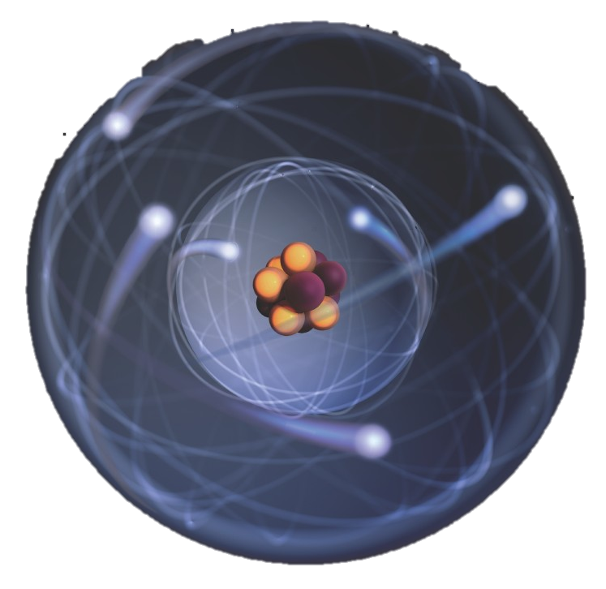
So what model do we use?
As 8th grade students we should have a good appreciation of the ways in which atomic theory has improved over the years.
We should recognize something like a simplified version of the Niles Bohr model shown to the right.

Slide 36
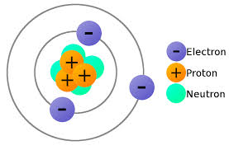
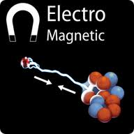
What keeps and atom together?
The electrons in the atoms are bound to the nucleus by electromagnetic force.
When an atom contains an equal number of protons and electrons it has a neutral charge.

Slide 37
Strong Nuclear Force
The neutrons and protons within the nucleus are bond together by a force known as the strong nuclear force or strong force.
This is one of the 4 fundamental forces in nature. The others being the electromagnetic force, gravity and the weak nuclear force.

Slide 38
Weak Nuclear Force
The weak nuclear force is what actually keeps sub-atomic particles together and is involved in nuclear decay.
We do not need to know much about it right now.

Slide 40
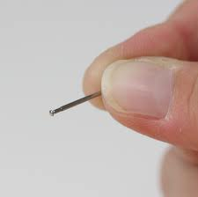
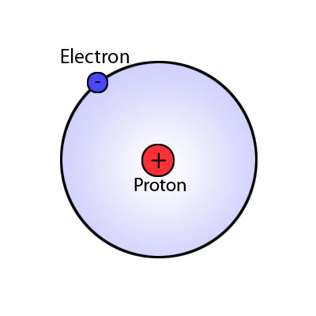
Just how small is an atom?
Atoms are so small that 5 trillion hydrogen atoms could fit on the head of a pin!

Slide 41
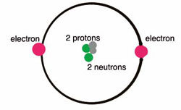
Measuring Length
Angstrom: metric length used to measure atoms (1 angstrom = 10⁻¹⁰ m or one ten billionth of a meter).
1,000,000 femtometer = 10 Angstrom.
Picometer: SI unit of length used to measure atoms. 1 angstrom = 100 pm.
A helium atom = 31 pm

Slide 42
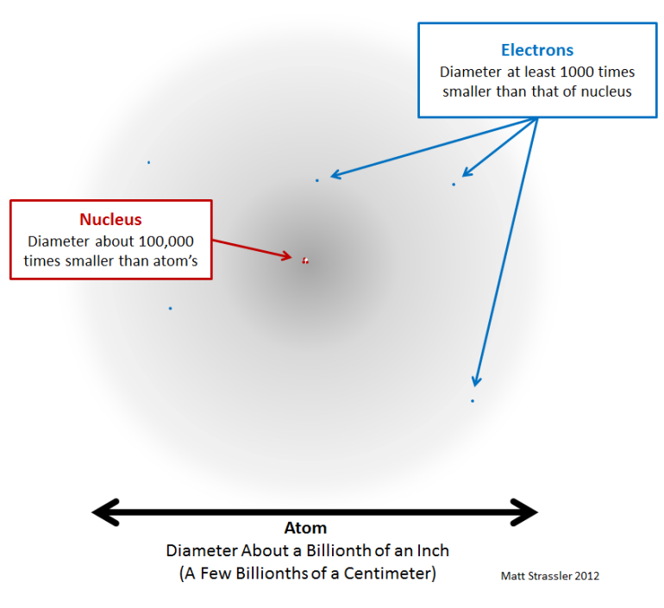
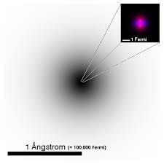
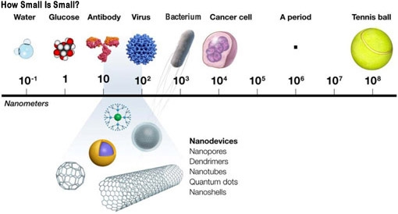
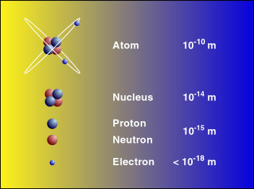
1 picometer = 1trillionth of a meter

Slide 44
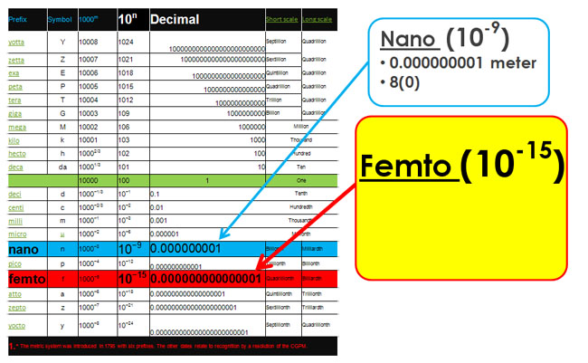

Slide 45
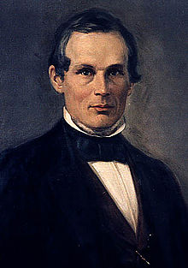
The Angstrom
The ångström (Swedish: [ˈɔŋstrøm]) or angstrom is a unit of length equal to 10⁻¹⁰ m (one ten-billionth of a meter) or 0.1 nanometer.
Its symbol is Å, a letter in the Swedish alphabet.
The unit is named after the Swedish physicist Anders Jonas Ångström (1814–1874).

Slide 46
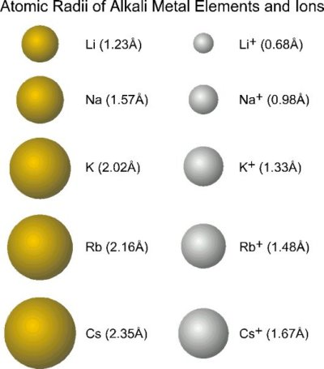
Dimensions of Atoms

Slide 47
Other words we should know
Element: a pure chemical substance consisting of only one type of atom
Molecule: a group of two or more atoms that are electrically neutral.
Ions: is an atom or a molecule where the number of electrons does not equal the number of protons. They either carry a positive (+ve) or a negative (-ve) charge.

