Slide 1
What is Energy?

Slide 2
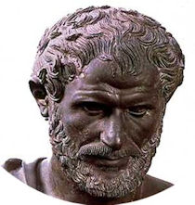
Historical Development of the Word "Energy"
The word "energy" has the Greek origin "Enérgeia".
Developed by Aristotle, Enérgeia has no direct translation to English, although it is frequently described as "being at work".
Energy was first used in the English language in the 1660s, referring to power.

Slide 3
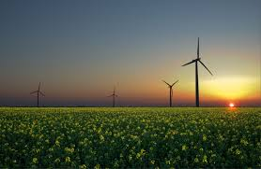
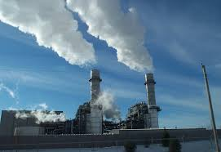
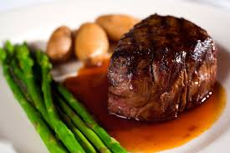
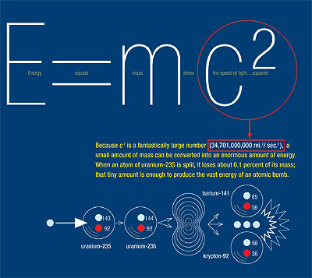
What is Energy
Energy is the ability to do work
Energy is the ability to cause change
All matter has energy but we only notice it when a change takes place.

Slide 4
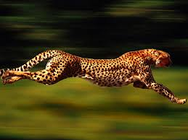
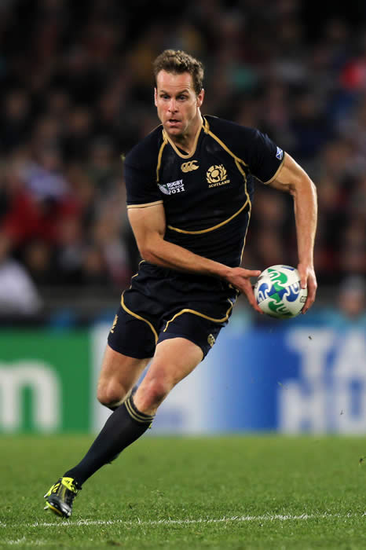
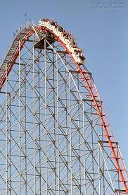
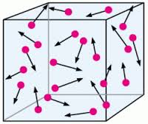
Energy of Motion
Things that move can cause change.
The energy of motion is called kinetic energy

Slide 5
Kinetic Energy
Kinetic energy (KE) is the energy of motion.
All matter is moving
The more KE something has the more it is moving.

Slide 6
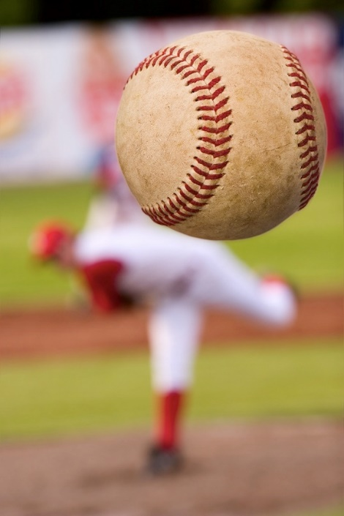
Kinetic Energy
The more kinetic energy something has the more it can change it can cause.
Faster moving objects have more energy than slower moving objects.

Slide 7
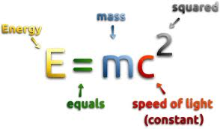
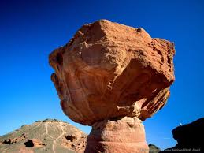
Kinetic Energy and Mass
The more mass something has the more energy it has.
A bowling bowl rolling down an alley at 5 m/s has more energy than a soccer ball rolling down an alley at the same speed.
The amount of kinetic energy depends on the mass of a moving object.

Slide 8
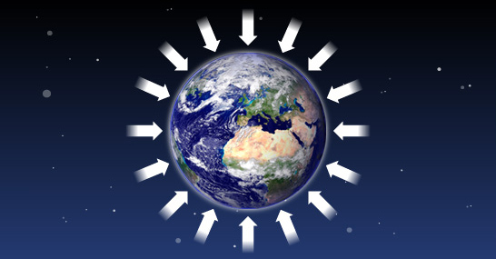
Potential Energy
Potential energy (PE) is the energy stored in an object due to its position.
Gravitational PE – depends on vertical position and mass

Slide 9
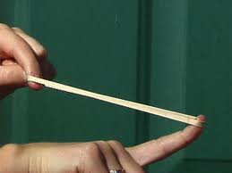
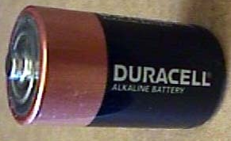
Other Types of Potential Energy
Elastic potential energy – of an extended spring or elastic band
Electric potential energy – of a charge in an electrical field
Chemical potential energy – for example the energy stored in food.

Slide 12
Potential Energy

Slide 14
The Law of Conservation of Energy
The law of conservation of energy states that;
Energy cannot be created or destroyed. It can be transferred from one type to another.
Newton's laws of thermodynamics tell us that there is an increasing amount of disorganized energy in the universe (entropy).

Slide 15
Identify the Types of Energy

Slide 26
Calculating PE
We can calculate the mathematical value of an objects potential energy.
Potential Energy = mass x gravity x height
PE = m x g x h
Mass is measured in Kg, height in m, and gravity is N (9.8N)

Slide 27
Calculating KE
Kinetic energy can also be calculated.
Kinetic energy = ½ mass x velocity²
KE= ½ mv²
Mass = kg, velocity = m/s. As both these calculations are measurements of energy the answer should be in Joules (J)

Slide 28
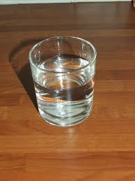
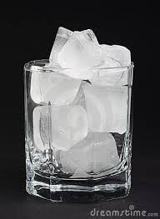
Types of Energy
Thermal Energy
All objects have thermal energy. Thermal energy is heat energy. Heat is the flow of energy from high to low.

Slide 29
Types of Energy
Chemical energy
Food contains chemical energy. Food contains bonds and energy is stored in these bonds. When chemical bonds are broken apart and new bonds are formed some energy is released.

Slide 30
Light Energy
Light travels at very fast speeds (300,000 Km/s).
When light strikes something it can be absorbed, transmitted or reflected.
Absorbed light becomes thermal energy. The energy carried by light is called radiant energy.

Slide 31
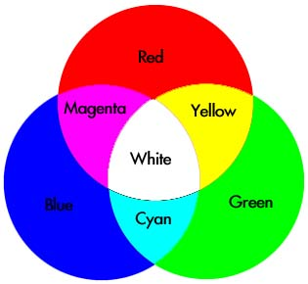
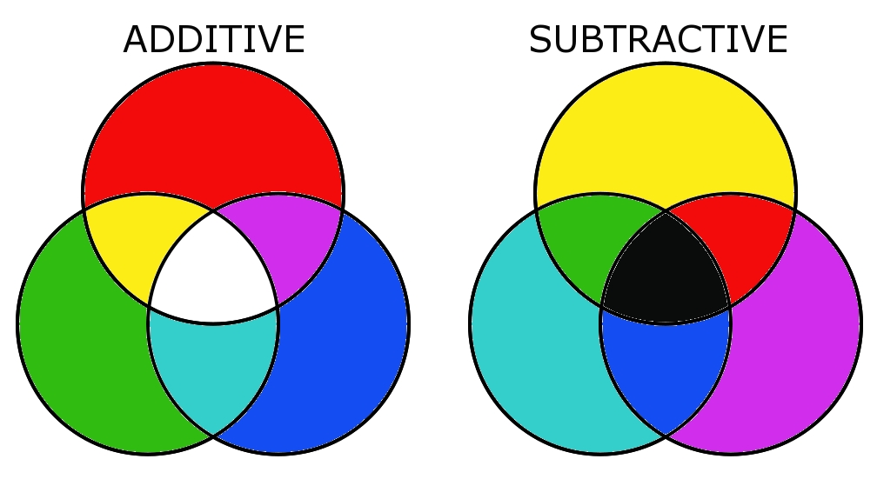
Light waves are electromagnetic waves that can travel through the vacuum of space.
This type of energy is sometimes referred to as radiant energy.

Slide 32
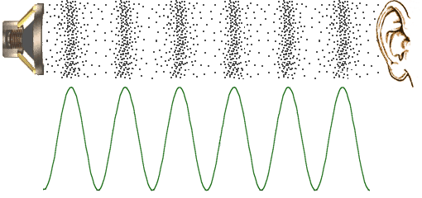
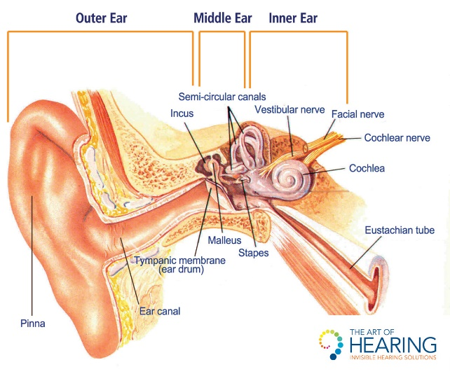
Sound Energy
Like light energy sound energy is also in wave form.
Unlike light, sound energy cannot travel through a vacuum and needs a medium to move through.

Slide 33
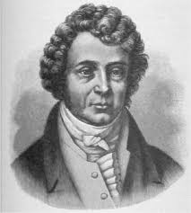
Electrical Energy
An electrical current carries electric energy. This energy is used to power our devices and light and heat our homes.
We produce electrical currents by passing a highly conductive metal such as copper through a magnetic field.
This produces amperes (amps). Amperes measure the rate at which electrons are flowing in a current.
André-Marie Ampère (1775–1836)

Slide 34
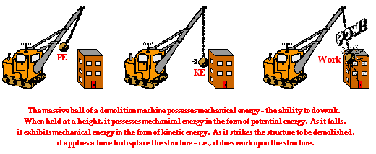
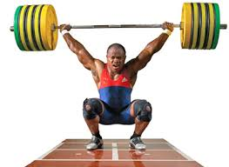
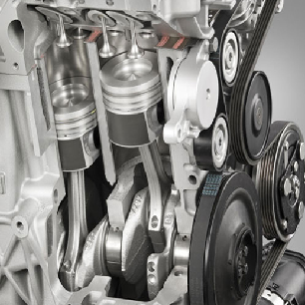
Mechanical Energy
Mechanical energy is the energy possessed by an object due to its motion or its stored energy of position.
This energy can be mechanical or potential.

Slide 35
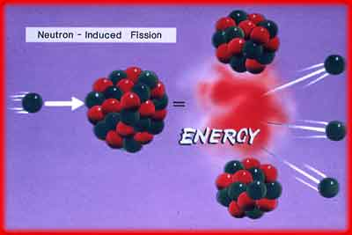
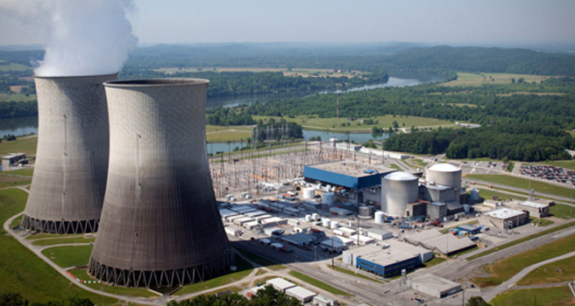
Nuclear Energy
Nuclear fission power plants use the energy released in atoms to generate electricity. This requires complex reactors and produces very dangerous waste products.
As radioactive atoms such as Plutonium decay they release energy.

Slide 36
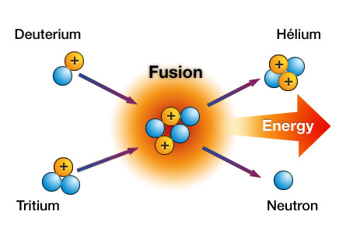
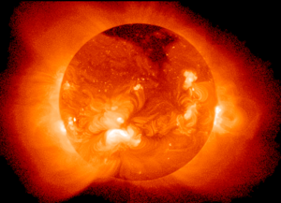
Fusion Reactors
New fusion reactors may soon create energy by joining atoms together. This also creates energy without the same environmental problems.

