Slide 1
What is Motion?

Slide 2
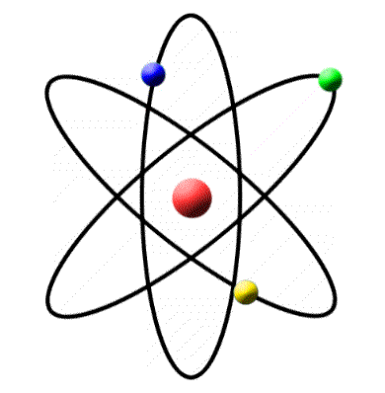
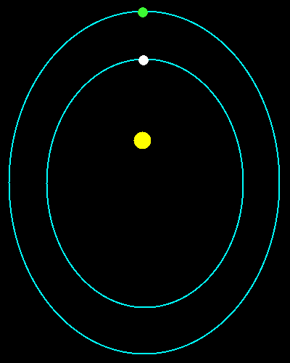
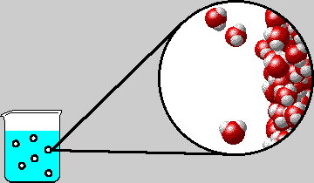
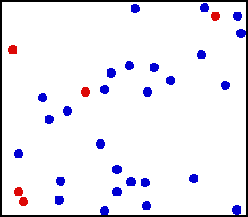
Matter and Motion
All matter is constantly in motion
From electrons moving round the nucleus of an atom to molecules circulating round a fluid or gas, to planets orbiting the Sun.
These are all examples of motion
How do we describe these different types of motion?

Slide 3
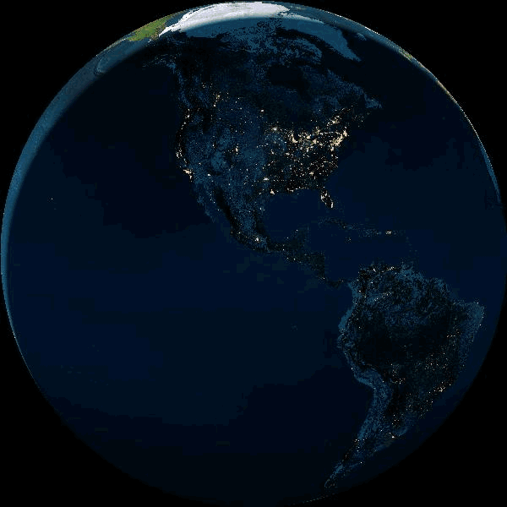
We are all moving very fast
The Earth rotates once every 23 hours, 56 minutes and 4.09053 seconds, called the sidereal period, and its circumference is roughly 40,075 kilometers.
Thus, the surface of the earth at the equator moves at a speed of 460 meters per second--or roughly 1,000 miles per hour

Slide 4
Questions
If I jump up have I changed position after I land?
If the earth is moving at 460 m/s am I in danger of falling of the Earth?
Why is this the case?

Slide 5
Changing Position
To describe an object in motion you must first recognize that an object is in motion.
How do we know something is moving?
What about a person running?

Slide 6
Frame of Reference
Something is in motion if it is changing position.
When an object moves form one location to another it is changing position.
But how can we see that an object has moved?

Slide 7
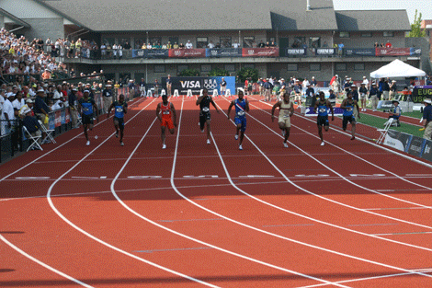
Relative Motion
Determining whether something has moved requires a point of reference.
An object changes position relative to a fixed reference point.
For example we can see that sprinters are moving by the action of their bodies but we can only measure that movement relative to the reference point.

Slide 8
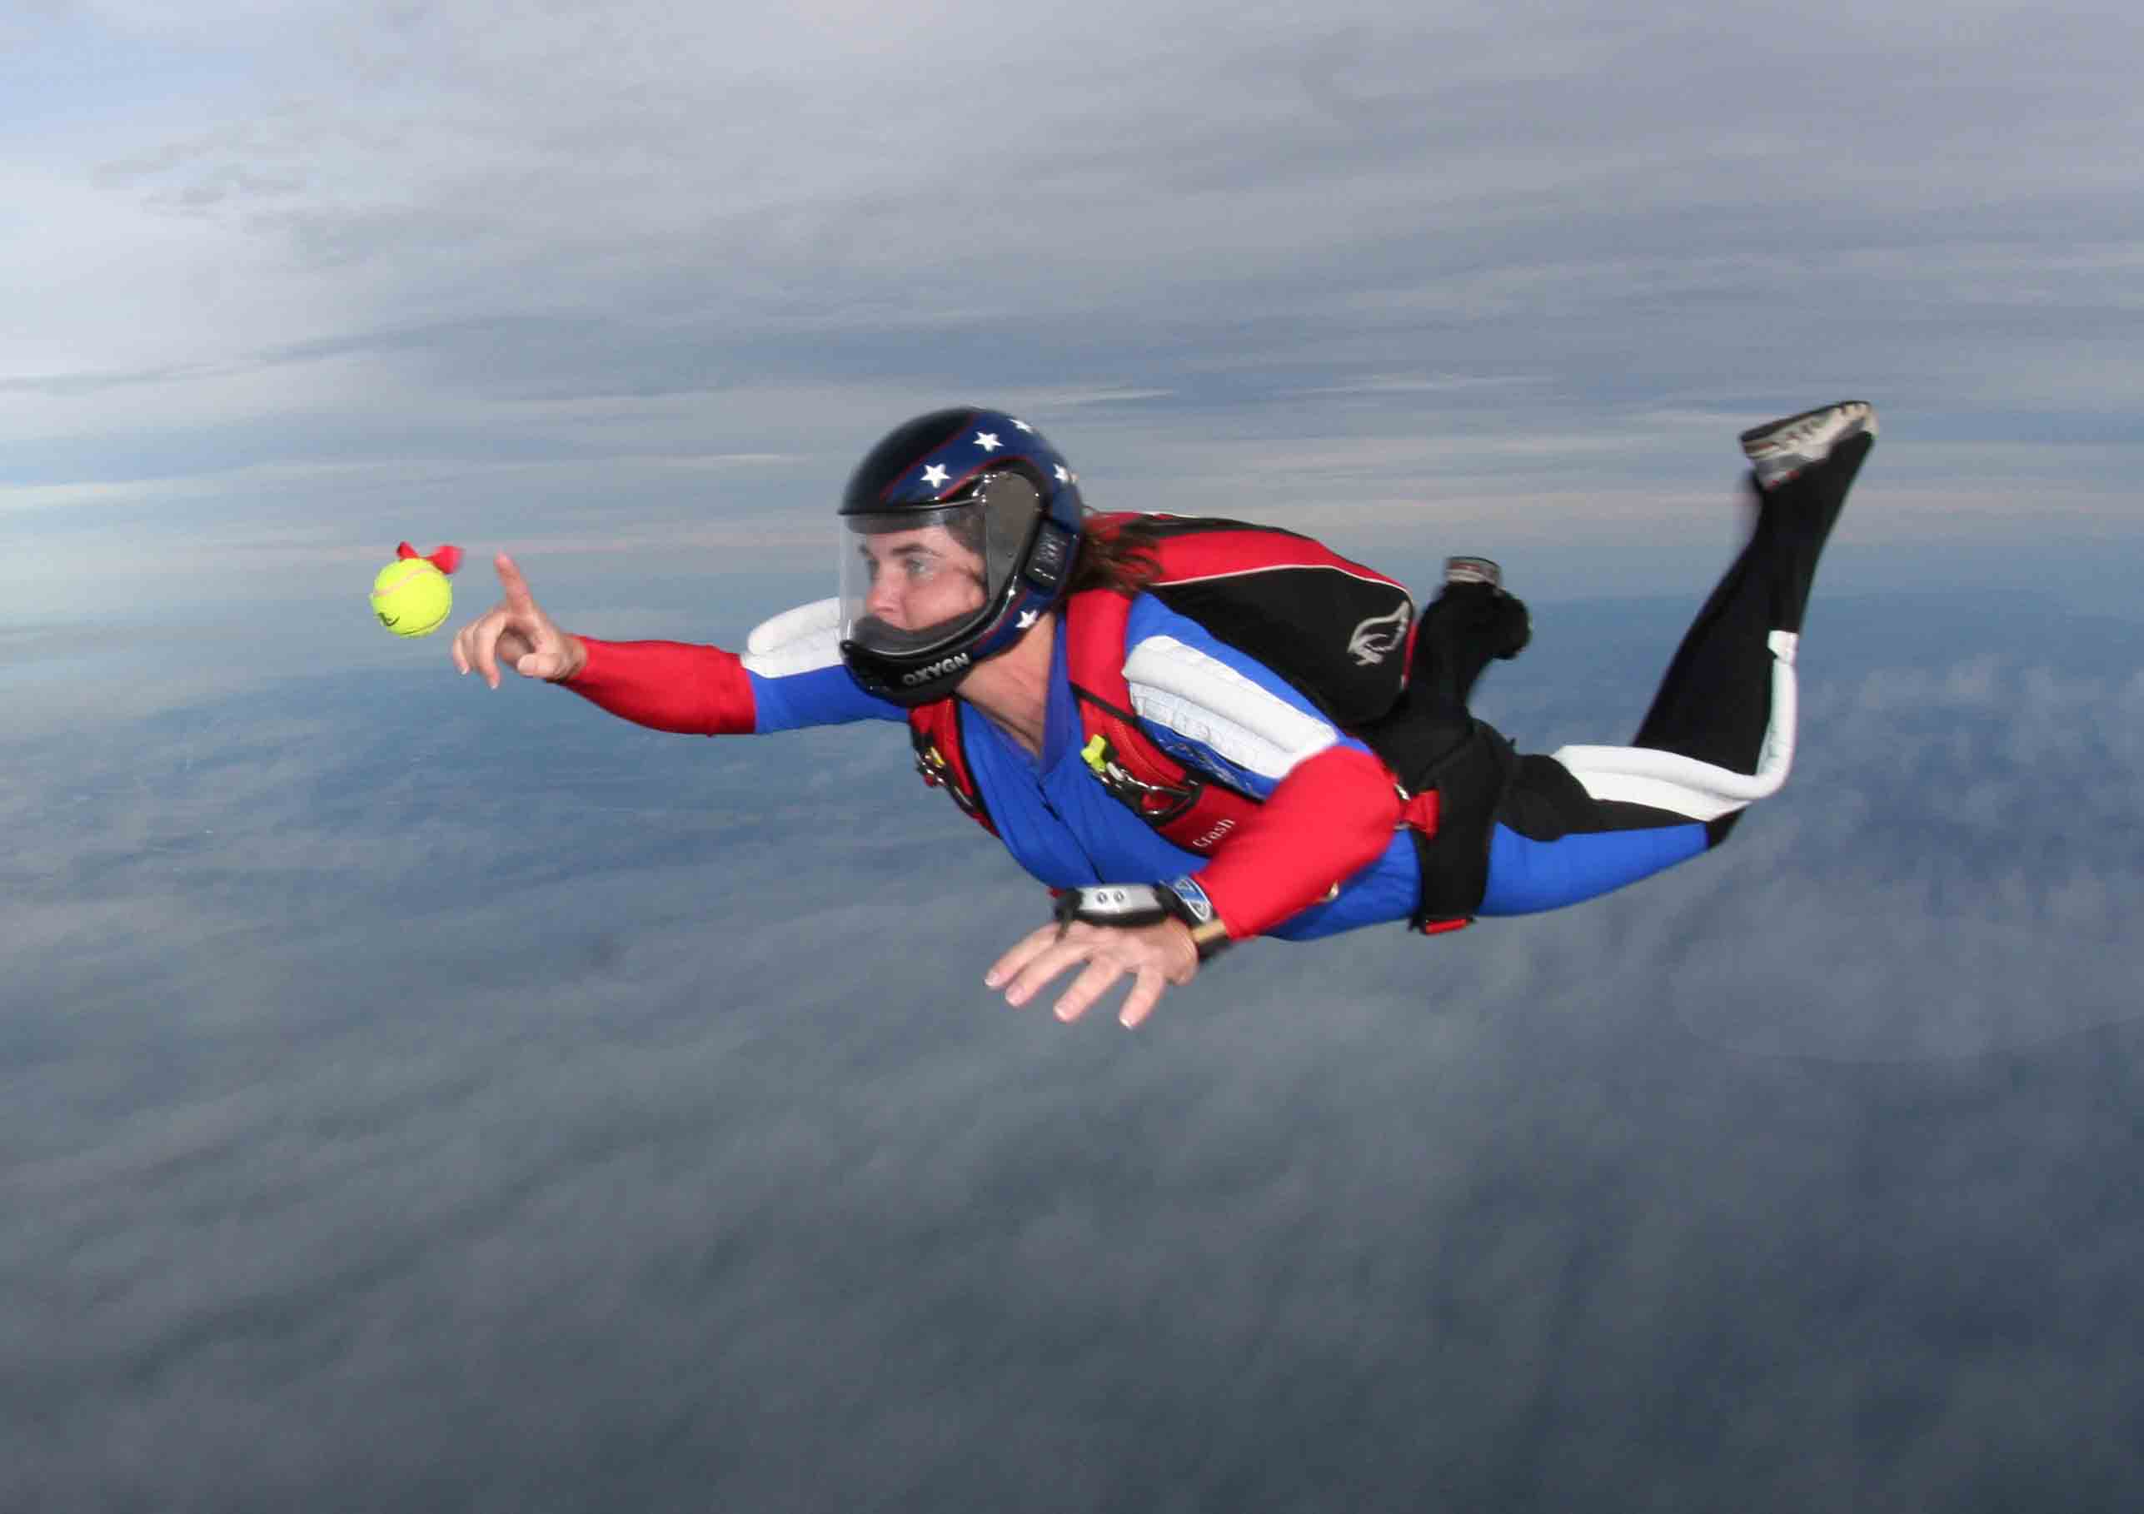
What is Motion?
All movement is relative.
Motion occurs when something changes position relative to a reference point.

Slide 9
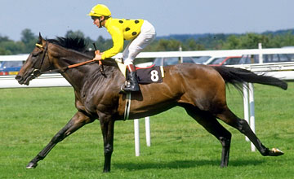
Reference Point
A reference point is a stationary object in the background.
This is known as the point of reference.

Slide 10
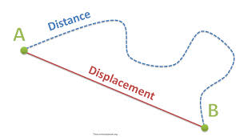
Distance and Displacement
Distance is the length of a route that an object will travel.
Displacement is the distance you travel and the direction you travel in.

Slide 11
Vector and Scalar
A scalar quality has only magnitude. Distance is a scalar quality.
This is known as a vector quality as it has both magnitude and direction.

Slide 12
Speed
Speed is the distance an object travels in a unit of time.
For example an object moving at 5m/s can travel 5m in 1 second.

Slide 13
Speed Equation
Speed (meters/second) $=\frac{distance (in meters)}{time (in seconds)}$ or s$=\frac{d}{t}$
The SI units for speed is meters per second but it can be calculated using other units such as kilometers and hours.

Slide 14
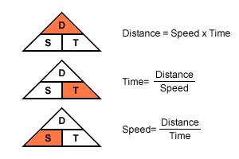
Speed, Distance, Time equations

Slide 15
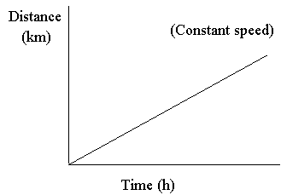
Constant Speed
When an object in motion travels at a constant speed (no acceleration – speeding up or slowing down) it is called constant speed.
Note: acceleration = rate
of change in velocity

Slide 16
Average Speed
Often objects do not move at a constant speed.
They are constantly speeding up and slowing down.
How can we describe the speed of an object that is constantly stopping and starting?
Average speed is found by dividing the total distance traveled by the total time taken
Average speed $=\frac{total distance traveled}{total time taken}$

Slide 18
Instantaneous Speed
As we just talked about sometimes objects speed up and slow down many times.
The speed of an object at any one instant in time is called instantaneous speed.
The instantaneous speed is like a snap shot of what is happening over a longer period of time. It may be faster or slower than the average speed.

Slide 19
Velocity
The motion of an object also depends on the direction in which it is moving.
Velocity is an objects speed and the direction of movement.
It is another example of a vector quality in that it has both magnitude and direction.
If you wanted to give a velocity it would have to contain both aspects. So for example a car may have a speed of 5m/s but its velocity would be 5 m/s north.

Slide 20
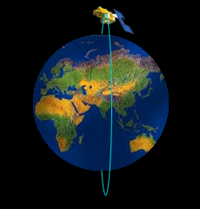
Change in Velocity
If an objects speed changes its velocity changes.
If an objects direction change its velocity also changes.
How would you describe the velocity of a satellite orbiting the Earth?

Slide 21
What is Orbital Motion?
Orbital motion is really just an object that is in freefall around the Earth.
In order to achieve this the object must be launched with a velocity of around 3000 m/s.
The object will then travel around the Earth at the same rate that it falls.
Thus it will never actually hit the Earth.

Slide 22
Graphing Motion
The motion of an object can be represented with a distance time graph.
Time is plotted on the horizontal axis ( ).
Distance is plotted on the vertical axis ( ).

Slide 23
Distance Time Graphs
Distance (m)
Time (s)
/s
TT

Slide 24
Distance Time Graphs and Speed
A distance time graph can be used to compare the speeds of objects.
Speed $=\frac{distance}{time}$ $=\frac{10m}{1s}$ $=$ 10 m/s
Speed $=\frac{distance}{time}$ $=\frac{5m}{1s}$ $=$ 5 m/s

Slide 25
Distance Time Graph – Showing Linear Velocity
10 m/s
Distance (m)
5 m/s
Time (s)

Slide 26
Distance Time Graphs
Distance time graphs can show the movement of objects
The graph opposite shows a number of different movement scenarios.

Slide 28
Interpret the Graphs
2
1
3

Slide 31
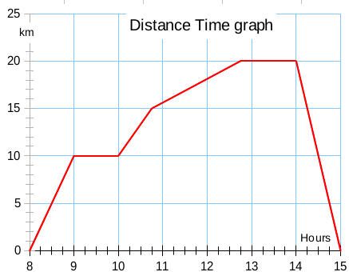

Slide 33
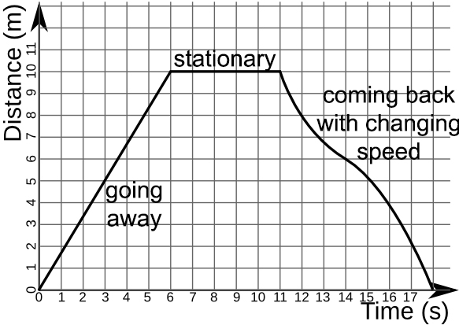

Slide 35
Scalar and Vector Qualities
Velocity is known as a vector quality
This means that it has both magnitude and direction
Speed is a scalar quality
This means that it has only magnitude

Slide 36
Knowledge and Understanding
How do we define motion?
An object is in motion when it changes position
How do we measure motion?
We measure motion relative to a frame of reference.
What is the definition of speed?
How far an object moves in a unit of time. The SI unit of speed is m/s
What is the definition of velocity?
Velocity is the vector quality of speed and direction.

Slide 37
Knowledge and Understanding
What is the definition of average speed?
Average speed is the distance traveled divided by the time taken to get there.
What is the definition of instantaneous speed?
Instantaneous speed is the exact speed at any point in time. I.S. may be more or less than the average speed.
If an object travels at a constant speed of 7m/s and changes direction from north to south every 5 seconds does its velocity change?
Yes. Velocity is both speed and direction so if you alter one of these qualities you change an objects velocity.

Slide 38
MCAS Questions
Distance-time graphs and motion

Slide 41
