Slide 1
Identifying the Substance of Genes
Chapter 12.1

Slide 2
Identifying the Substance of Genes
How does a gene work?
If we wanted to understand how a car engine works we would first need to learn what the individual parts do.
The same principle hold true for understanding genes. If we want to know how a gene works we first need to know what the basic unit of a gene is, and how it is structured.
A gene is made from DNA.

Slide 3
Identifying the Substance of Genes
In the first half of the 20th century biologist were developing the filed of genetics.
Scientist already knew about genes but they did not know about the chemical structure of genes.
In order to fully understand genetics scientist would have to learn more about the actual physical structure of genes.
The discovery of the chemical nature of genes began (like many scientific discoveries) when scientists were looking for something else.

Slide 4
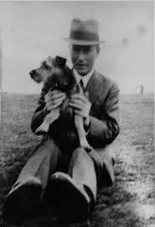
Frederick Griffith
Frederick Griffith was a British scientist who was trying to figure out why bacteria made people sick.
Specifically he was looking at the bacteria that caused the serious lung illness pneumonia (Streptococcus pneumonia).
He conducted what are now known as the Griffith experiments.
Frederick Griffith (1879-1941)

Slide 5
The Griffith Experiments
Griffith had isolated two very similar types of bacteria from mice.
They were actually two strains of the same bacterial species.
Both strains grew well in culture plates. One had smooth edges and caused pneumonia (S strain) and one had rough edges and did not cause pneumonia (R strain).
The difference in appearance made the two colonies very easy to tell apart.

Slide 6
Griffith’s Experiments
When Griffith injected mice with the S strain (disease causing) they developed pneumonia and died.
When he injected mice with the R strain they remained healthy.
Griffith wandered what it was that killed the mice injected with the S strain? Was it some sort of toxin produced by the S strain bacteria?

Slide 7
Griffith’s Experiments
To investigate this Griffith conducted a number of experiments.
First he took a culture of the S strain, heated the bacteria to kill them, then injected the heat-killed bacteria into laboratory mice.
The mice survived. This suggested that the cause of pneumonia was not a toxin produced by bacteria.

Slide 8
Griffith’s Experiments
In Griffiths next experiment he mixed some of the heat-killed bacteria with the non-disease causing R strain bacteria, then injected the mixture into some mice.
Remember neither type of bacteria should have killed the mice. To Griffith’s surprise the injected mice developed pneumonia and died.
When he examined the mice he found that their lungs were filled with the S strain bacteria.
How could this have happened if the S strain in the mix were dead?

Slide 9
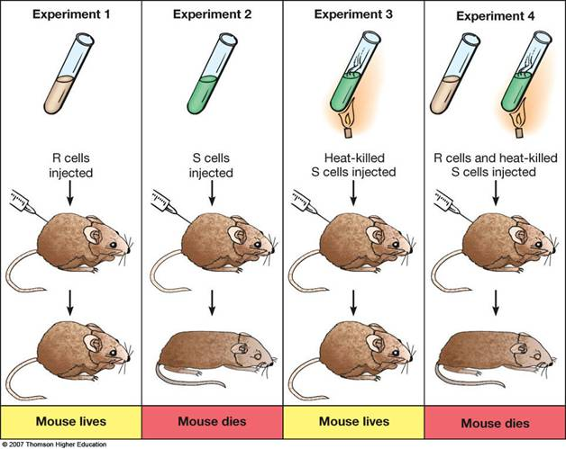
Griffith’s Experiments

Slide 10
Transformation
Somehow the heat killed bacteria had transferred their disease-causing ability to the harmless R strain bacteria.
Griffith reasoned that when he had mixed the two strands together some chemical factor had transferred from the heat-killed cells of the S strain to the live cells of the R strain.
He called this process transformation as one type of bacteria had been permanently changed into another.
Because the ability to cause disease was inherited by the offspring of the transformed bacteria Griffith concluded that the transforming factor must be a gene.

Slide 11
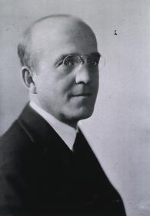
The Molecular cause of Transformation
In 1944 a group of scientists in NY led by Canadian biologist Oswald Avery decided to repeat Griffith’s experiments.
They hypothesized that if they could find the most important molecule in transformation it might reveal the chemical nature of the gene.
Oswald Avery (1877-1955)

Slide 12
The Molecular cause of Transformation
Avery’s team extracted a mixture of various molecules from the heat-killed bacteria.
They treated the mixture with enzymes that destroyed proteins, lipids, carbohydrates, and some other molecules including the nucleic acid RNA.
Transformation still occurred. Since all of the above molecules had been destroyed none of them could be responsible for transformation.

Slide 13
The Molecular cause of Transformation
Avery’s team repeated the experiment again. This time they used enzymes that destroyed a different nucleic acid – DNA.
This time transformation did not occur.
By observing bacterial transformation Avery and other scientists discovered that the nucleic acid DNA (deoxyribonucleic acid) transmits genetic information from one generation to the next.

Slide 14
Bacterial Viruses
What role did bacterial viruses play in identifying genetic material?
Due to the nature of science it usually takes several experiments (repeated multiple times) to convince scientist about something as important as the nature of genes.
One of the most important discoveries was made by two people in Avery’s team – Alfred Hershey and Avery Chase.
They conducted experiments of viruses – tiny non-living particles that can infect living cells.

Slide 15
Bacteriophage
A bacteriophage is a type of virus that infects bacteria.
The bacteriophage attaches itself to the surface of the bacteria cell and injects its genetic information into the cell.
The genetic information is used to produce many new copies of the bacteriophage.
Eventually the bacteria cell bursts open and hundreds of new viruses leave to go and infect more cells.

Slide 16
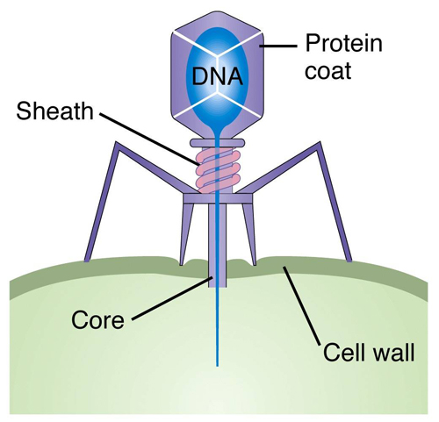
Bacteriophages

Slide 17
The Hershey-Chase Experiment
Hershey and Chase studied a bacteriophage that consisted of a protein coat and a DNA core.
They wanted to determine which part of the bacteriophage entered the cell – the protein coat or the DNA core.
The results would either support or reject Avery’s findings that genes were made of DNA.

Slide 18
The Hershey-Chase Experiment
They grew bacteriophages in cultures that contained two different radioactive isotopes – phosphorus-32 (³²P) and sulphur-35 (³⁵S).
This was a good strategy as protein contains almost no phosphorus and DNA contains no sulphur.
If they found 35S in the bacteria cells it would mean that the protein coat had been injected into cell.
If they found 32P it would confirm that the DNA had been injected into the cell.

Slide 19
The Hershey-Chase Experiment
Hershey and Chase mixed the marked viruses with bacterial cells. They waited a few minutes for the bacteria to be infected and then separated the viruses and bacteria.
They then tested bacteria to find out which radioactive marker had been passed on – the one in the DNA or the one in the protein coat.
The results showed that nearly all the radioactivity found in the infected bacterial cells was ³²P – the marker found in DNA.
This confirmed the fact that the bacteriophage was passing on its genetic information through DNA and confirmed Avery’s findings.

Slide 20
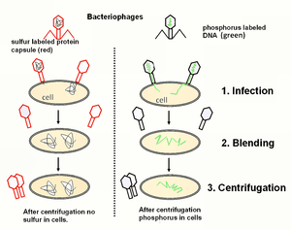
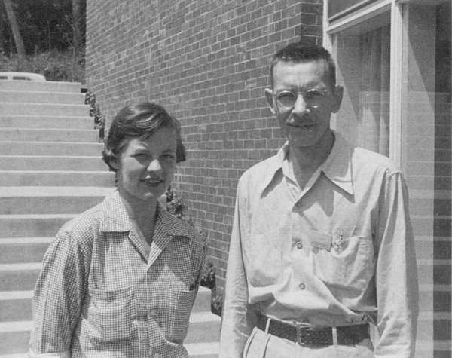
The Hershey-Chase Experiment
Video: Hershey-Chase Experiment
Martha Chase (1927-2003) and Alfred Hershey (1908-1997)

Slide 21
The Role of DNA
Scientist know knew that genes were made of DNA.
The next step was to more fully understand exactly hom DNA passed on this genetic information.
The next era of study beagan with the following basic assumption;
The DNA that makes up genes must be capable of storing, copying, and transmitting the genetic information from a cell.
This happens in much the same way that knowledge is passed down from one generation to the next in books.

Slide 22
Storing Information
The foremost role of DNA is to store the genetic information of an organism.
For example the genes of a red flowered plant must have the information that produces red pigment.
Genes control patterns of development so the information that turns a single cell into a complex multi-celled organism such as a human must be contained in the DNA of our genes.

Slide 23
Copying Information
Before a cell divides it must make a complete copy of every one of its genes.
The mechanism for this was unclear until the exact structure of DNA had been discovered.
Once this was known, within a few weeks scientists had come up with a working model for DNA replication.

Slide 24
Transmitting Information
As Mendel’s work had shown genes are passed down from one generation to the next.
Therefore DNA molecules must be carefully sorted and passed along during cell division. This is especially true during the process of meiosis where cells divide in order to produce gametes.
Eukaryotic cells contain many chromosomes. The loss of any genes (or any DNA) would result in important genetic information not being passed down to the next generation.

