Slide 1
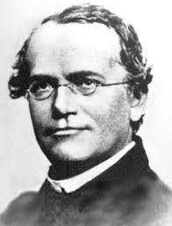
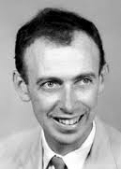
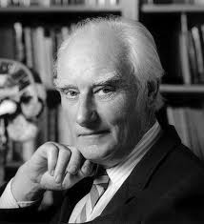
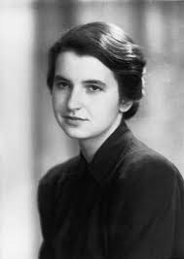
The Structure of DNA
Mendel
Watson
Chapter 12.2
Crick
Franklin

Slide 2
The components of DNA
Scientists now knew that DNA was the molecule that passed on and carried genetic information.
The next step was to explain how DNA did this.
Scientists needed to explain how DNA was able to code for proteins as well as how it was replicated and inherited.
To do this they needed to understand the chemical componets of DNA.

Slide 3
Deoxyribonucleic Acid
DNA is a nucleic acid made up of nucleotides joined into long strands or chains by covalent bonds.
Nucleic acids are long, slightly acidic molecules that were originally identified in cell nuclei.
Like many other macromolecules nucleic acids are made up of smaller subunits liked together to form long chains.
Nucleotides are the building blocks of nucleic acids. Each nucleotide is made from 3 components; a 5-carbon sugar, called deoxyribose, a phosphate group and a nitrogenous base.

Slide 4
Nitrogenous Bases and Covalent Bonds
Nitrogenous bases are simply bases that contain nitrogen. DNA has 4 different types of base; adenine (A), thymine (T), guanine (G), and cytosine (C).
Nucleotides are joined together by covalent bonds (a bond between atoms where electrons are shared) that form between the phosphate group of one nucleotide and the sugar group of another.
In this way the nitrogenous bases stick out sideways from the nucleotide chain.
The nucleotides can be arranged in any order and as we will see it is the sequence of nitrogenous bases that makes up our genetic code.
At first is was unclear, and scientists were mystified, how this simple structure could provide such diversity of life as is witnessed on Earth.

Slide 5
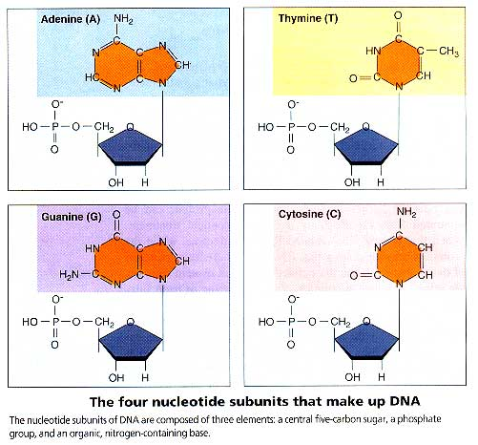
DNA Nucleotides

Slide 6
Solving the Structure of DNA
Knowing the chemical structure of DNA was only the beginning of our understanding of how it works.
To fully comprehend how DNA works we needed to understand how those chains were arranged in three dimensions.
To find out how this was discovered we need to take a look at the work of several prominent scientists.

Slide 7
Chargaff’s Rules
An Austrian-American scientist named Erwin Chargaff discovered that DNA had equal percentages of adenine and thymine bases.
The same is true for guanine and cytosine.
The fact that [A] = [T] and [G] = [C] became known as one of “Chargaff’s rules”.
This was true even when DNA samples were taken from organisms as different as bacteria and humans.
Nobody could say why this was the case.

Slide 8
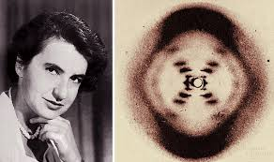
Franklin’s X-Rays
Rosalind Franklin was a British scientist who began to study DNA in the early 1950s
She used a technique called X-ray diffraction to get information about the structure of DNA.
This involved stretching out some molecules of DNA and then aiming a powerful X-ray at them. She worked tirelessly to obtain better and better patterns.

Slide 9
Franklin’s X-Rays
By itself her work does not give the structure of DNA but it does offer some very important clues.
The X-shaped pattern she discovered shows that DNA strands are twisted around each other in a shape known as a double helix.
The angle of the X shows that there are two strands in the structure.
Other clues suggest that the nitrogenous bases are near the center of the DNA molecule.

Slide 10
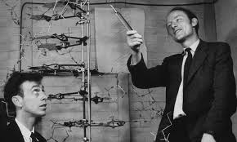
Watson and Crick
At the same time that Franklin was conducting her experiments, James Watson (an American Biologist) and Francis Crick (a British physicist) were also trying to understand the structure of DNA.
They made 3-dimensional models from card and wire but were unable to come up with a structure that could explain DNA’s properties.
In 1953, Watson was shown a copy of one of Franklin’s X-rays and the structure of DNA immediately became apparent to him.

Slide 11
Watson and Crick
Watson and Crick were able to build a model that explained the specific structure and properties of DNA.
Their results were published in April 1953, the same time that Franklin’s work was published.
Watson and Crick were later awarded the Nobel Prize in Physiology or Medicine. Franklin died in 1958 and so was ineligible for nomination.

Slide 12
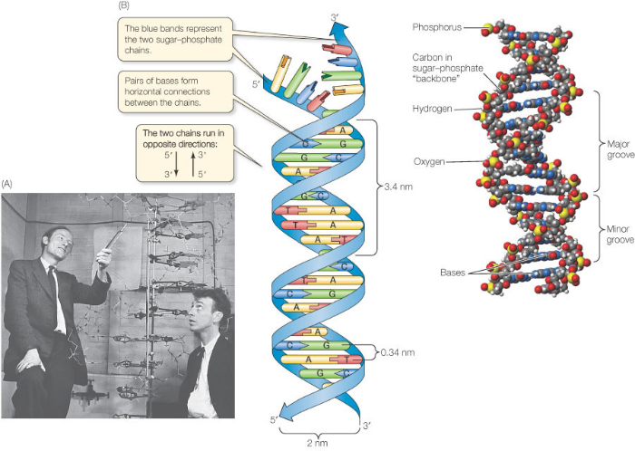
The Double-Helix Model

Slide 13
The Double-Helix Model

Slide 14
The Double-Helix Model
What does the double-helix model tell us about DNA?
A double-helix looks like a spiral staircase or a twisted ladder. Two stands of DNA twist around each other.
Watson and Crick realized that the double-helix model accounted for Franklin’s X-ray pattern.
It also explained Chargaff’s rule of base pairing and how the two strands of DNA are held together.
The model can even tell us how DNA can function as a carrier of genetic information.

Slide 15
Antiparallel Strands
In the double-helix model the two stands run in opposite directions.
In biochemistry we say they are antiparallel.
This enables the nitrogenous bases to come into contact at the center of the molecule.
It also allows the double-helix to carry a sequence of nucleotides, arranged like letters in a four-letter alphabet.

Slide 16
Hydrogen Bonding
At first Watson and Crick could not explain what forces held the two strands together.
They then discovered hydrogen bonds could form between certain nitrogenous bases providing just enough force to keep both strands together.
The fact that both strands are held together by these weak hydrogen bonds is very important to the way in which DNA functions.

Slide 17
Base Pairing
Watson and Crick’s model showed that hydrogen bonds could create a nearly perfect fit between nitrogenous bases.
However these bonds can only form between certain base pairs. Adenine will only bond with thymine and and guanine will only join with cytosine.
The nearly perfect fit between A-T and C-G is known as base pairing.
The ability of their model to explain Chargaff’s observations further increased Watson and Crick’s confidence that their conclusions were correct.

Slide 18
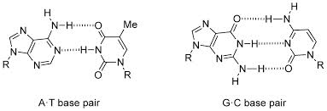
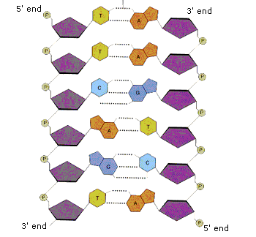
Base Pairing and Hydrogen Bonds
A-T pairs actually have 2 hydrogen bonds and G-C pairs have 3 hydrogen bonds. Remember hydrogen bonds are the same types of bonds that give water its special qualities.
The 5’ and 3’ ends are named after the carbon number on the ribose sugar in each nucleotide.

