Slide 1
DNA Replication
Chapter 12.3

Slide 2
Copying the Code
When Watson and Crick discovered the structure of DNA they immediately realized that the base pairing explained how DNA could be copied.
Each strand of DNA has all the information necessary to reconstruct the other strand.
Because each strand can be used to reconstruct the other strand we say that they are complimentary.

Slide 3
The Replication Process
Before a cell divides it duplicates its DNA in a process called replication.
This occurs during late interphase in the cell cycle and ensures that each cell has the same complete set of DNA molecules.
During replication the DNA separates into two strands and then produces two new complimentary strands, following the rules of base pairing.
Each strand of DNA acts as a template for the new strand.

Slide 4
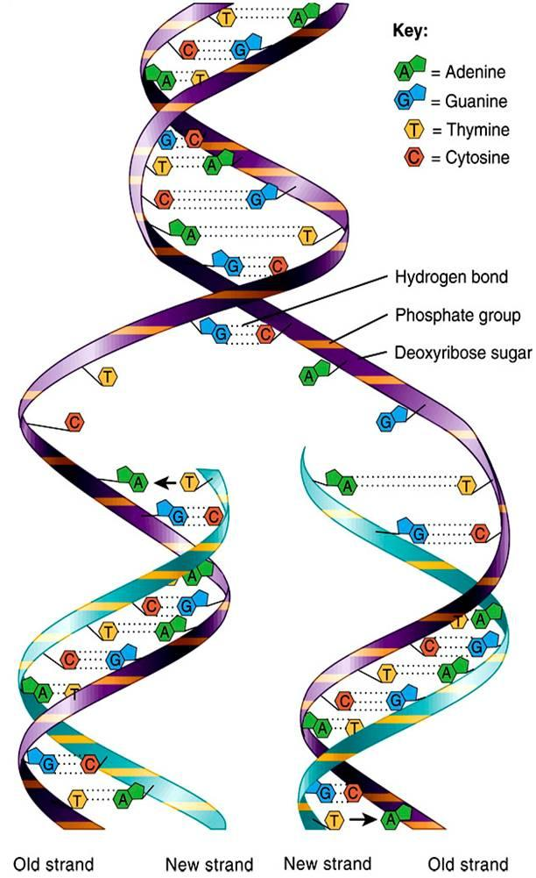
The Replication Process
The DNA molecule is unzipped – this allows two replication forks to form.
As each new strand forms as new bases are added. Adenine is always joined to Thymine and Cytosine is always added to Guanine.
A=T (double bond) and C=G (triple bond).
The result is two DNA strands (made from nucleotide monomers) that are identical to each other and to the original strand.
Each DNA molecule has one of the original strands and one of the new strands.

Slide 5
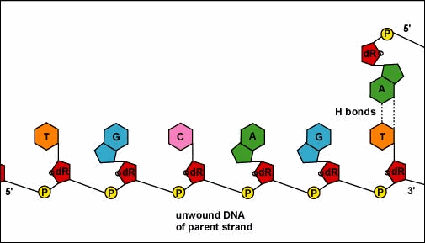
Base Pairing

Slide 6
The Role of Enzymes
DNA replication is carried out by a series of enzymes
The enzymes are responsible for unzipping the molecule of DNA by breaking the hydrogen bonds between the base pairs and unwinding the two strands.
The principle enzyme involved in DNA replication is DNA polymerase. DNA polymerase joins new nucleotides to produce a new strand of DNA.
DNA polymerase also proof reads each new strand to make sure there are no errors.

Slide 7
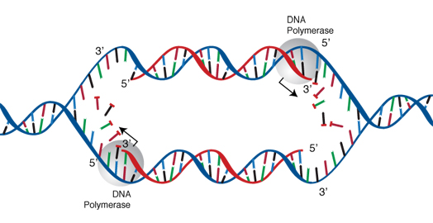
The Role of Enzymes
Direction of replication
Direction of replication

Slide 8
Leading Strands and Lagging Strands
As DNA is being replicated it has two strands a leading strand and a lagging strand.
As you can see the leading strand is replicated in the overall direction of DNA replication or in the 5’ – 3’ direction.
However the lagging strand is replicated in the 3’ – 5’ direction which means DNA polymerase has to work in the opposite direction.
This is accomplished by laying down a RNA primer and then bit by bit adding new nucleotides in fragments called Okazaki fragments.
Another enzyme then cuts out the RNA primers then another enzyme fills in the gaps between the DNA fragments.

Slide 9
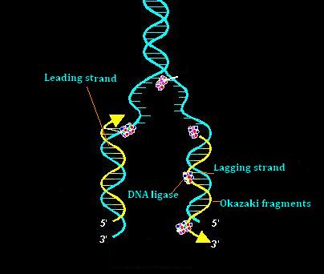
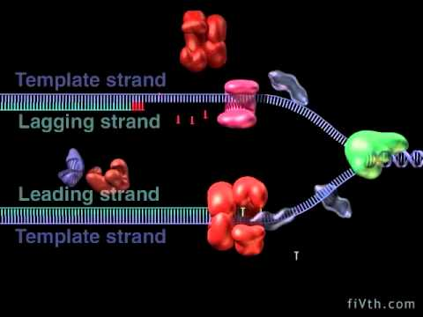
Leading Strands and Lagging Strands
http://shelf3d.com/kfUbYhkk1X8#3 Perpetual Loop DNA replication... Historical animation from 1999

Slide 10
Other Enzymes and Proteins
In addition to DNA polymerase (actually DNA polymerase III) there are several other important enzymes.
Helicase unwinds the original DNA strand
Primase adds an RNA primer in the 3’-5’ direction or lagging strand
DNA polymerase I removes RNA primers
DNA ligase joins the Okazaki fragments together.
Single strand binding proteins also prevent the DNA from joining back together before replication can take place.

Slide 11
Videos
http://www.youtube.com/watch?v=yqESR7E4b_8
http://www.youtube.com/watch?v=OnuspQG0Jd0

Slide 12
Telomeres
The tips of chromosomes are known as telomeres.
Because of the way in which DNA is replicated the tips of chromosomes are hard to copy.
Over time DNA can actually be lost from telomeres each time a chromosome is replicated.
Another enzyme called telomerase compensates for this problem by adding short repeated DNA sequences to the telomeres.
This makes it less likely that important genes will be lost during replication.

Slide 13
Eukaryotic Cells vs Prokaryotic Cells
DNA replication differs in prokaryotic cells and eukaryotic cells.
The cells of prokaryotes have a single circular DNA molecule that contains most of the cells genetic information
Eukaryotic cells have up to 1000 times more genetic information and this is found in the nucleus packaged into chromosomes.
Together the DNA and histone proteins tightly pack together to form nucleosomes. The nucleosomes condenses to form chromatin and the chromatin condenses further into chromosomes.

Slide 14
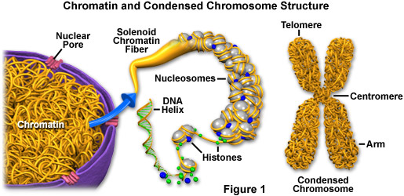
Eukaryotic DNA

Slide 15
The Prokaryotic Cell Cycle
The prokaryotic cell cycle is a regular pattern of growth, DNA replication, and cell division that can take place very quickly under ideal conditions.
Little is known about the prokaryotic cell cycle but scientists believe that once the cell reaches a certain size, DNA replication begins and the cell divides.
The process of cell division in prokaryotes is a form of asexual reproduction known as binary fission.

Slide 16
Binary Fission
The chromosome is replicated
The two DNA molecules attach to opposite ends of the cell
A network of fibers forms between them stretching from one side of the cell to the other
The fibers constrict and the cell is pinched inward, dividing the cytoplasm and the chromosomes between two newly formed cells

Slide 17
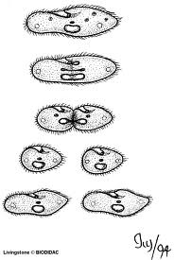
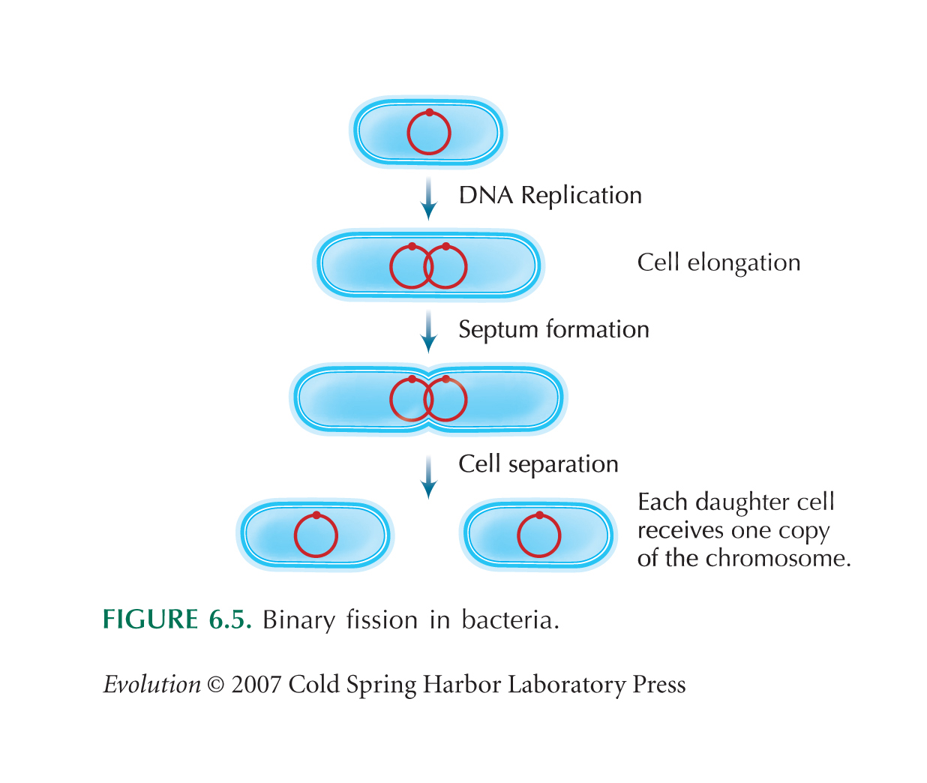
Binary Fission

Slide 18
Eukaryotic Cell Cycle

