Slide 1
RNA
Chapter 13.1

Slide 2
The Role of RNA
We know that DNA is genetic material and a genetic code. We also know that The base pairs (A-T and C-G) are the “language” of this code.
But what exactly do these bases code for?
When Watson and Crick solved the structure of DNA they immediately figured out how DNA could make a copy of itself.
However this did not explain how a gene actually works.
This question was answered when another nucleic acid, RNA – ribonucleic acid, was discovered.

Slide 3
The Role of RNA
Genes contain coded DNA instructions that tell cells how to build proteins.
The first step of this process is to copy part of the base sequence of DNA into RNA.
RNA then uses these instructions to direct the production of proteins.
These proteins then help to determine an organisms characteristics.

Slide 4
Comparing DNA and RNA
Each nucleotide of DNA is made up of a 5-carbon sugar, a phosphate group, and a nitrogenous base. This is also true for RNA.
However there are 3 important differences between DNA and RNA;
The sugar in RNA is ribose instead of deoxyribose.
RNA is generally single stranded and not double stranded like DNA.
RNA contains uracil instead of thymine (A-U instead of A-T).
These chemical differences make it easy for enzymes in the cell to tell the difference between DNA and RNA.

Slide 5
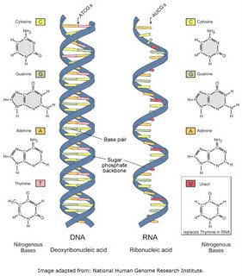
The Structure of RNA
Deoxyribonucleic Acid (DNA)
Ribonucleic Acid (RNA)

Slide 6
DNA is the Master Plan
DNA can be compared to the master plan for a building that has been drawn my an architect.
As such this plan is very valuable and the builders cannot risk taking it to the building site where it might become damaged.
Instead they use inexpensive copies called “blue prints” which can be disposed of when they have served their purpose.
This is similar to the way DNA and RNA are used. DNA is the master plan. Moreover the organisms long-term survival depends upon the integrity of its DNA.
Because of this the DNA will never leave the safety of the nuclear envelope (except during cell division). Instead RNA is transcribed from DNA to act as a disposable copy that can leave the nuclear envelope and carry the genetic code that is used to produce proteins.

Slide 7
Functions of RNA
RNA is a disposable copy of a segment of DNA. A working facsimile of a single gene.
RNA has many functions but most RNA molecules are involved in a single process – protein synthesis.
RNA controls the assembly of amino acids (AA)into proteins. There are several types of RNA and each one controls a different aspect of this process.

Slide 8
Types of RNA
Messenger RNA: the RNA molecules that contain instructions for assembling AA into proteins are called messenger RNA (mRNA). They carry information from DNA to other parts of the cell.
Ribosomal RNA: proteins are assembled on ribosomes – small organelles composed of two subunits. These subunits are composed of ribosomal RNA and as many as 80 different proteins.
Transfer RNA: a third type of RNA transfers each AA to the ribosome as it is specified in the genetic code of mRNA. These molecules are known as transfer RNA (tRNA).

Slide 9
RNA Synthesis (Transcription)
Cells invest a large amount of raw materials and energy making RNA. Understanding how this process works is important in understanding how genes work.
Most of the process of making RNA takes place during transcription. In transcription segments of DNA serve as templates to produce complimentary RNA molecules.
In prokaryotic cells RNA synthesis takes place in the cytoplasm. In eukaryotes it takes place in the nucleolus. We will focus on transcription in eukaryotic cells.

Slide 10
Transcription
Transcription involves an enzyme called RNA polymerase. This is similar to DNA polymerase.
RNA polymerase binds to DNA and separates the DNA into two strands. It then uses one strand as a template from which it assembles nucleotides into a complementary strand of RNA.
Because a single DNA sequence can be a copied a single gene is able to produce hundreds or even thousands of RNA molecules.

Slide 11
Promoters
RNA polymerase needs a system to tell it where to stop and where to start making a strand of RNA.
The enzyme binds to DNA only at a specific region known as a promoter – a region with a specific base sequence.
A similar system is used to tell RNA polymerase when to stop.

Slide 12
RNA Editing
RNA molecules sometimes need a bit of editing before they are ready to be read.
Sometimes RNA molecules will have pieces cut out of them before they are ready to be read. These unedited versions are known as pre-mRNA molecules.
The portions that are cut out are called introns. In eukaryotes these are removed before the RNA leaves the nucleus.
The remaining pieces are known as exons and are spliced back together to from the final mRNA molecule.

Slide 13
RNA Editing
The process of removing introns is very important. At first scientist were unsure as to why this occurred. Some pre-mRNA molecules may be edited differently depending upon the type of tissue it is being made in. This means that a single gene could code several different forms of RNA.
Introns and exons may also play an important role in evolution. They make it possible that very small changes in DNA sequences can have dramatic effects of how genes affect cellular function.

Slide 14
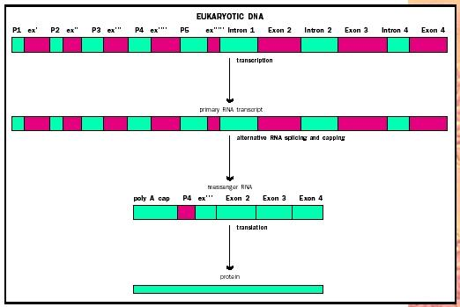

Slide 15
Cap and Tail
In addition to the removal of exons and splicing back together of the mRNA molecule a cap and tail are also added.
The cap is added to the 5’ end and the tail is added to the 3’ end.
The cap helps the mRNA bind to the ribosome and the tail helps prevent the mRNA from being degraded after it leaves the nucleus.

