Slide 1
Ribosomes and Protein Synthesis
Chapter 13.2

Slide 2
The Genetic Code
What is the genetic code and how do we read it?
The first step in decoding genetic messages is to transcribe a nucleotide base sequence from DNA into RNA.
This transcribed information contains code for making proteins.
As we know proteins are made from amino acids (AA) which are joined together into long chains called polypeptides.
The specific sequence of AA in a polypeptide determine the properties of different proteins.
How then do the sequence of bases in DNA and RNA determine the sequence of AA?

Slide 3
RNA Bases
RNA consists of 4 bases – adenine, uracil, guanine, and cytosine.
In effect these bases form a language of just 4 letters – A, U, G, and C. We call this language the genetic code.
The genetic code is read 3 letters at a time. In other words each “word” is 3 bases long and corresponds to a single AA.
Each “3 letter word” is known as a codon. Although this may sound extremely simple the 3 base codon system actually provides more than enough codons to cater for all the AA.

Slide 4
How to Read Codons
Because there are 4 different bases in RNA there are 64 possible three-base codons (4x4x4=64) in the genetic code.
Most AA can be specified by more than one codon. For example the AA leucine has 6 different condon (UUA, UUG, CUU, CUC, CUA, and CUG). However only one codon (UGC) specifies the AA tryptophan.
We can make the job of decoding codons simple by using a genetic code table.

Slide 5
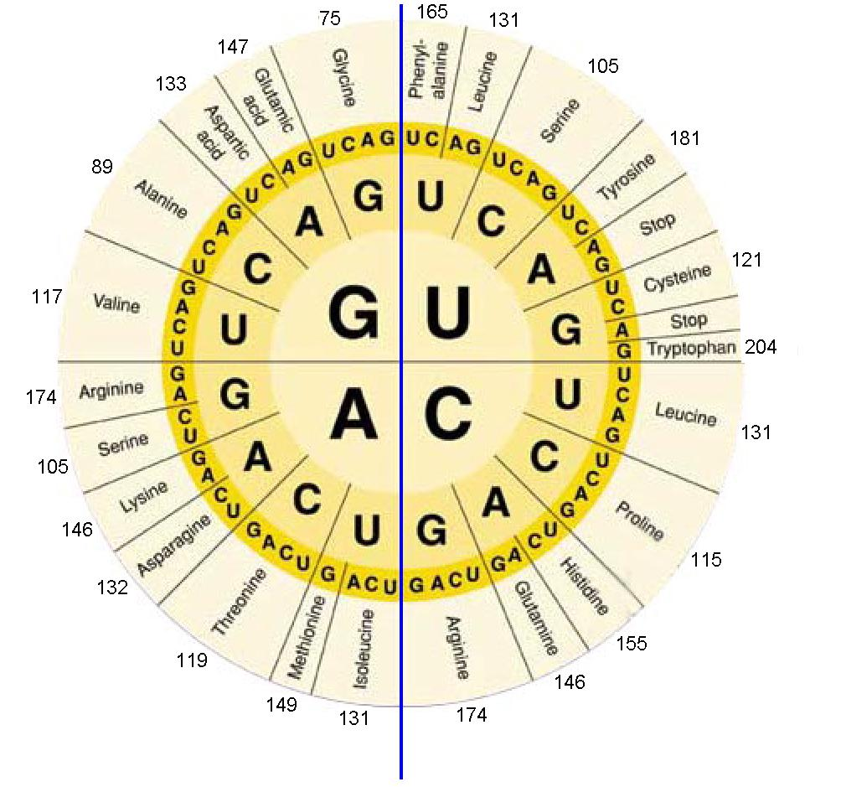
Reading Codons
Start at the middle and move outwards.
Move to the second ring to find the second letter.
Find the third letter amoungst the smallest set of letters in the outer ring.
Then read the AA from that sector.

Slide 6
Start and Stop Codons
Any language needs punctuation marks. In English punctuation tells us when to stop or when to pause.
In the genetic code there are also codons that tell us when to stop and when to start.
The codon AUG, which codes for methionine also serves as an initiation or “start” codon for protein synthesis.
Following the start codon mRNA is read 3 bases at a time until it reaches one of 3 different “stop” codons (UGA, UAA, UAG). At this point the polypeptide is complete.

Slide 7
Translation
What role does the ribosome play in assembling proteins?
The sequence of bases in the mRNA provides the instructions for the order in which AA are to be assembled into a polypeptide chain.
One the polypeptide is complete it will be folded and possibly combined with other polypeptides to create a functional protein.
Ribosomes fulfill the role of reading the mRNA codon sequence and then joining the appropriate AA into a polypeptide chain.
The decoding of mRNA into a protein is called translation.

Slide 8
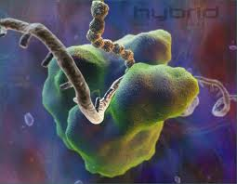
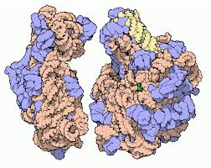
Ribosomes
The site of protein synthesis within a cell
Small sub-unit
mRNA binding site
Large sub-unit
A-site (aminoacyl-tRNA binding site)
P-site (peptidyl-tRNA binding site)
E-site (exit site)
Exit tunnel (for PP)
A ribosome is made up of approximately 2/3 ribosomal RNA (rRNA) and 1/3 protein.

Slide 9
Steps in Translation
Transcription is the process of making an mRNA molecule from a DNA template. Transcription is not part of translation but it is critical to it.
Transcription occurs in the nucleus (in eukaryotic cells). Translation is carried out by ribosomes after the mRNA has been transported out of the nucleus in to the cytoplasm.
Translation can often be split into 3 sections; initiation, elongation and termination.

Slide 10
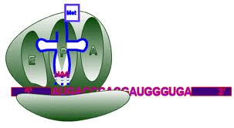
Initiation
Translation begins when a ribosome attaches to a mRNA molecule in the cytoplasm.
mRNA and small sub-unit bind together
Initiator tRNA (UAC) base pairs with start codon (AUG). Start codon tRNA contains methionine (MET) – this may be removed later
Large sub-unit arrives, completing the initiation complex
Energy throughout translation comes from hydrolysis of GTP to GDP+Pi.

Slide 11
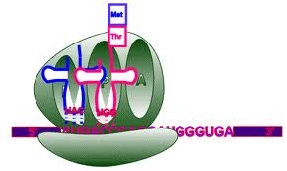
Elongation
As each codon passes through the ribosome tRNA brings the appropriate AA into the ribosome
The ribosome attaches these AA to the growing polypeptide chain.
Each tRNA molecule carries just one kind of AA.
tRNA has 3 unpaired bases called anticodons. These are complimentary to the mRNA codon. For example the anticodon for AUG would be UAC.

Slide 12
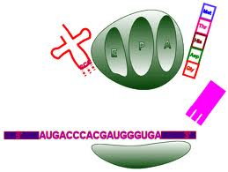
Termination
The polypeptide continues to grow until the ribosome reaches a “stop” codon (UAG, UAA, and UGA) on the mRNA molecule.
When the stop codon is reaches the ribosome releases both the polypeptide chain and the mRNA molecule, completing the process of translation.

Slide 13
The Roles of tRNA and rRNA in Translation
All 3 major forms of RNA – mRNA, tRNA and rRNA come together in the ribosome during translation.
The mRNA molecule carries the coded message
The tRNA molecules make sure that exactly the right AA is delivered
The ribosomes themselves are composed of roughly 80% proteins and 3 or 4 different rRNA molecules. The rRNA molecules help to hold the ribosomal proteins in place and help to locate the beginning of the mRNA molecule.
The rRNA may also help carry out the chemical reaction that joins the AA together.

Slide 14
The Molecular Basis of Heredity
Mendel might have been surprised that most genes contain nothing more than instructions for assembling proteins.
What do proteins have to do with the shape of a seed or the color of a leaf?
The answer is that they have everything to do with these traits!

Slide 15
The Molecular Basis of Heredity
Many proteins are enzymes which control the rate of chemical reactions. So a protein may be responsible for making a pigment that determines what color a plants flowers are.
Another protein may control patterns of development in an embryo or tissue growth in a leaf.
Proteins are specifically designed tools meant to build or operate a component of a living cell.

Slide 16
Molecular Biology
The discoveries made by Watson and Crick as well as several other prominent scientists lead to the creation of the field of molecular biology.
Molecular biology seeks to explain living organisms by studying them at the molecular level.
One of the earliest discoveries came to be known as the fileds “central dogma” – information is transferred from DNA to RNA to protein
There are exceptions to this rule (for example retro-viruses transfer information from RNA to DNA).

Slide 17
The Universal Nature of the Genetic Code
There is a nearly universal nature to the base sequence of DNA.
Although there are a few slight variations in some organisms in terms of AA assigned to particular codons, the code is always read 3 bases at a time and in the same direction.
Despite the large differences and diversity in life on Earth living organisms display remarkable unity at life’s most basic level – molecular biology and the gene.

