Slide 1
Mutations
Chapter 13.3

Slide 2
Types of Mutations
The sequence of bases in DNA are like the letters of a coded message or even the letters of a simple alphabet.
If we change the sequence of the letters do we change the nature of the message?
That Taht
Alphabet A hap belt
Such changes to our genetic code are known as mutations and can have profound affects on the way genes are expressed, or the affects can be hardly noticeable.

Slide 3
Mutations
Mutations occur when a cell makes a mistake copying its DNA. A base could be skipped or inserted when a strand is being put together.
Mutations are heritable changes in DNA.
Mutations that produce changes in a single gene are known as gene mutations and those that produce changes in a whole chromosome are known as chromosomal mutations.

Slide 4
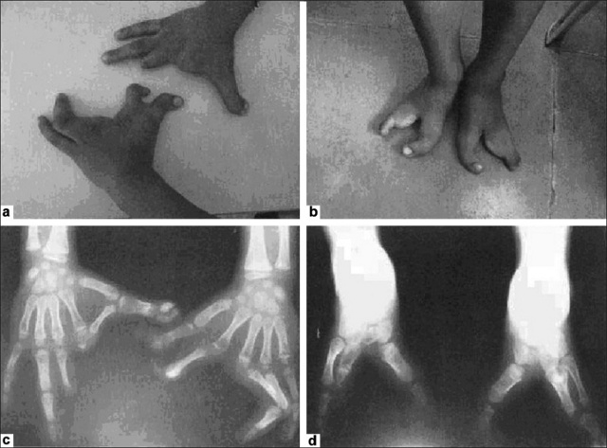
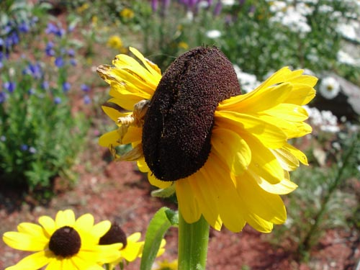
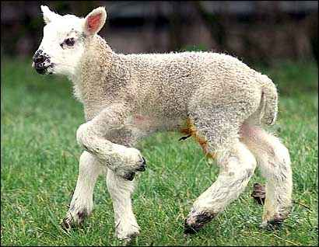
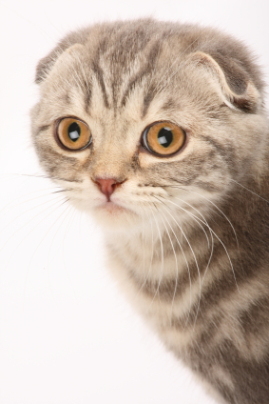
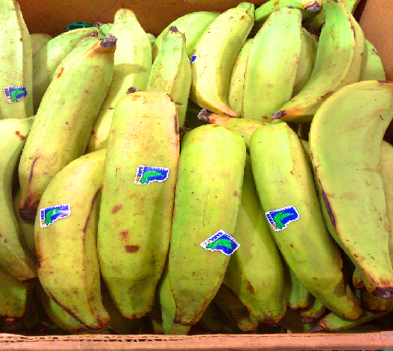
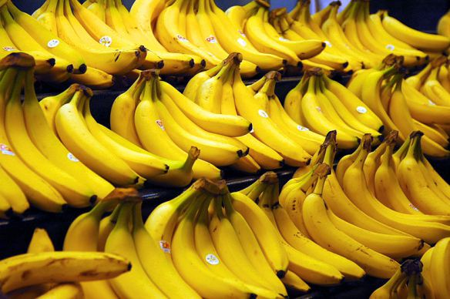
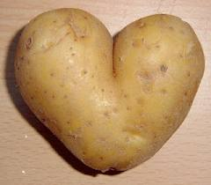
Mutations

Slide 5
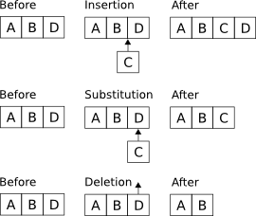
Gene Mutations
Gene mutations that involve changes in one or a few nucleotides are known as point mutations – as they occur at a single point of the DNA sequence.
Point mutations include: substitutions, deletions, and insertions.

Slide 6
Substitutions
In a substitution, one base is change to a different base.
Substitutions normally only effect a single amino acid and sometimes can have non effect at all.
For example if a substitution changed mRNA from CCC to CCA, the codon would still code for the amino acid proline.
A change from CCC to ACC would replace proline with threonine.

Slide 7
mRNA Codons

Slide 8
Insertions and Deletions
Insertions and deletions are point mutations where one base is inserted or deleted from the DNA sequence.
The effects of these changes can be dramatic – remember the genetic code is read 3 bases at a time.
If a base is added or deleted the code is still read 3 bases at a time.
Insertions and deletions are called frameshift mutations because they shift the reading frame. Thus they can change every amino acid from the point of the mutation.
Sometimes these mutations will alter a protein so much that it is unable to perform its normal functions.

Slide 9
Substitutions often make no change or change only one amino acid in a polypeptide chain.
Insertions and deletions can result in a frameshift mutation, changing every amino acid after the mutation.
This often results in the protein being unable to function in its intended way.
Remember the primary, secondary, tertiary and quaternary structure of the protein and how these are all related to each other and the function of the protein.

Slide 10
Chromosomal Mutations
Chromosomal mutations involve changes in the number or structure of the chromosomes.
These mutations can change the location of genes on a chromosome or even the number of copies of some genes.
There are 4 types of chromosomal mutation; deletion, duplication, inversion, and translocation.

Slide 12
Effects of Mutations
Genetic material can be altered by natural events or artificial means.
The resultant mutations may or may not affect an organism. Some mutations that affect an individual may go on to affect a whole species or even an entire ecosystem.
Many mutations are created by errors in DNA replication.
The cellular machinery that replicated DNA inserts an incorrect base once in every 10 million bases. These small changes can accumulate over time.

Slide 13
Effects of Mutations
Stressful environmental conditions have been shown to increase mutation rates in some bacteria.
These mutations can give these bacteria an advantage by supplying them with new traits.
For example they may be able to consume new food or resist medication.
This is why mutations are the building block of evolution.

Slide 14
Mutagens
Mutagens are chemical or physical agents in the environment that interact with DNA and lead to higher rates of mutations.
For example tobacco smoke is a strong mutagen as are environmental pollutants. X-rays, ultra-violet light and many common chemicals are also mutagens.
Some mutagens weaken the DNA strand causing inversions and breaks. Others interfere with base pairing increasing the error rate.
Cells can sometimes repair this damage but when they cant the DNA is altered permanently.

Slide 15
Harmful and Helpful Mutations
The effects of a mutation on a gene varies widely. Some have little effect, some produce beneficial variations, and some negatively disrupt gene function.
Whether a mutation is beneficial, harmful or neutral often depends on the how the DNA is changed relative to the organisms situation.
Without mutations organisms could not evolve as mutations are the source of genetic variability in a species.

Slide 16
Harmful Effects
Some of the most harmful effects are form mutations that dramatically change protein structure or gene expression.
The normal biological functions are disrupted and result in genetic disorders.
Some cancers for example are the result of genetic mutations that cause cells to divide in an uncontrolled manner.

Slide 17
Beneficial Effects
Mutations often produce proteins with new or altered functions that can be useful to organisms in different or changing environments.
For example many insects have developed resistnace to chemical pesticides.
In humans mutations have caused increased bone strength and density. Mutations have also increased resistance to HIV the virus that causes AIDS.

Slide 18
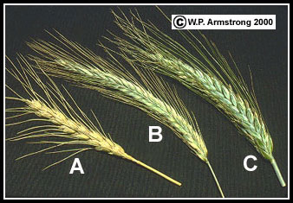
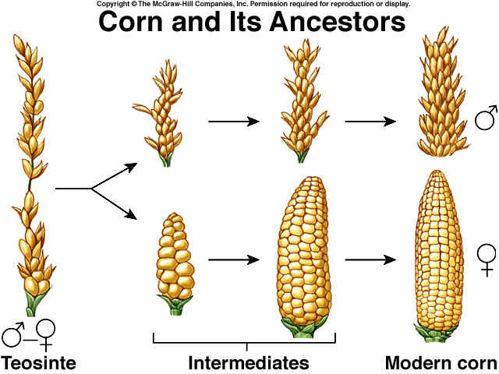
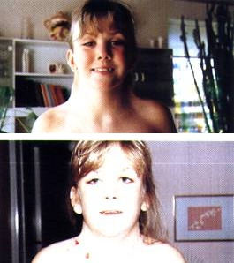
Beneficial Effects
Plant breeders take advantage of chromosomal mutations when a chromosome fails to separate during meiosis.
The resultant plant may produce triploid (3N) or even tetraploid (4N) offspring. This is known as polyploidy. These plants are often larger and stronger than diploid plants.

Slide 19
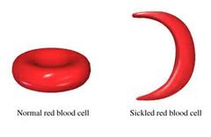
Sickle Cell Disease
Sickle cell disease is associated with changes in the shape of red blood cells.
It is caused by a point mutation in one of the polypeptides found in hemoglobin – the bloods principle oxygen carrying protein.
Symptoms include anemia, severe pain, frequent infection and stunted growth.

Slide 20
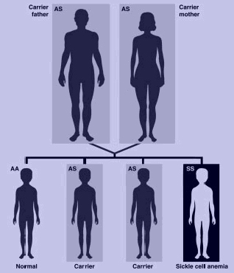
Sickle Cell Disease
You would expect that such a disease would be rare and possibly even die out.
However such diseases are still common today, especially in regions where malaria is a big problem.
This is because individuals who carry a recessive sickle cell gene whist suffering from some of the same problems also are less susceptible to malaria.

