Slide 1
Gene Regulation and Expression
Chapter 13.4

Slide 2
Prokaryotic Gene Regulation
A library contains many books. If we want to take one out we might look up that specific book in the catalogue and then go to the right shelf and borrow that book.
We would not borrow every book in the library to make sure we got the right one.
In a similar way organisms need to select one gene from many in order to express just that gene and not have to make many proteins they don’t need.

Slide 3
Prokaryotic Gene Regulation
In order to save energy and other resources prokaryotes (who can have 4000-plus genes) need a way to select only the necessary genes for transcription.
By regulating gene expression prokaryotes can respond to changes in their environment.
DNA-binding proteins regulate genes by controlling transcription.

Slide 4
Operons
One of the keys to gene transcription is the organization of genes into operons.
An operon is a group of genes that are regulated together. The genes in an operon usually have related functions.
For example of the 4288 genes in an E. coli bacteria 3 genes must be turned on together before the bacterium can use the sugar lactose as a food.
These 3 genes are known as the lac operon.

Slide 5
The Lac Operon
Why does E. coli need to be able to switch the lac genes on and off?
Lactose is a compound made from two simple sugars – galactose and glucose. The bacteria must be able to transport lactose across its cell membrane, then break the bond between the two sugars.
These tasks are performed by proteins which are coded for by the genes of the lac operon.

Slide 6
The Lac Operon
If the bacterium grows in a medium containing lactose it will need to transcribe these genes and produce these proteins.
But if the E. coli were grown in a medium containing glucose, it would have no need for these proteins.
The bacteria seems to be aware of when the genes are needed. When lactose is not present the genes are turned off by proteins that bind to DNA and block transcription.

Slide 7
Promoters and Operators
On one side of the operon’s three genes are two regulatory regions.
The first is a promoter (P). This is a site where RNA-polymerase can bind to begin transcription.
The other region is called the operator (O). This is a site where DNA-binding protein known as the lac repressor can bind to DNA.

Slide 8
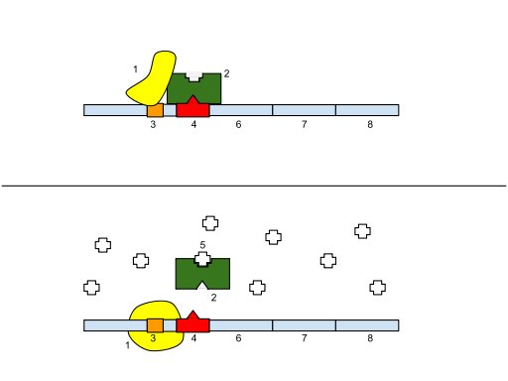
Lac Repressor Gene
DNA Polymerase
Lac repressor
The lac repressor gene codes for the repressor protein.
The promoter (P) and the operator (O) are situated downstream of the lac genes.
Promoter
Operator
Lactose

Slide 9
The Lac repressor Blocks Transcription
When the lac repressor binds to the O region, RNA polymerase cannot reach the lac genes.
This has the effect of switching the operon “off” by physically preventing the transcription of genes.
The must also be a way of removing the lac repressor and switching the gene “on”

Slide 10
Lactose Turns the Operon “On”
The lac repressor protein also has a binding site for lactose.
When lactose is present it will bind to the repressor protein and cause it to fall off the operator.
RNA-polymerase can now transcribe the genes from the lac operon.
In the presence of lactose the operon is automatically switched on.

Slide 11
Lactose Turns the Operon “On”
When lactose is present, it binds to the repressor.
With the repressor protein in place the genes of the lac operon cannot be transcribed
This causes the release of the repressor which then moves away from the operating region.
Transcription can now take place.
DNA Polymerase
Lac repressor
Promoter
Operator
Lactose

Slide 12
Eukaryotic Gene Regulation
The general principles of gene regulation in prokaryotes also apply to eukaryotes – however there are some differences.
Most eukaryotic genes are controlled individually and have more complex regulatory sequences than those of the lac repressor system.

Slide 13
The TATA Box
The TATA box is a short region of DNA (about 25 or 30 base pairs before the start of a gene) that contains the sequence TATATA or TATAAA.
The TATA box binds a protein that helps position RNA polymerase by marking a point just before the beginning of a gene.

Slide 14
Transcription Factors
Gene regulation in eukaryotic cells can be regulated at a number of levels. One of the most critical is the level of transcription.
Proteins known as transcription factors bind DNA sequences, known as enhancers or promoters, in the regulatory regions of eukaryotic genes. In doing so transcription factors control the expression of those genes.

Slide 15
Transcription Factors
Some achieve this by opening up tightly packed chromatin - histone acetyltransferase (HAT) activity.
Others do the opposite and make the histone proteins pack tighter – histone deacetylase (HDAC) activity
Others help attract RNA-polymerase. Still others block access to certain genes (like prokaryotic repressor proteins) – coactivator or corepressor proteins
In most cases multiple transcription factors must bind in order for RNA-polymerase to be able to attach to the promoter region and start transcription.

Slide 16
Transcription Factors
Promoters have multiple binding sites for transcription factors, each of which can influence gene expression.
Some factors can activate scores of genes at once – this can dramatically change patterns of gene expression.
Other factors form in the response to chemical signals – for example streroid hormones enter the cell and bind to receptor proteins.
These “receptor complexes” then act as transcription factors that bind to DNA. In this way a single chemical signal can activate multiple genes.

Slide 17
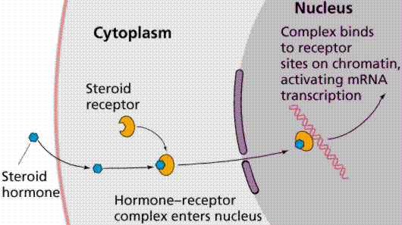
Steroid Hormones

Slide 18
Other Regulatory Factors
There are many other regulatory factors in eukaryotic organisms.
Such as the exit of mRNA molecules from the nucleus – the portions selected as exons and introns.
The stability of mRNA and even the breakdown of a genes protein products.

Slide 19
Cell Specialization
Gene regulation is much more complex in eukaryotes due to the nature of multi-cellular organsims.
Every cell contains a complete copy of an organisms entire DNA.
However the cells in your blood do not produce the same proteins as the cells in your kidneys.
Cell specialization requires genetic specialization. Complex gene regulation is what makes cell specialization in eukaryotes possible.

Slide 20
RNA Interference
For many years scientists wondered why cells contained many small molecules of RNA that didn’t belong to any of the main RNA groups (mRNA, tRNA, or rRNA).
In the last few years we have discovered that these molecules play an important role in gene regulation.
After being transcribed the small interfering RNA molecules fold into a double loop and an enzyme caller the “dicer” enzyme cuts the double strands into microRNA (miRNA) each about 20 base pairs in length.

Slide 21
RNA Interference
The two strands of the loop then separate and one of the miRNA pieces attaches to a cluster of proteins to form what is known as the silencing complex.
The silencing complex binds to and destroys any sequence of mRNA that is complimentary to the miRNA.
In effect the miRNA sticks to a certain mRNA molecule and stops them from passing on their protein-making instructions.

Slide 22
RNA Interference
The silencing complex effectively shuts down the expression of the gene whose mRNA it destroys – blocking gene expression by means of a miRNA silencing complex known as RNA interference.
At first RNAi seemed to be a rare event found only in a few select species.
Now we know that it is found throughout the living world and that it even plays a role in human development.

