Slide 1
Introduction to Evolution

Slide 2
Who was Darwin?
Charles Darwin was a drop-out medical student (from Edinburgh University) and a failed priest.
In 1809 he was presented with the opportunity to travel on H.M.S. Beagle and during his journey he fundamentally changed science forever.
In fact he basically made sense of and tied together all we know about science.
His theory of evolution is known as one of the unifying theories of science.

Slide 3
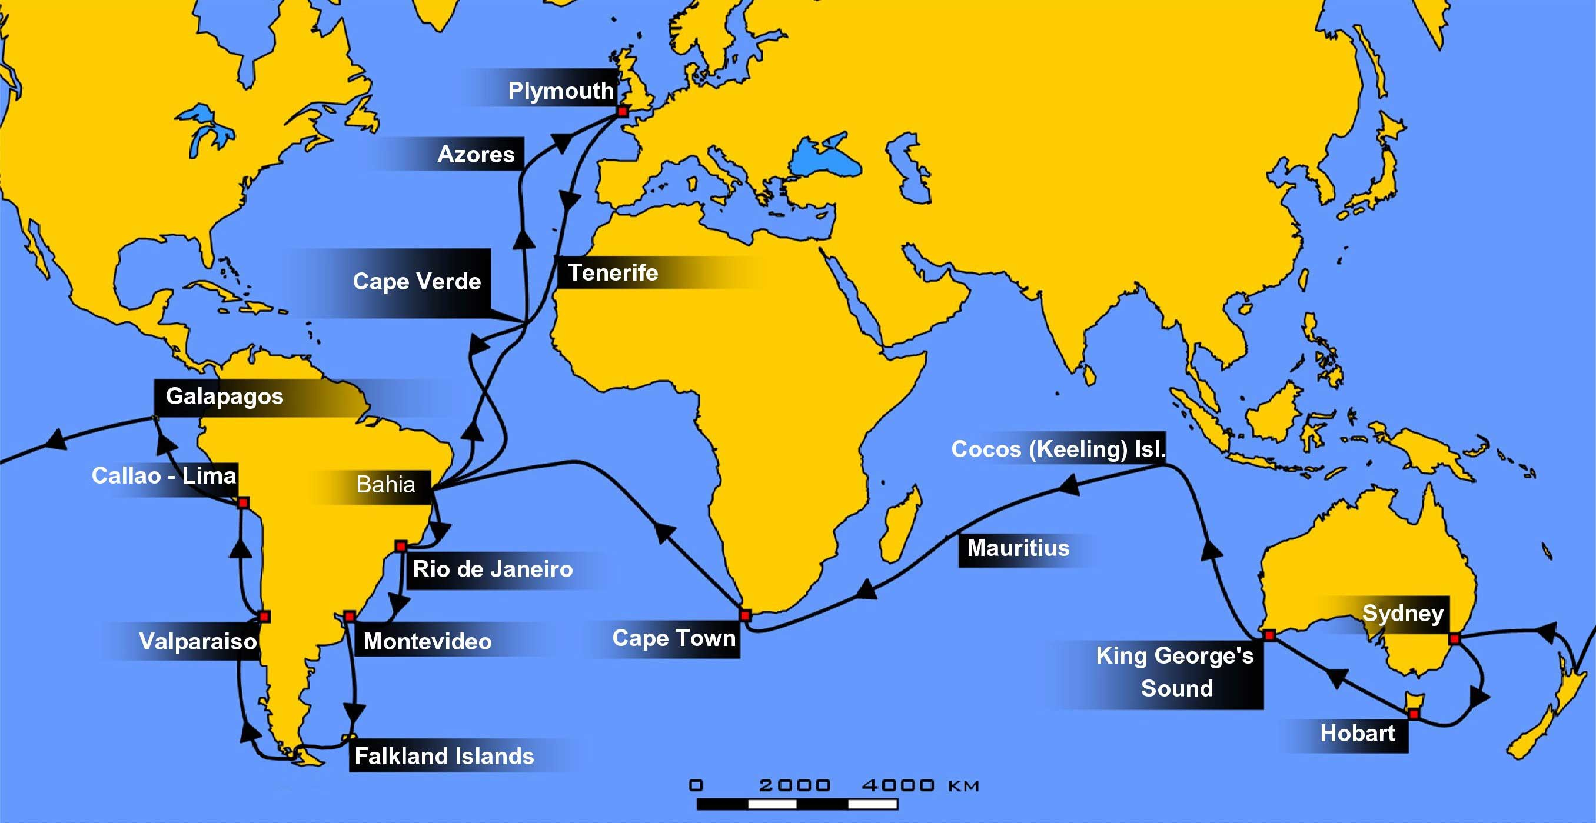
Voyage of the Beagle

Slide 4
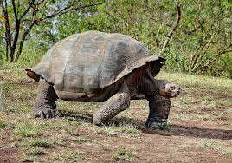
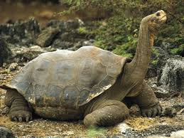
Biogeography
Santa Cruz tortoise – vegetation much lower down.
Throughout Darwin’s voyage he observed life.
However life was not the same wherever he went. For example in Australia he saw marsupial mammals but in North America there are no marsupial mammals except for opossums.
This made Darwin question existing creationist theories as to how life had developed.
Pinta island tortoise – vegetation is up higher.

Slide 5
The Theory of Evolution
During his travels Darwin made numerous observations and collected evidence that led him to propose a revolutionary hypothesis about the way life changes.
Darwin observed many different and similar species. He was intrigued as to why so many organisms seemed so well adapted to their environments.
In particular his journey to the Galapagos islands and the finches that he observed shaped his theory.

Slide 6
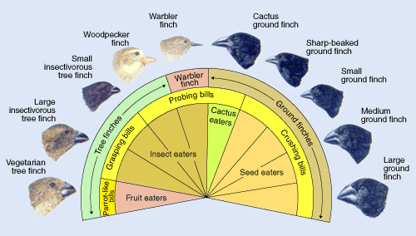

Slide 7
Fossils
Darwin soon realized that living organisms formed only part of the picture.
In many places on his journey Darwin collected the preserved remains of ancient organisms called fossils.
Some of these creatures looked like animals Darwin has already observed. Some looked unlike anything he had ever seen.

Slide 8
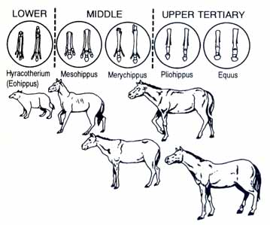
Horse Fossils
Horse fossils suggested how horse feeding habits had changed from browsing like a deer to grazing.

Slide 9
The Journey Home
Darwin noticed that the characteristics of many animals and plants varied noticeably among the different islands of the Galapagos.
Darwin wondered if these animals had once been members of the same species.
Was it possible that after becoming isolated from one another they could have developed differently?

Slide 10
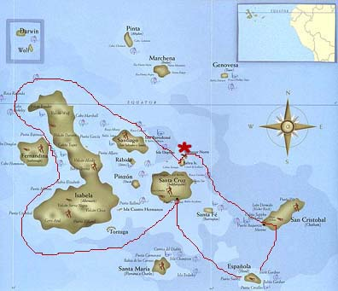
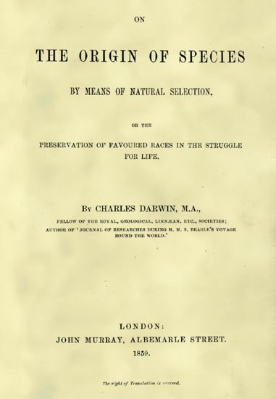
Summary
Charles Darwin (1809-1882) put together his scientific theory, the origin of species, following his voyage on HMS Beagle.
He observed species that occurred nowhere else on Earth as well as separate species that appeared to be related to one another

Slide 11
Summary of Darwin’s Theory
Individual organisms differ, and some of this variation is heritable.
Organisms produce more offspring than can survive, and many that do survive do not reproduce.
Because more organisms are produced than can survive, they compete for limited resources.
Each unique organism has different advantages and disadvantages in the struggle for existence.
Species alive today are descended with modification from ancestral species. In this way all species on Earth are evolved from common ancestors.

