Slide 1
Organic Chemistry
Chapter 2.3

Slide 2
Carbon Compounds
In the early 1800s many chemists called the compounds created by organisms “organic” as they believed they had to be fundamentally different from the compounds found in other things.
Today we understand that the principles governing the chemistry of living and non-living things is the same.
However the term organic chemistry is still around and refers to the study of compounds that contain bonds between carbon atoms.

Slide 3
What’s so important about carbon?
Carbon atoms have 4 valence electrons. This allows them to form strong covalent bonds between many other elements.
Carbon can bond between many elements including; hydrogen, oxygen, phosphorus, sulfur and nitrogen to form the molecules of life.
Living organisms are made up of molecules that consist of carbon and these other elements.

Slide 4
What’s so important about carbon?
Most compounds that contain carbon are termed organic compounds.
Exceptions – Carbon dioxide and the carbonates (minerals and rock), because they are found in nonliving things.

Slide 5
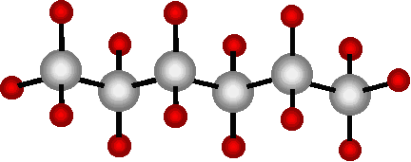
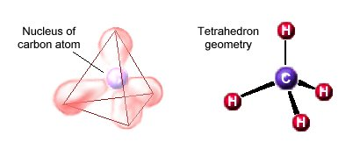
Carbon to carbon bonding
Even more importantly one carbon atom can bond to another carbon atom – this gives carbon the ability to form chains.
These chains can be almost unlimited in length.
The 4 bonds are in the form of a tetrahedron, a triangular pyramid.

Slide 6
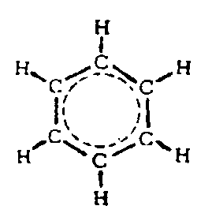
Carbon to carbon bonding
The C-C bonds can be single, double or triple covalent bonds.
Chains of carbon atoms can even close up on each other to form rings.
For these reasons carbon is very versatile and can form large complex structures.

Slide 7
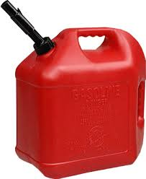
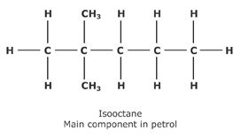
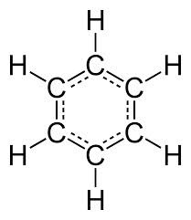
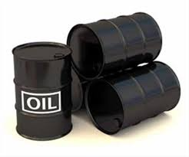
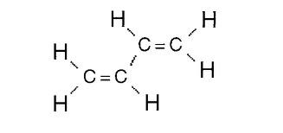
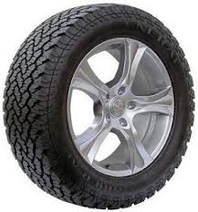
Common Carbon Structures
Benzene
Butadiene

Slide 8
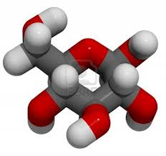
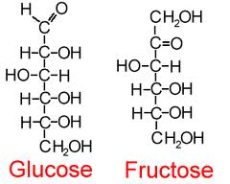
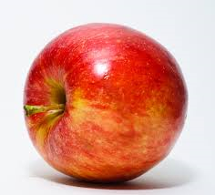
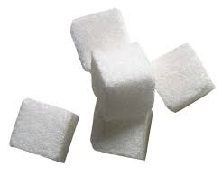
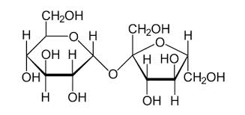
Common Carbon Structures
Sucrose

Slide 9
Macromolecules
Many organic compounds in living cells are so large they are known as macromolecules – macro means giant.
Most of these molecules are formed by a process known as polymerization – large compounds are build by joining smaller ones together.

Slide 10
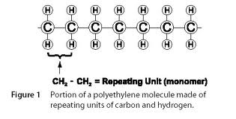
Macromolecules
In polymerization smaller units or monomers, join together to form polymers.
The monomers in a polymer may be identical or they may be different

Slide 11
The Macromolecules of Life
Biologists sort the macromolecules found in living things into groups based on their chemical composition;
Carbohydrates
Lipids
Proteins
Nucleic Acids

Slide 12
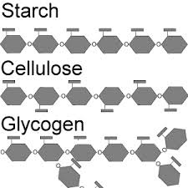
Carbohydrates
Carbohydrates are compounds made up of carbon, hydrogen, and oxygen atoms.
Living things use carbohydrates as their main source of energy. Plants, some animals and other organisms also use carbohydrates for structural purposes.
The cells in our bodies break down glucose to supply energy for cell activities.
Many organisms store extra sugar as
complex carbohydrates – starch.

Slide 13
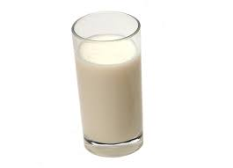
Simple Sugars
Simple sugars are also known as monosaccharides. Glucose is a simple sugar.
Other simple sugars include;
Galactose and lactose– components of milk.
Fructose – found in many fruits
Similar to monosaccarides, disaccharides consist of two simple sugars.
Sucrose – is a combination of glucose and fructose more commonly referred to as table sugar

Slide 14
Complex Carbohydrates
The large macromolecules formed from monosaccharides are known as polysaccharides
Many organisms (including humans) store excess sugars in a polysaccharide known as glycogen.
When your blood sugar drops glycogen is broken down into glucose, which is then released into the blood from your liver.

Slide 15
Lipids
Lipids are a large varied group of biological molecules that are generally not soluble in water.
Lipids are made mostly from carbon and hydrogen atoms and are commonly split into 3 groups;
Fats
Oils
Waxes
Lipids can be used to store energy and some lipids are important parts of biological membranes and waterproof coverings.
Steroids are lipids that are synthesized by the body. Many steroids act as important chemical messengers.

Slide 16
Glycerol and Fatty Acids
Many lipids are formed when a glycerol molecule combines with compounds called fatty acids.
If each carbon atom in the lipids fatty acid tail is joined to another carbon atom by a single bond the lipid is said to be saturated.
We say a lipid is saturated because the fatty acids contain the maximum possible number of hydrogen atoms.
Saturated fats tend to be solid at room temperature.

Slide 17
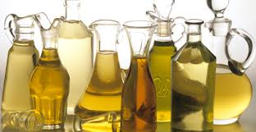
Carbon to Carbon Bonding
If there is at least one C-C double bond in a fatty acid the fatty acid is said to be unsaturated. Lipids with more than one double bond are said to be polyunsaturated.
Unsaturated and polyunsaturated lipids tend to be liquid at room temperature.

Slide 18
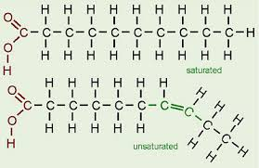
Saturated and Unsaturated Fats

Slide 19
Proteins
Proteins are macromolecules that contain nitrogen as well as carbon, hydrogen, and oxygen.
Proteins are polymers of molecules known as amino acids.
Amino acids are compounds with an amino group (-NH₂) on one end and a carboxyl group (-COOH) on the other end.
In addition each amino acid also contains an R-group that distinguishes one amino acid from another.

Slide 20
Peptide Bonds
Covalent bonds called peptide bonds link amino acids together to form a polypeptide.
A molecule of H₂O is released when the bond is formed.
A protein is a functional molecule built from one or more polypeptides.

Slide 21
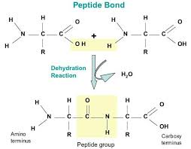
Peptide Bonds Form Through Dehydration Reactions.

Slide 22
Functions of Proteins
Proteins are involved in many different cellular functions:
Control the rate of reactions
Regulate cell processes
Form important cellular structures
Transport substances into and out of cells
Help fight disease

Slide 23
Protein Structure and Function
There are more than 20 different amino acids found in nature.
All are identical in the regions they are joined together by covalent bonds (carboxyl end and the amino group end).
This allows any amino acid to be joined to any other amino acid.
The R-group differentiates amino acids from each other. Some R-groups are acidic, some are basic, some are polar and some are non-polar, and some even contain large ring structures.

Slide 24
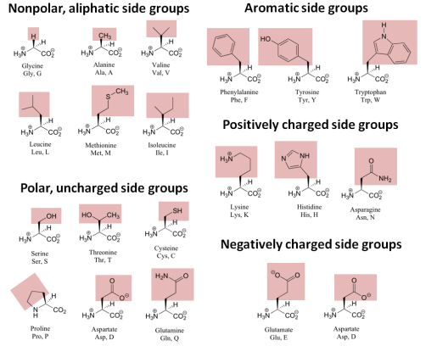
Amino Acids

Slide 25
Levels of Organization
Proteins are split in to various levels of organization, depending on how many polypeptide chains make up a protein.
Primary structure: the sequence of amino acids – this is coded by a cells DNA.
Secondary structure: the folding or coiling of the polypeptide chain.
Tertiary structure: the complete 3D arrangement of the polypeptide chain.
Quaternary structure: proteins with more than one polypeptide chain are said to have a 4th level of structure that describes the ways the polypeptide chains are arranged with respect to each other

Slide 26
Nucleic Acids
Nucleic acids are macromolecules that contain hydrogen, oxygen, nitrogen, carbon, and phosphorous.
Nucleic acids are polymers assembled from monomers known as nucleotides.
Nucleotides consist of 3 parts: a 5-carbon sugar, a phosphate group (-PO4), and a nitrogenous base.
Some nucleic acids contain the compound adenosine tri-phosphate (ATP). This plays an important role in capturing and transferring energy within cells.

Slide 27
Genetics and Heredity
Nucleic acids store and transmit heredity, or genetic information.
There are two types of nucleic acid involved in the transfer and expression of genes – deoxyribose nucleic Acid (DNA) and ribonucleic acid (RNA)
DNA contains the sugar deoxyribose and RNA contains the sugar ribose.

Slide 28
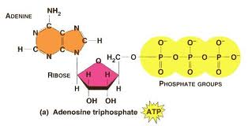
Nucleotide Structure
DNA Structure
ATP Structure
The sequence of complimentary bases hold the key to DNAs ability to transfer genetic information.
ATP stores and releases energy by attaching and snapping off the end phosphate group.

