Slide 1
Acceleration
Section 2

Slide 2
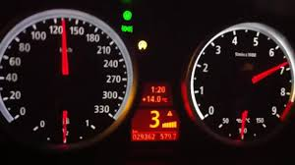
Acceleration and Motion
Acceleration is the change in an objects motion.
Acceleration is the change in velocity divided by the time it takes for the change to occur. It is the rate of change of velocity.
Note: when calculating acceleration it is really important that you understand the difference between average velocity and instantaneous velocity

Slide 3
Calculating Acceleration
When an object is moving in only one direction we use the following equation to calculate acceleration.
Acceleration $=\frac{\left(final velocity\right)−(initial velocity)}{\left(final time\right) −(initial time)}$
or a $=\frac{Vf−Vi}{tf −ti}$

Slide 4
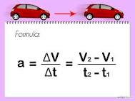
Calculating Acceleration
Time is the length of time over which the object accelerated. Speed is usually measured in meters per second.
The SI unit of acceleration is m/s²

Slide 5
Acceleration
Acceleration = change in velocity/time
Remember acceleration is a vector quantity so it must have a direction

Slide 6
Why m/s²
When we write m/s² its like saying meters per second per second.
In other words her acceleration has been 1m/s/s (one meter per second per second).
To simplify this we simply say 1m/s².

Slide 7
Why m/s²
For example if a car is moving at 5m/s and the driver puts her foot on the gas peddle so that she increases from 5m/s to 7m/s in 2 seconds
She has increased her speed by 1m/s every second for 2 seconds.

Slide 8
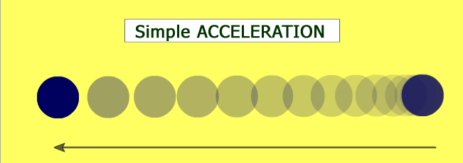
Speeding Up
If you were to get on a bike and start to peddle you would move slowly at first and then get faster.
Remember velocity is the speed of an object and its direction. So acceleration occurs whenever an objects velocity changes.

Slide 10
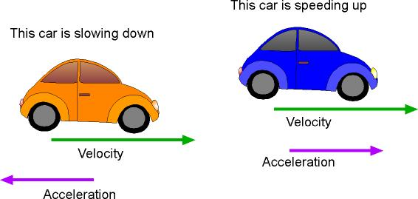
Slowing Down
When riding on your bike or driving in a car, you hit the breaks and slow down.
This causes a change in velocity as your direction has stayed the same but your speed has decreased.
This is also an example of acceleration.

Slide 11
Slowing Down
In everyday English we tend to use the term acceleration to describe getting faster.
However in physics the term acceleration simply describes a change in velocity.

Slide 12
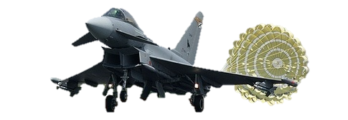
Negative Acceleration
When you slow down you experience an acceleration in the opposite direction to the one you are moving in.

Slide 13
Positive and Negative Acceleration
An object is accelerating whether it is speeding up or slowing down.
If it speeds up the acceleration is in the same direction as the motion.
If it slows down the acceleration is opposite the motion.

Slide 14
Positive and Negative Acceleration
When you speed up your final velocity is always greater than your initial velocity.
So if you subtract your initial speed from the final speed the number will be positive.
a $=\frac{Vf −Vi}{tf −ti}$
Your acceleration is positive so you increase your velocity.

Slide 15
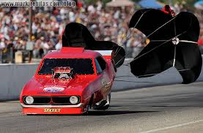
Positive and Negative Acceleration
When you slow down your final velocityis less than your initial velocity.
When you experience a negative acceleration it means you have slowed down.
In normal conversation we would say this is a deceleration but in physics we call it a negative acceleration.

Slide 16
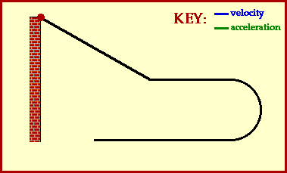
Changing Direction
The velocity of an object also changes if the direction of motion changes.
When an object is moving in a on a curved path it is constantly changing direction.
This also means that it is constantly accelerating – because its velocity is changing.
With a curved path the direction of acceleration is at an angle to the direction of motion.

Slide 17
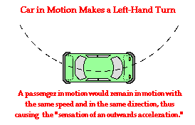
Changing Direction
If you were driving in a car and you turned to go round a bend the direction (and velocity) of the car’s motion would change.
The car has accelerated.
The direction of the acceleration is in the direction of the turn.

Slide 18
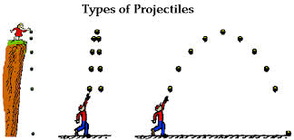
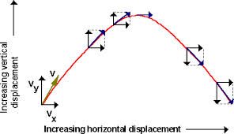
Acceleration of a Thrown Ball (Projectile Motion)
If you were to throw in an upward trajectory, the ball would accelerate upward.
As gravity pulls it down and the ball starts to accelerate downward.
The longer the ball accelerates the more it’s path turns toward the direction of the acceleration.

Slide 19
Graphing Accelerated Motion
We can graph acceleration of an object that is moving in a single direction.
Speed is plotted on the vertical axis and time is plotted on the horizontal axis.
What would acceleration look like on other types of graph?
Speed m/s
Time (s)

Slide 20
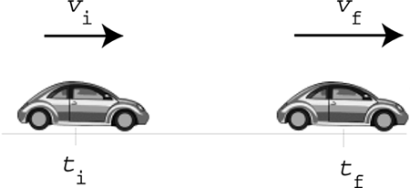
Acceleration
Acceleration $=\frac{\left(final velocity\right)−(initial velocity)}{Time}$
or a $=\frac{Vf−Vi}{t}$
The SI unit for acceleration is meters per second per second or m/s²

Slide 21
Speed vs. Time

Slide 22
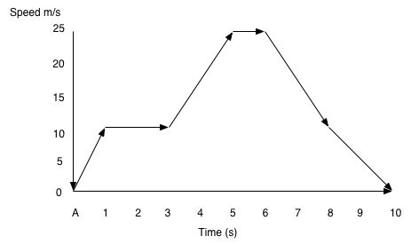
Analysis of Data
What is the speed after 1 second?
What is the acceleration between 1 second and 3 seconds.
Calculate the acceleration between 6 seconds and 8 seconds.
Which point shows the largest acceleration?

