Slide 1
Energy Transformations
Chapter 5 Section 2 and 3

Slide 2
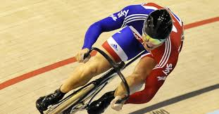
Changing Forms of Energy
Our bodies are constantly transforming chemical energy into kinetic energy.
For example a bike rider transforms chemical energy from food into kinetic energy in the bike by pushing down on the pedals.

Slide 3
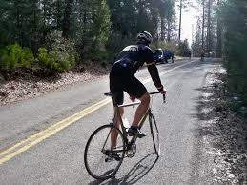
Changing Forms of Energy
This kinetic energy may be transformed into potential energy if the cyclist rides up a hill.
In addition thermal energy will be produced. The exercise will make the cyclist warmer and friction will heat up the moving parts of the bike.

Slide 4
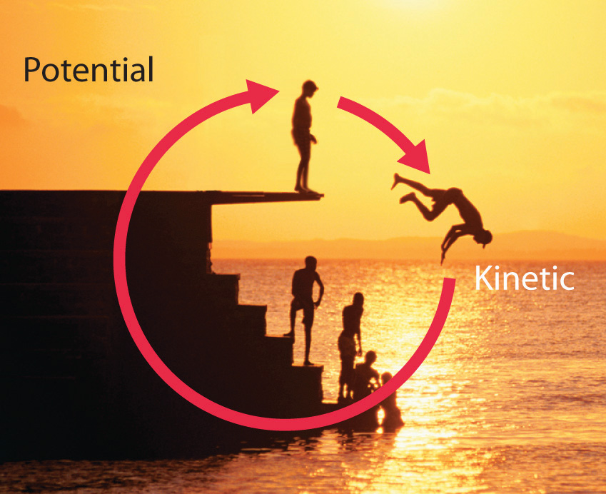
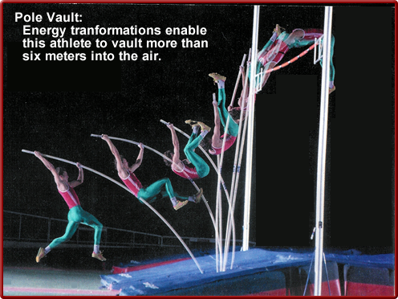
Potential and Kinetic Energy

Slide 5
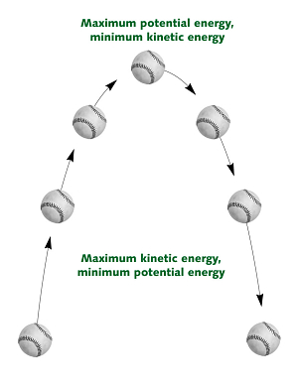
Changing Potential Energy into Kinetic Energy
As a ball rises and falls the relative amounts of kinetic and potential energy change.
The total energy never changes.
Energy moves from place to place and changes form but is never created or destroyed.

Slide 6
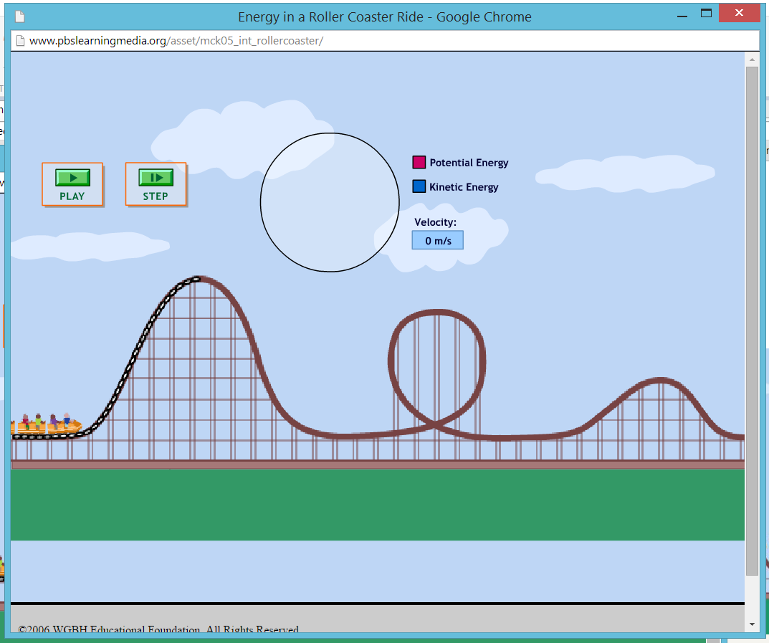
Conservation of Energy Rollercoaster

Slide 7
The Law of Conservation of Energy
The law of conservation of energy states that;
Energy cannot be created or destroyed. It can be transferred from one type to another.
Newton's laws of thermodynamics tell us that there is an increasing amount of disorganized energy in the universe (entropy).

Slide 8
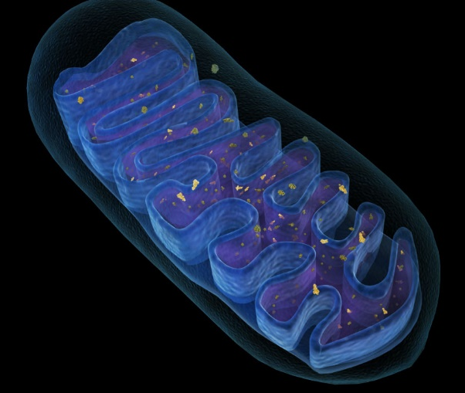
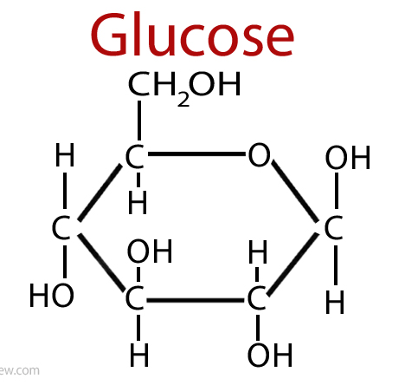

Energy Changes Form
The cells in your body are like miniature power plants that convert chemical energy into kinetic energy.
You also produce some thermal energy. This makes things get hotter.

Slide 9

Entropy
The change of energy from one form to another is never fully efficient.
There is a general shift toward more chaotic energy in the universe.

Slide 10
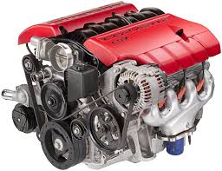
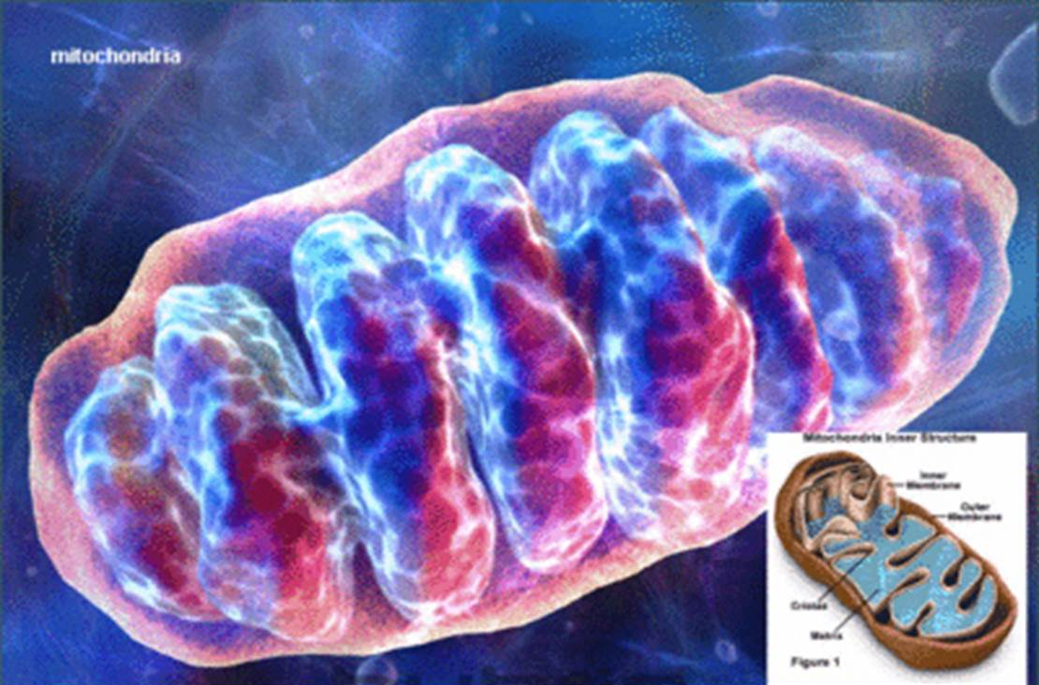
Combustion Reactions

Slide 11
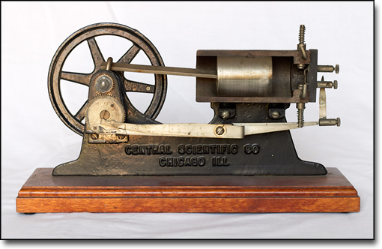

Transforming Chemical energy
Your bodies convert about 30-35% of the energy from food into usable energy. The rest is converted to thermal energy.
In contrast the average car engine is about 25% efficient.

Slide 12
Transforming into Electrical Energy
Electrical energy is created by converting other forms of energy.
For example coal is burned in a coal power station to release thermal energy.
This energy is converted into mechanical energy and ultimately converted in to electrical energy.

Slide 13
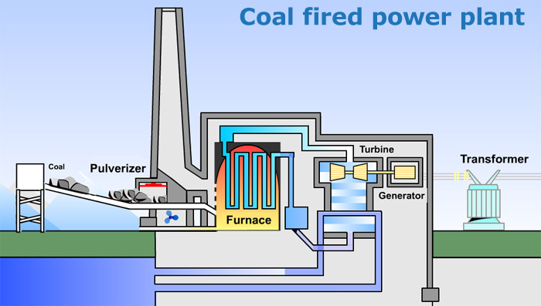
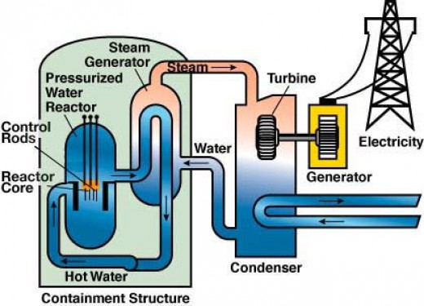
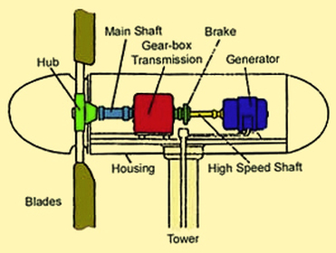
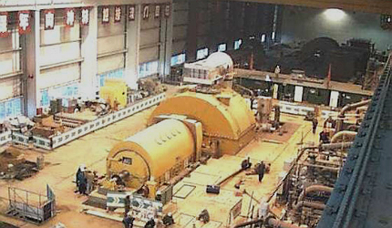
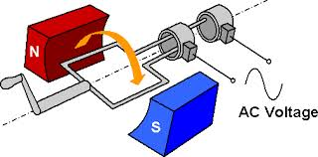

Slide 14
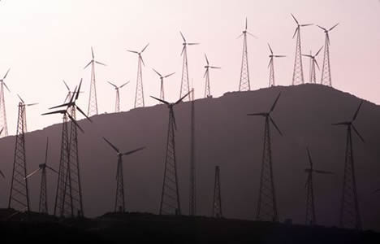
Production of Electricity
Chemical Energy of coal
Thermal energy of water
Kinetic energy of steam
Kinetic energy of turbine
Electrical energy out of a generator
Producing electricity from renewable sources is a simpler process.

Slide 15
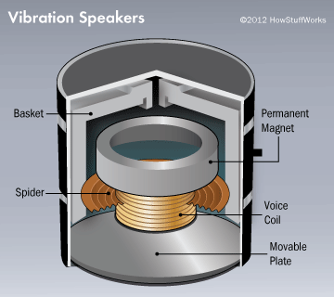
Transforming Energy
This electrical energy might ultimately be converted into the kinetic energy of your TV speaker.

Slide 16
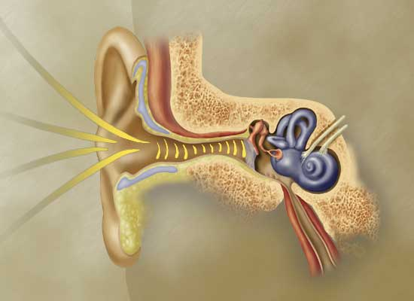
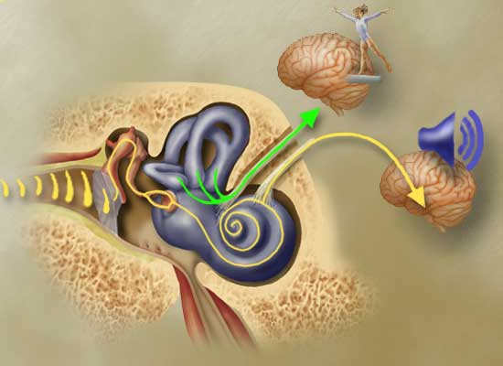
Transforming Energy
This energy is then converted into sound energy. Which is then converted into kinetic energy in the eardrum.
Finally this is converted into electrical energy in your nerve cells and interpreted by the brain.

Slide 17
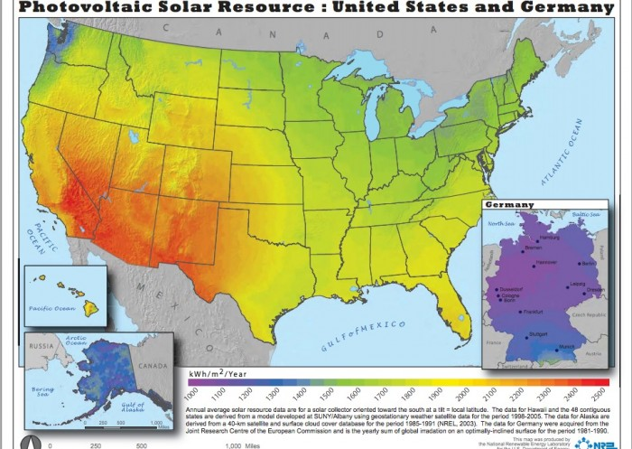

Slide 18
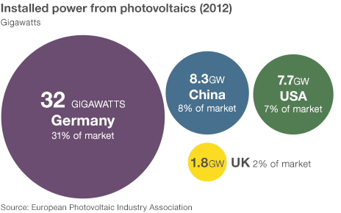

Slide 19
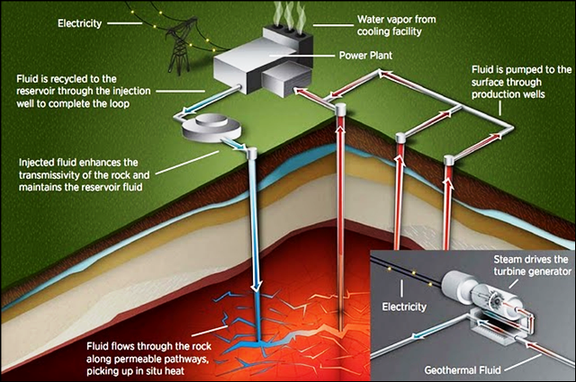
Electrical Energy
We can transform different types of energy into electrical energy
Fossil Fuels
Nuclear
Hydroelectric
Solar
Geothermal
Tidal
Wind

Slide 20
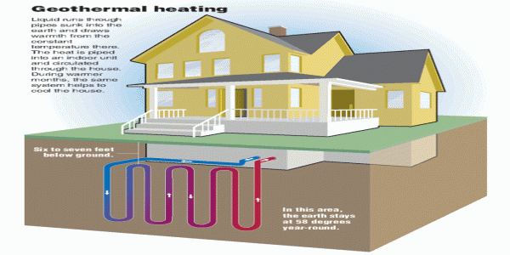
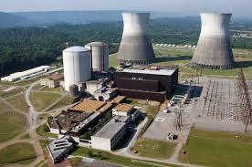
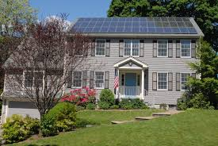
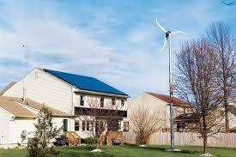
Why Don’t We Use More Renewable Energy?
VS

Slide 21
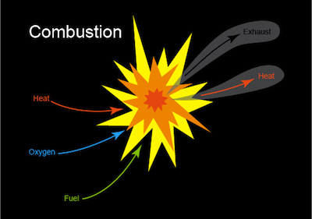
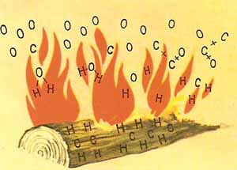
Transforming Thermal Energy
Different forms of energy can be converted into thermal energy.
For example chemical energy changed into thermal energy when something burns

Slide 22
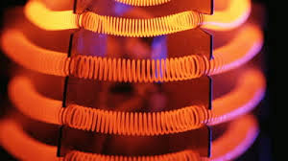
Transforming Thermal Energy
Electrical energy changes into thermal energy when a wire gets hot as the electrons encounter resistance.
This energy is sometimes used to heat buildings.
When an object is heated to a very high temperature it may glow. This a conversion to radiant energy and is how we light our homes.

Slide 23
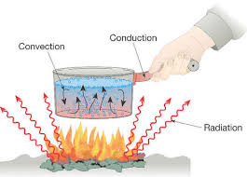
Movement of Thermal Energy
Heat is the movement of thermal energy in predictable ways, from high temperature to low temperature.
Thermal energy is transferred via conduction, convection and radiation

Slide 24
Class Debate
Should the US adopt more renewable energy sources or should we increase our use of fossil fuels?
Split into groups
Prepare a position statement
Defend your statement

