Slide 1
Ideas That Shaped Darwin's Thinking

Slide 2
The Theory of Evolution
Darwin was influenced by the work of economist Thomas Malthus who noted that the human population was growing very quickly.
He hypothesized that if it grew unchecked there wouldn’t be enough living space and this would lead to war and famine.
Darwin applied this reasoning to all species.
He was also influenced by the works of many other scientists.

Slide 3
The Age of the Earth
If we want to understand evolution we have to understand how old the Earth is.
Scientific estimates range from 4.4 to 4.8 billion years old!
Early attempts to calculate the age of the Earth were way off due to flawed assumptions about thermodynamics and the internal make-up of the Earths core.
James Hutton and Mark Lyon concluded that the Earth is in fact very old and that the processes that formed it are the same ones in operation today.

Slide 4
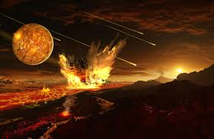
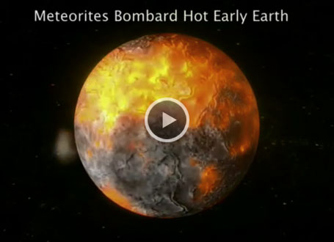
The Early Earth
http://www.precisiongraphics.com/portfolio/animation/

Slide 5
The Early Earth
Scientists estimate that earth is 4.6 billion years old!
Temperature was very hot
Volcanoes were erupting and tectonic plates are shifting
Other rock in the form of sediment is building up very slowly
The atmosphere had water vapor, carbon dioxide and nitrogen
Life as we know it could not have survived these conditions

Slide 6
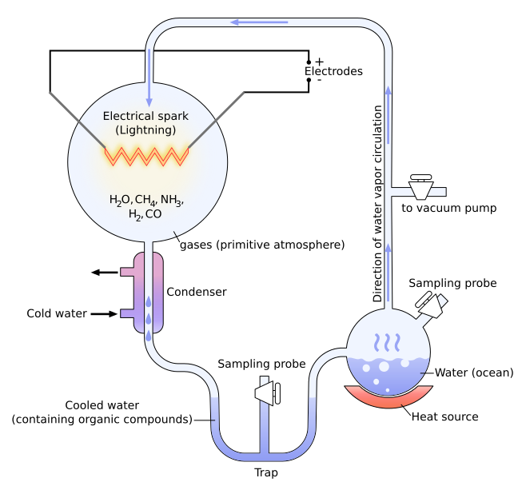
The Primordial Soup
Earths early atmosphere probably contained hydrogen, cyanide, carbon dioxide, carbon monoxide, nitrogen, hydrogen sulfide, and water – had you been there a few deep breaths would have killed you!
Miller and Urey recreated the conditions of the early Earth and were able to make simple organic compounds.
Later simple cells called proteinoid microspheres formed.
Then DNA and RNA molecules would have formed – scientists are still trying to understand when and how this occurred.

Slide 7
Lyell’s Principles of Geology
In addition Lyell also concluded that the laws of nature are constant over time and that scientists must explain past events in terms of processes thar are observable today.
This became known as uniformitarianism.
During his voyage on HMS Beagle Darwin had started to study the works of Hutton and Lyell.

Slide 8
The Age of the Earth and Evolution
The discovery of a more accurate measurement of the Earth was essential for the proper application of evolutionary theory.
The processes that we will examine require many years in order to take effect. Darwin termed this concept deep time.
Evolution is not a linear process as is often depicted. Many species have evolved new traits and then evolved out of them, only to evolve them again.
Likewise species have constantly come into and gone out of existence – speciation and extinction.

Slide 9
The age of the Earth
Cosmos episode 1:
http://www.hulu.com/watch/604551 27 minutes in

Slide 10
Early Earth

Slide 12
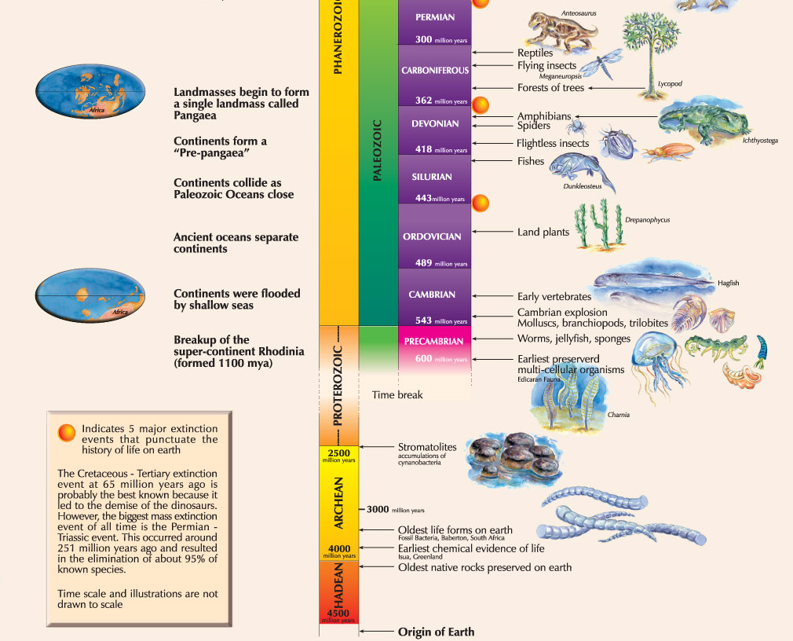

Slide 13
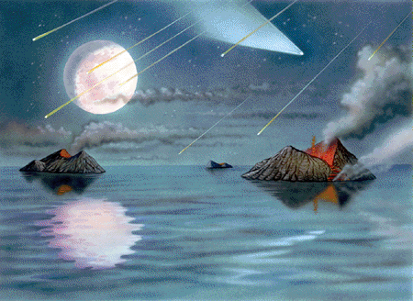
3.9 billion years ago…
Earth cooled enough for the water vapor to condense to rain.
Rainstorms lasted millions of years.
Lightning also occurred.
This is around the time that scientists believe the first living organisms appeared.

Slide 14
Lamarck’s Evolutionary Hypothesis
NO!
NO!
NO!
Darwin wasn’t the first scientist to try to explain how a species characteristics could change over time.
Jean-Baptiste Lamarck, a French scientist, proposed the notion that organisms could change during their lifetimes by using or not using various parts of their bodies.
He suggested that individuals could pass these acquired traits on to their offspring.

Slide 15
Can We Pass Acquired Traits to Our Children?

Slide 16
Alfred Wallace
Initially Darwin was worried that his proposals were too radical for a scientific community that had been molded around the Catholic church.
He delayed releasing his paper until he realized that another scientist Alfred Wallace had come to almost the same conclusions.
As Darwin released his paper first he was given all of the credit. We are now belatedly starting to recognize the work of Wallace.

