Slide 1
What is Ecology
Chapter 3.1

Slide 2
Ecology
From the Greek word for house ecology is the scientific study of organisms and their interactions with each other and their environments.
Scientists will study life at many different levels from the cellular to the entire planet – the biosphere.
The Biosphere consists of the entire planet and everything in it (from about 8 km above the Earth to about 11 km below the surface.

Slide 3
Levels of Ecological Organization
Ecologists study life at many levels. They consider individual organisms and entire biospheres.
Our level of understanding of Ecology has increased to the point were we now see little benefit in focusing solely on single organisms.
If we are to help that organism we must first save the biosphere in which it lives.

Slide 4
Levels of Organization
Some ecologists study life at the level of an individual. Remember a group of organisms so similar that they can produce fertile offspring is called a species.
A population consists of all members of that species in a particular area.
Communities consist of all the different populations in a defined area.

Slide 5
Levels of Organization
An ecosystem consists of all the living as well as the non-living parts or physical environment.
Scientists also study biomes. Biomes are a group of ecosystems that have the same climate, and similar dominant communities. This is the second larges level of study next to the biosphere.

Slide 6
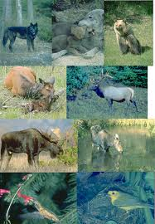
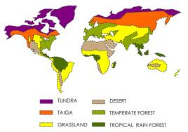
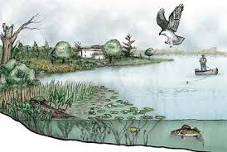
Levels of Study
Individual
Population
Community
Ecosystem
Biomes
Biosphere

Slide 7
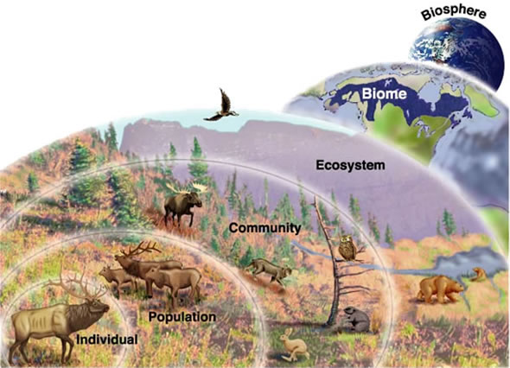
Levels of Ecology

Slide 8
Ecological Methods
Scientists use a variety of methods to study ecological systems.
Observations: Often the first step. Some can be simple like what organisms live here and some can be more complex and lead to designing experiments.
Experimenting: Experiments can be conducted to test hypotheses. Experiments can be conducted within laboratory setting or in natural ecosystems.
Modeling: Many ecological phenomena occur over such long periods of time that they are difficult to study. Ecologists use models to gain insight into complex phenomena. For example global warming.

