Slide 1
Cycles of Matter
Chapter 3.3

Slide 2
Biogeochemical Cycles
Nutrients circulate endlessly throughout the environment in complex cycles called biogeochemical cycles or nutrient cycles.
Carbon, oxygen, phosphorus and nitrogen are matter that make up nutrients that cycle through all the Earth’s spheres and organisms.
The water cycle plays a role in all of these cycles.

Slide 3
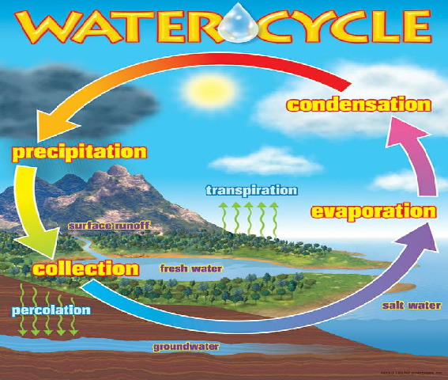
Evaporation, transpiration, precipitation and condensation are the major processes of the water cycle.

Slide 4
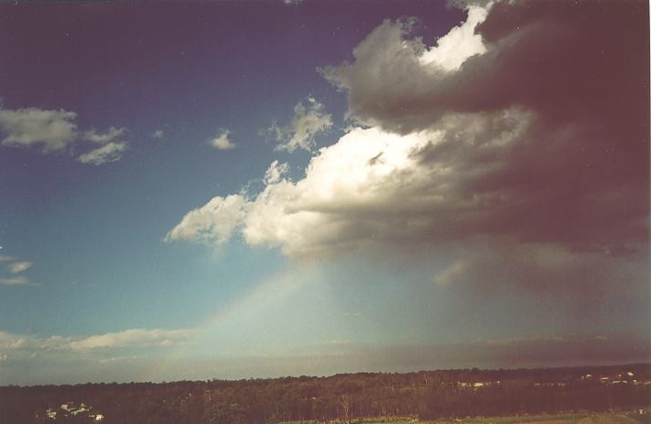
Properties of the water Cycle
Evaporation – movement of water from bodies of water or moist soil into the atmosphere.
Transpiration – The release of water vapor by plants
Evaporation and transpiration distill water naturally filtering out minerals and pollutants.
Precipitation – rainfall or snow
Condensation - after water evaporates it condenses into clouds and when saturation is reached results in precipitation.
Percolation (seepage) – water percolates down through soil and rock into ground water deposits

Slide 5
The carbon Cycle

Slide 6
Producers
Primary producers are organisms such as plants and algae that produce their own food.
The suns chemical energy is harnessed to make ATP which is then combined with carbon dioxide (CO₂) and water (H₂O) to produce simple sugars, such as glucose (C₆H₁₂O₆) and oxygen (O₂). This process is known as photosynthesis.
These simple sugars will then be used for cellular respiration or to form that actual structure of the plant
6CO₂ + 6H₂O + energy >> C₆H₁₂O₆ + 6O₂

Slide 7
Consumers and Decomposers
The carbon in a producer may be passed on to another organism.
A consumer may eat the producer or a decomposer breaks down its waste or remains.
Consumers are organisms (mainly animals) that eat other organisms in order to obtain nutrients.
Decomposers are organisms such as bacteria and fungi that break down wastes and dead organisms.

Slide 8
Cellular Respiration
Remember when we refer to cellular respiration this does not refer to breathing.
Cellular respiration is the process by which organisms use oxygen to release the chemical energy of sugars and release CO2 and H2O
C₆H₁₂O₆ + 6O₂ >> 6CO₂ + 6H₂O + energy

Slide 9
Carbon Cycle Summary
Atmospheric carbon (CO₂)
Atmospheric carbon is taken in by primary producers
Primary producers – photosynthesis
Carbon from plants is eaten by consumers and consumers are eaten by other consumers
Herbivores and omnivores
Consumers and waste products decompose
Decomposers (bacteria and fungi)
CO₂ is released back in to the atmosphere

Slide 10
Carbon Sinks
Plants and animals don’t respire all of the carbon that they take in.
Much of it is used for their life processes.
The abundance of plants on Earth and the amount of carbon that they use up for photosynthesis and other processes make them a major carbon sink.
A sink is a reservoir of a substance that takes in more of that substance than it lets out.

Slide 11
Carbon in Sediments
When organisms die in water their remains may settle as sediments (a material that settles at the bottom of a liquid).
As new layers of sediment accumulate the amount of pressure on earlier layers increases.
These conditions convert soft tissue into fossil fuels and shells and skeletons into sedimentary rock.

Slide 12
Carbon in Sediments
Limestone and other sedimentary rock make up some of the largest carbon reservoirs. They release their carbon through erosion and volcanic eruption.
Fossil fuel deposits contain lots of carbon. This carbon is released when fossil fuels are burned.
Remember sedimentary rock and fossil fuel stores are built up over geological time!

Slide 13
Carbon in Oceans
The worlds oceans are the second largest carbon reservoir.
They absorb carbon compounds from the atmosphere, runoff and undersea volcanoes. This is in addition to the role the ocean plays in creating sedimentary rock and fossil fuel deposits.
The rate at which the ocean absorbs and releases carbon depends on many factors including; water temperature and the amount of marine life living in it.

Slide 14
Human impacts on the Carbon Cycle
By extracting fossil fuels we remove carbon from storage in the lithosphere. When we then burn these fossil fuels we release the carbon (in the form of CO₂ gas) into the atmosphere.
Cutting and burning of forests has a two fold effect. When the wood is burned the carbon is released and there are also then fewer plants to absorb carbon.
Producers cannot absorb enough carbon to keep up with human activities.

Slide 15
The Phosphorus Cycle

Slide 16
The Phosphorus Cycle
The Phosphorus cycle keeps phosphorus naturally low.
Phosphorus is a key component of cell membranes and several other very important molecules such as DNA and RNA.
The amount of phosphorus in organisms is dwarfed by the amounts held in rock, soil, sediment, and the ocean.

Slide 17
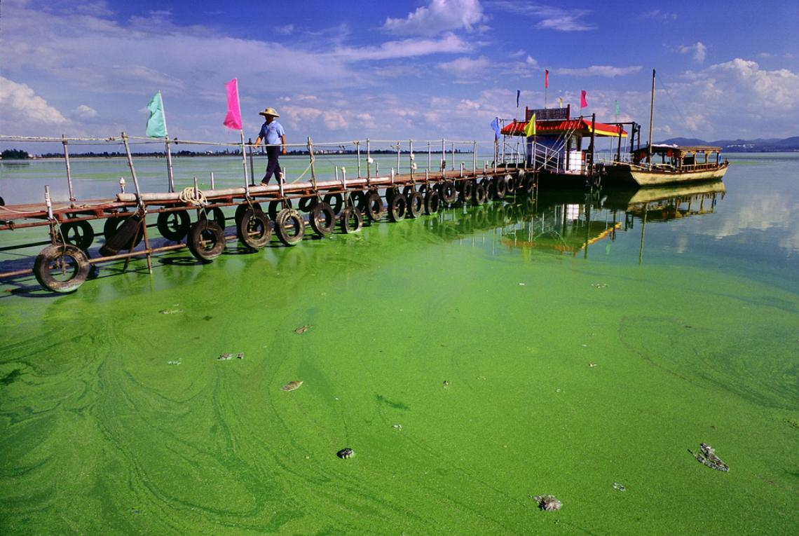
The Phosphorus Cycle
Phosphorus is released by the erosion of rocks by water and wind. It is the only cycle not to have an atmospheric component.
This scarcity explains why plant and algae growth dramatically jumps when phosphorus us added to an ecosystem.
Phosphorus compounds are added to many detergents to improve cleaning power.
This can find its way into the water supply and leads to a process called eutrophication – an overgrowth of primary producers such as algae. This in turn can lead to hypoxia

Slide 18
The Nitrogen Cycle
The nitrogen cycle relies on bacteria that make nitrogen useful to organisms and bacteria that can return it to the atmosphere.
Nitrogen makes up 78% of our atmosphere by mass. It is also the 6th most abundant element and is essential for proteins, DNA and RNA.
Plants also rely on nitrogen for growth.

Slide 19
The Nitrogen Cycle

Slide 20
Forms of Nitrogen
Nitrogen gas (N₂) cannot be taken in by organisms and useable forms of nitrogen are therefore relatively rare in our environment.
Nitrogen needs to be chemically changed (fixated) by; lightning, bacteria, or human technology in order to become useable.
Nitrogen compounds can become potent fertilizers in the biosphere.

Slide 21
Nitrogen Fixation
Nitrogen gas (N₂) must be chemically altered or “fixed” in a process termed nitrogen fixation.
This involves the turning of nitrogen gas into ammonia.
This can be achieved via
lightning strikes
nitrogen fixing bacteria
Nitrogen fixing bacteria either live freely in the soil or in a symbiotic relationship with plants (such as soybean, clover and other legumes)

Slide 22
Nitrification and Denitrification
Other types of soil bacteria use ammonium ions from nitrogen fixation or from waste decomposers to perform nitrification.
Ammonium ions >>> nitrite ions (NO₂⁻) >>>nitrate ions (NO₃⁻).
Plants can then utilize nitrate ions
The nitrogen cycle is complete when denitrifying bacteria convert nitrates in soils or water back into nitrogen gas.

Slide 23
The Nitrogen Cycle in Summary
Atmospheric nitrogen
Nitrogen fixation via bacteria or lightning
Ammonium
Nitrification via nitrifying bacteria
Nitrites
Nitrification via nitrifying bacteria
Nitrates
Denitrifying bacteria
Atmospheric nitrogen

Slide 24
Human Impacts to the Nitrogen Cycle
Nitrogen fixation is a fairly slow process.
German scientist Fritz Haber and Hans Bosch discovered a way to produce ammonia on a large scale.
The Haber-Bosch process enabled people to overcome the natural scarcity of nitrogen.

Slide 25
Human Impacts
By fixing more nitrogen we increase its flow into the atmosphere and into other reservoirs.
Nitrogen when combined with the increased levels of nitric oxide (through burning fossil fuels) forms nitrogen dioxide (NO₂).
This can in turn lead to acid precipitation.

Slide 26
Conflicting Interests
Similar problems to the phosphorus cycle can occur when the nitrogen cycle is unbalanced (eutrophication).
Leaching of nitrogen into water ways can occur when more nitrogen is added to soil.
This can place marine based economies in direct conflict with agricultural based economies.

Slide 27
Summary
The water cycle plays a role in all other nutrient cycling.
If ample sunlight and water are available an ecosystem may be limited by the availability of nutrients.
Like all matter the nutrients we have looked at in these cycles are never created or destroyed, they simply change from one form to another.
All the nutrient cycles are interconnected and any ecosystem will be dependent on all 4. Likewise if we manipulate one we may drastically change the others.

