Slide 1
Compounds and Mixtures
Chapter 1 Section 3

Slide 2
Key Vocab
Atom – smallest unit of an element that still maintains the characteristics of that element (e.g. Hydrogen – H or Oxygen – O)
Pure Substances – Matter with the same properties throughout (e.g. pure gold – Au or hydrogen gas H₂)

Slide 3
Key Vocab
Compounds – A substance who's’ smallest unit is made up of atoms of more than one element e.g. water.
Molecules – The smallest unit of a compound that maintains the characteristics of that compound (e.g. H₂O)

Slide 4
Compounds and Mixtures
O – Atom or elemental symbol
Oxygen (O₂) – Substance matter that has the same properties throughout
H₂O - Molecule
Glass of water (many H₂O) is a Compound – smallest unit is a molecule

Slide 5
Atoms, Molecules, and Compounds
A useful analogy goes as follows;
Think of atoms, molecules and compounds as parts of a paragraph.
Atoms are the individual letters. Molecules are the individual words, and a compound is the complete paragraph.

Slide 6
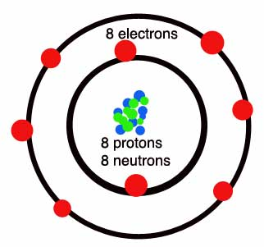
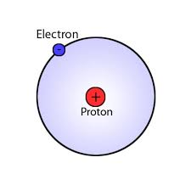
Compounds
Compounds often have characteristics that are very different to the elements that make them up.
For example hydrogen and oxygen are both gasses but when they combine to make H₂O the resulting compound is a liquid.

Slide 7
Compounds
Water (H₂O) is essential for life. We drink water, bath in water and are even composed mostly of water.
Hydrogen peroxide H₂O₂ is harmful to the eyes and although useful for many things can be very harmful to the body.

Slide 8
Formulas
The chemical formulas tell us how many atoms of a certain element are present in a compound.
The subscript number tells us how many atoms there are.

Slide 9
Formulas
For example water has 2 hydrogens and 1 oxygen (H₂O)
Hydrogen peroxide has 2 hydrogens and 2 oxygen (H₂O₂)

Slide 10
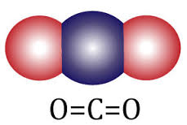
Compounds and Proportions
No matter the quantity of the compound the formula remains the same.
Carbon dioxide has a formula of CO₂. If we had 6 carbons and 12 oxygen and they formed carbon dioxide we would write it as 6CO₂
The number before the molecule tells us how many molecules there are.

Slide 11
Coefficients
The coefficient tells us how many molecules there are.
2H₂O means two molecules of H₂O

Slide 12
Parentheses
Parentheses indicate that there are a certain number of atoms in a compound.
Al₂(SO4)₃
This shows that there are three times the number of atoms which are in the brackets:
S - 1 x 3 = 3 atoms
O - 4 x 3 = 12 atoms

Slide 13
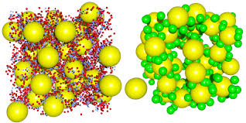
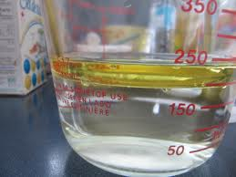
Mixtures
When two or more substances (compounds or elements) come together but don’t make a new substance a mixture results.

Slide 14
Air – A Mixture
The most common mixture that we encounter on a day to day basis is the air that we breath.
Air is mixture of nitrogen, oxygen, carbon dioxide, argon, and other gases.

Slide 15
Separating Mixtures
Sometimes we can use water to separate a mixture.
What would happen if we added water to a mixture of sugar and a mixture of sand?
What do you think would happen if we then heated the remaining water and sugar?

Slide 16
What happens when you heat water and sugar?
What happens when you heat water and sand?

Slide 17
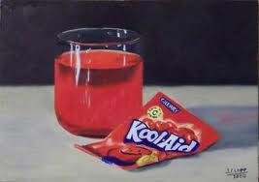
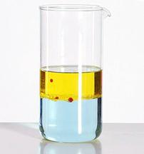
Homogeneous and Heterogeneous
Mixtures can be classified as homogenous or heterogeneous.
Homogenous – “the same throughout” you cant see the different parts of the mixture.
Heterogeneous – has parts that are different from each other e.g. sand and water.

Slide 18
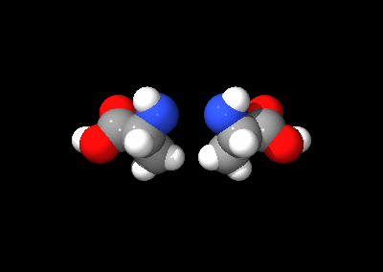
Chemical Bonding
A bond is the force that holds atoms together in a chemical compound.
There are basically 4 types of bond. Each has different strengths and the type of bond an atom will possess depends on its individual qualities.

Slide 19
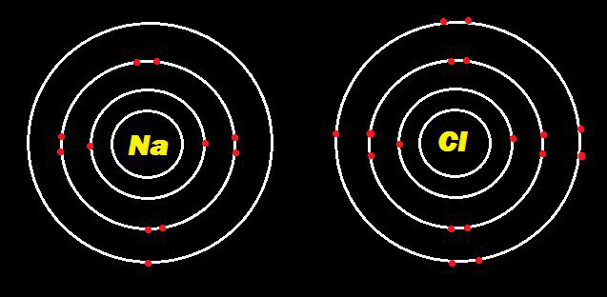
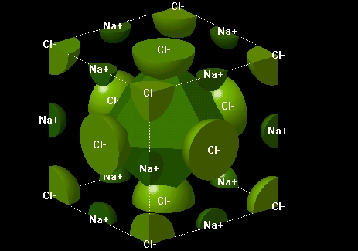
Ionic Bonding
Ionic bonding occurs when one atom transfers an electron to another.
This creates an attractive force that forms an ionic bond. This type of bond can be repeated many times in substances such as NaCl, creating a crystal structure.

Slide 20
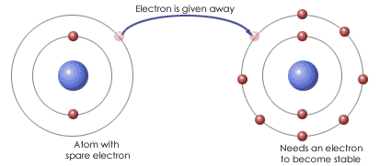

Slide 21
Ions
When an atoms gains or loses an electron we call it an ion.
Such an atom will have either a positive or a negative charge.

Slide 22
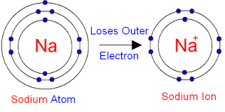
Ions – Cations
An atom that has lost one or more electrons is called a cation. It will have a positive charge.

Slide 23
Ions –Anions
An atom that has gained one or more is called an anion. It will have a negative charge.

Slide 24
Chemical Formulas
Ions are recorded as superscripts e.g. Na⁺ or Cl⁻
Sometimes an atom will lose more than one electron and we will record this in the superscript e.g. O²⁻

Slide 25
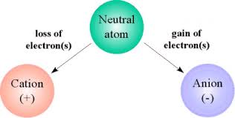
Ions – Cations and Anions
Typically when recording the chemical name of a substance we record the cation first then the anion.

Slide 27
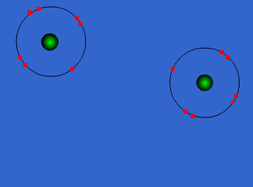
Covalent Bonding
This type of bond occurs when electrons pair up and the force of this sharing creates a covalent bond.

Slide 28
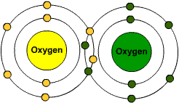
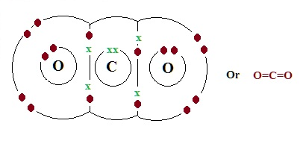
Covalent Bonding
This type of sharing does not produce ions. These are the strongest types of bond. Covalent bonds can be in single, double, or triple form.
O=0

Slide 29
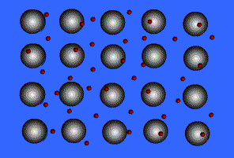
Metallic Bonding
In metals, atoms are so tightly packed that electrons can be shared between several atoms. Metalic bonds involves the sharing of electrons between many positive ions.

Slide 30
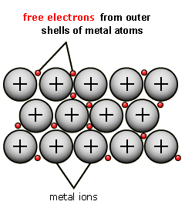
Metallic Bonding
The outermost electrons are so loosely held that they can readily drift from one atom to another.
This explains why metals are so good at conducting electricity. These are called metallic bonds.

Slide 31
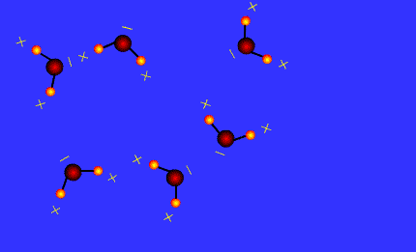
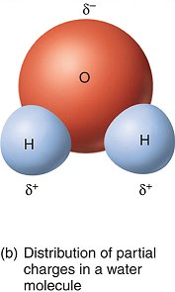
Van der Waals Bonding
This is a weak attraction that can occur between electrically neutral molecules due to the distribution of their charges.
Delta

Slide 32
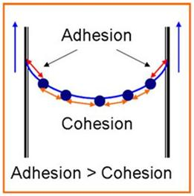
Van der Waals Bonding
The positive end of one molecule will be attracted to the negative end of another.
This creates a weak bond that is easily broken. This is often referred to as a hydrogen bond.

Slide 33
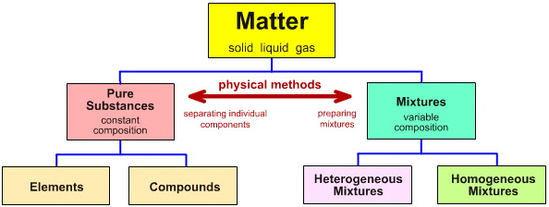

Slide 34
Knowledge and Understanding
What is the difference between an atom, a molecule, and a compound?
Give 3 examples of basic elements and 3 examples of basic compounds.
What is the difference between a mixture and a pure substance?

