Slide 1
Momentum
Chapter 1 Section 3

Slide 2
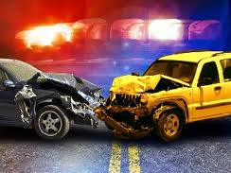
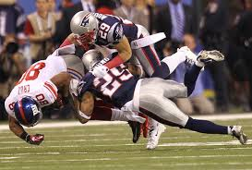
Collisions
A collision occurs when a moving object collides with other objects
This results in a change in velocity
This means that an object may change its speed or direction of motion.

Slide 3
Mass and Inertia
The mass of an object effects how easy it is to change its motion.
The tendency for an object to resist a change in its motion is called inertia.
The amount of inertia increases as an objects mass increases.

Slide 4
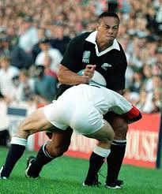
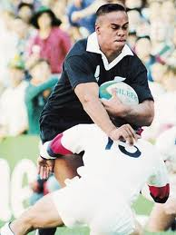
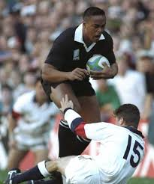
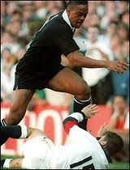
Momentum
The faster an object moves the harder it is to stop.
Likewise increasing the mass of an object makes it harder to stop.
The momentum of an object is a measure of how hard it is to stop.

Slide 5
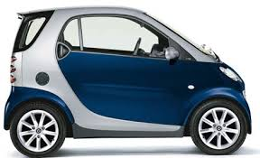
Momentum Equation
In a collision at 20 m/s who will “win”, the SMART car or the SUV?
Who will experience the largest acceleration force?
Momentum (in kg ● m/s) = mass (in kg) x velocity (in m/s)
p=mv
(units = kg ● m/s)
Note: because velocity has a direction momentum also has a direction. It is the same as the velocity..

Slide 6
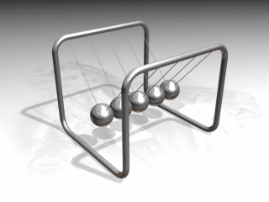
Conservation of Momentum
When you play pool and you hit another ball with the cue ball you may notice that the cue ball slows down and the other ball speeds up.
This is an example of the law of conservation of momentum.
The total momentum of a group of objects remains constant unless outside forces act on the group.

Slide 7
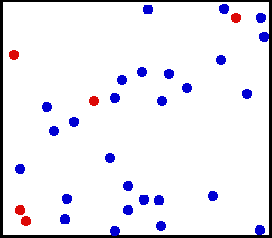
Types of Collisions
Elastic collisions occur when two bodies rebound from each other without any change kinetic energy.
This type of collision can be seen when a balling ball hits a pin or when moving cars bounce off each other.

Slide 8
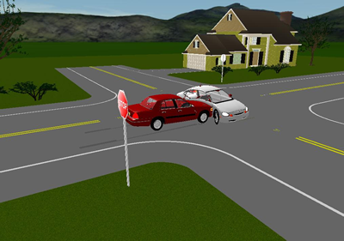
Types of Collision
Inelastic collisions result in a loss of kinetic energy
In a perfectly inelastic collision both the objects will be stuck to each other.

Slide 9
Using Momentum Conservation
The law of conservation of momentum can be used to calculate the velocity of objects after they collide.
If we have two objects colliding, one with a mass of 2kg and the other with a mass of 48kg.
The 2kg object has a velocity of 5 m/s East and the 48kg object has a velocity of 0 m/s East (it is at rest).

Slide 10
Using Momentum Conservation
The first thing we need to do is calculate total momentum.
Total momentum = large object p + small object p.
= 2kg x 5m/s east + 48 kg x 0 m/s.
= 10 + 0
= 10 kg ● m/s east
Total momentum (p) = 10 kg ● m/s east

Slide 11
Using Momentum Conservation
Lets assume a perfectly inelastic collision. After the collision, the total momentum will remain the same.
Only one object will be moving. Its mass will be the sum of the large object and the slow object.

Slide 12
Using Momentum Conservation
We can use the equation for momentum to find the final velocity.
10 kg ● m/s east = (2kg + 48 kg) x velocity
10 kg ● m/s east = (50 kg) x velocity
0.2 m/s east = velocity (10 divided by 50)

Slide 13
Colliding and Bouncing Off
In some collisions the objects will bounce off each other.
These are called elastic collisions
If two identical objects collide whilst traveling at the same speed their total momentum before the collision would be zero (their momentums were the same but in opposite directions).
After the collision the total momentum would also be zero. This is the conservation of momentum in action.

