Slide 1
The Endocrine System
Chapter 34.1

Slide 2
Cellular Communication
Cells in a large organism communicate via chemical signals passed from one cell to another.
These signals can change the rate that cells are performing activities and can thus cause dramatic effects in cells.
Via this communication cells can establish homeostasis.

Slide 3
Cellular Junctions
Cells within a tissue are connected to one another via cellular junctions
Some of these junctions hold cells tightly together.
Others allow small molecules to pass through that carry chemical signals to other adjacent cell.
The cell receiving this signal must have an appropriate receptor that the signaling molecule can bind to (located on the cell membrane or in the cytoplasm.

Slide 4
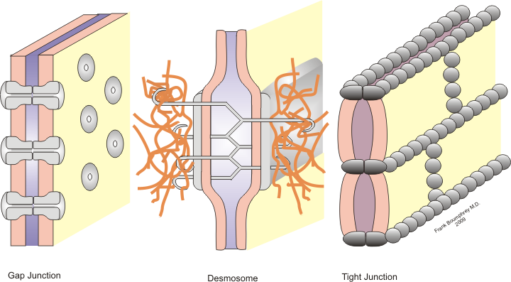
Types of Junction
Allow Cellular communication
Anchor the cell
Anchor tissue

Slide 5



Types of Cell Communication

Slide 6
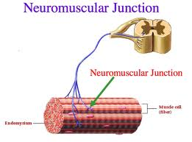
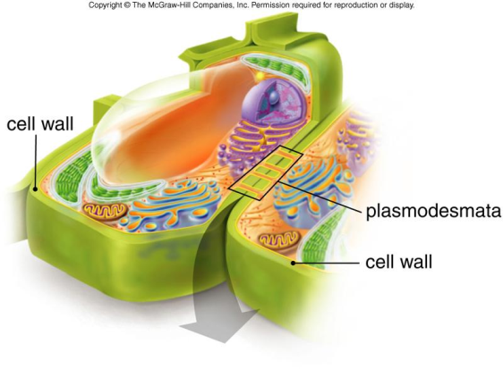
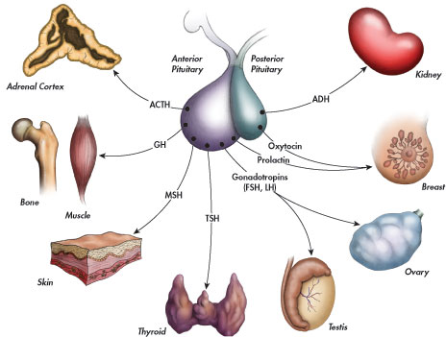
Cell Communication
Short distance
No distance
Long distance
Cell to cell
Hormones – Affect many cells

Slide 7
Hormones and Glands
The endocrine system is s form of cell communication that broadcasts a chemical message
The endocrine system is made up of glands that release hormones
Hormones deliver messages throughout the body

Slide 8
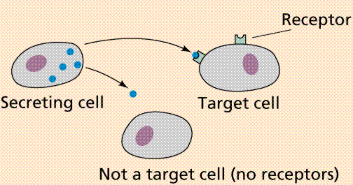
Hormones
Hormones act by binding to specific receptors on a cell membrane or within a cell.
Cells that have the appropriate receptor are known as target cells.
In general the bodies response to hormones are slower and last longer than the responses to nerve impulses.
Many bodily functions depend on the effects of two opposing hormones. For example insulin and glucagon.

Slide 9
Glands
A gland is an organ that produces and releases a substance or secretion.
Exocrine glands release their substances through ducts either out of the body or into the digestive system. E.g. sweat, tears, and digestive enzymes.
Endocrine glands usually release their secretions (hormones) directly into the blood.

Slide 10
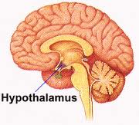
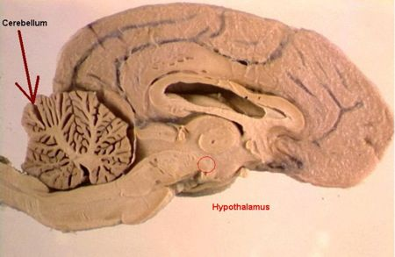
Hypothalamus
Makes hormones that control the pituitary gland (releasing hormones or neurohormones) and hormones that are stored in the pituitary gland.
The hypothalamus also controls body temperature, hunger, fatigue, sleep and circadian rhythms.

Slide 11
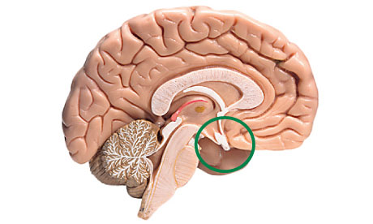
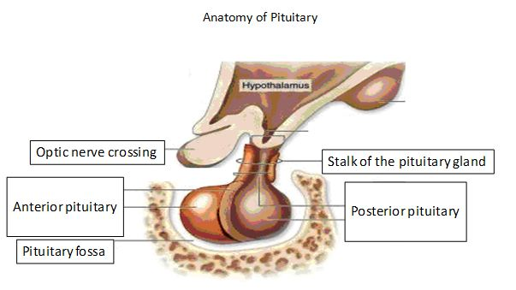
Pituitary Gland
Produces hormones that regulate many other endocrine glands and some organs.
Anterior pituitary gland – controlled by regulatory hormones released by the hypothalamus.
Posterior pituitary gland – develops as an extension of the hypothalamus. Neurosecretory cells extend from the hypothalamus with terminals in the posterior pituitary gland.

Slide 13
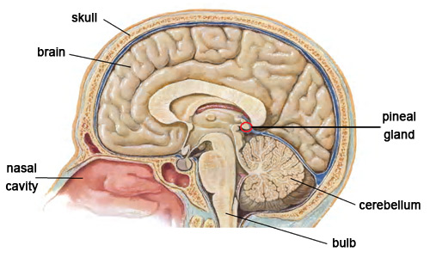
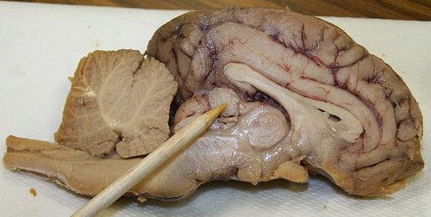
Pineal Gland
The pineal gland releases melatonin, which is involved in rhythmic activities, such as daily sleep-wake cycles.

Slide 14
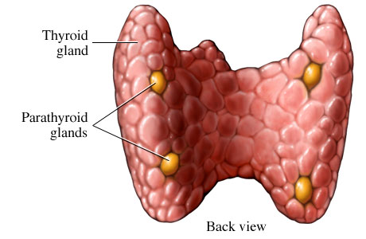
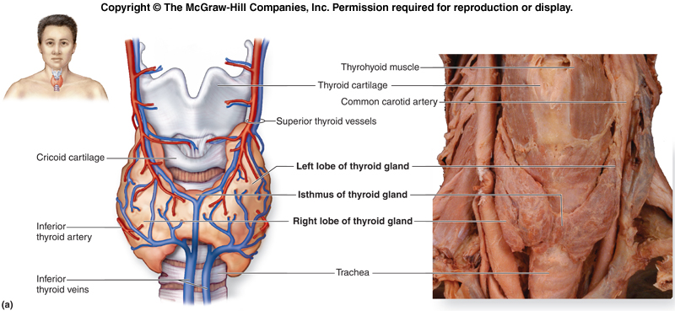
Thyroid and Parathyroid Glands
Thyroid produces thyroxin which regulates metabolism throughout the body
Parathyroid Glands – 4 glands which release parathyroid hormone, which regulates the level of calcium in the blood.

Slide 15
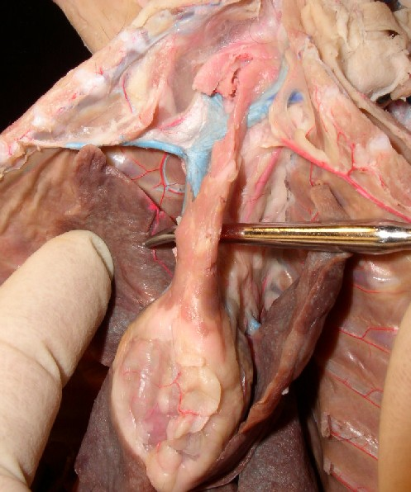
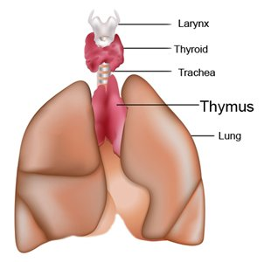
Thymus
During childhood the thymus releases thymosin, which stimulates T cell development and proper immune response.

Slide 16
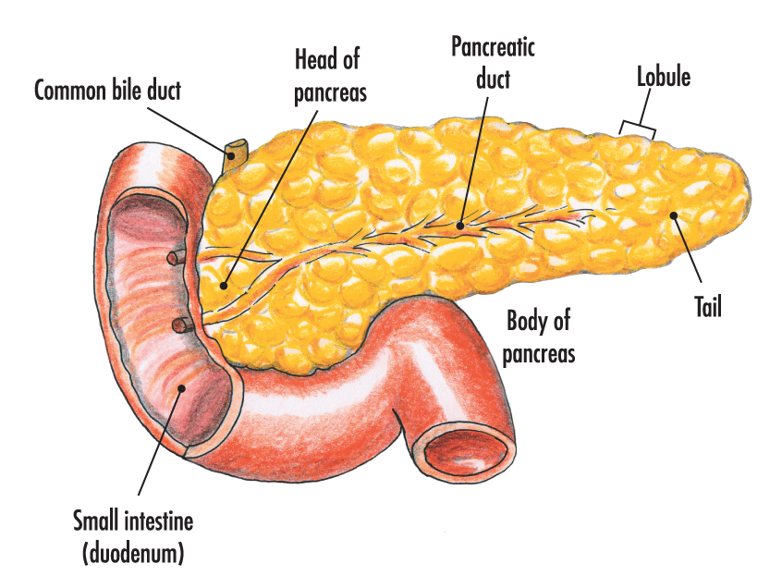
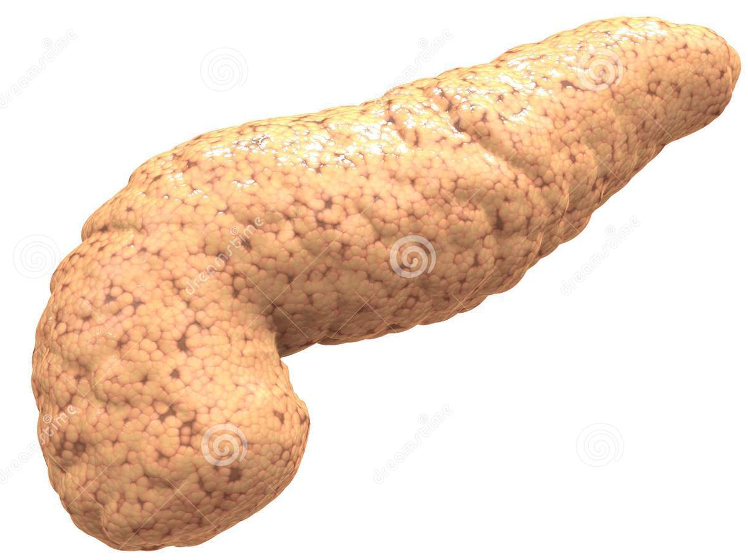
Pancreas
The pancreas produces insulin and glucagon which regulate blood sugar levels.
Glucagon is a peptide hormone produced by alpha cells and raises blood sugar levels. Glucagon causes the liver to convert stored glycogen into glucose.
Insulin is a peptide hormone produced by beta cells. It lowers blood glucose levels by causing cells in the skeletal muscles and fat tissue to absorb glucose from the blood.

Slide 17
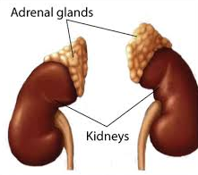
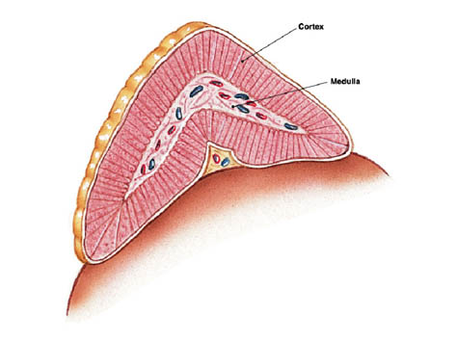
Adrenal Glands
The adrenal glands release hormones which help the body respond to stress.
Corticosteroids – steroid hormones e.g. cortisol
Catecholamines – e.g. epinephrine (adrenaline) and norepinephrine (noradrenaline)

Slide 18
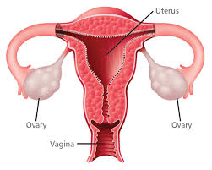
Ovaries
Ovaries produce estrogens and progesterone
Estrogens are required for the development of secondary sex characteristics and for the development of eggs.
Progesterone prepares the uterus for a fertilized egg.

Slide 19
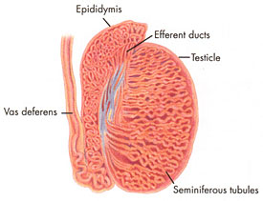
Testes
The testes produce testosterone, which is responsible for sperm production and the development of male secondary sex characteristics.

Slide 20
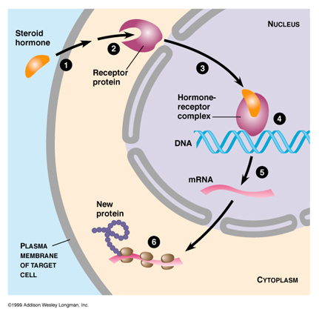
Hormone Action – Steroid Hormones
Because steroid hormones are lipids they can pass across the cell membrane.
Once inside they bind to a receptor (found only in the target cells) and form the hormone-receptor complex.
The hormone-receptor complex becomes a transcription factor
Transcription and translation

Slide 21
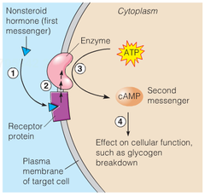
Hormone Action – Nonsteroid Hormones
A nonsteroid hormone binds to receptors on the cell membrane
The binding of the hormone activates enzymes on the inner surface of the cell membrane
These enzymes release secondary messengers such as calcium ions, nucleotides, and fatty acids.
Another very common type of secondary messenger is cAMP which is produced from ATP
Secondary messengers activate or inhibit a wide range on cellular functions.

Slide 22
Prostaglandins
The glands of the endocrine system were once thought to be the only organs that produced hormones.
We now know that all cells produce hormone like substances called prostaglandins.
These are modified fatty acids produced by a wide variety of cells. Some cause smooth muscle to contract or things like pain sensations during a headache.
The generally effect only nearby cells and for this reason are referred to as “local hormones”.

Slide 23
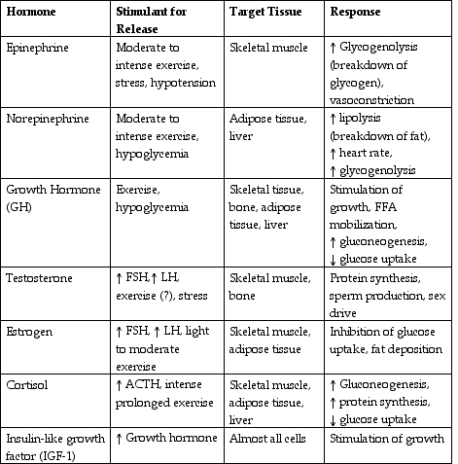

Slide 24
