Slide 1
Nervous System

Slide 2
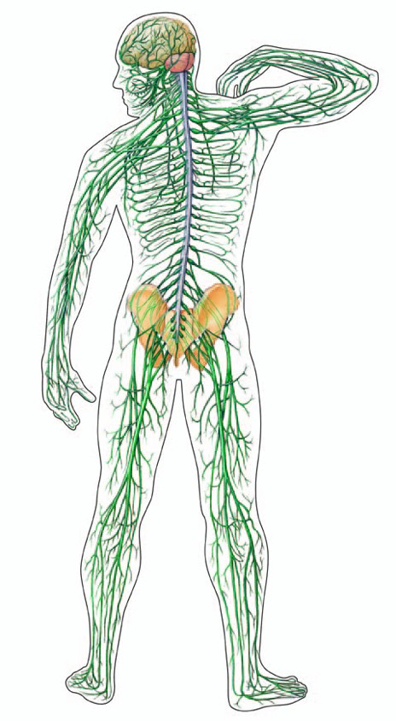
Nervous System
The main function is to control and coordinate functions throughout the body
Respond to internal or external stimuli.

Slide 3
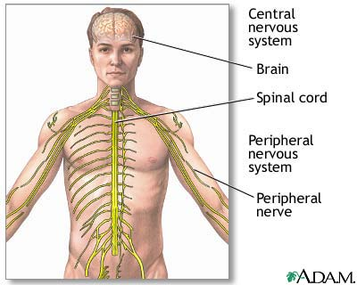
Nervous System
Transmitted electrical signals are called impulses.
Neurons are the basic cell unit.
There are 3 types.
Motor neurons
Sensory neurons
Interneurons

Slide 4
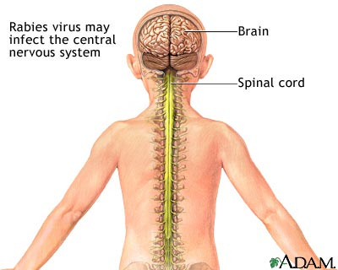
Nervous System
Impulses travel up and down the spinal cord to the brain where signals are processed.
The Brain and spinal cord are collectively known as the central nervous system (CNS).

Slide 5
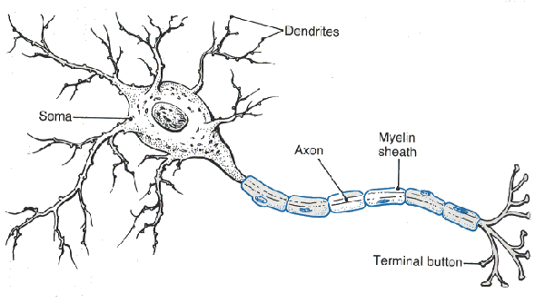
Parts of the Neuron
Cell Body with Nucleus: largest part of the neuron (has cytoplasm).
Dendrites: Extend off the cell body, carry impulses from environment

Slide 6
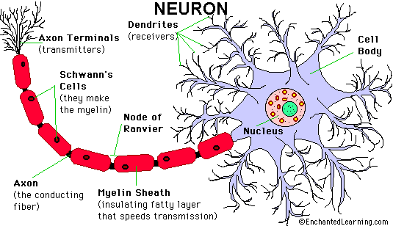
Parts of the Neuron
Axon: long fiber, carries impulses away from the cell body.

Slide 7
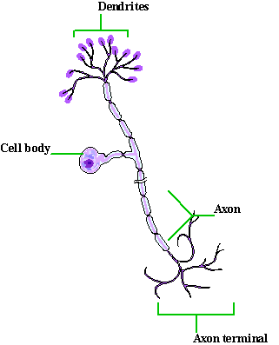
Sensory Neurons
Carry impulses from the sense organs to the spinal cord and brain.
Eyes and skin to brain and/or spinal column – sensory receptors to CNS.

Slide 8
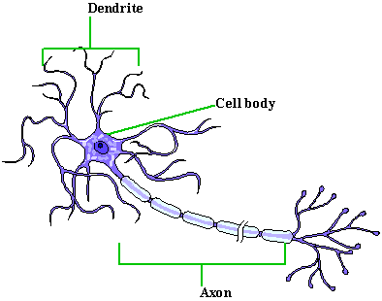
Motor neurons
Carry impulses from the brain and spinal cord to muscles and glands.
Organs and skeletal muscles to brain

Slide 9
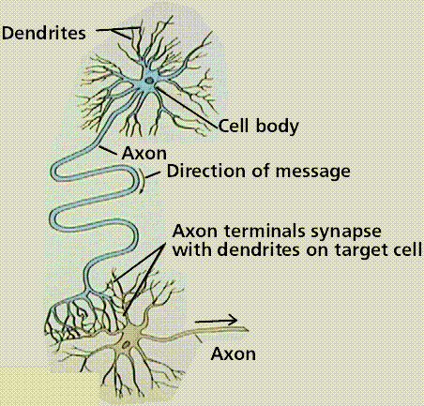
Interneurons
Connect sensory neurons and motor neurons.
Carry impulses between them.

Slide 10
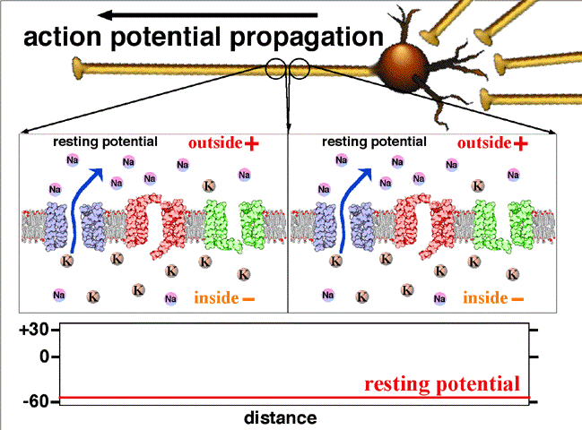
Action Potentials (AP)
At the leading edge of the nerve impulse gates in the sodium channels open. The membrane becomes more permeable to Na⁺ ions and an action potential occurs.
As the AP passes, gates the potassium channels open, allowing K⁺ ions to flow out and restoring negative potential inside the axon.
The AP moves along the axon

Slide 11
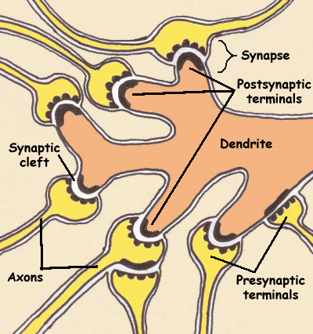
Synapse
Where the impulse is transferred from one neuron to the next by neurotransmitters.

Slide 12
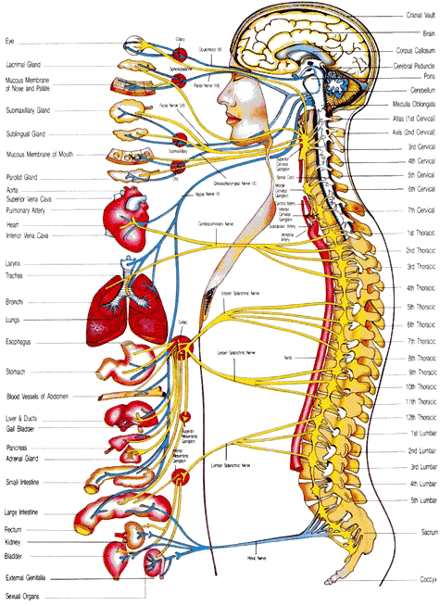
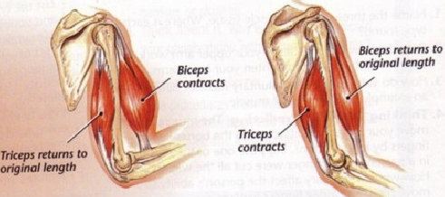
Somatic vs Autonomic
Somatic: controls conscious movement (skeletal muscles).
Autonomic: controls and regulates involuntary muscle action – sympathetic and parasympathetic

Slide 13
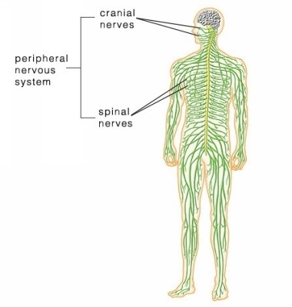
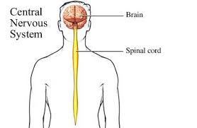
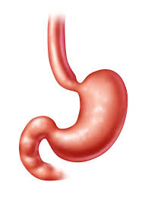
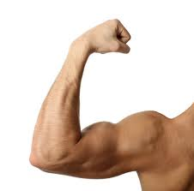
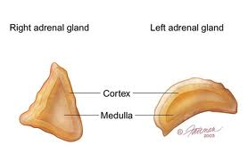
Nervous System
Peripheral
Central
Somatic
Autonomic
Sympathetic
“fight or flight”
Parasympathetic
“rest and digest”

Slide 14
Nerve Flow
Sensory receptors receive impulse
Impulse travels up sensory nerves to spinal cord and brain
Brain processes the information
Brain sends impulse down spinal cord to the motor neurons
Motor neuron signals muscle action

Slide 15
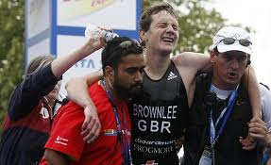
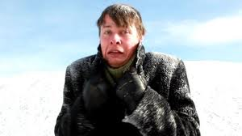
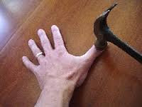
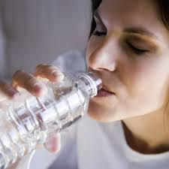
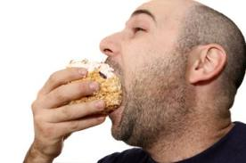
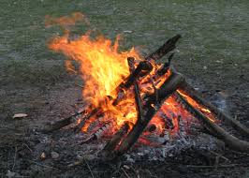
Nervous System
Processes internal and external stimuli.

Slide 16
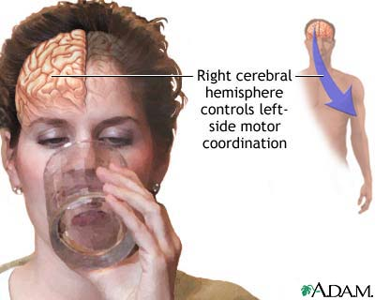
Parts of the Brain
Cerebral Hemisphere.
You have two hemispheres
Right and Left
They control the opposite sides of your body

Slide 17
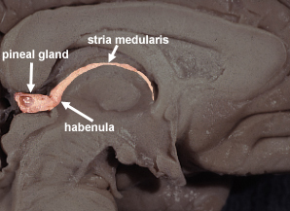
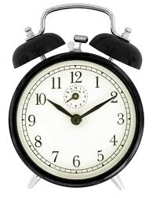
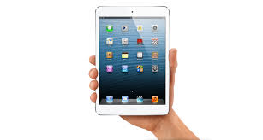
Parts of the Brain
Epithalamus.
Made up of a gland that responses to daylight.
Your “biological clock”
What happens when you look at a bright screen late at night?

Slide 18
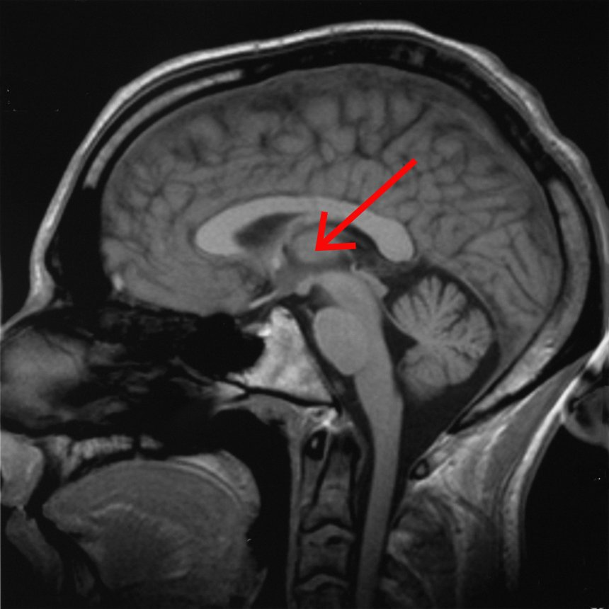
Parts of the Brain
Thalamus.
This translates the information from your sensory organs

Slide 19
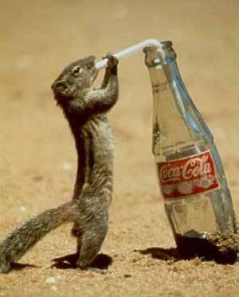
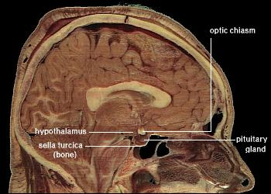
Parts of the Brain
Hypothalamus.
This is the control center of the autonomic nervous center.
Thirst, hunger, anything to do with homeostasis

Slide 20
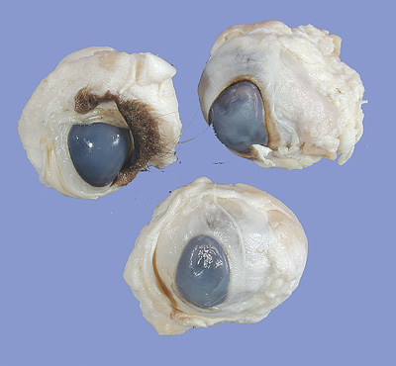
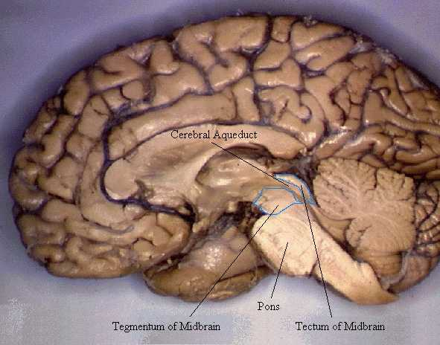
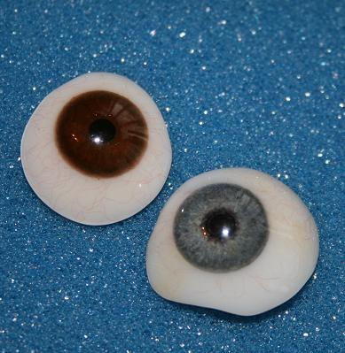
Parts of the Brain
Midbrain.
This controls your eyes’ muscles.
Your eyes’ movements, pupil dilation, and lens shape

Slide 21
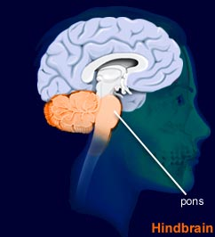
Parts of the Brain
Pons.
Another messenger.
Connects sensory info and motor impulses from the face to the brain

Slide 22
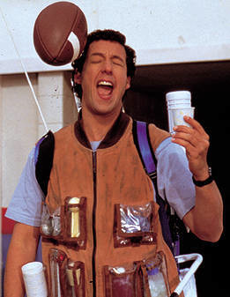
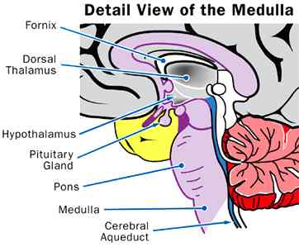
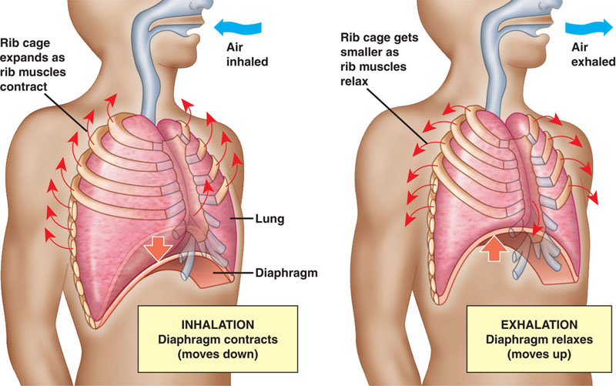
Parts of the Brain
Medulla.
This is a major part of the endocrine system (hormone system)
Controls heart rate and breathing

Slide 23
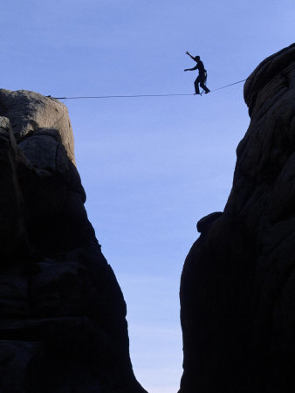
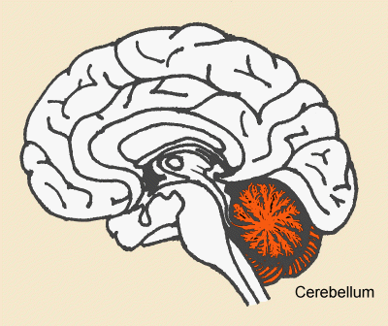
Parts of the Brain
Cerebellum.
This controls your balance, movement, and posture

Slide 24
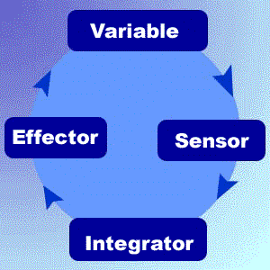
Physiological (Physical stimulus) Feedback loops
This happens when an organ/tissue monitors a condition (ex. Blood sugar)
When the condition is not normal, the organ releases a hormone

Slide 25
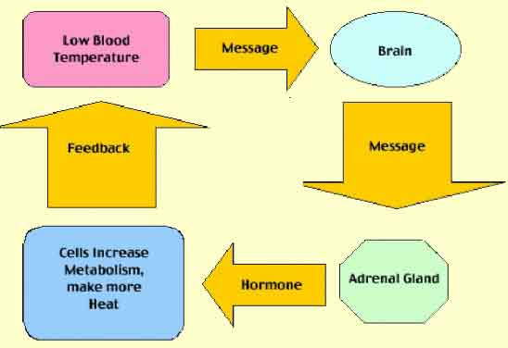
Physiological (Physical stimulus) Feedback loops
This hormone causes a second tissue/organ to somehow change the monitored condition.
Once it is back to normal, the monitoring tissue stops releasing hormone.

Slide 26
