Slide 1
Skeleton, Muscular, and Integumentary System
The Body’s Support and Locomotion System

Slide 2
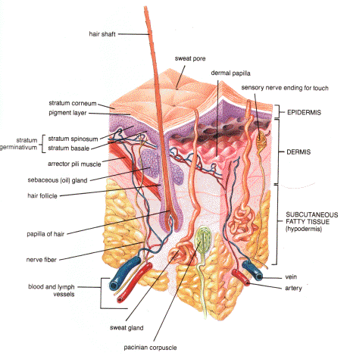
The Skin – Integumentary System
The outer protection against the environment – infection and injury
Growing Hair
Insulation
Temperature Control
You shed thousands of skin cells a day
The skin you see is already dead
Hair and nails are also part of the integumentary system

Slide 3
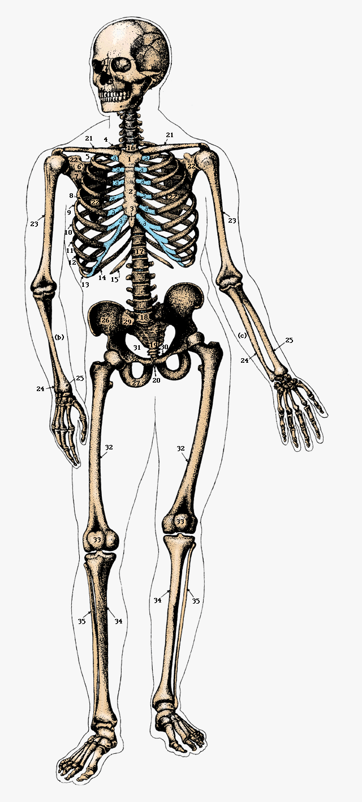
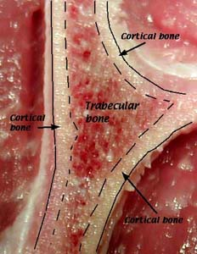
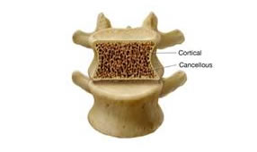
The Skeleton
You have 206 bones in your body
Each has a function
Five main functions:
Protection: Rib cage
Storage of minerals (Ca)
Storage of fat
Production of blood cells
Structure/movement

Slide 4
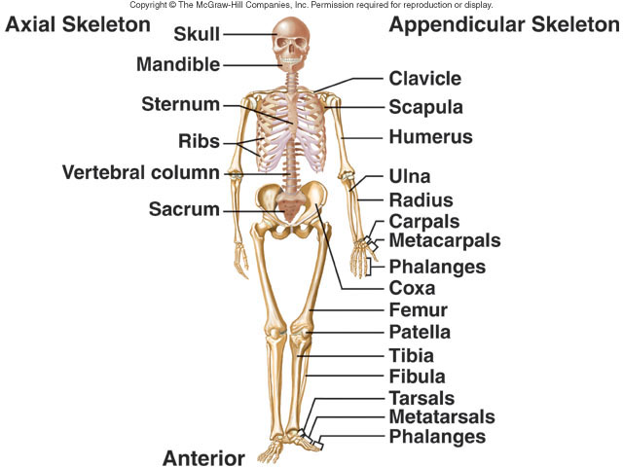
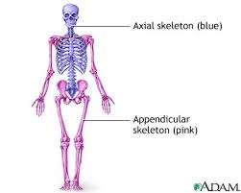
The Skeleton
Bones split into 2 main Categories:
Axial skeleton: bones in the center: head, neck, ribs, and spinal cord
Appendicular skeleton: bones on the outer ends: arms, legs, shoulder, and pelvis

Slide 6
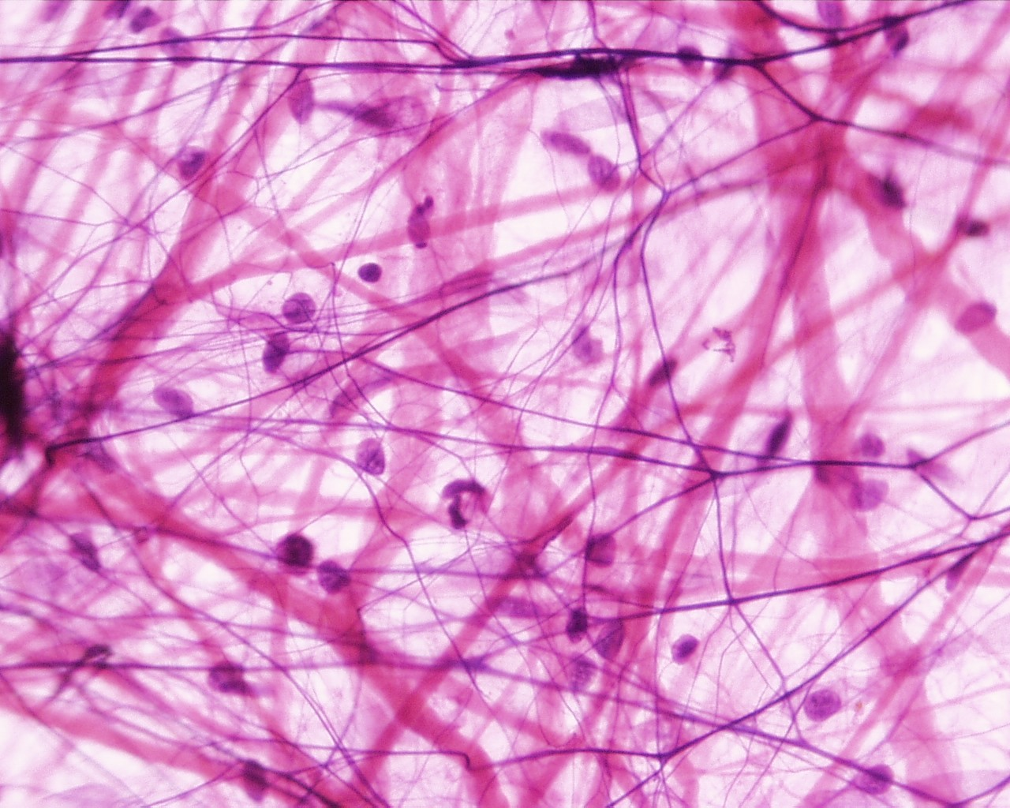
Connective Tissue
Three main types of connective tissue:
Ligaments: connect one bone to another bone
Tendon: connect a muscle to a bone
Cartilage: cover the end of bones to protect them

Slide 7
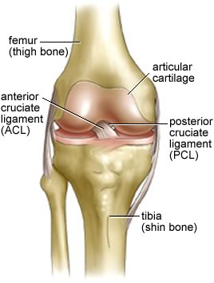
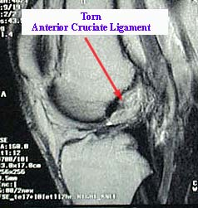
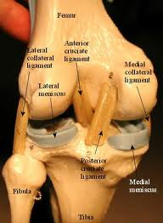
Ligament

Slide 8
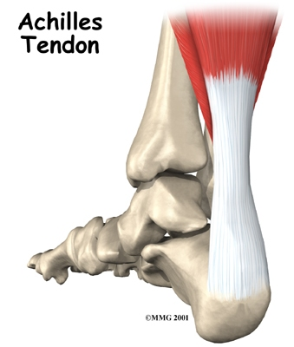
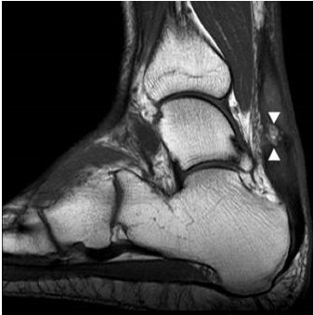
Tendon

Slide 9
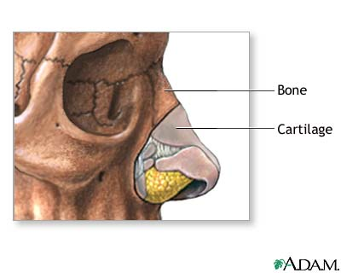
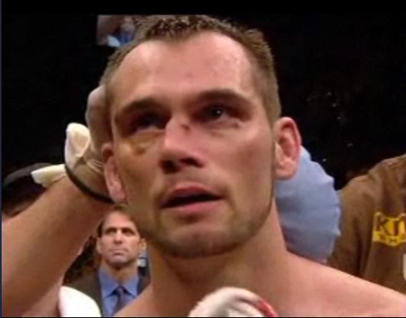
Cartilage

Slide 10
The Joints
Four main types of joints:
Ball and Socket: rotational movement, hips and shoulders
Pivot: Bones twist around each other, elbow
Hinge: back and forth movement, knees and fingers
Gliding: Allow bones to slide past each other, wrists and ankles

Slide 11
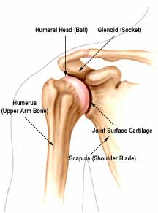
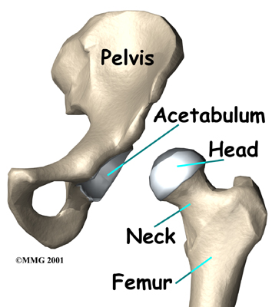
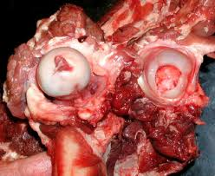
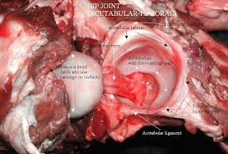
Ball and Socket

Slide 12
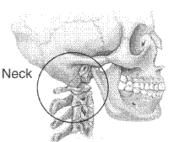
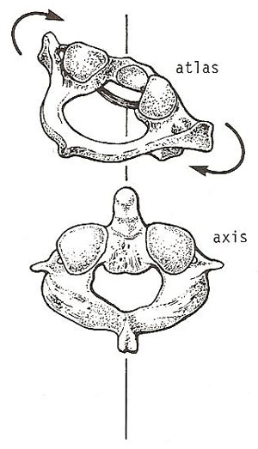
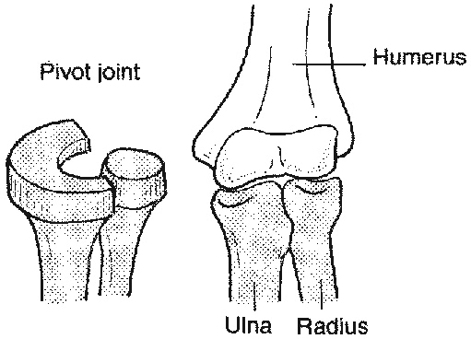
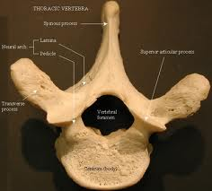
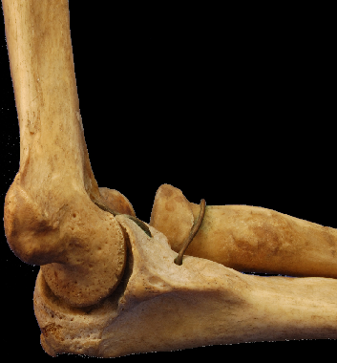
Pivot

Slide 13
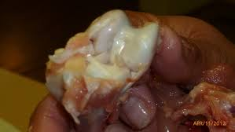
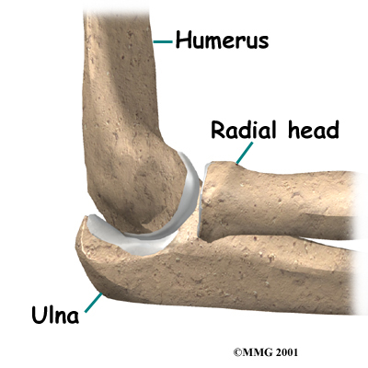
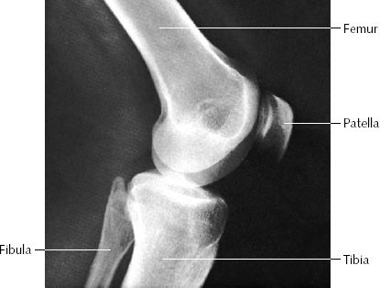
Hinge

Slide 14
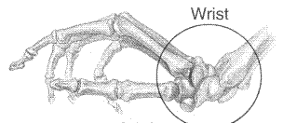
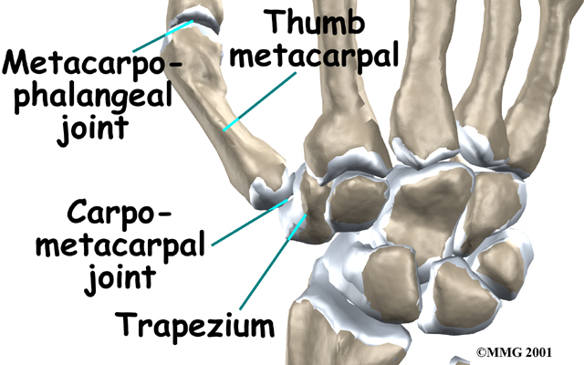
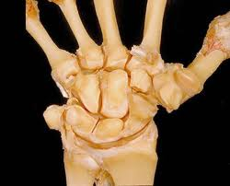
Gliding

Slide 15
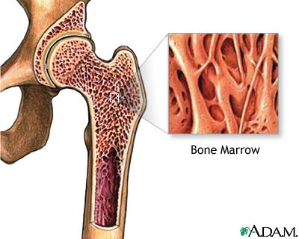
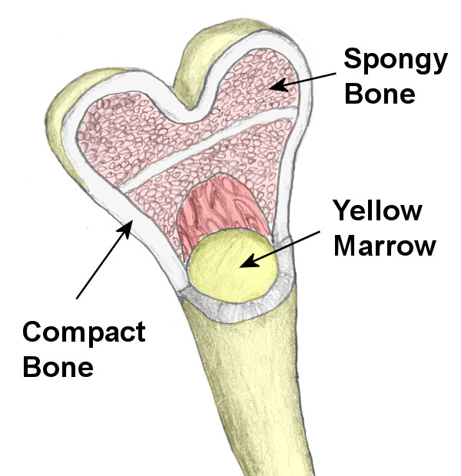
Skeletal Functions
Types of Marrow:
Red Marrow: Production site for red and white blood cells
Yellow Marrow: Storage for fat
Also stores calcium

Slide 16
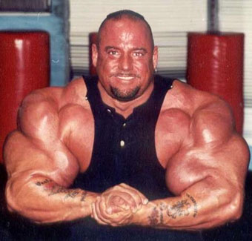
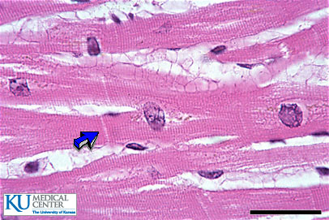
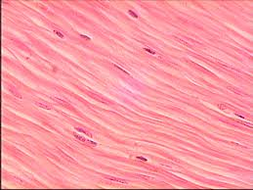
The Muscles
Three types of muscles:
Skeletal: Attached to bones, allow for movement, voluntary
Cardiac: Found in the heart, involuntary
Smooth: found in hollow structures (stomach and blood vessels), involuntary

Slide 17
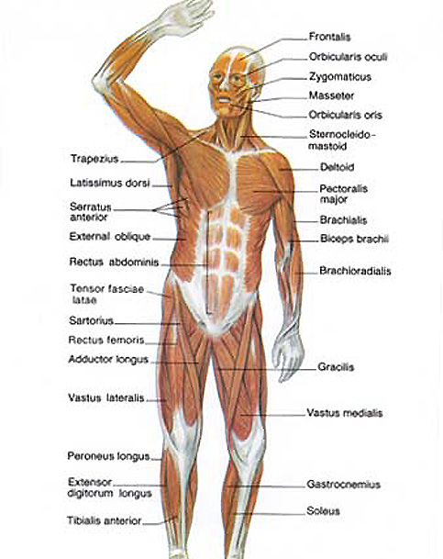
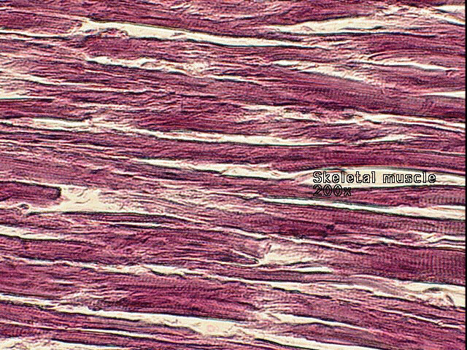
Skeletal Muscle
YOU HAVE CONTROL OVER THESE MOVEMENTS:
They work in opposing pairs to move joints.
Ex. Biceps and triceps

Slide 18
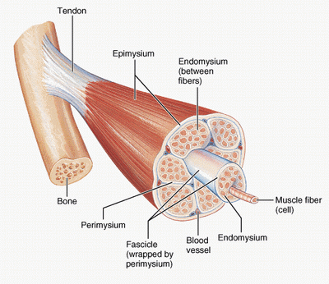
Skeletal Muscle

Slide 19
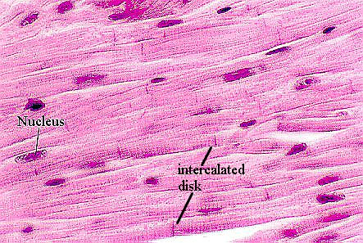
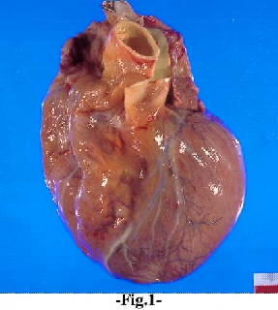
Cardiac Muscle
YOU HAVE NO CONTROL OVER THESE MOVEMENTS:
Done independently of concious thought
Ex. Heart and blood vessels

Slide 20
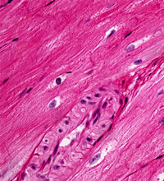
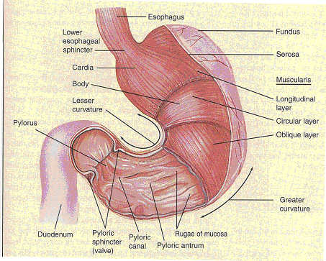
Smooth Muscle
YOU HAVE NO CONTROL OVER THESE MOVEMENTS:
Ex. Stomach

Slide 21
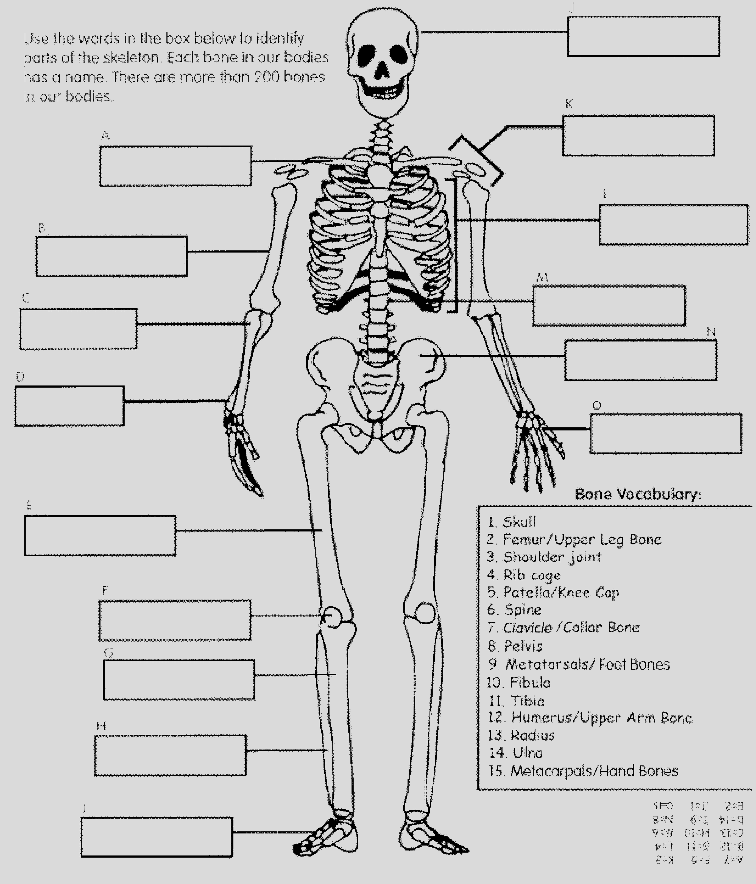
Main Parts of the Skeleton
Skull
Shoulder Joint
Clavicle
Rib Cage
Humerus
Spine
Radius
Pelvis
Ulna
Metacarpals
Femur
Largest bone?
Femur
Patella
Smallest bone?
Tibia
Stirrup
Fibula
Metatarsals

