Slide 1
The Respiratory System
Chapter 37.3

Slide 2
What is Respiration?
In biology we tend to use respiration in two different ways. We have previously looked at cellular respiration which takes place in the cytoplasm and mitochondria of cells.
In order to fully catabolize a molecule of glucose our cells need to have oxygen.
The blood carries oxygen from the lungs to the bodies tissues and carbon dioxide from the tissue to the lungs where it is expelled.

Slide 3
The Human Respiratory System
The basic function of the human respiratory system is remarkably simple.
Air enters the body and fills the lungs, where gas exchange takes place.
The respiratory system consists of the nose, pharynx, larynx, trachea, bronchi, and lungs.

Slide 4
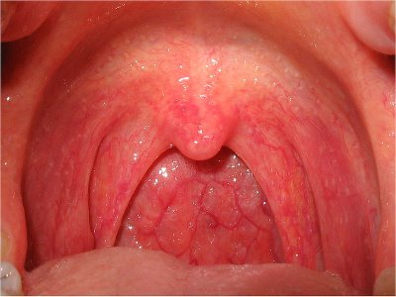
The Pharynx
Air moves through the nose to a tube at the back of the mouth called the pharynx (throat). It is filtered, warmed, and moistened.
The pharynx serves as a passageway for both air and food.

Slide 5
Trachea and Epiglottis
Air moves from the pharynx into the trachea (windpipe)
A flap of tissue called the epiglottis covers the entrance to the trachea when you swallow.

Slide 6
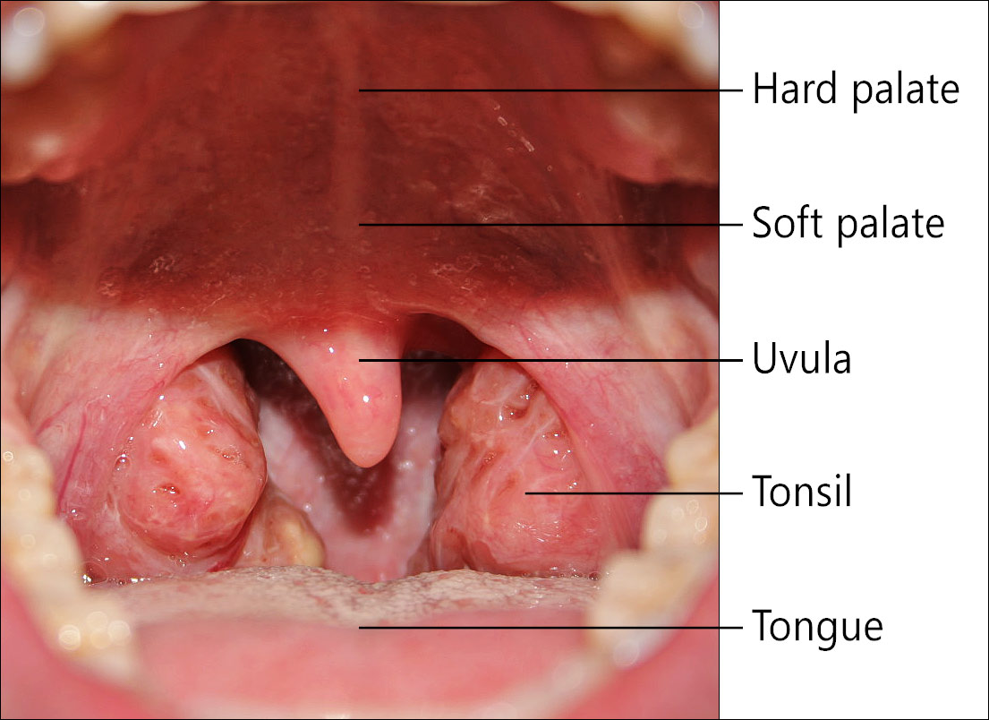

Slide 7
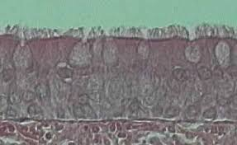
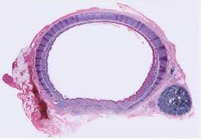
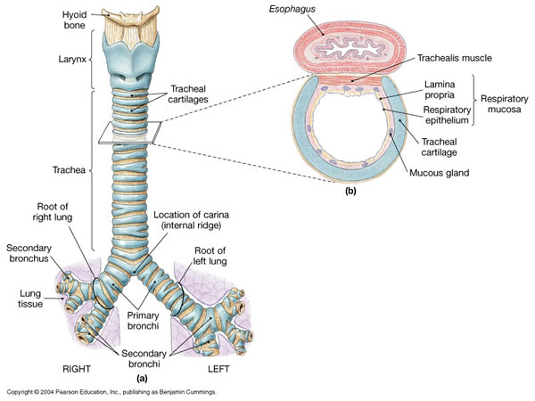
Cillia and Mucus
The respiratory passageways allow air to pass directly into some of the most delicate areas of the body.
The air is further warmed, moistened, and filtered.
Some of the cells which line the respiratory system produce mucus which moistens the air and traps particles.
Cilia sweep the trapped particles away from the lungs.

Slide 8
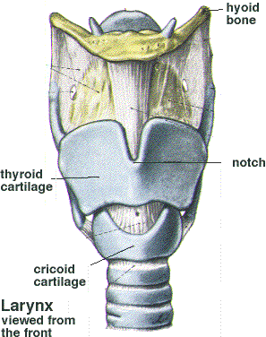
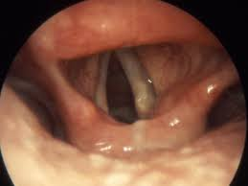
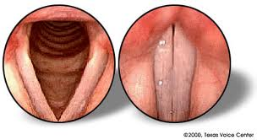
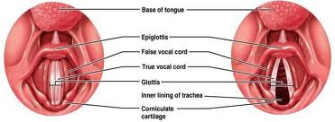
Larynx
At the top of the trachea is the larynx.
The larynx consists of two very elastic chords that vibrate and produce sounds
This is where you get your ability to speak, shout, and sing.

Slide 9
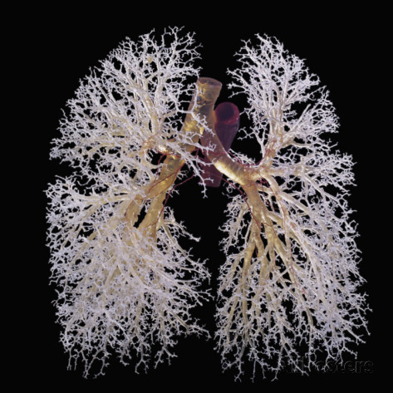
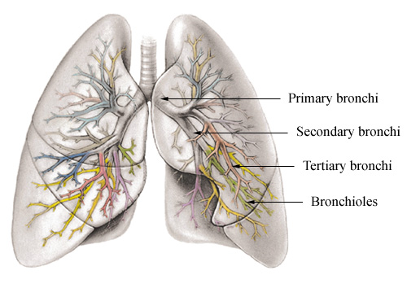
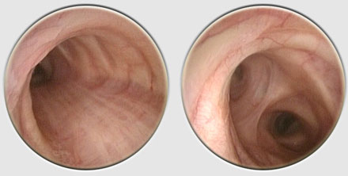
The Bronchi
From the larynx air passes down the trachea into two air passageways in the chest cavity called the bronchi (singular: bronchus).
Each bronchus leads in to a lung, where it sub divides into smaller bronchi, which lead into even smaller passageways called bronchioles.
The passageways are surrounded by smooth muscles that enable the nervous system to control the size of the passageways as needed.

Slide 10
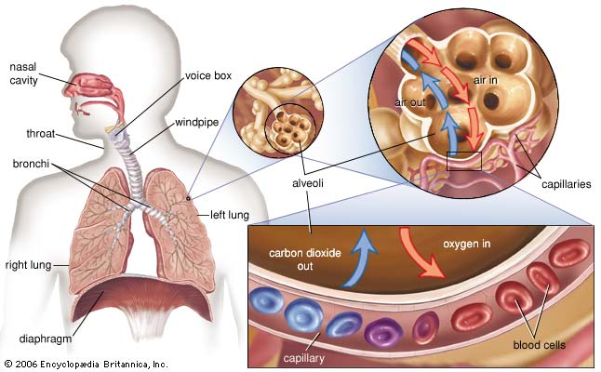
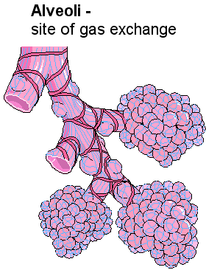
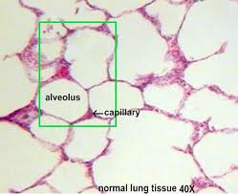
Alveoli
The bronchioles continue to sub-divide until they reach a series of dead-ends – millions of tiny air sacks called alveoli.
This is where gas exchange takes place.

Slide 11
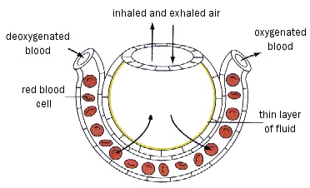
Gas Exchange
Each lung has about 150 million alveoli. This provides an enormous surface area for gas exchange.
Oxygen dissolves in the moisture on the inner surface of the alveoli and then diffuses across the thin-walled capillaries into the blood.
Carbon dioxide in the blood diffuses the other way across the membrane of the alveolus and into the air within.
CO₂
O₂

Slide 12
Bohr Effect
The Bohr effect is a physiological phenomenon first described in 1904 by the Danish physiologist Christian Bohr, stating that hemoglobin's oxygen binding affinity is inversely related both to acidity and to the concentration of carbon dioxide.
That is to say, a decrease in blood pH which leads to an increase in blood CO₂ concentration will result in hemoglobin proteins releasing their loads of oxygen.
Conversely, a decrease in carbon dioxide provokes an increase in pH, which results in hemoglobin picking up more oxygen. Since carbon dioxide reacts with water to form carbonic acid, an increase in CO₂ results in a decrease in blood pH.

Slide 13
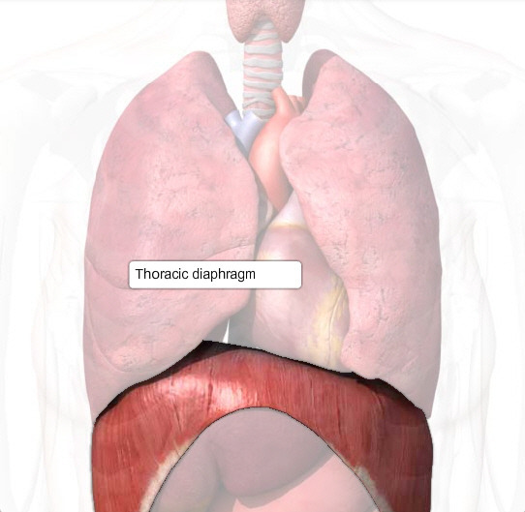
Breathing
Breathing is the movement of air into and out of the lungs.
The force that drives the air into the lungs comes from ordinary air pressure.
The lungs are sealed in two sacs called the pleural membranes.
At the bottom of the chest cavity is a large muscle called the diaphragm.

Slide 14
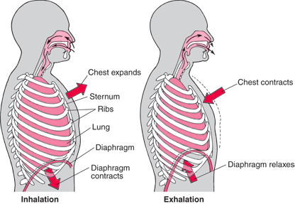
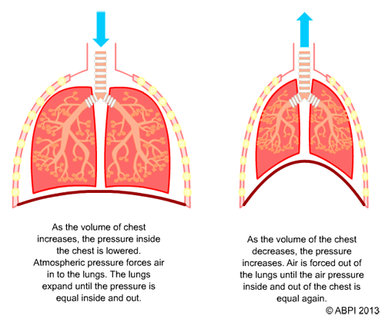
Diaphragm
When you inhale the diaphragm contracts and the rib cage rises up.
This expands the volume of the chest cavity.
As the chest cavity is tightly sealed this created a partial vacuum inside the cavity and atmospheric pressure fills the lungs with air.
Most of the time exhaling is a passive event. The rib cage lowers and the diaphragm muscles relax.
The pressure in the chest cavity is now higher than atmospheric pressure so air rushes back out.

Slide 15
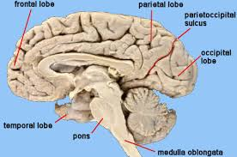
How Breathing is Controlled
You can control your breathing when ever you want but breathing is not entirely voluntary.
If you hold your breath eventually your body will take over. Breathing is such an important function that your nervous system will not allow you complete control over it.
The medulla oblongata controls breathing. Autonomic nerves from this part of the brain connect to the diaphragm and chest muscles producing cycles of contraction that bring air into the lungs.
Other cells in the medulla oblongata monitor CO₂ levels. As levels rise the breathing center increases the rate and depth of breathing.

Slide 16
Smokers Lungs v Non-smokers Lungs

