Slide 1
Excretory / Kidney Systems
Chapter 38.3

Slide 2
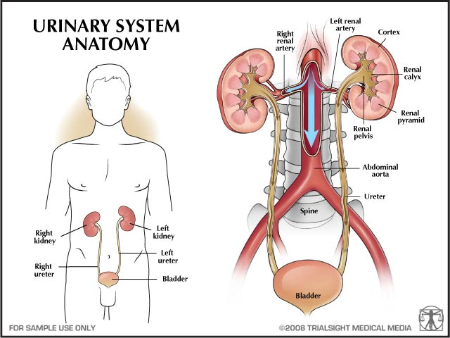
Excretory System
The main function is to maintain homeostasis by filtering out and removing metabolic wastes (urea, CO₂)

Slide 3
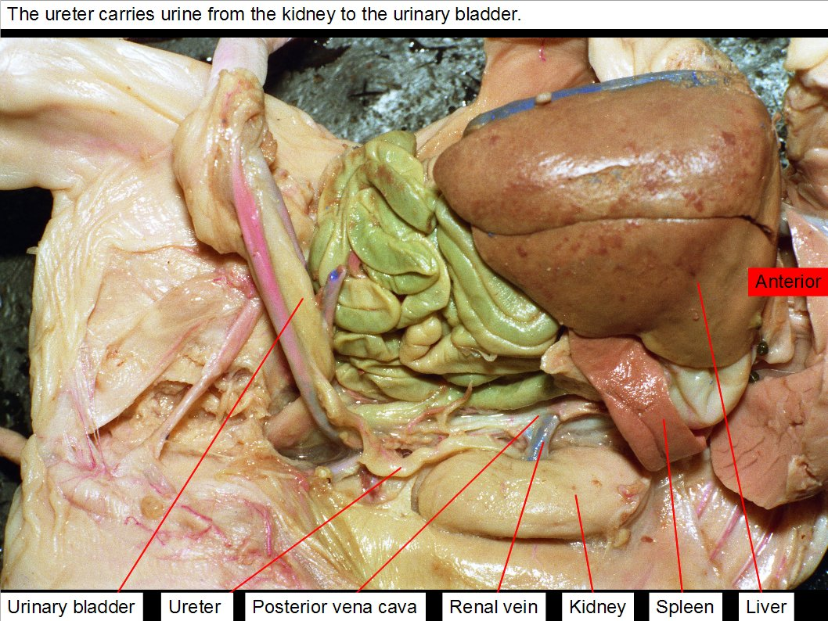
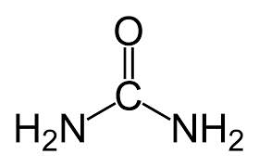
Excretory System
Urea is a toxic compound that is produced when amino acids are used for energy

Slide 4
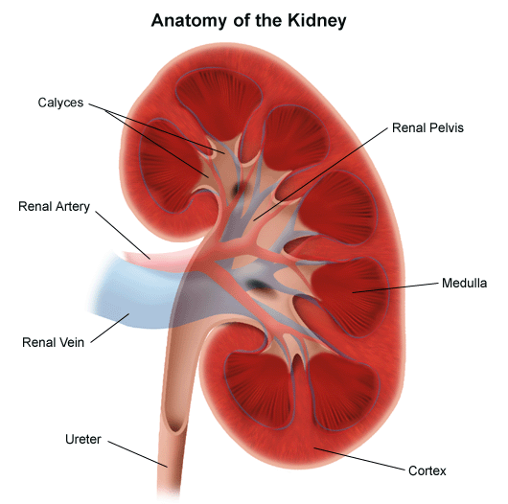
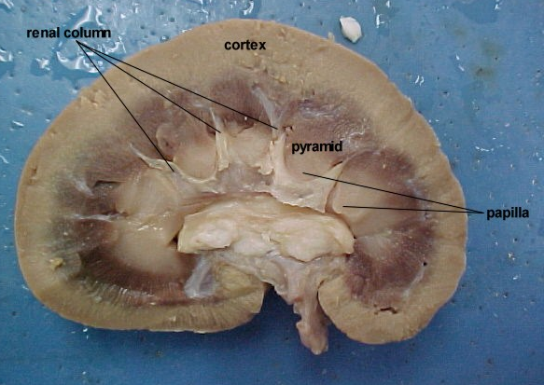
Parts of the Excretory System
Kidney- located on either side of the spinal column near the lower back.
Removes excess water, urea, and other waste products from the blood via diffusion and osmosis

Slide 5
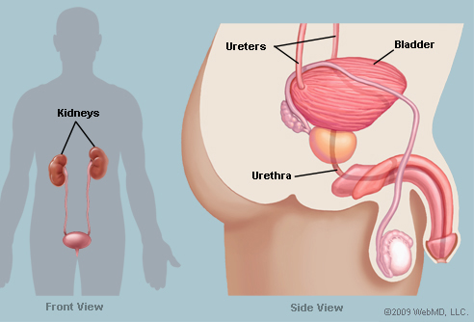
Parts of the Excretory System
These wastes from the kidneys are collected as urine

Slide 6
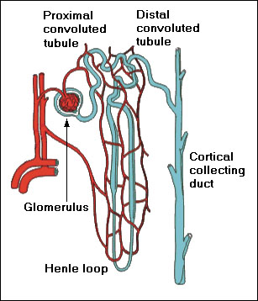
Parts of the Excretory System
Nephron: This is a small independent processing unit of the kidney, where filtering takes place.
Typically you have around 1 million per kidney

Slide 7
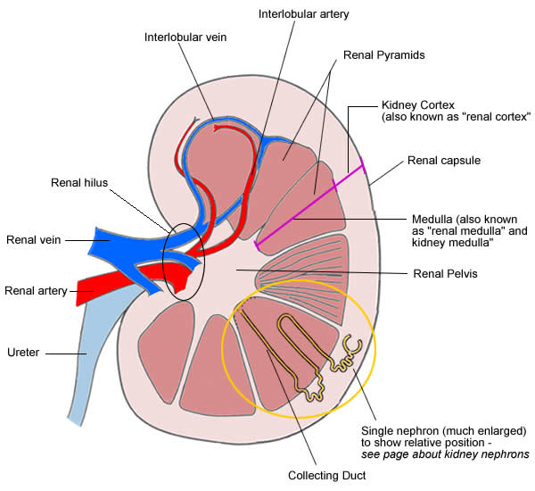
Parts of the Excretory System
Renal Artery: This artery brings blood containing wastes to the kidneys

Slide 8
Parts of the Excretory System
Renal Vein: blood that has been filtered exits the kidney

Slide 9
Parts of the Excretory System
Ureter: all waste products that have been filtered are transported from the kidneys to the urinary bladder for excretion.

Slide 10
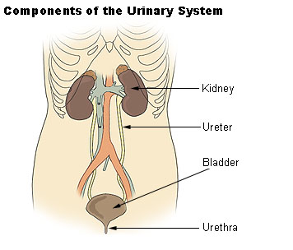
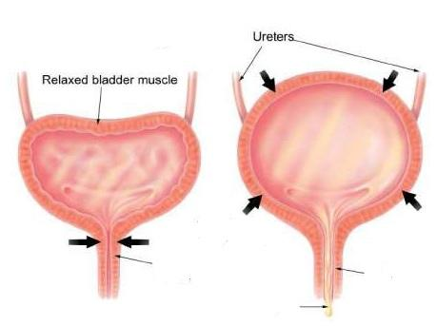
Parts of the Excretory System
Urinary Bladder: Urine is stored until excreted.

Slide 11
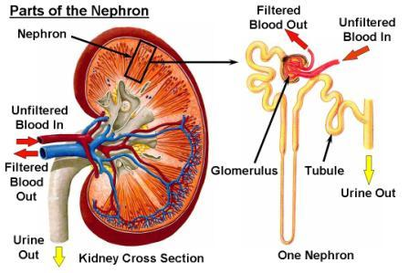
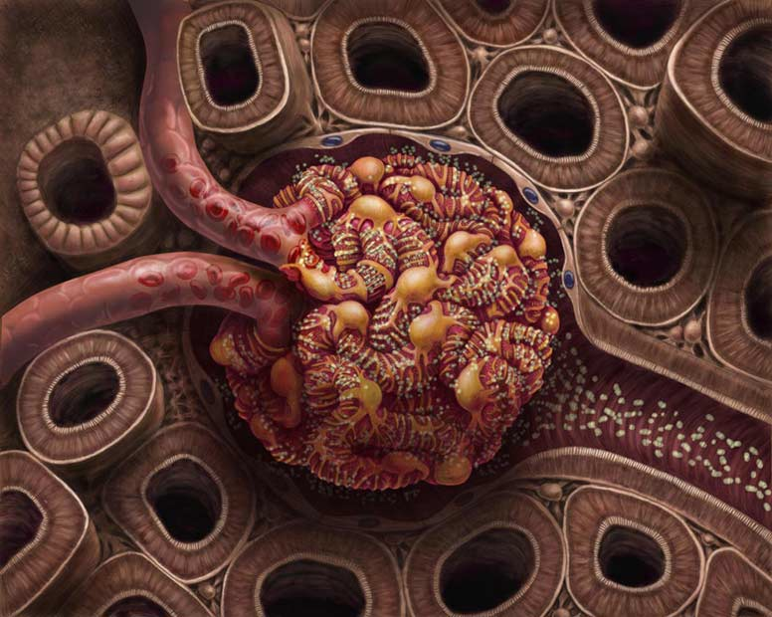
Inside The Nephron
L: Glomerulus: a small network of capillaries encased in the cup shaped Bowman’s capsule.

Slide 12
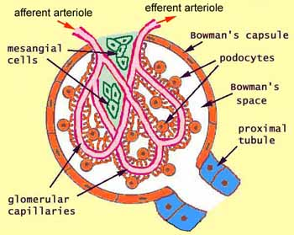
The Glomerulus
Basically filters everything out of the blood apart from plasma, proteins, cells and platelets.
Blood pressure forces water, salt, glucose, amino acids, urea across the permeable membrane
This is known as filtrate

Slide 13
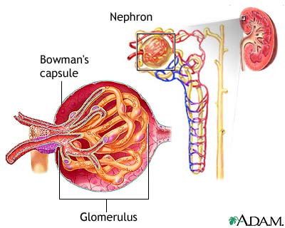
The Bowman’s Capsule
Collects the filtrate from the substances listed above.
Because blood cells and platelets are too large to pass through capillary walls, they remain in the blood.

Slide 14
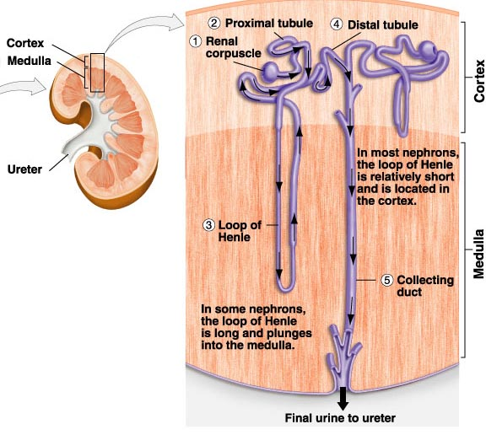
Reabsorption
Occurs in the tubule which connects to the Loop of Henle.
Runs through a series of capillaries
Diffusion happens here and some filtrate is reabsorbed into the blood.

Slide 15
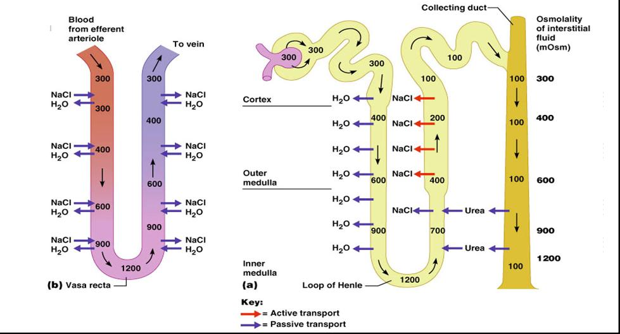
Osmolality = osmotic concentration = amount of solute in a solution.

Slide 16
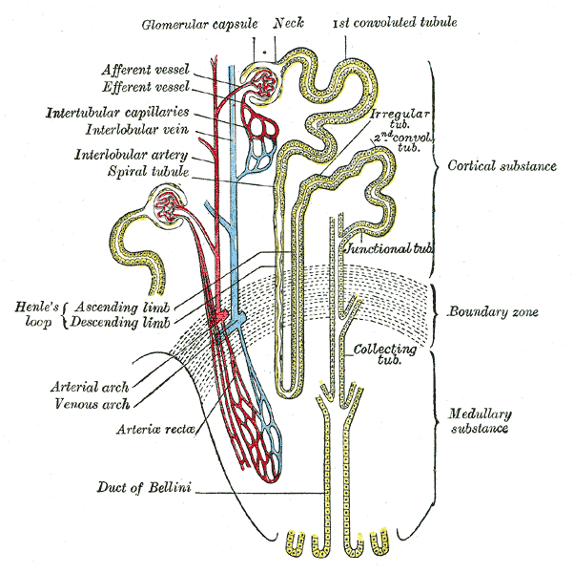
The Loop of Henle
Nutrients: amino acids and glucose and water are reabsorbed.
99% of the water that enters is reabsorbed back into the blood
Creates a concentration gradient in the medulla of the kidney

Slide 17
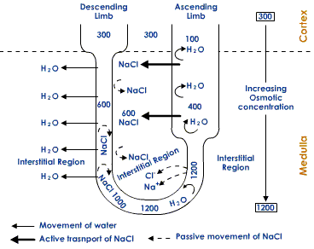
As the filtrate passes through the descending limb of the loop of Henle. NaCl is lost to the interstitial fluid in the renal medulla by diffusion.
The increased concentration of the solutes in the interstitial fluid draws out water by osmosis
There is no water reabsorption from the ascending limb because its walls are impermeable to water. As large amounts of Na⁺ is lost due to active transport, the filtrate again becomes isotonic.

Slide 18
The water reabsorption mainly occurs through the wall of the collecting tubules
The permeability of which is controlled by vasopressin or antidiuretic hormone (ADH). A hormone released by the posterior lobe of pituitary gland.
The secretion of ADH is controlled by the osmotic pressure of the blood.

Slide 19
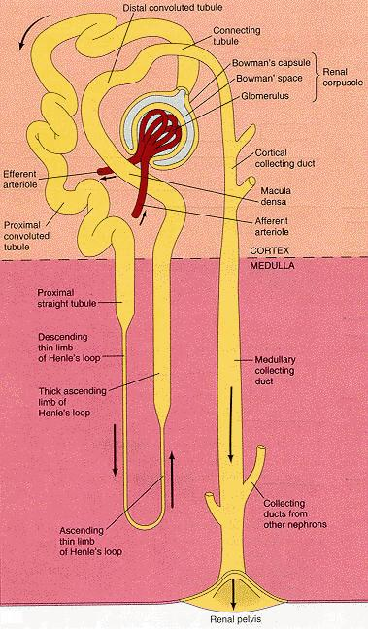
The Collecting Duct
Collects the leftover waste, which is now called urine.
Connected to the ureter to transport fluid to bladder.

