Slide 1
The Reproductive System
Chapter 39.3

Slide 2
What is Reproduction?
Reproduction is the formation of new individuals.
Sexual reproduction involves receiving half of your genetic information from your mother and half from your father.
Sexually produced offspring resemble, but are not identical to their parents.
During fertilization the nuclei of each parents gametes fuse together to create a zygote.

Slide 3
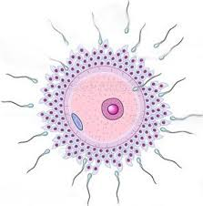
What is Reproduction?
Sexual reproduction involves the combining together of gametes. Gametes are produced in the testicles and ovaries via meiosis.
During fertilization the nuclei of each parents gametes fuse together to create a zygote.
The zygote will then divide via mitosis to form a new individual.

Slide 4
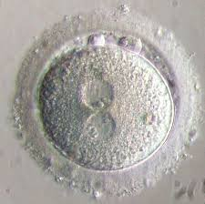
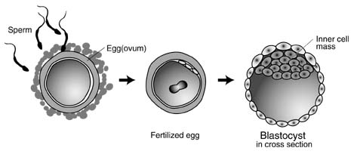

Slide 5
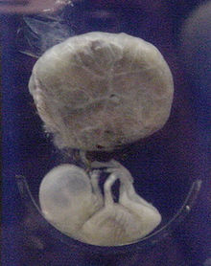
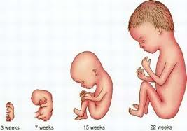
Fetus (foetus): the stage after the embryonic stage and before birth.
Zygote Embryo Fetus

Slide 6
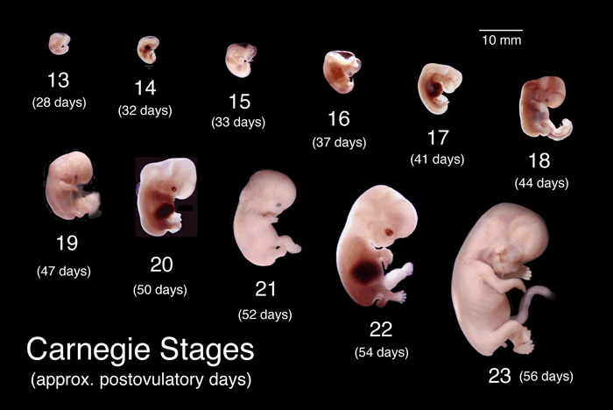

Slide 7
Sexual Development
For the first six weeks of development human male and female embryos are identical in appearance.
Major changes occur during the 7th week. In males the testes develop and in females the ovaries develop.
The testes begin to produce testosterone and the ovaries produce estrogen. In response to these hormones male and female reproductive systems are developed.

Slide 8
Human Development - Post Utero
After birth the gonads produce small amounts of sex-hormones that continue to influence the development of the reproductive organs.
During puberty the testes and ovaries are capable of producing active reproductive cells (gametes).
Puberty is a period of rapid growth and development and usually happens between the ages of 9 and 15.
The hypothalamus signals the pituitary glad to produce increased levels of follicle stimulating hormone (FSH) and luteinizing hormone (LH).

Slide 9
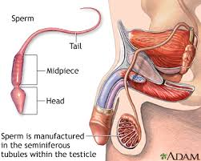
The Male Reproductive System
FSH and LH stimulate the testes to produce testosterone. This stimulates the production of sperm.
The main function of the male reproductive system is to produce and deliver sperm.
When the male is sexually aroused the autonomic nervous system prepares the male organs to release sperm.
Smooth muscle surrounding the glands in the reproductive tract contract and sperm is ejaculated.
2 to 6 ml of semen are ejaculated containing 50 to 130 million sperm per ml.

Slide 10
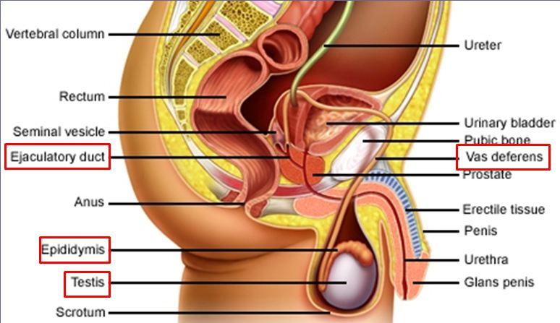
The Male reproductive System
Seminal Vesicle
Urethra
Scrotum

Slide 11
Scrotum: Just before, or just after birth the testes descend through a canal into an external sac called the scrotum.
Seminiferous: clusters of hundreds of tiny tubules where sperm are produced.
Epididymis: sperm produced in the seminiferous are moved to the epididymis. Here they fully mature and are stored before transfer to the vas deferens.
Vas deferens: extends upward from the scrotum into the abdominal cavity.
Urethra: eventually the vas deferens merges with the urethra which is a tube that leads to the outside through the penis.
Prostate and bulbourethral glands: add the nutrient rich seminal fluid. This nourishes the sperm and protects them from the acidic female reproductive tract.

Slide 12
The Female Reproductive System.
The main function of the female reproductive system is to produce ova. In addition, the female reproductive system prepares the female body to nourish a developing embryo.
In contrast to the millions of sperm produced each day the ovaries usually produce only one mature ovum (plural: ova) or egg each month.
A female is born with thousands of immature eggs but only about 400 will actually be released – approximately every 28 days.

Slide 13
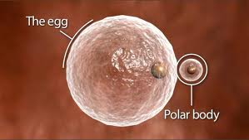
The Female Reproductive System.
Under the control of FSH a follicle gets larger and undergoes meiosis producing a single large egg and 3 smaller cells called polar bodies. The polar bodies have very little cytoplasm and soon disintegrate.
Each ovary contains about 400,000 primary follicles which are clusters of cells surrounding a single egg. These cells help the egg mature for release into the reproductive trackt.

Slide 14
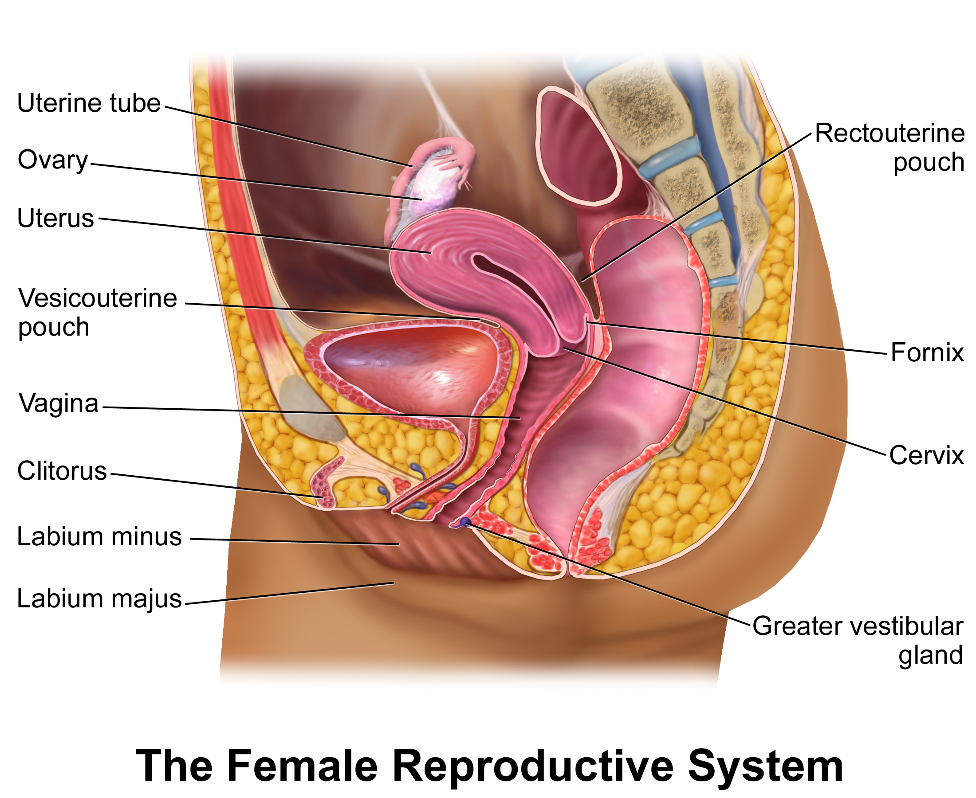

Slide 15
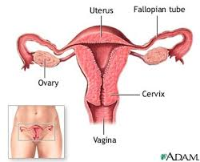
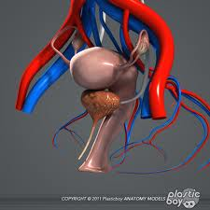
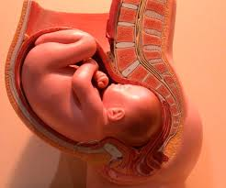

Slide 17
When a follicle has completely matured, its egg is released in a process called ovulation.
The follicle breaks open and the egg is swept from the surface of the ovary into the opening of one of the two fallopian tubes.
Microscopic cilia push the egg through the fallopian tube.
During this stage fertilization can take place.
After a few days the egg passes into a cavity known as the uterus.
If fertilization has occurred the lining of the uterus is ready to receive the egg
Beyond the cervix is a canal called the vagina that leads to the outside of the body.

Slide 18
The Menstrual Cycle
After puberty the female reproductive system and the endocrine system takes the form of a complex series of periodic events known as the menstrual cycle.
During the menstrual cycle an egg develops and is released from the ovary and the uterus is prepared to receive a fertilized egg.
If an egg is fertilized it is implanted in the uterus and embryonic development begins.
If an egg is not fertilized it is discharged along with the lining of the uterus.

Slide 19
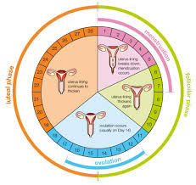
Menstrual Cycle
The menstrual cycle has 4 phases:
Follicular
Ovulation
Luteal
Menstruation

Slide 20
Follicular
The follicular phase begins when the estrogen levels in the blood are relatively low.
The hypothalamus reacts and produces a releasing hormone that stimulates the anterior pituitary gland to secrete FSH and LH.
These hormones travel through the circulatory system to the ovaries where they cause a follicle to develop (sometimes two or three develop).

Slide 21
Follicular
As the follicle develops the cells surrounding the egg enlarge and begin to produce increasing amounts of estrogen.
This causes the estrogen in the blood to rise dramatically.
Estrogen causes the lining of the uterus to thicken in preparation to receive a fertilized egg.
The development of an egg in this phase of the cycle takes about 10 days.

Slide 22
Ovulation
This is the shortest phase and occurs about midway through the cycle, lasting around 4 days.
During this phase the pituitary gland sends a large amount of releasing hormone to the pituitary gland which in turn causes the pituitary gland to produce FSH and LH.
This causes the follicle to rupture and a mature egg is released into one of the Fallopian tubes.

Slide 23
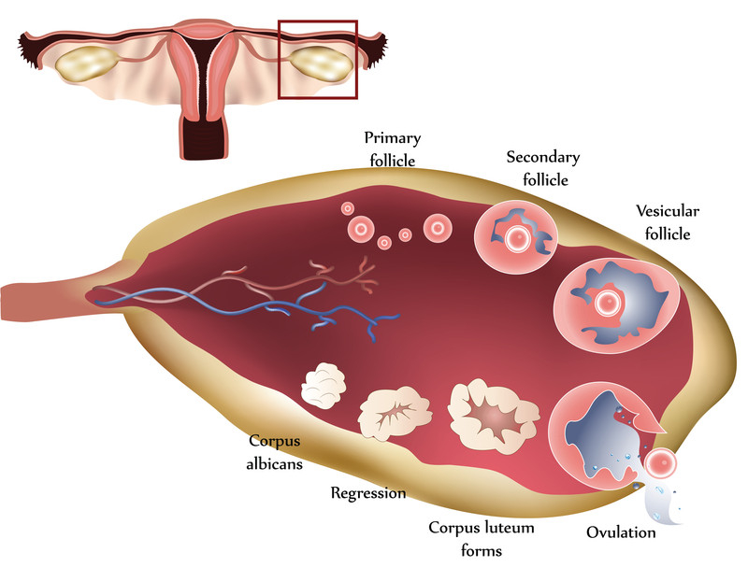

Slide 24
Luteal Phase
The luteal phase begins after the egg is released. As the egg moves through the Fallopian tube the cells of the ruptured follicle change.
The follicle turns yellow and is now known as the corpus luteum. The corpus luteum releases estrogen and progesterone.
The estrogen stimulates cell growth and tissue development in the lining of the uterus. Progesterone stimulates the growth and development of a blood supply and surrounding tissue.
The first 2 days of the luteal phase are when fertilization is most likely to take place (usually 10 to 14 days after the last menstrual cycle).
Within a few days of implantation, the uterus and the growing embryo will release hormones that keep the corpus luteum functioning for several weeks. This allows the lining of the uterus to nourish and protect the developing embryo.

Slide 25
Menstruation
If fertilization does not occur within 2 or 3 days of menstruation the egg will pass through the uterus without implantation.
The corpus luteum will begin to disintegrate. Less estrogen and less progesterone will be released.
When the level of estrogen falls below a certain point the wall of the uterus begins to detach.
This tissue along with blood and the unfertilized egg are discharged through the vagina. This is known as menstruation.
A few days after menstruation ends, levels of estrogen in the blood are once again low enough to stimulate the hypothalamus and the menstrual cycle begins again.

Slide 26
Early Development
While still in the fallopian tube the embryo continues to undergo mitosis.
After 4 days of development the embryo is a solid ball of about 64 cells called a morula.
The stages of early development include implantation, gastrulation, and neuralation.

Slide 27
Implantation
As the morula grows a cavity forms in the center. This transforms the morula into a hollow structure called a blastocyst.
About 6 or 7 days after fertilization the blastocyst attaches itself to the wall of the uterus by secreting enzymes that digest a path into the soft tissue. This is known as implantation.
At this point cells in the blastocyst start to specialize as a result of gene activation. This is the start of differentiation.
A cluster of cells known as the inner cell mass develops within the inner cavity of the blastocyst. This will develop into the embryo, the outer cells will become the tissues surrounding the embryo.

Slide 28
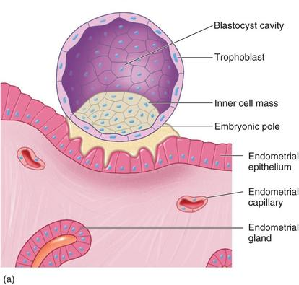

Slide 29
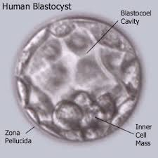
Gastrulation
The inner cell mass gradually sorts itself into 2 layers, and then a 3rd layer.
The 3rd layer is produced by a process of cell migration known as gastrulation.
The end result of gastrulation is the formation of 3 cell layers; ectoderm, mesoderm, and endoderm. These are referred to as the primary germ layers.

Slide 30
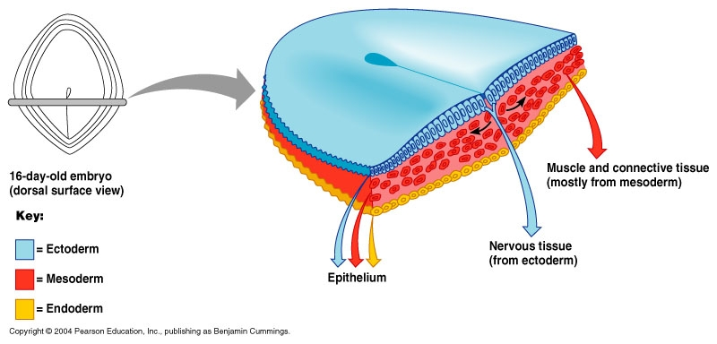
Embryological Development

Slide 31
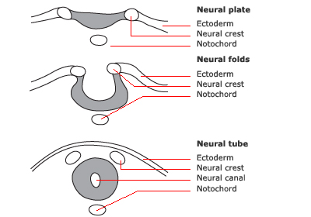
Neurulation
The next stage in development is neurulation – the development of the nervous system.
Shortly after gastrulation a block of mesoderm develops into the notochord. All chordates posses a notochord at some stage of development.
The neural groove changes shape and produces two pairs of ridges, or neural folds. These gradually move together and create a neural tube from which the spinal cord and the rest of the nervous system develop.

Slide 32
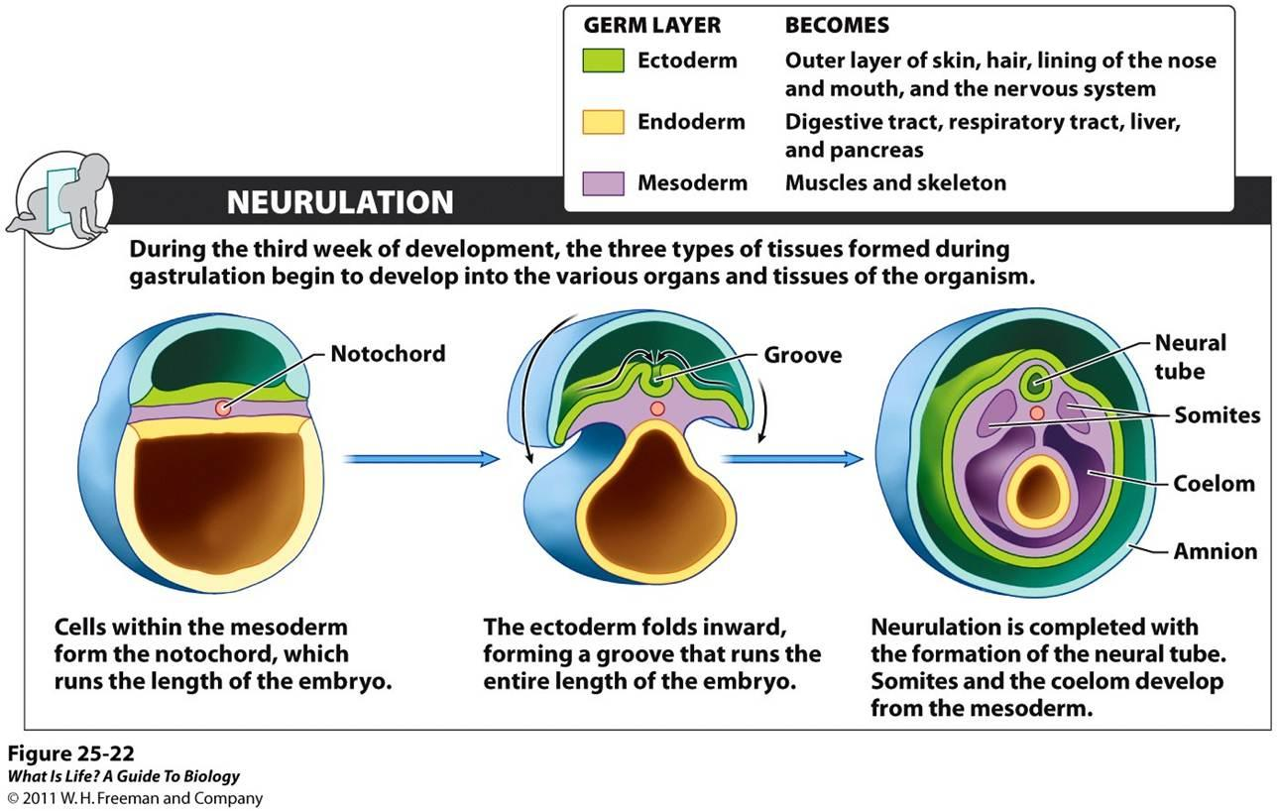

Slide 33
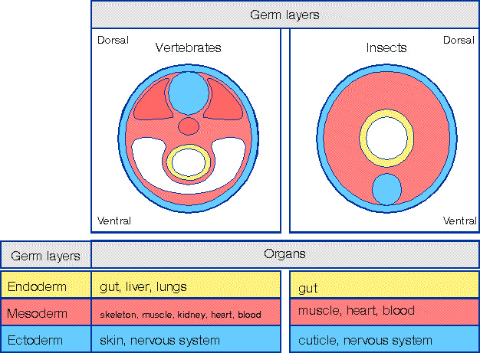
Vertebrates and Invertebrates

Slide 34
Extraembryonic Membranes
As the embryo develops membranes form that protect and nourish it.
Two of these are the amnion and the chorion. The amnion develops into the amniotic sac to cushion and protect the the developing embryo
By the end of the 3rd week the outermost membrane the chorion has formed. Small finger like projections called chorionic villi form on the outer surface and extend into the uterine lining.
This chorionic villi and the uterine lining form the placenta – the connection between mother and child. This controls nutrition, waste removal and oxygen suppy.

Slide 35
