Slide 1
Climate
Chapter 4.1

Slide 2
Weather and Climate
The weather is the day-to-day condition of the Earth’s atmosphere.
The climate is defined as the year-after-year patterns of temperature and precipitation.
Climate is rarely uniform within a region and we will often see differences across small distances creating microclimates.

Slide 3
Factors that Affect Climate
Many factors affect global climate:
Solar energy and the greenhouse effect.
Latitude and solar energy
Heat transport in the Biosphere

Slide 4
Solar Energy and The Greenhouse Effect
The main force that determines our climate is the solar energy that strikes the Earth's surface.
Some of that energy is reflected back into space.
Some is absorbed and converted into heat energy. Some of this in turn radiated back into space but some is trapped in the biosphere.
The balance of heat trapped to heat reflected into space determines the Earth’s average temperatures.

Slide 5
Solar Energy and The Greenhouse Effect
The balance is largely determined by the concentrations of three gasses found in the atmosphere.
Carbon dioxide, methane, and water vapor.
Collectively these gasses are referred to as greenhouse gasses. A rise in greenhouse gasses will result in a rise in temperature.
Without these gasses the surface of the Earth would be about 30◦ C cooler

Slide 6
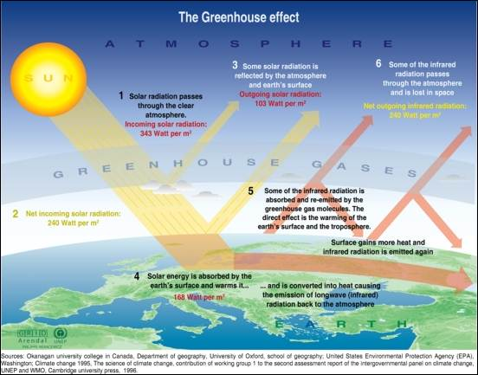

Slide 7
Latitude and Solar Energy
Near the equator solar energy is most intense as the sun is almost directly overhead at noon year round.
The tropics are located 23.5◦ north and south of the equator. This zone receives direct sunlight all year.
Either sides of the tropics are the temperate zones, between 66.5◦ and 90◦ north and south.
Temperate and polar zones receive very different amounts of solar energy throughout the year, due to the Earth’s axis as it revolves around the sun.
During winter in the temperate and polar regions the sun is much lower in the sky, days are shorter, and solar energy is less intense.

Slide 8
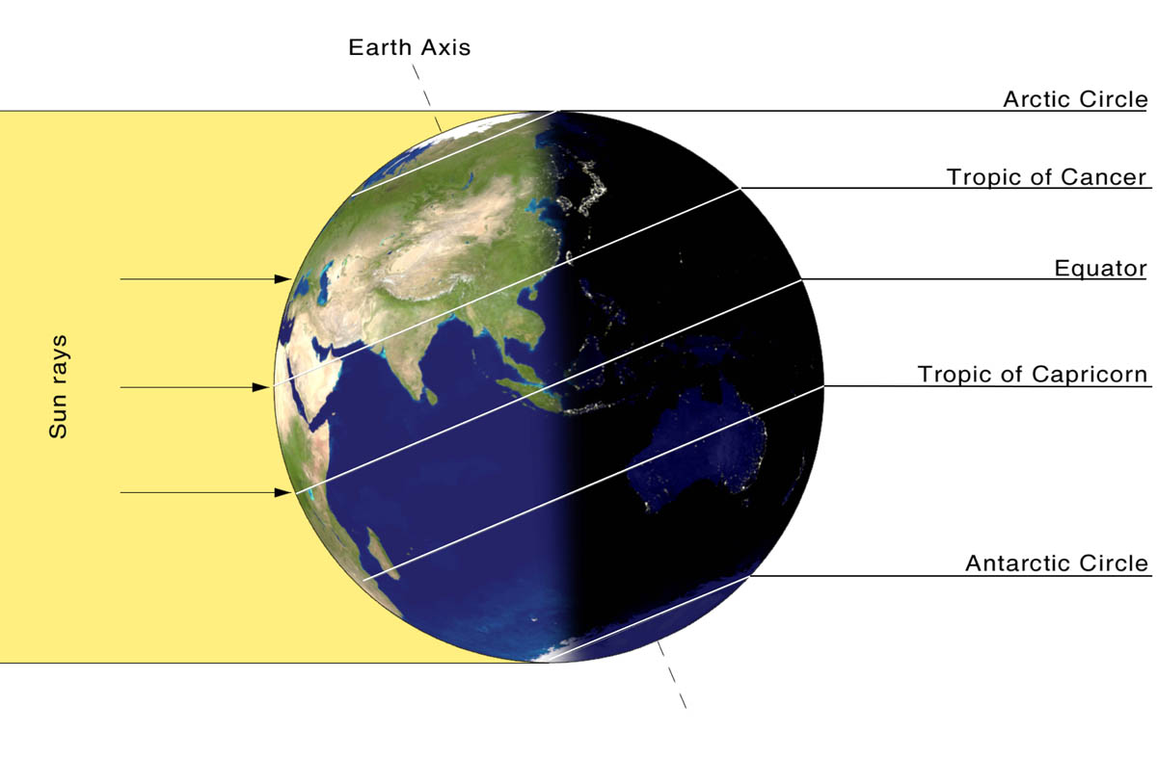
Latitude and Solar Energy
Less Direct
Most Direct
Less Direct

Slide 9
Heat Transport in the Biosphere.
The distribution of heat across the globe creates wind and ocean currents, which transport heat and moisture.
Warm air is less dense than cold air and so rises. As it rises it cools, expands and spreads north and south.
As the air cools it sinks towards the surface. At the same time cooler air towards the poles sinks, pushing air outwards. This air in turn warms as it travels over the surface. As it warms it rises.

Slide 10
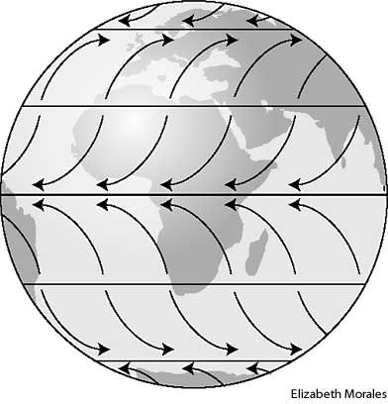
Wind
The upward and downward movement of air creates wind.
The Earths rotation means that winds usually blow from west to east over the temperate zones and from east to west over the tropics and poles.

Slide 11
Ocean Currents
Similar patters of heating and cooling also happen in the oceans.
Surface water is also pushed by wind. Like the winds ocean currents transport enormous amounts of heat.
Warm surface currents add heat and moisture to the air that passes over them.
Cool surface currents cool the air that passes over them.
Deep ocean currents are caused by cold water near the poles sinking and flowing along the ocean floor. This water rises in warmer regions through a process called upwelling.

Slide 12
