Slide 1
Niches and Community Interactions
Chapter 4.2

Slide 2
The Niche
Organisms occupy different places in part because each species has a range of conditions under which it can grow and reproduce.
These conditions help to define where and how an organism lives, according to each species range of tolerance.
A species tolerance range then helps to define its habitat.

Slide 3
Defining the Niche
A niche is the range of physical and biological conditions in which a species lives and the way the species obtains what it needs to survive and reproduce.
A niche is defined by:
Resources of the niche – any necessity for life such as water, food, or space.
Physical aspects of the niche – abiotic factors such as temperature or moisture levels.
Biological aspects of the niche – when and how an organism reproduces, or the food it eats.

Slide 4
Biotic and Abiotic Factors
Biotic Factors: parts of an ecosystem that are living or used to be living.
Dead organisms are only considered to be living as long as they are still composed of cells.
Abiotic Factors: parts of an ecosystem that have never been living or are now no longer composed of cells.

Slide 5
Competition
In any given community there will probably be more than one kind of organism attempting to use various essential resources.
This will inevitably lead to competition.
Competition can occur in many different ways from competition for food to competition for soil nutrients.
Competition can be between species (inter-species) or between members of the same species (intra-species).

Slide 6
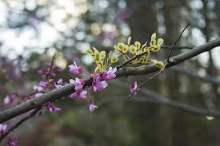
Competition

Slide 7
Competitive Exclusion
Direct competition often results in a winner and a loser.
If one species is very successful they may exclude a species from a resource entirely.
This is termed the competitive exclusion principle.

Slide 8
Dividing Resources
Instead of competing for similar resources, species will often divide them.
3 species of North American warblers all live in the same trees and feed on insects. One species feeds on high branches, one on middle branches, and one down low.
By causing species to divide resources, competition helps to determine the number and kinds of species in a community and the niche each species occupies.

Slide 9
Resource Partitioning and a Realized Niche

Slide 10
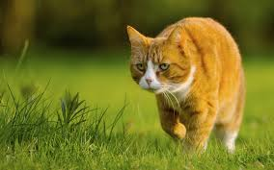
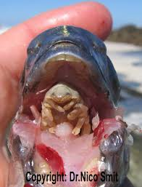
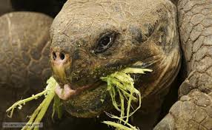
Predation,Herbivory and Keystone Species
Predation parasitism and herbivory are interactions where one species benefits whilst the other is harmed.

Slide 11
Predation
All living things need food. Whilst plants can make their own food using photosynthesis, many organisms are forced to eat other organisms in order to obtain energy.
Predation is the means by which one species hunts, captures, kills, and consumes another.

Slide 12
Herbivory
The interaction where an animal feeds on a plant is called herbivory.
Insect are the most common type of herbivore. Usually the plant is not killed but its reproduction and growth may be affected.
In response to herbivores plants have developed many defenses – toxic or bad tasting chemicals, thorns and spines, or irritating hairs.
Herbivores may in turn evolve ways to overcome these defenses.

Slide 13
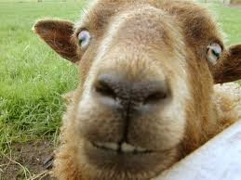
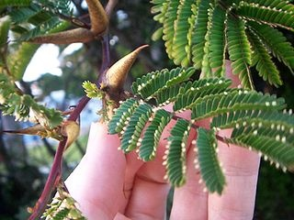
Plant v Goat

Slide 14
Keystone Species
A species that has a strong or wide reaching impact on an ecosystem is called a keystone species.
A keystone is an analogy A keystone is an important brink in an arch. If it is removed the arch will collapse.

Slide 15
The Sea Otter

Slide 16
The Sea Otter

Slide 17
Symbioses
When two organisms live close to one another we call their relationship a symbiosis.
Biologist recognize 3 main classes of symbiotic relationships in nature: parasitism, mutualism and commensalism.
In addition the herbivore and predator could also be considered to be in a symbiotic relationship and often evolve together.

Slide 18
Parasitism
One organism (parasite) depends on another (host) for nourishment or some other benefit.
Unlike predation parasitism does not usually result in an organisms immediate death.
A close, long lasting relationship where at least one organism benefits is known as a symbiosis.
The term symbiosis means “living together”.

Slide 19
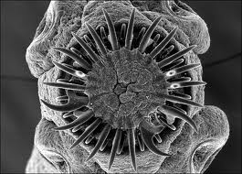
Tape Worms

Slide 20
Mutualism and Commensalism
Not every interaction between species results in one species being harmed.
Both can in fact benefit or one can benefit without the other being harmed
These relationships are called mutualism and commensalism

Slide 21
Mutualism
In a mutualistic relationship both species benefit.
Many mutualistic relationships are symbiotic.
For example plant roots and some fungus form mycorrhizae.
Such relationships can be a key part of nutrient absorption.

Slide 22
Pollination

Slide 23
Commensalism
Occurs when one-species benefits and the other is unaffected.
Examples include trees providing shade and thus moister ground that smaller plants can grow in e.g. Palo verde trees in the American Southwest.

Slide 24
Commensalism

