Slide 1
Succession
Chapter 4.3

Slide 2
Ecological Succession
Ecosystems change over time, especially after disturbances, as some species die out and new species move in.
Eventually some ecosystems may return to their original state. Others may be permanently changed, if the disturbance is severe enough.
When a disturbance occurs a community undergoes a fairly predictable series of changes called succession.

Slide 3
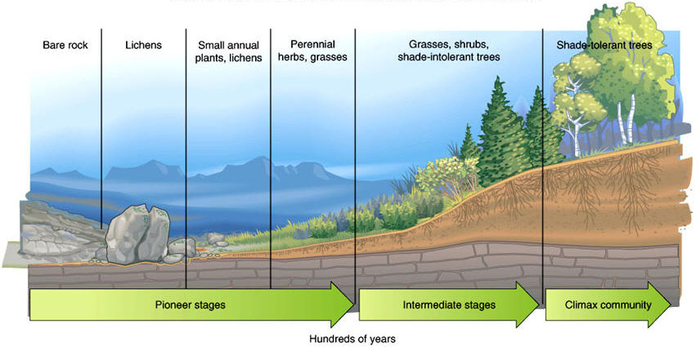
Succession

Slide 4
Primary and Secondary Succession
Ecologists recognize two types of succession; primary and secondary.
We usually look at the type of plant species that predominate in a community but animals and other organisms will also change over the course of a succession.

Slide 5
Primary Succession
Primary succession occurs when a disturbance is so severe that no vegetation or soil life remains.
This type of succession basically involves building a community from scratch.
Primary succession occurs when bare rock, sand or sediment is exposed for the first time.

Slide 6
Pioneer Species
The species that colonize the exposed land first are called pioneer species.
Pioneer species are usually well suited to colonization. For example they usually have spores or seeds that can travel long distances

Slide 7
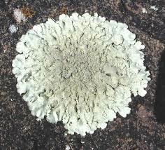
Lichen
Lichen are good pioneer species for bare rock. They consist of a mutualistic relationship between a fungus and algae.
The algae provide food from photosynthesis whilst the fungus is very good at clinging to bare rock.
As lichens grow they release acids that break down the rock.
This can in turn lead to the beginnings of soil and then more complex plants.

Slide 8
Secondary Succession
Secondary succession begins with a disturbance such as a fire, logging or farming.
A community has been dramatically disturbed but not all living things or organic matter has been destroyed.

Slide 9
Abandoned Agricultural Field
Initially the site will be colonized by grasses and herbs local to that general area.
This will take a few years as opposed to the 15 or more it takes for lichens to colonize an area of rock.
Shrubs and fast growing trees such as aspens rise up. Then Pine trees forming a pine dominated forest.
The Pine forest will create an understory of hardwood trees that grow well under the canopy until the hardwood trees eventually outgrow the pines creating a hardwood forest.

Slide 10
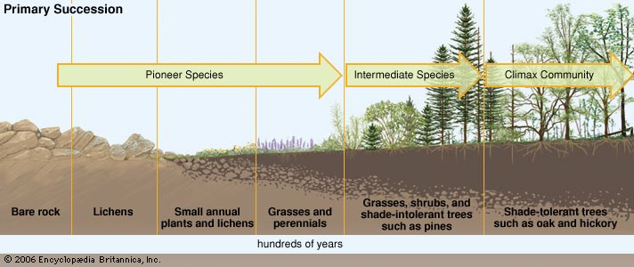
Succession
Secondary succession

Slide 11
Climax Communities
A climax community is a stable community that completes the succession process.
Ecologists used to think that each region had its own climax community determined by soil conditions.
However we now know that climate, soil and many other factors can influence a communities composition.
In addition various factors can speed up or slow down a communities progression between succession stages.

Slide 12
Community Stability
Many communities may appear stable but we now know that both small and large disturbances are constantly affecting communities, even those which appear to be stable.
Once a community has been disturbed then there is no guarantee that that community will ever return to its original state.

