Slide 1
Defining Biomes
Chapter 4.4

Slide 2
What Should Our Planet Look Like?
Fossil evidence shows that our planet has had great ecological shifts over the millennia.
What is a normal state?
What determines which plants and animals are native to an area?
What makes a natural community natural?

Slide 3
What is a Biome?
Ecologists classify different ecosystems according to their similarities into different biomes.
Biomes are characterized by their climates as well as their typical plant and animal life.
A biome is a group of ecosystems that share similar abiotic and biotic conditions.

Slide 4
Major Biomes of the Earth

Slide 5
Biomes and Climate
A regions climate largely determines what type of biome will predominate.
By climate we mean the average conditions over a long period of time, including temperature and precipitation.
Climate is different to weather; which is the day-to-day conditions in Earths atmosphere. For example sunny and humid or cold and snowy.

Slide 6
Climatographs
Climatograph for Edinburgh, Scotland
Above is a climatograph for Edinburgh, Scotland. Often data like this will be displayed with the temperature as a line graph and the precipitation as a bar graph. Sometimes the temperate and precipitation will both be presented as two separate lines on the same graph.
When the precipitation lies above the temperature the region experiences relatively moist conditions. If the precipitation were below the temperature conditions would be dry.

Slide 7
Temperature and Rainfall
Temperature and rainfall tend to exert the greatest influence on biome determination.
Global climate patterns cause biomes to occur in large patches in different parts of the world. For example temperate forest is found in North America, North-central Europe, and Eastern China.
This is due to the north-south temperature gradient and atmospheric circulation patterns (we will learn more about these later)

Slide 8
The major Biomes of the Earth

Slide 9
Biomes and Precipitation

Slide 10
Biomes and Organisms
Natural selection tends to result in the survival and reproduction of organisms best suited to their environment.
Although some generalists always thrive almost anywhere each biome tends to have a suite of characteristic organisms which have adapted to its particular conditions.
As we will see later certain biomes consist of a few different ecosystems. These are usually caused by local differences such as soil type, elevation or wind exposure.

Slide 11
Primary Production
Ecologists also compare each biome based on how productive it is. That is how much new organic matter it generates through photosynthesis or chemosynthesis. This makes the gross primary production.
The net primary production is the amount of biomass left over after the primary producers have used what they need for cellular respiration.
Each biome varies in its net primary production (the rate that ecosystems convert energy to biomass). Ecologists tend to measure that annual net primary production.

Slide 12
Net Primary Productivity
Notice that in general warmer, wetter biomes have higher primary production than colder drier biomes.
Aquatic ecosystems are limited by the available sunlight and nutrients.

Slide 13
Biomes of the Earth

Slide 14
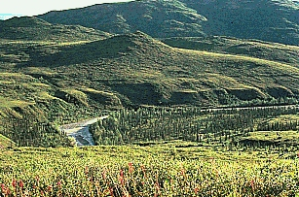
TUNDRA

Slide 15
Tundra
Northernmost biome, 10- 60 cm of precipitation, cold temps.
Treeless land
Long summer days, short winter days
Only top layer of soil thaws, underneath is permafrost
Thin topsoil, only shallow rooted shrubs and grasses can grow
Low nutrients, because decay is slow
Short growing season
Mosquito is the most common animal!
Large animals only in summer months
Organisms must adapt to cold: blubber, fur, feathers + migration
Must adapt to short growing season as well

Slide 16
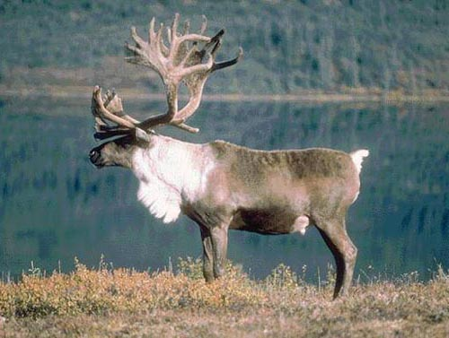
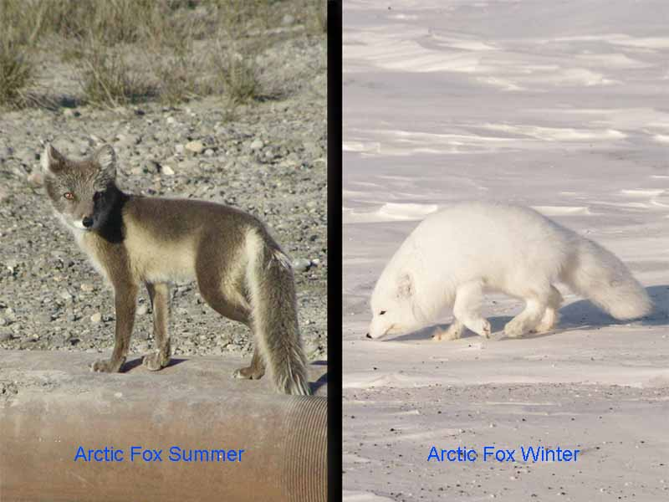
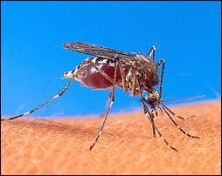
Tundra

Slide 17
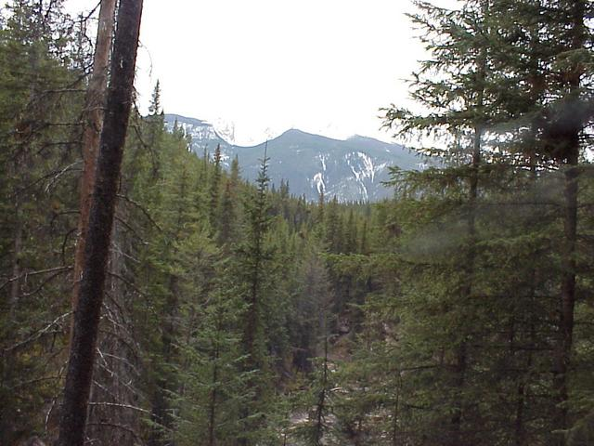
Taiga

Slide 18
Taiga
Just south of the Tundra
Also called northern coniferous forest
Many tall evergreen trees
Precipitation is 60-120 cm / year
Cold temperatures, above freezing in summer
Permafrost is absent
More trees provide habitat so there are more animals than in the tundra

Slide 19
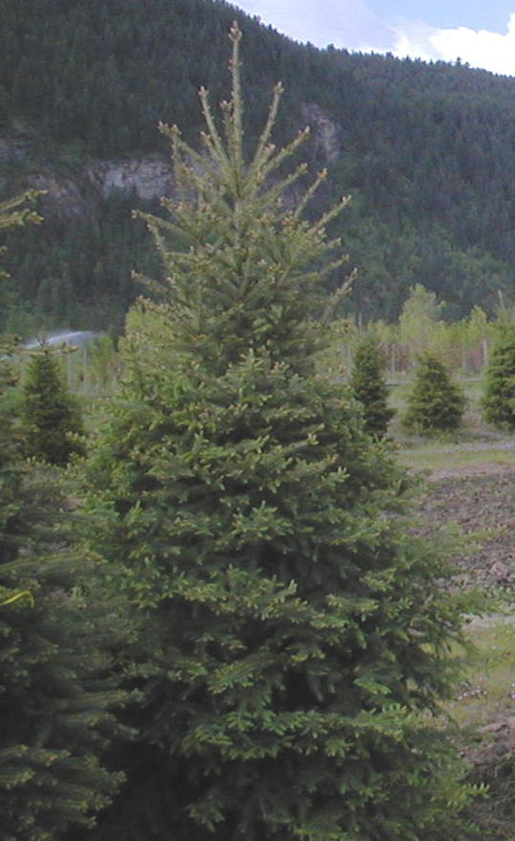
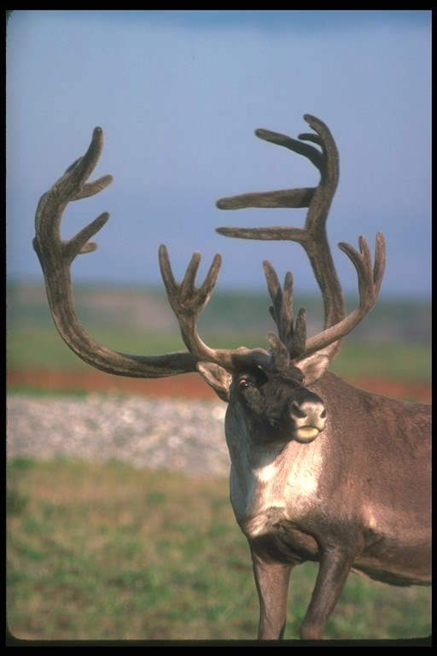

Slide 20
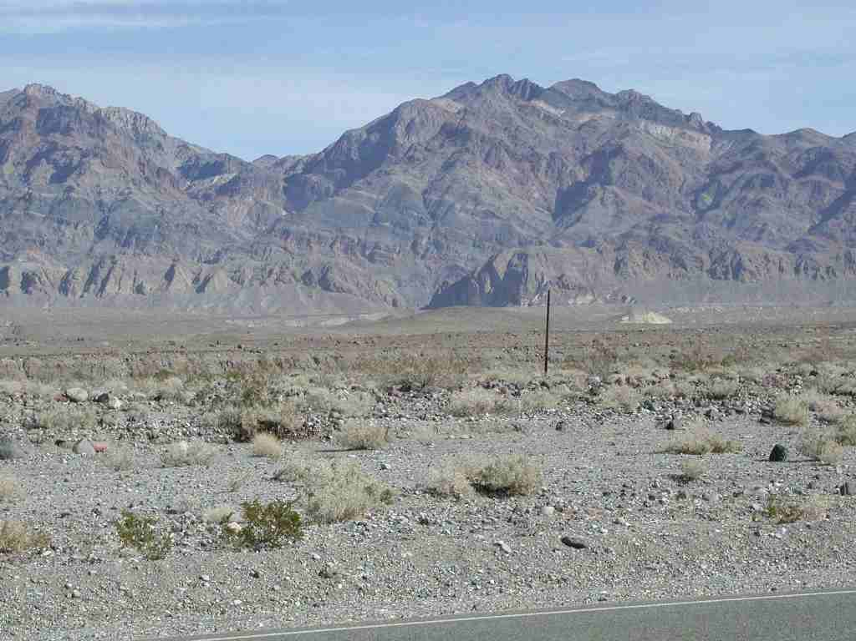
Desert

Slide 21
Deserts
Arid region with sparse plant life
Less than 25 cm of rain/ year
Large fluctuations in temp between night and day
Organisms must adapt to very dry conditions
Plants use reduced leaves, animals are nocturnal or underground

Slide 22
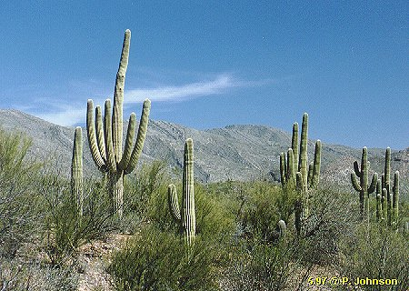
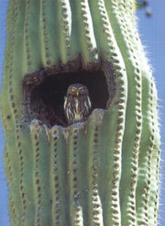
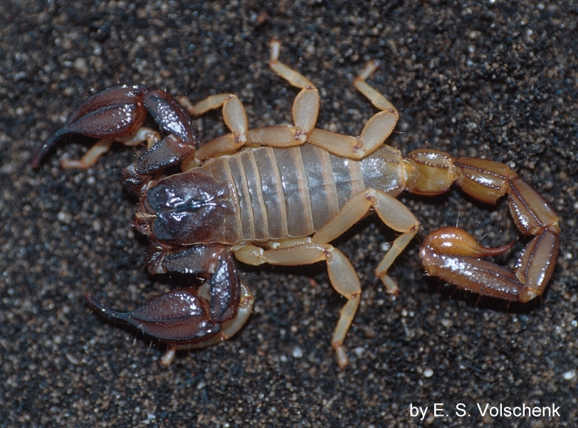
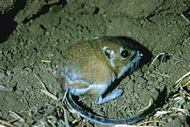
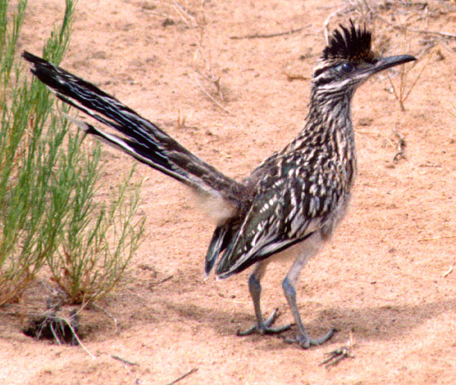

Slide 23
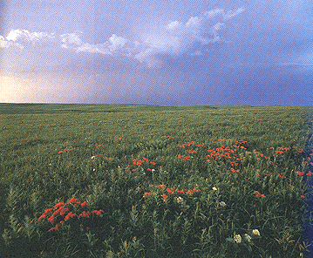
Grasslands

Slide 24
Grasslands
Receives between 25 and 75 cm of precipitation
Communities covered with small plants, few trees
Usually have a dry season, temp varies
Also steppes, savannas, pampas & prairies
Nutrient rich soil
Used for farming and grazing

Slide 25
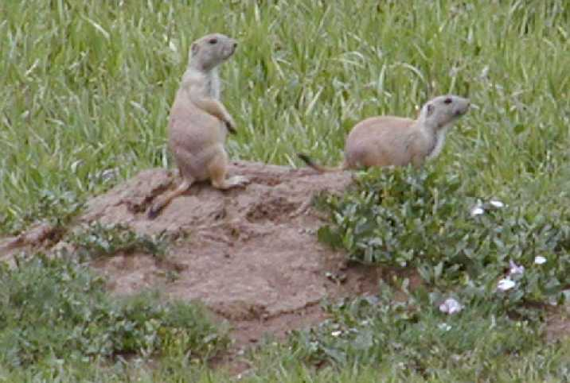
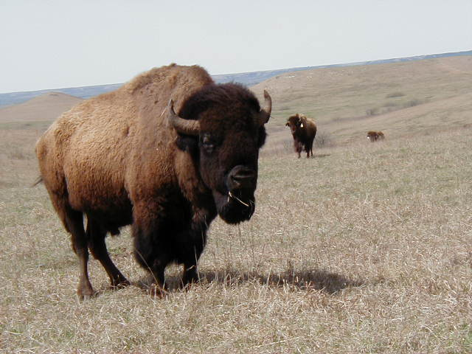
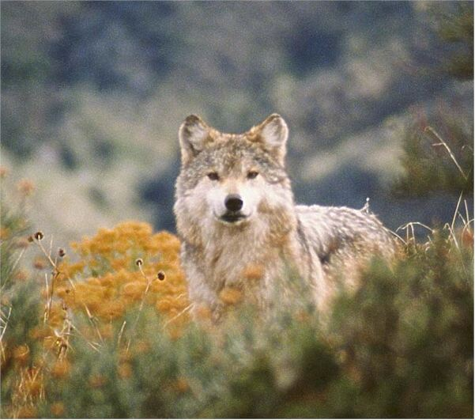

Slide 26
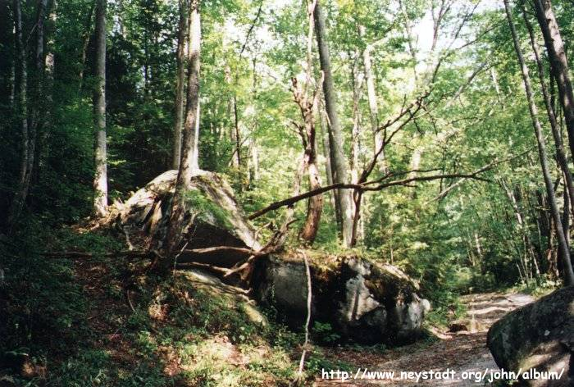
Temperate Forest

Slide 27
Temperate Forest
Precipitation from 70 cm- 150 cm/ year
Cold winters and warm summers
Deciduous trees lose leaves for winter
Rich top layer of soil called humus
Man animals inhabit

Slide 28
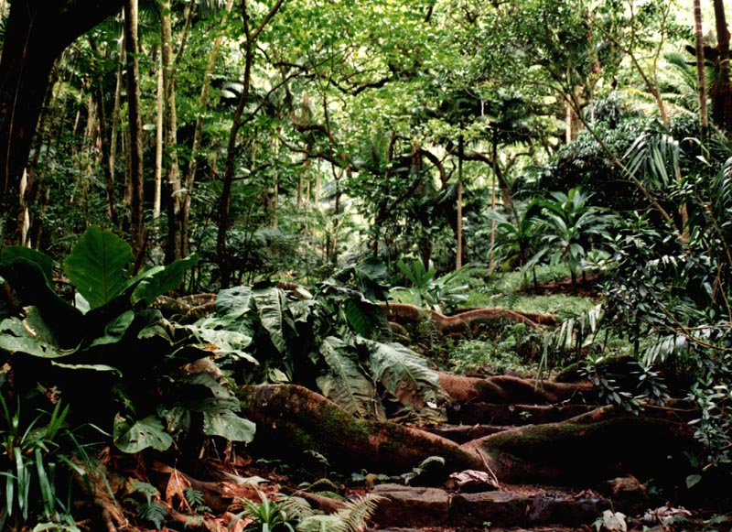
Tropical Rain forest

Slide 29
Tropical Rain Forests
Over 200 cm of precipitation / year
Located near equator
Tropical temperatures = warm constant temps of about 25 degrees Celsius
Large biodiversity in small area
Nutrients stored in plants, soil is nutrient poor and thin

Slide 30
