Slide 1
Aquatic Ecosystems
Chapter 4.5

Slide 2
Conditions Underwater
Aquatic organisms are affected primarily by the waters depth, temperature, flow, and amount of dissolved nutrients.
The region where light reaches is known as the photic zone and the regions that light cannot penetrate are known as the aphotic zone.
Many aquatic organisms live on or in rocks and sediment. These organisms are called the benthos.

Slide 3
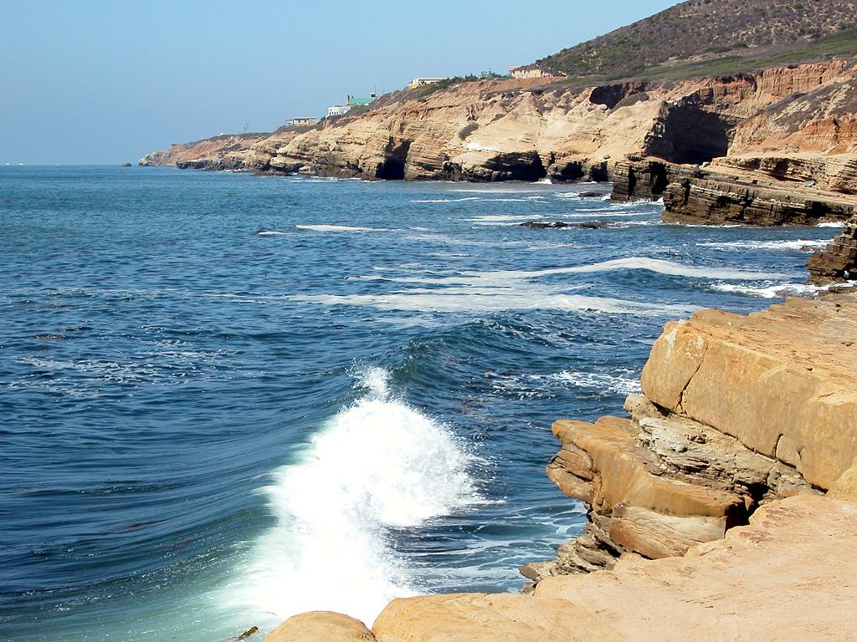
Marine Biome

Slide 4
Marine Biome
Consists of oceans
Largest amount of biomass
Majority of life is microscopic plankton

Slide 5
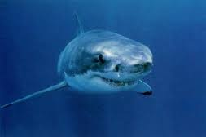
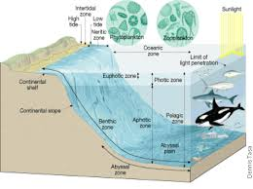
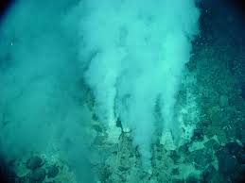
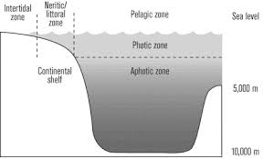

Slide 6
Marine Ecosystems
Coastal Ocean – extends from the low tide mark to the outer edge of the continental shelf. Water is brightly lit and often supplied with nutrients by freshwater runoff from land. As a result coastal ocean is usually highly productive.
Open Ocean – begins at the edge of the continental shelf and extends outward. More than 90% of the worlds ocean is considered open ocean. Split into photic and aphotic zones.

Slide 7
Photic Zone
Open ocean typically has low nutrient levels and supports the smallest species of phytoplankton.
Because of its large area however most photosynthesis on Earth happens here in the top 100cm.

Slide 8
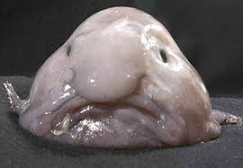
Aphotic Zone
The permanently dark aphotic zone includes the deepest parts of the ocean.
Food webs here are based either on organisms that fall from the photic zone above or chemosynthetic organisms who feed from deep sea vents.
Deep water fish are exposed to high pressure and frigid temperatures.
Psychrolutes marcidus

Slide 9
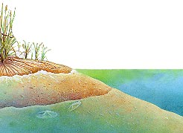
Intertidal Zone - portion of the shoreline that lies
between high and low tide lines
High levels of sunlight, nutrients and oxygen
Many organisms live here, but they must
be adapted to crashing waves, and changing
water levels.

Slide 10
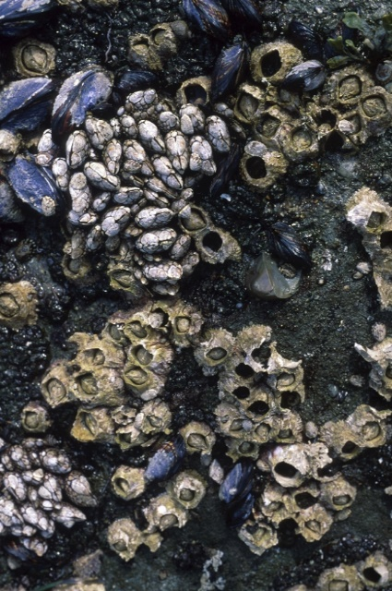
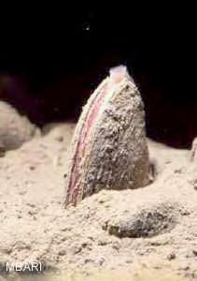
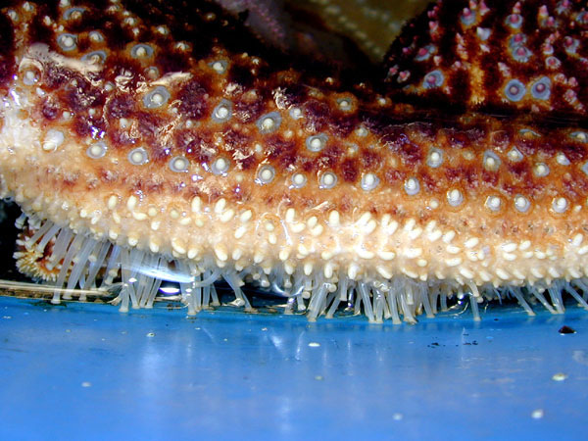
Examples:
Barnacles secrete glue to hold onto rocks
Clams burrow into sand
Sea stars use tube feet to suction onto rocks

Slide 11
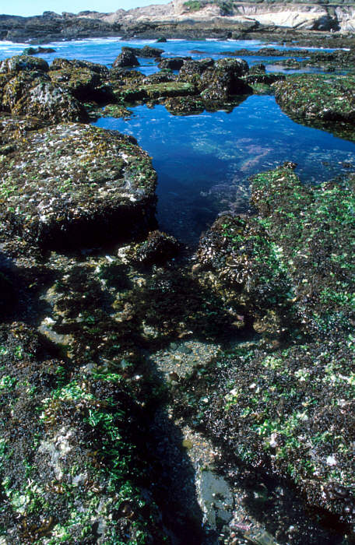
Some organisms survive by living in tide pools.
Some organisms survive by living in
tide pools until the water returns again.

Slide 12
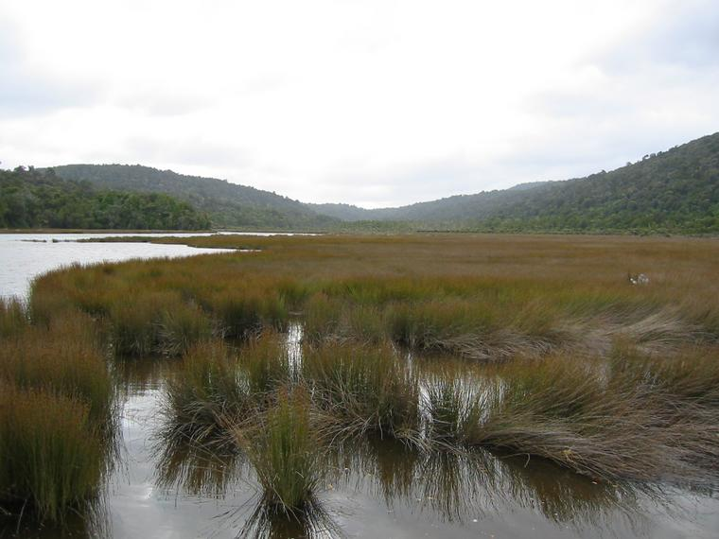
An estuary is where the freshwater meets salt water.
Salinity changes with the tide.
Organisms must be able to tolerate changes in salinity levels.
Estuaries serve as spawning and nursery grounds for many ecologically and commercially important fish and shellfish species including bluefish, striped bass, shrimp, and crabs.

Slide 13
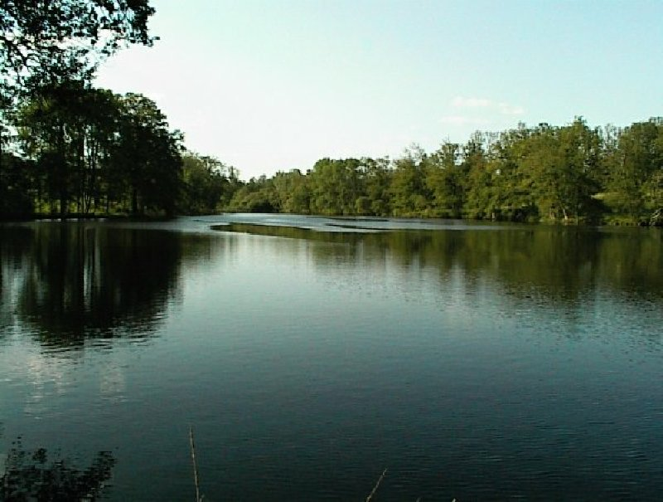
Freshwater biomes are made up of
water with less than 1.5% salt.
They include lakes, ponds, rivers and streams.
The deeper the pond, the colder the temperature.
The cold temperature and amount of sunlight on
the bottom are abiotic limiting factors.

