Slide 1
Matter
Chapter 2 Section 1

Slide 2
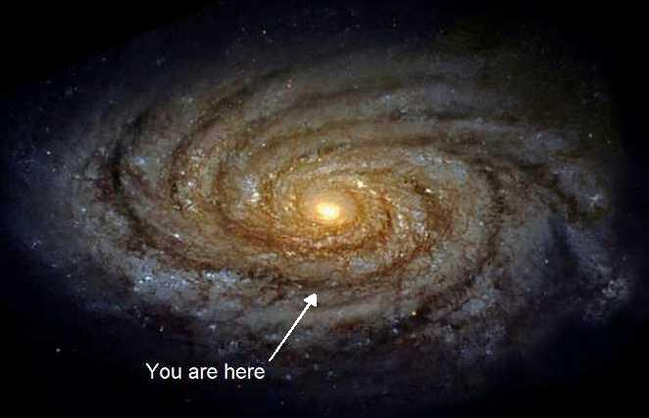
Unit Overview
In this unit we will cover:
States of Matter
Changes in Phase
The role of Energy
Types of Energy
Physical Changes
Chemical Changes

Slide 3
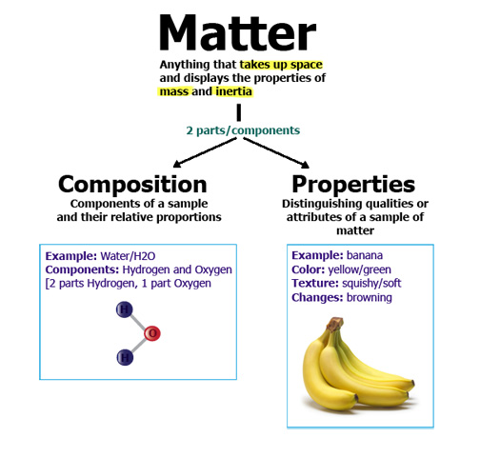
What is Matter?
Matter is everything that has volume and has mass.
Matter is made up of smaller particles such as atoms, molecules and ions.
Compounds and Mixtures

Slide 4
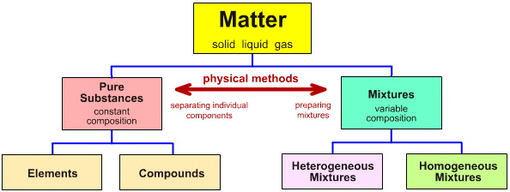

Slide 6
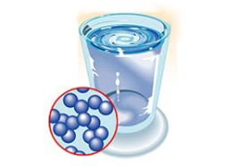
What is Matter
Every particle attracts other particles.
The particles themselves are constantly moving.
The speed at which the particles move and the strength of the attraction between them determines the material’s state of matter.

Slide 7
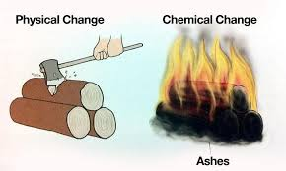
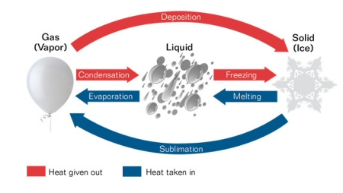
Physical and Chemical Changes
When matter changes it will either undergo a physical change or a chemical change.
Physical changes are often easily reversed.
Chemical changes are not easily reversed.
(catalase)

Slide 8
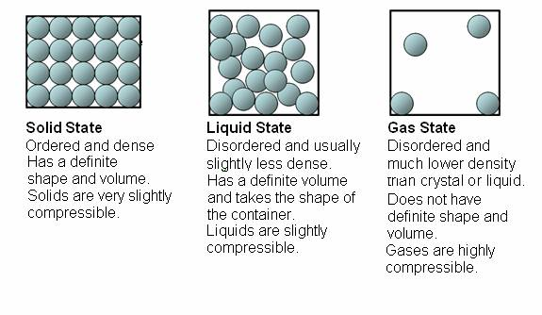
States of Matter
Solid
Liquid
Gas
Plasma

Slide 9
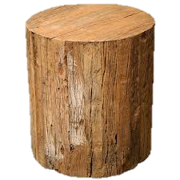
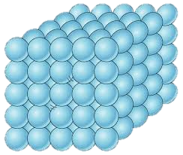
Solids
Particles are packed close together.
Does not change shape or take the shape of its container.
The particles vibrate in place rather than move out of position.

Slide 10
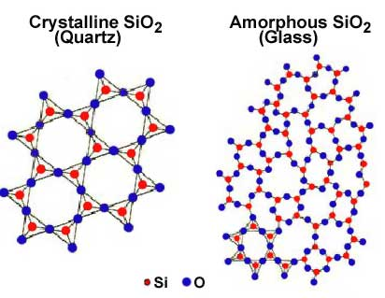
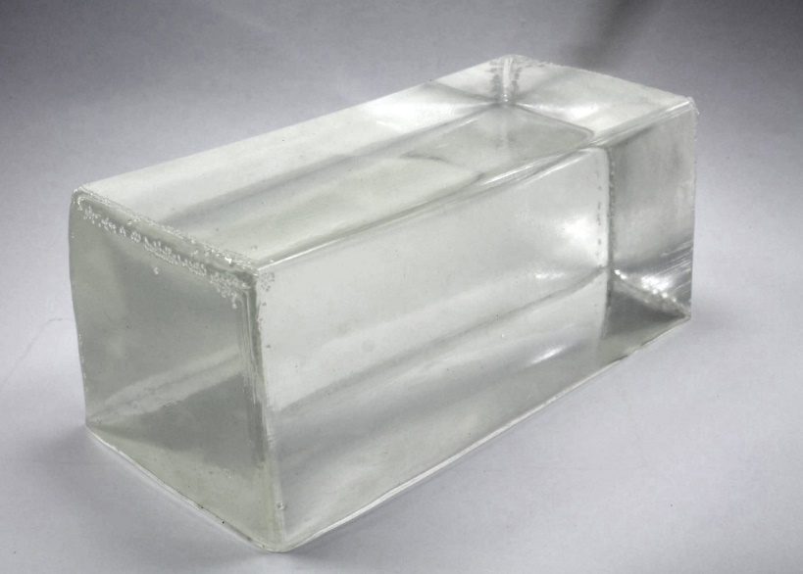
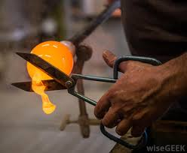
Amorphous Solids
Amorphous solids are resistant to changes in shape, like solids, but like liquids, lack a crystalline structure.

Slide 11
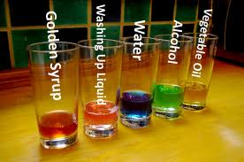
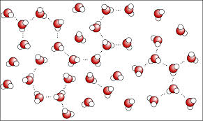
Liquids
Takes the shape of its container.
The volume of the liquid is always the same regardless of the shape of the container.
The particles in a liquid move more freely as they have more energy, but not enough to move far apart.

Slide 12
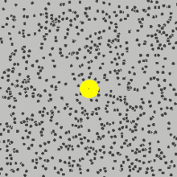
Brownian Motion
The movement of molecules in a substance is known as Brownian motion.
This is the random motion of particles suspended in a fluid (a liquid or a gas).
It results from the collisions between molecules in the fluid.

Slide 13
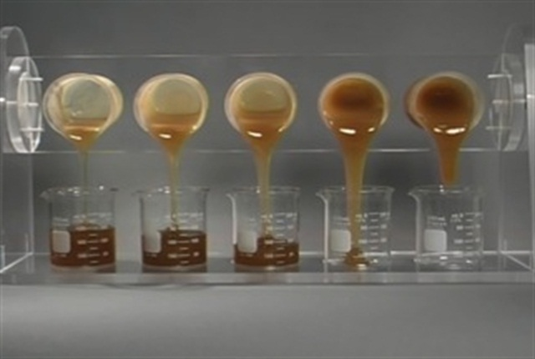
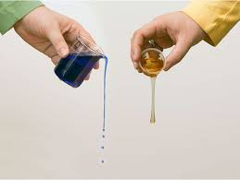
Viscosity
Viscosity is ease with which a liquid flows and is determined by the strength of the attraction between particles. The more viscous a liquid the longer it takes to flow.

Slide 14
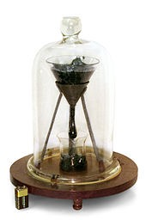
The Pitch Drop Experiment
The pitch drop experiment is a long-term experiment that measures the flow of a piece of pitch over many years.
Pitch is the name for any of a number of highly viscous liquids that appear solid, most commonly bitumen.
At room temperature, tar pitch flows at a very low rate, taking several years to form a single drop.

Slide 15
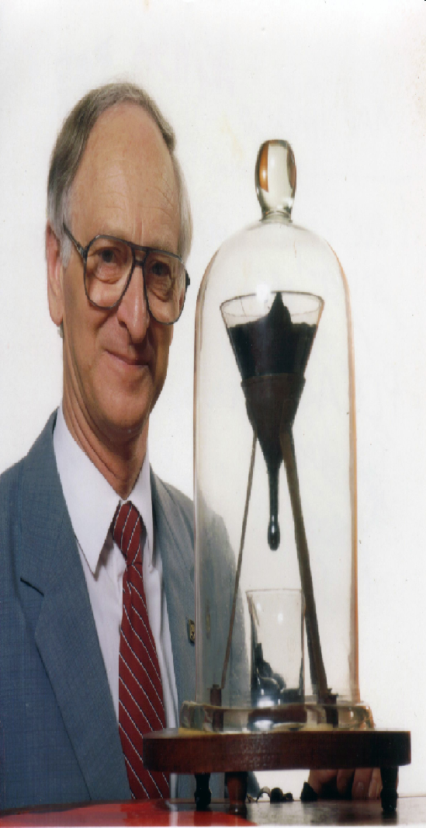
The Pitch Drop Experiment
The University of Queensland pitch drop experiment.
Professor John Mainstone (taken in 1990, two years after the seventh drop and 10 years before the eighth drop fell).

Slide 16
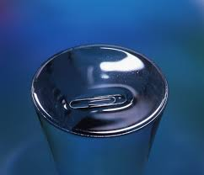
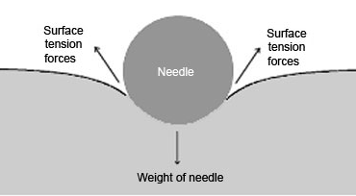
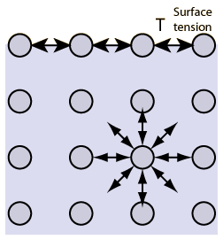
Surface Tension
Surface tension results from the particles pulling towards each other.
As no liquid particles are above the liquid the surface tension can be strong enough to balance objects on.
The attractions between H₂O molecules are known as van der Waal forces.

Slide 17
Van der Waal Forces
Distributions of partial charges in water – van der Waal forces.
These allow water molecules to bind together. This created surface tension and many of the unique properties of water.

Slide 19
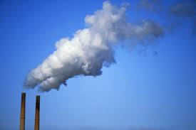
Gas
Most gases are invisible. The air you breath is a mixture of gases.
Gas does not have a definite shape or volume.

Slide 20
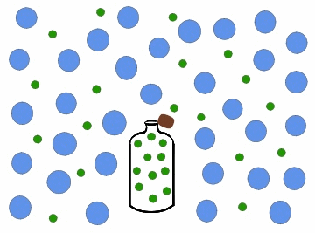
Gas
The particles of a gas are much further apart than in a liquid or a solid. There is empty space between the particles.
Gas particles move at high speed in all directions.

Slide 21
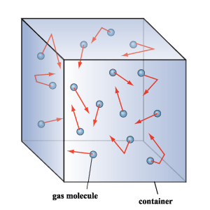
Gas
If you poured a small volume of a liquid into a container the liquid would fill the bottom.
However if you poured the same volume of gas into a container the gas would fill the container.

Slide 22
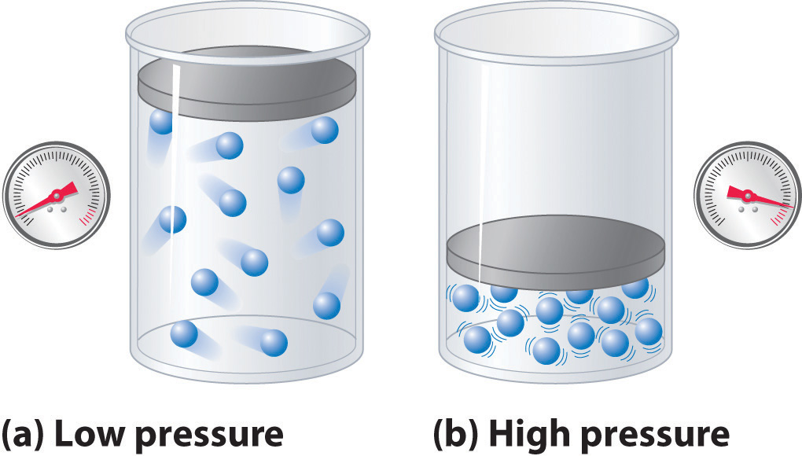
Gas
Decreasing the volume of a container squeezes the gas particles closer together.
This increases the pressure.

Slide 23
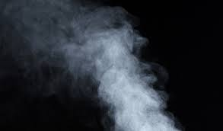
Gas
Matter that is generally a liquid or solid at room temperature but exists as a gas is called vapor.
For example water vapor is the given name for water when it is in a gas state.

Slide 24
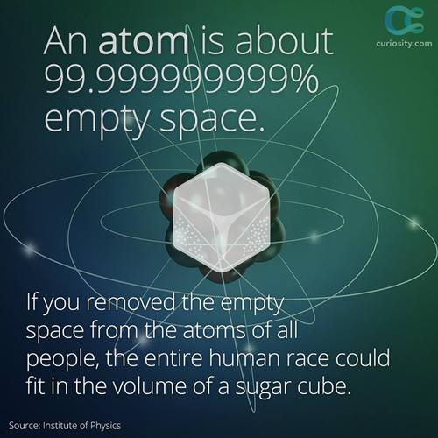
What is empty space?
Empty space literally has nothing in it.
When we say something is empty conversationally we are really being factually incorrect.
And empty box is full of gas - air.

Slide 25
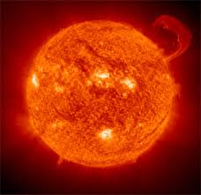
Plasma
If we add enough energy to a gas the molecules can completely break apart.
This is known as a plasma.

Slide 26
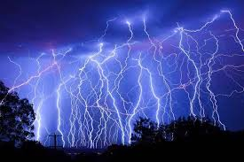
Lightning
A plasma is a highly ionized gas containing a roughly equal number of positive ions and electrons.
Plasmas conduct electric current. Neon lights are an artificial form of plasms.
Lightning is a sudden electrostatic discharge during an electrical storm between electrically charged regions of a cloud.
Intra-cloud lightning or IC, or between that cloud and another cloud (CC lightning), or between a cloud and the ground (CG lightning).

Slide 27
Thunder and Lightning
Which comes first, the thunder of the lightning?
LS = 299 792 458 m / s
SS = 340.29 m / s

Slide 29
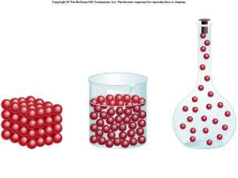
The Shape of Matter
Solids have a defined shape
Liquids take the shape of the bottom of a container
Gasses take the shape of an entire container.

Slide 31
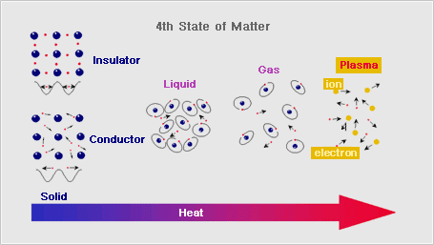

Slide 32
Freezing and Melting
Freezing is the process of moving from liquid state to solid state.
Melting is the process of moving from solid state to liquid state.
When we add more energy into a substance the particles have more energy and move around more. This is what we see happening when ice melts.

Slide 33
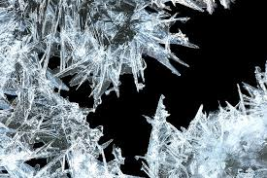
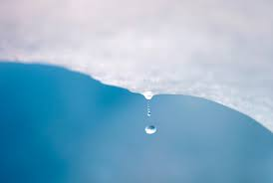
Freezing and Melting
Freezing
Melting

Slide 34
Vaporization and Condensation
Vaporization is the process of moving from liquid into gas form.
Condensation is the process of moving from gas into liquid form.
As a gaseous substance loses energy the particles slow down and they can begin to form liquids.

Slide 35
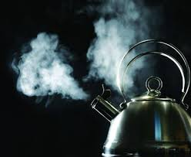
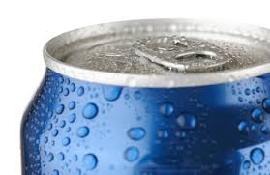
Vaporization and Condensation
Vaporization
Condensation

Slide 36
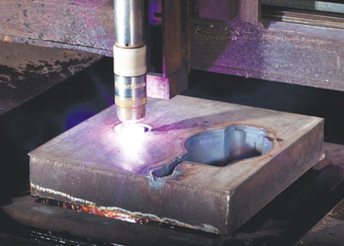
Ionization and Deionization
When a gas is super heated it may start to break apart. At this point it undergoes ionization and becomes a plasma.
In a plasma H ions, and electrons break off. Since they have a positive or negative charge a plasma is a highly ionized gas that has roughly an equal charge.

Slide 37
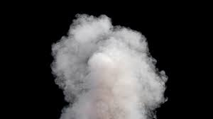
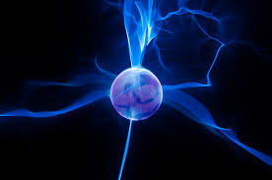
Ionization and Deionization
Ionization =>
<= Deionization

Slide 38
Deposition and Sublimation
When a substance moves straight from being a gas to being a solid this is deposition.
When a substance moves straight from being a solid to being a gas this is sublimation.

Slide 39
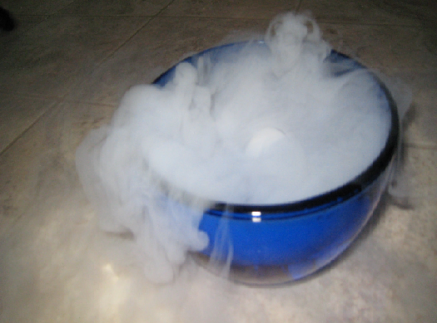
Deposition and Sublimation
Sublimation
e.g.
Solid => Gas

Slide 40
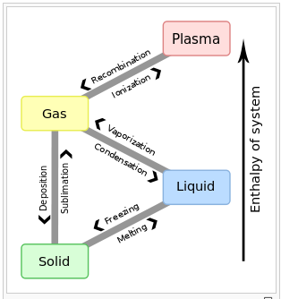

Slide 41
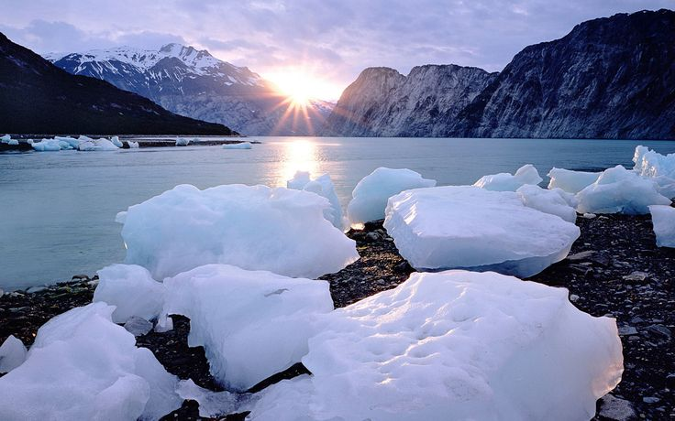
Under normal circumstances how will this solid change phase into a gas?
Sublimation
Melting
Notes:
Use this slide to explain that under normal circumstances ice will melt and sublimate, not just melt.

