Slide 1
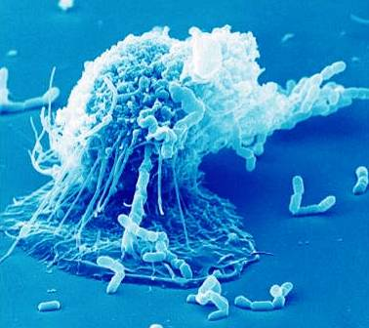
Immune Defense
Chapter 43

Slide 2
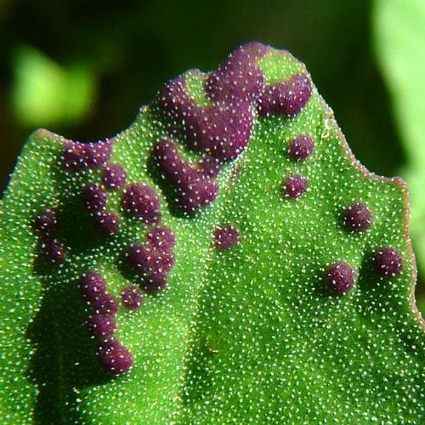
Infection
Infection disturbs homeostasis
Plants and animals are constantly under attack from bacteria, viruses, protists and fungi
Plants and animals have a variety of chemical defenses against infection

Slide 3
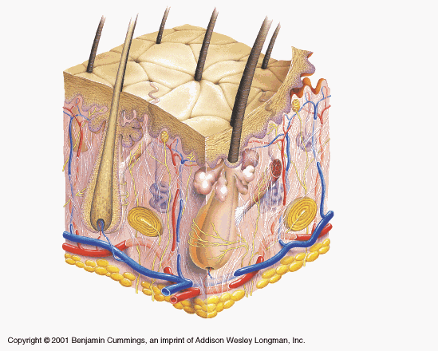
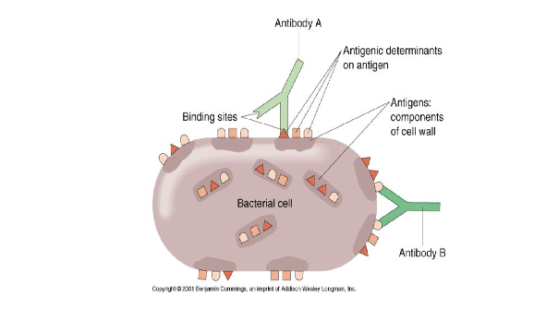
Organization of Chemical defenses
Non-specific defenses: work against any pathogen
Specific defenses: Based on recognition of the pathogen’s identity and only functions against that specific pathogen

Slide 4
Non Specific Defenses
Innate Immunity
Detect a broad range of pathogens
Rapid response
Barrier Defenses
Skin
Mucous membranes
Secretions
Internal Defenses
Phagocytic cells
Antimicrobial proteins
Inflammatory response
Natural killer cells.
Compliment system

Slide 5
Specific Defenses (only vertebrates)
Acquired Immunity
Recognition of traits specific to particular pathogens, using a vast array of receptors
Slower response
Humoral Response
Antibodies defend against infection in body fluids
Cell-mediated Defenses
Cytoxic lymphocytes defend against infection in body cells.

Slide 6
Plant Defenses
Receptor proteins sense presence of pathogens or effects of infection triggering several chemical pathways
R proteins – produce products that confer some resistance to pathogens
RNAi – interference RNA that binds to pathogen RNA thereby silencing it
Ubiquitin – marks pathogen proteins for destruction by proteasomes
Plants tend to wall of affected areas preventing further destruction of healthy tissue

Slide 7
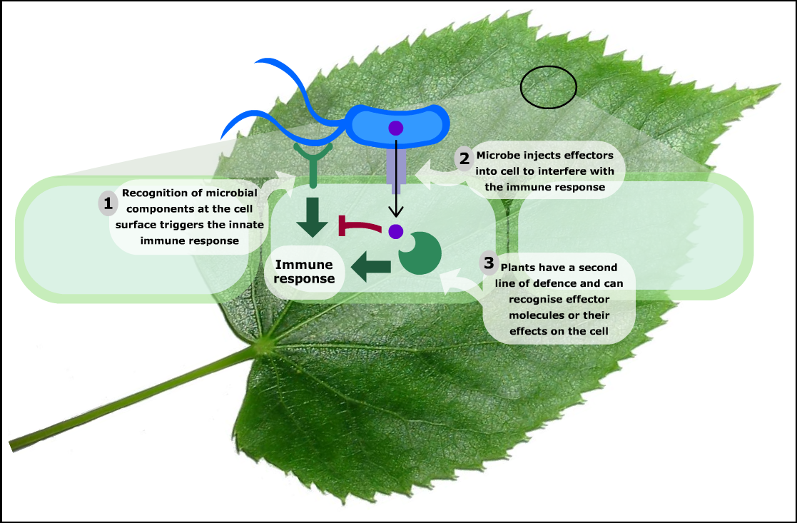

Slide 8
Innate Immunity

Slide 9
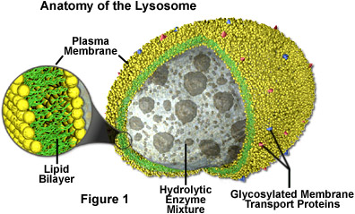
Phagocytosis
Phagocytic white blood cells (leukocytes) ingest and digest bacteria and other foreign substances
Recognize fragments of molecules characteristic of a set of pathogens
A white blood cell recognizes and engulfs invading microbes trapping them in a vacuole
The vacuole fuses with a lysosome and nitric oxide and other gasses poison it before lysosome and other enzymes degrade it.
The most abundant phagocytic cells in mammals are neutrophils
Macrophages are large phagocytic cells present in the spleen and lymph nodes that are particularly effective and combating microbes.
Eosinophils have a low phagocytic ability but help to defend agains multi-cellular invaders.
Dendritic cells populate cells that are in contact with the environment and mainly help with acquired immunity.

Slide 10
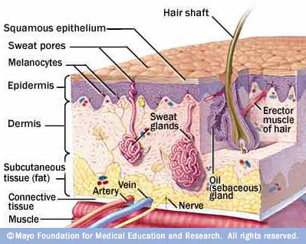
Non-specific defenses
In innate immunity, recognition and response rely on shared traits of pathogens
Physical barriers
skin
mucus
stream of tears or urine
Inflammation
Chemical barriers
pH (stomach, vagina)
enzymes such as DNAases (stomach, tears)
Interferons
Complement system
Epithelial tissues block the entry of many pathogens. These include skin and mucous membranes
Certain cells produce mucous that traps microbes and other particles. Cilliated epithelial cells sweep the mucous up away from vital organs
Lysosomes in saliva and tears kills amny microbes. The skin releases sebaceous oils that have a low pH (3 to 5) and kills many microorganisms.

Slide 11
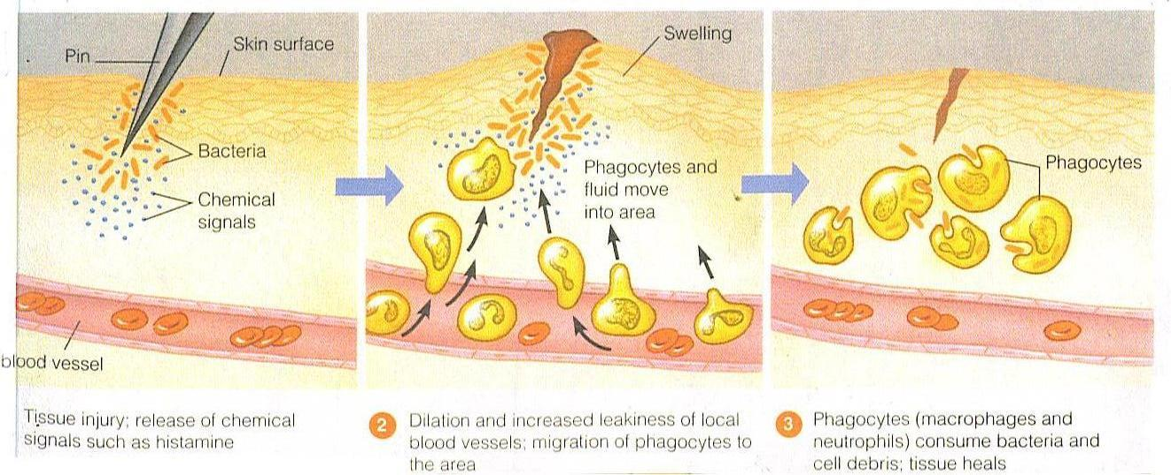
Inflammation

Slide 12
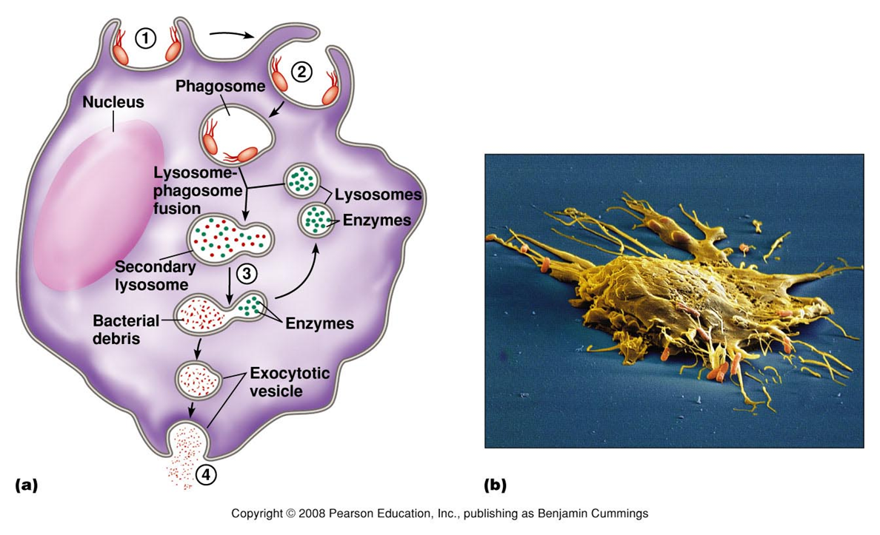
Inflammation
Mast cells store histamine which is released at the site of tissue damage.
Symptoms of inflammation:
Redness
heat
Swelling
- pain
Various chemical signals attract neutrophils and macrophages.
Macrophages phagocytize foreign matter and use enzymes to break it down

Slide 13
Systemic Inflammation Fever
Small injuries result in localized inflammation but larger injuries or infection may trigger a systemic response.
White blood cells will be produced and injured or infected tissue may secrete molecules stimulating the release of additional neutrophils
Many activated macrophages (and some toxins released by pathogens) can reset the bodies temperature to a higher level.
The increased temperature may help in phagocytosis and accelerate tissue repair.
Certain bacterial infections can result in an overwhelming systemic inflammatory response leading to septic shock. This results in very low blood pressure and low blood flow. It is fatal in about one-third of the cases.

Slide 14
Interferon
Protein secreted by a cell currently infected by a virus
Interferon warns the neighboring cells of the impending viral infection
The neighboring cells synthesize proteins that will block the virus from hijacking the cell DNA replication machinery
Animation:
http://people.eku.edu/ritchisong/interferon2.gif

Slide 15
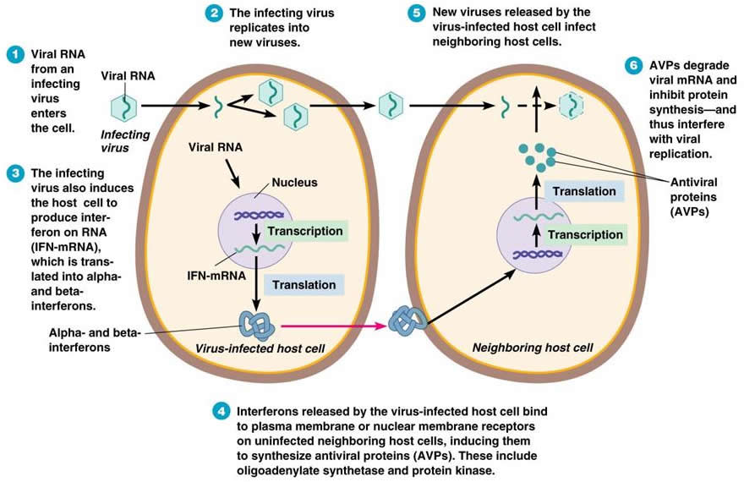

Slide 16
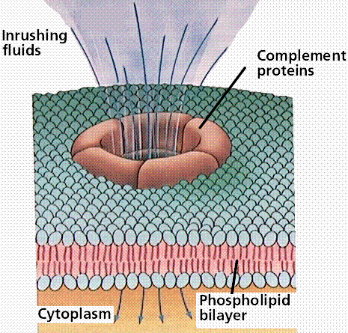
Complement system
Complement system consist of roughly 30 proteins that function together to fight infection.
Complement proteins become activated either by direct contact with a pathogen or by contact with a bound antibody.
In an activated state, they form a complex which opens a hole in a pathogen’s cell membrane → bacterial lysis
Complement system also promotes inflammation

Slide 17
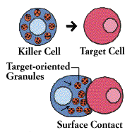
Natural Killer cells = NK cells
Able to recognize a wide range of pathogens without prior exposure
When recognition and binding occur, the NK cells destroy the pathogen through cell lysis
With the exception of red blood cells all cells in the body usually have a protein called I MHC on their surface.
Following infection or conversion to a cancerous state many cells stop expressing this protein.

Slide 18
MHC Molecules
Antigen recognition begins with a pathogen either infecting or being engulfed by a host cell.
Once inside enzymes cleave the pathogen protein into smaller fragments.
These fragments then bind to MHC molecules inside the cell.
MHC is then bound to the cell surface in a process called antigen presentation.
The cell is then targeted for destruction

Slide 21
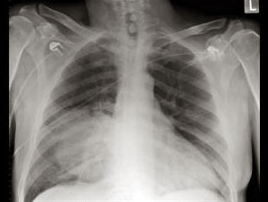
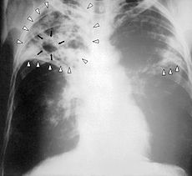
Innate Immune System Evasion
Some pathogens are able to mask their polysaccharides thus avoiding detection – Streptococcus pneumoniae
Other pathogens are able to resist breakdown by lysosomes following phagocytosis – The bacterium that causes tuberculosis.

Slide 22
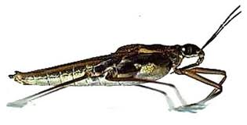
Acquired Immunity

Slide 23
Lymphocytes
Lymphocytes consist of B cells and T cells and are critical to the acquired immune defense.
Lymphocytes are made in the bone marrow. Cells that migrate from the bone marrow to the thymus become T cells.
Cells that mature in the bone marrow become B cells.
B cells and T cells recognize and inactivate most foreign cells and molecules. Both types o f cell also contribute to immunological memory.
The innate immune system and the acquired immune system do not work independently. Signals from the innate immune response activate lymphocytes.
Macrophages and dendritic cells release cytokines after ingesting microbes. These activate lymphocytes.

Slide 24
Acquired Immunity an Overview
Each B and T cell has many receptor proteins on its surface.
The receptor proteins on each B and T cell are the same but there are many different types of lymphocytic cell.
When a pathogen is engulfed by a phagocytic cell the B and T cells interact with fragments displayed on the surface and become activated.
Activated lymphocytes undergo cell division
Some T cells assist in activating other lymphocytes. Some T cells kill infected host cells.
Specialized B cells secrete soluble receptor proteins that attack foreign molecules.

Slide 25
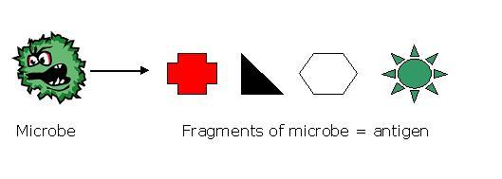
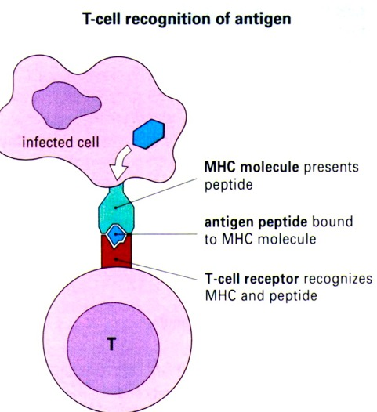
Specific immunity
Specificity: based on shape recognition of cell surface antigens
Diversity: Any shape can be recognized by a B or T-lymphocytes and trigger an immune reaction
Memory: once a pathogen has activated the immune system, memory cells remain and will protect against a secondary infection
Self-tolerance: the immune system does not attack itself (Usually)

Slide 26
Specific immunity: Meet the players
Macrophages (antigen presenting cell = APC): phagocytize pathogens and present antigens to helper-T lymphocytes
Helper-T cells: secrete lymphokines and activate B and killer T cells
B-cells: multiply and specialize into plasma cells → secrete antibodies
Killer-T cells: kill (through lysis) infected or cancerous cells
Antibodies (immunoglobulin): antigen receptors that recognize a small accessible portion of an antigen called an epitope.

Slide 27
Antibody-mediated immunity (humoral)
1- Macrophages phagocytize a pathogen and present an antigen to a matching helper-T cell
2- At the same time, some pathogens contact B-cells matching the pathogen’s antigens
The helper-T cells multiply, secrete signals which stimulate the B-cells to multiply and specialize into plasma cells
The plasma cells secretes antibodies

Slide 28
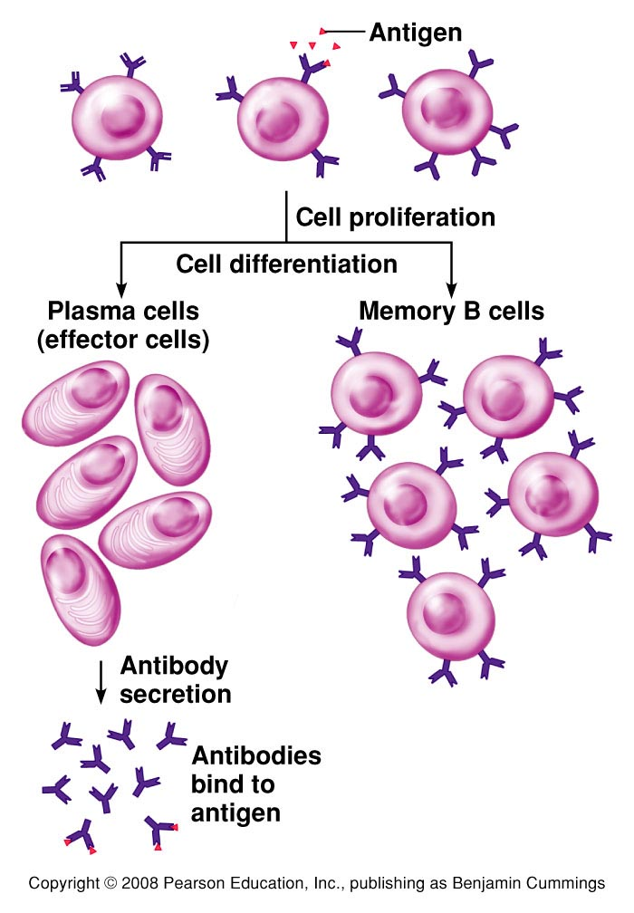
Figure 23.7

Slide 29
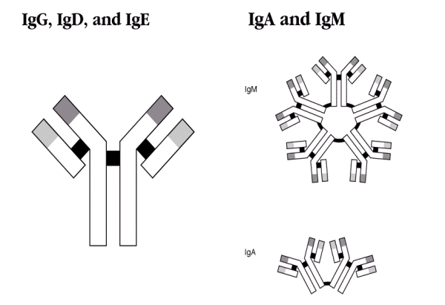
What are antibodies?
Structures formed by 4 proteins
Two main regions:
The upper region is highly variable and bind to a specific shape (the antigen)
The base region is constant for all antibodies
This region, when the antibody is bound to its antigen, activates the innate system

Slide 30
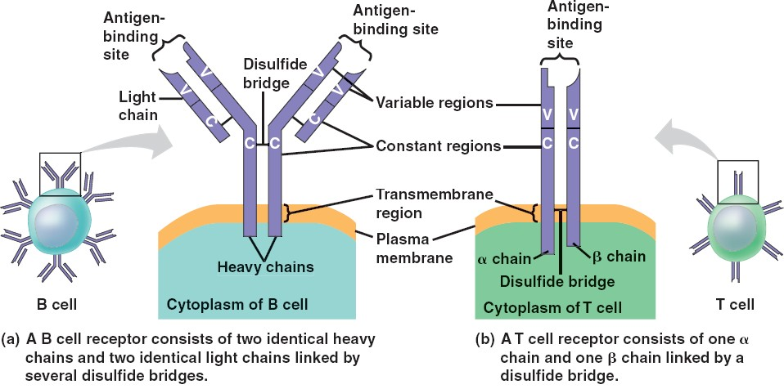
B and T Cell Receptors
The upper region is highly variable and can bind to a specific shape (the antigen)

Slide 31
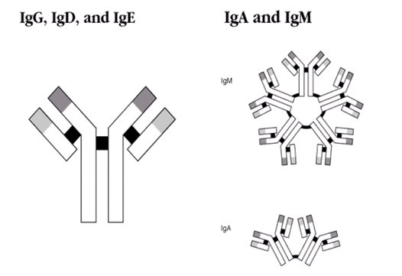
Role of the antibodies

Slide 32
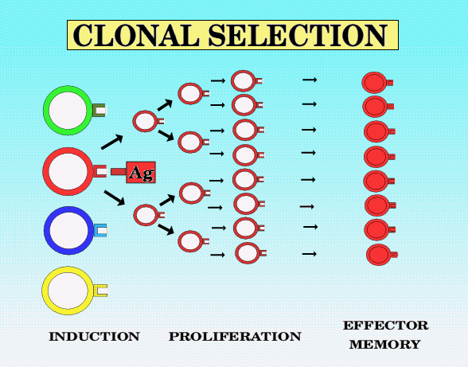
Clonal selection
Once a T, B or killer lymphocytes have made contact with their specific antigen, they are triggered into action but they also divide and form a large amount of identical cells, called a clone.

Slide 33
Cell-mediated immunity
Similar reaction to antibody mediated immunity
The pathogen triggering the reaction is a virus infected cell or a cancerous cell.
Killer T lymphocytes are sensitized by contact and activated by lymphokines secreted by activated helper T cells

Slide 34
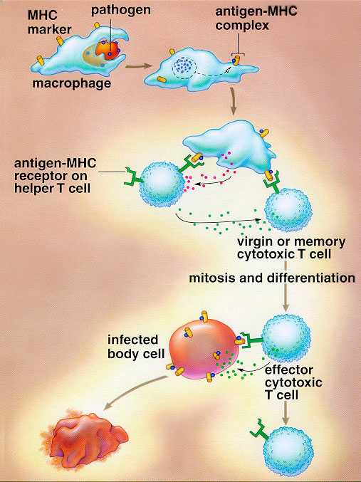
Killer T-Cells lyse and kill specific cells to which they have been activated for

Slide 35
First and second exposures to a pathogen
Second exposure equals faster response

Slide 37
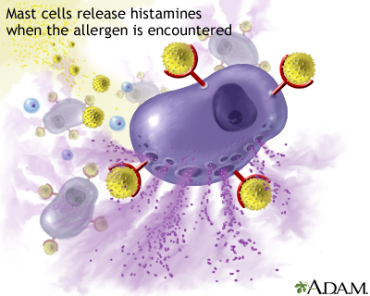
Clinical applications
Both allergies and tissue transplant rejection due to “overactive” immune response

