Slide 1
Evidence of Evolution

Slide 2
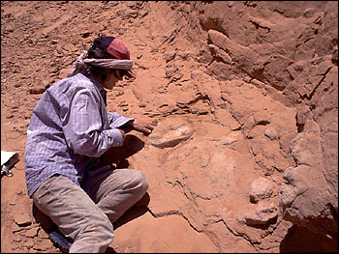
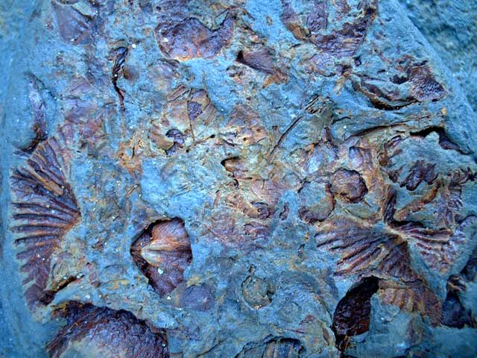
Clues to the past
Since humans weren’t around millions of years ago, scientists study clues in the rocks to understand what was happening.
The best clues that scientists have are fossils.
FOSSILS: evidence of an organism that once lived.

Slide 3
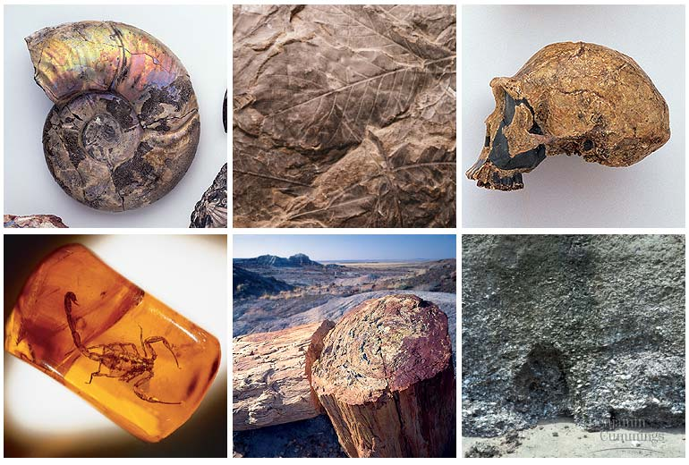
Fossils
Darwin collected many fossils on his voyage.
Many of these fossils were of ancient organisms, that resembled creatures that were still alive.
Darwin looked at fossils found in various types of rock and amber.

Slide 4
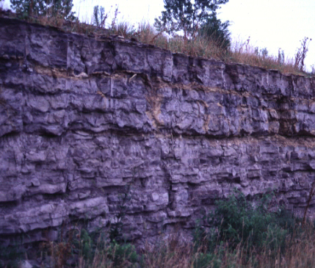
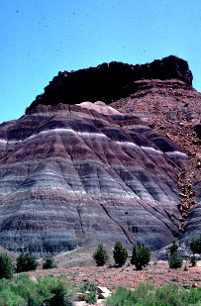
Sedimentary Rocks
For a fossil to form, organisms usually have to be buried in mud, sand or clay.
Mud, sand or clay are compressed over time and harden into sedimentary rock.
Sedimentary rocks form in layers which helps preserve the fossils.
Fossils aren’t usually found in other types of rocks because the heat required to make them usually ruins the fossils.

Slide 5
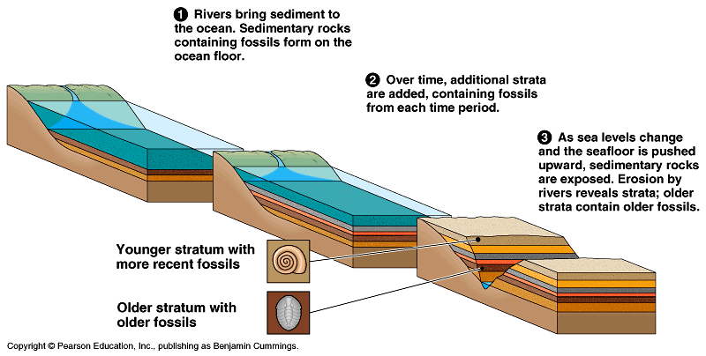

Slide 6
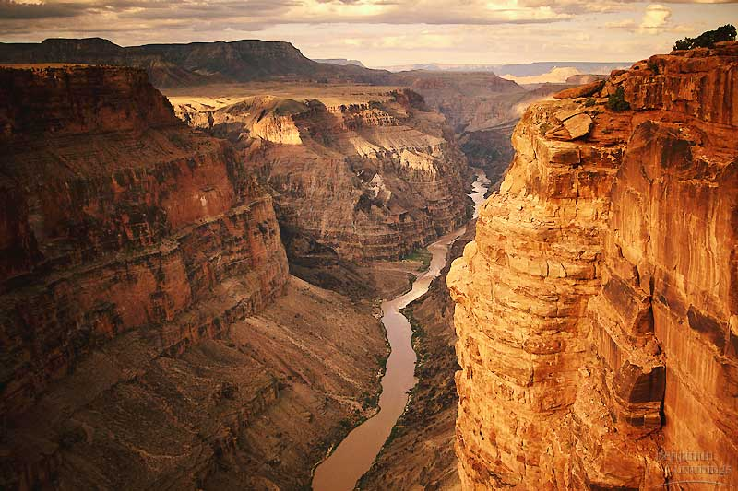
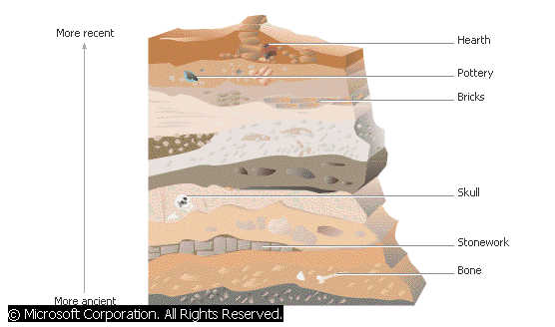
Relative Dating
Scientists also use index fossils to compare the relative ages of fossils.
An index fossil must have existed for a relatively short period of time and had a wide geologic range.
Relative dating allows a scientist to etimate a fossils age compared to that of other fossils.

Slide 7
Geologic Time Scale
Paleontologists use divisions of the geologic time scale to represent evolutionary time (deep time).
After Precambrian time the basic divisions of the geologic time scale are eras and periods.
Paleozoic – 544 million years ago. Lasted 300 million years. Saw the emergence of many vertebrate and invertebrate animals.
Mesozoic – 245 million years ago. Lasted 180 million years. Sometimes called the age of dinosaurs. Many other animals were alive at this time too, including mammals.
Cenozoic – 65 million years ago to present day. Sometimes called the age of mammals.

Slide 8
Periods
Eras are sub-divided into periods which range in length from tens of millions of years to less than two million years.
For example the Mesozoic era is split into three periods: the Triassic period, the Jurassic period, and the Cretaceous period.
Many periods are named after the region where geologists first described rocks. For example the Cambria period is named after Cambria – the old Roman word for Wales.

Slide 9
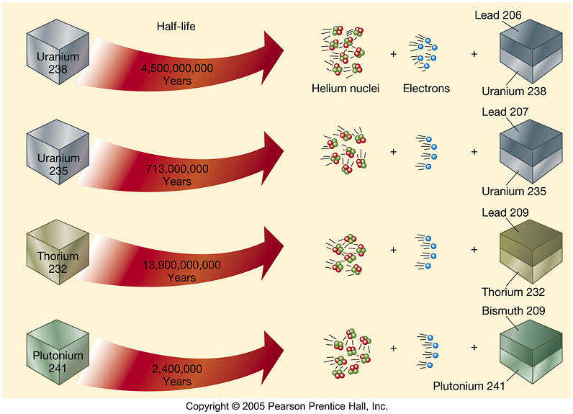
Radiometric Dating
In radioactive dating scientists calculate the age of a sample based on the amount of remaining radioactive isotopes it contains.

Slide 10
Comparative Anatomy
Evolutionary theory states that organisms that share homologous structures have descended, with modification, from a common ancestor.
Similarities and differences amongst homologous structures can help determine how recently a species shared a common ancestor.
Scientists have also identified homologous structures in plants.

Slide 11
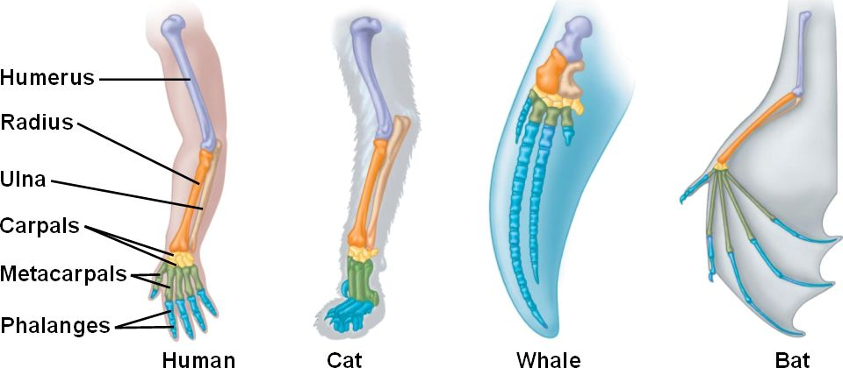
Homologous Structures

Slide 12
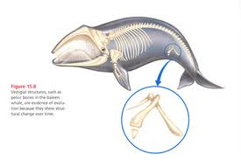
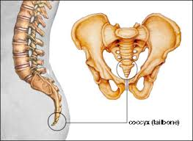
Vestigial Structures
Not all homologous structures have important functions.
Some structures are so reduced in size that they are just vestiges, or traces of homologous structures in other species.
For example whale hip bones and the human coccyx are vestigial structures.

Slide 13
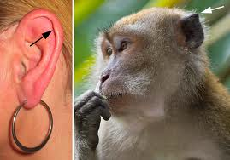
Darwin’s Tubercle
We can see the remnants of the point of a mammalian ear on some of our own ears (about 10.4% of the population).
This is also an example of incomplete dominance in the human phenotype.

Slide 14
Embryology
Scientist noticed a long time ago that the developmental stages of many animals with a back bone (vertebrates) look very similar.
The same embryonic cells develop in the same order and in similar patterns to produce many homologous structures.
Similar patterns of embryonic development provide further evidence that organisms have descended from a common ancestor.

Slide 15
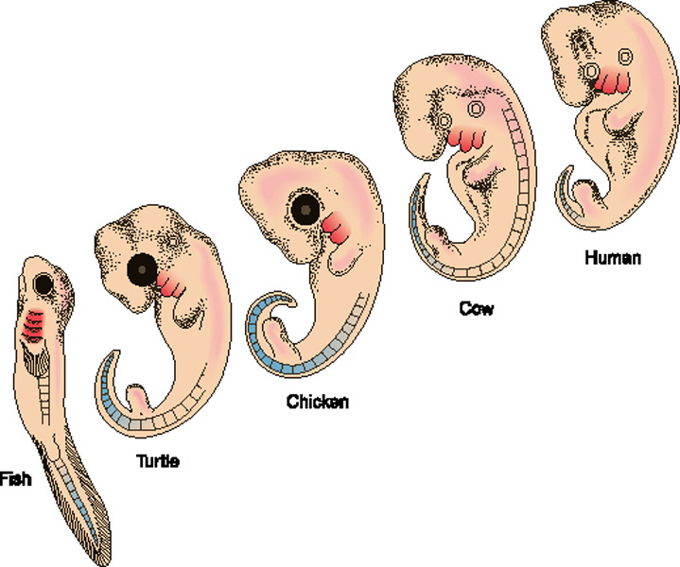
Embryo Development

Slide 16
Genetics – Allele frequency
By calculating the frequent od certain alleles scientists can calculate whether or not evolution is occurring in a population, and at what rate.
As mentioned before this is done through a Hardy-Weinberg equilibrium equation.
P² + 2pq + q² = 1

Slide 17
Molecular Biology - DNA and RNA
Now our increased knowledge of DNA and RNA has lead scientists to review much of what we thought we knew about evolution and the tree of life.
New technology makes it possible for us to make connections between species that the fossil record did not.
We now have a far clearer understanding of the interrelatedness of species.

Slide 18
The Common Genetic Code
As we know there is a universal genetic code. The genetic code is identical in almost all organisms including bacteria, yeasts, plants, fungi, and animals.
All living cells use information coded in DNA and RNA to carry information from one generation to another.
We also now understand how mutations and gene reshuffling during gamete formation produce heritable variation on which natural selection operates.

