Slide 1
Opening Task
Define immigration
When organisms move into an area
Define emigration
When organisms leave an area

Slide 2
Limits to Growth
Chapter 5.2

Slide 3
Limiting Factors
The productivity of an ecosystem can be limited by the availability of a limiting nutrient.
A limiting nutrient is an example of a limiting factor. A limiting factor is a factor that controls the growth of a population.
Acting separately or together, limiting factors determine the carrying capacity of an environment for a species.

Slide 4
Limiting Factors and Biotic Potential
Limiting factors regulate a populations growth.
Limiting factors result in a decrease in birthrate or immigration
or
An increase in death rates or emigration.
Some factors will have more effect on a more dense populations.

Slide 5
Density-Dependent Factors
High population density increases competition for food and water.
Competition is a density-dependent factor.
Predation, herbivory and disease are examples of density-dependent factors.

Slide 6
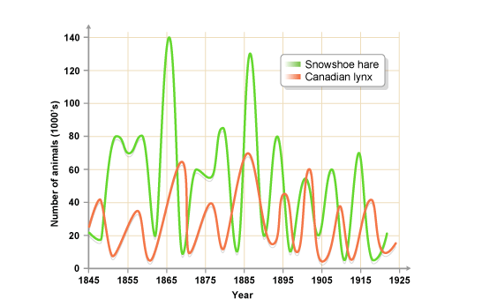
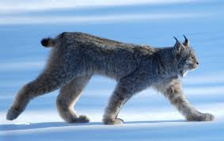
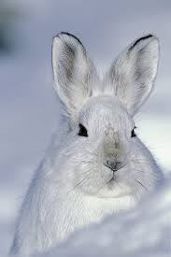
Predator Prey Relationships

Slide 7
Density-Independent factors
Density independent factors are not affected by population density.
These factors include events such as fires, landslides, and floods.
The result is the same regardless of population density – a sudden reduction in population size.

Slide 8
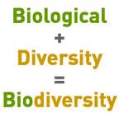
Biodiversity – 6.3
Biodiversity is the sum total of the genetically based variety of all organisms in the biosphere.
Ecosystem diversity includes the variety of habitats, communities, and ecological processes in the living world.
Species diversity refers to the number of different species in the biosphere.
Genetic diversity refers to the sum total of all the different forms of genetic information carried by all species on the Earth.

Slide 9
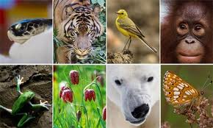
Biodiversity
Biodiversity is one of Earth’s greatest natural resources.
Species of many kinds have provided us with foods, industrial products, and medicines – including painkillers, antibiotics, heart drugs, antidepressants, and anticancer drugs.

Slide 10
Threats to Biodiversity
Human activity can reduce biodiversity by various means;
Habitat alteration
Hunting species to extinction
Introducing toxic compounds into food webs (pollution)
Introduction of non-native species
Overharvesting
Climate change
This can lead to organisms being placed on the endangered list or becoming extinct from all or part of its range.

Slide 11
Pollution
Many types of pollution can threaten biodiversity.
When sulfur oxide and nitrogen oxide are released they react with water and cause acid precipitation.
The lead in fuels we burn has resulted in increased lead levels in all organisms.
Hydraulic fracking has polluted many waterways and ecosystems to the point where the water can be set on fire!

Slide 12
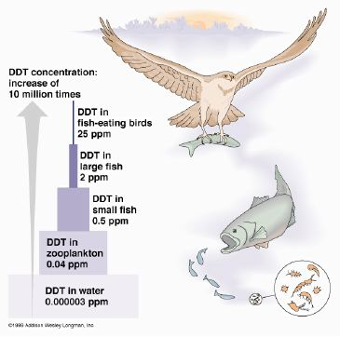
Biological Magnification
One of the biggest problems as far as chemicals are concerned is biological magnification.
In this process concentrations of harmful substances increase in organisms at higher tropic levels.
A classic example of this is in the chemical DDT which was widely sprayed to help combat malaria in many countries including the US.

Slide 13
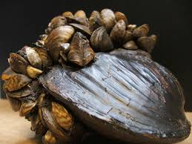
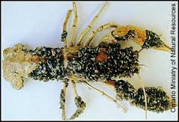
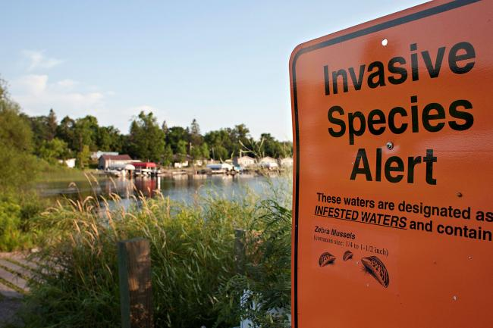
Invasive Species
An invasive species is a non-native species that spreads widely in a community once introduced.
Invasive species represent a different type of disturbance and are a huge problem in many parts of the world.
The Zebra mussel is an example of an invasive species.

Slide 14
What Makes a Species Invasive?
Not all foreign or exotic species are invasive.
A species is only considered invasive if a lack limiting factors (such as predators or herbivores) fail to constrain population growth.
Many foreign species may move to an area and remain in small numbers or eventually die out.

Slide 15
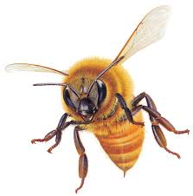
Not all invasive species are bad
The European Honeybee was introduced to North America by European colonists.
It now is responsible for pollinating the majority of North Americas commercial crops.

Slide 16
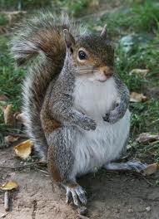
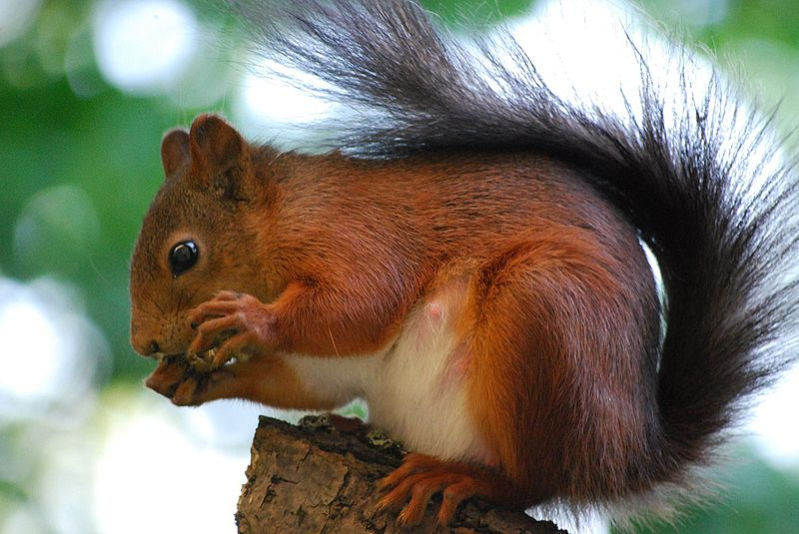
The Eastern Grey Squirrel
The introduction of the Eastern grey squirrel from North America has devastated the numbers of the smaller Eurasian red squirrel in the U.K.

Slide 17
Conserving Biodiversity
Most people would like to conserve Earths biodiversity. The wide management of natural resources is known as conservation.
Today conservation efforts focus on protecting entire ecosystems as well as single species.
Protecting an ecosystem will ensure that natural habitats survive and many different species will be preserved at the same time.

Slide 18
