Slide 1
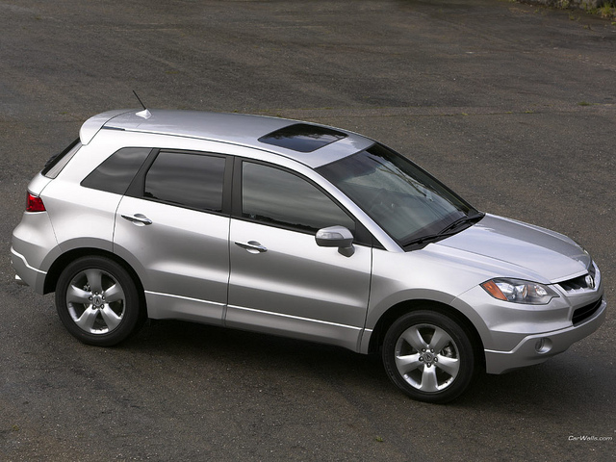
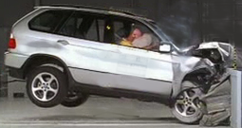
Free Body Diagrams

Slide 2
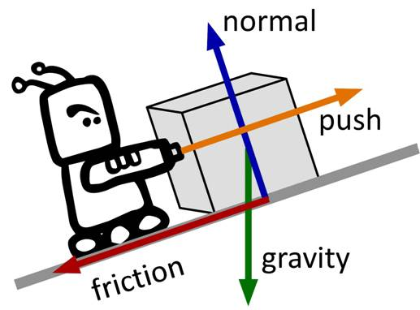
What Forces Affect an Object?
Distant
Gravity
Electrical
Magnetic
Contact
Normal
Tension
Applied
Frictional
Air resistance
Spring

Slide 3
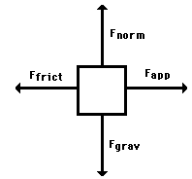
What are Free Body Diagrams?
Free-body diagrams are diagrams used to show the relative magnitude and direction of all forces acting upon an object in a given situation.

Slide 4
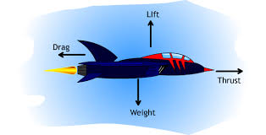
Vector Forces = Magnitude and Direction
A free body diagram is a depiction of a vector force. That is it has both magnitude and direction.

Slide 5
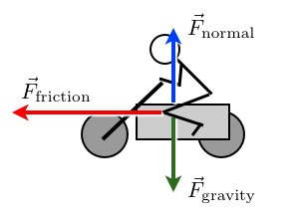
Using a Free Body Diagram
The length of the arrow is usually used to depict the strength or magnitude of a force. Since we are dealing with vector forces they have both magnitude and direction.
The direction of the arrow shows the direction of the force.

Slide 6
A book is at rest on a tabletop. Diagram the forces acting on the book.

Slide 7
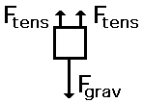
A girl is suspended motionless from the ceiling by two ropes.

Slide 8
An egg is free-falling from a nest in a tree. Neglect air resistance.

Slide 9
A flying squirrel is gliding (no wing flaps) from a tree to the ground at constant velocity. Consider air resistance.

Slide 10
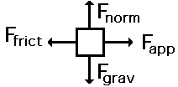
A rightward force is applied to a book in order to move it across a desk at constant velocity. Consider frictional forces. Neglect air resistance

Slide 11
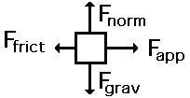
A rightward force is applied to a book in order to move it across a desk with a rightward acceleration. Consider frictional forces. Neglect air resistance.

Slide 12
A football is moving upwards towards its peak after having been booted by the punter. Neglect air resistance.

Slide 13
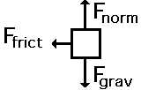
A car is coasting to the right and slowing down. Neglect air resistance.

