Slide 1
Physical and Chemical Properties
Chapter 3 Section 1

Slide 2
Physical Properties
A physical property is a characteristic that you can observe without trying to change the composition of the substance.
For example the look, smell, sound, or taste of an object are examples of physical properties.

Slide 3
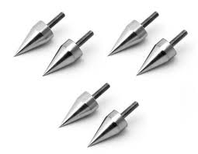
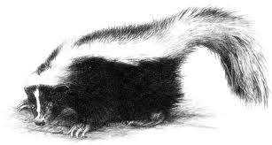
Using Your Senses
Some physical properties describe the appearance of matter.
You can detect many of these properties with your senses.

Slide 4
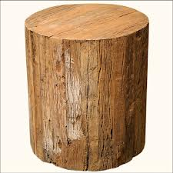
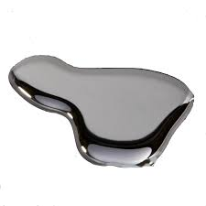
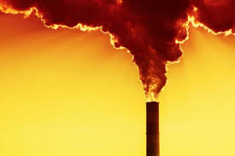
Physical State
To describe a sample of matter you need to identify its state.
Is it solid, liquid, gas, or plasma?
So state is a physical property that you can observe.

Slide 5
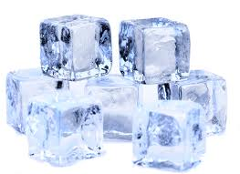
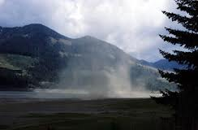
Water
Solid
Liquid
Gas

Slide 6
Size-Dependent Properties
Some physical properties depend on size.
The volume of an object is the amount of space it takes up.
Volume = length x width x height
S.I. unit for volume is the cubic meter (m³), cm³, or mL, are also commonly used.

Slide 7
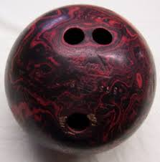
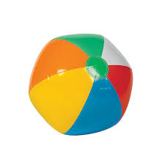
Mass
Mass is another way to describe an objects physical characteristics.
The mass of an object is how much matter it contains.

Slide 8
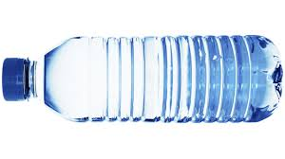
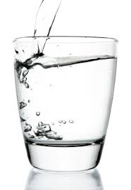
Size Independent Properties
Some physical properties do not depend on size.
For example density is the amount of mass in a given volume.
What is the difference in density of these two containers of water?

Slide 9
Melting and Boiling Point
Melting point and boiling point are also independent of size.
100mL of water will boil at 100ºC
1L of water will boil at 100ºC

Slide 10
Notes:
www.ptable.com

Slide 11
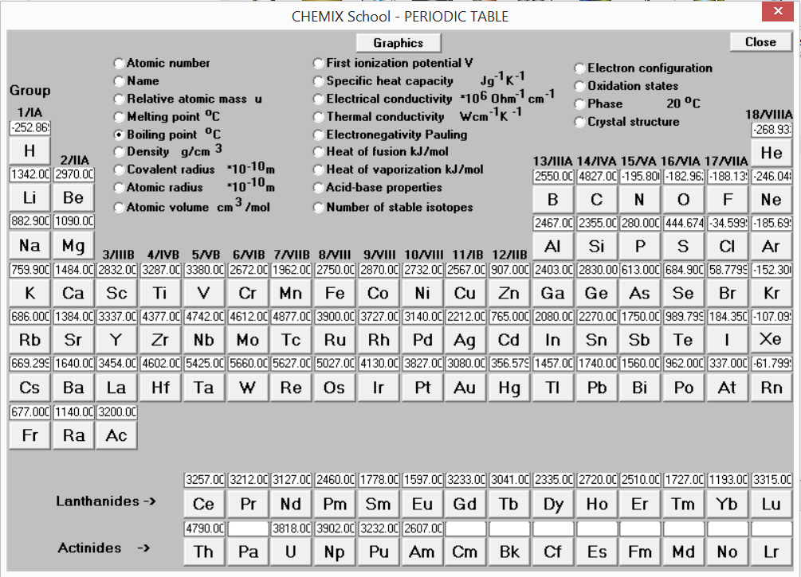

Slide 12
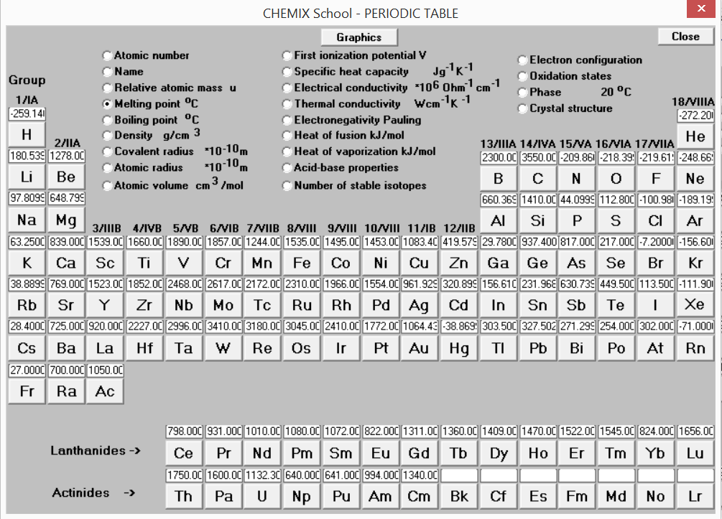

Slide 13
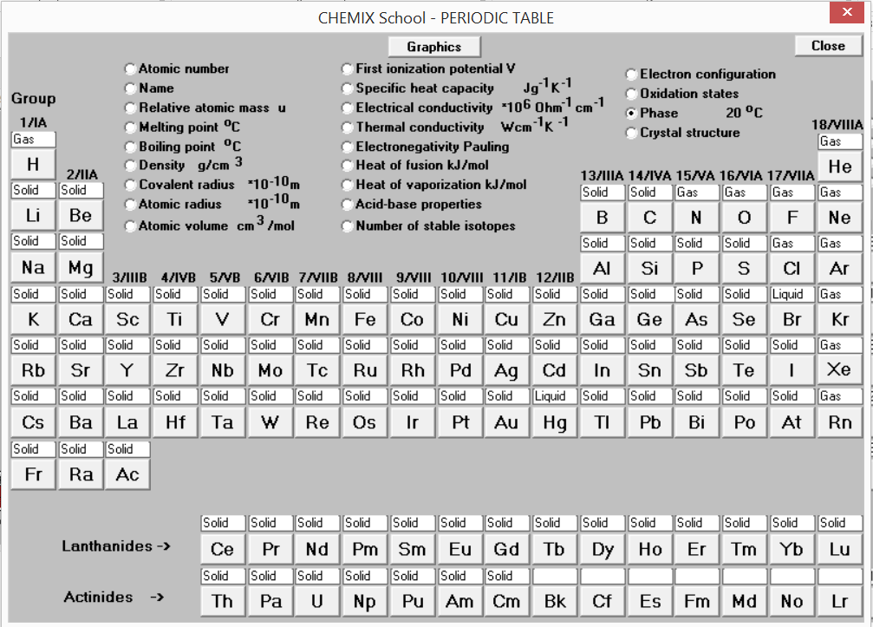

Slide 14
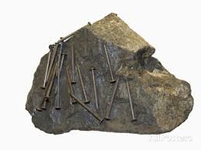
Magnetic Properties
Some matter can be described by the specific way in which it behaves.
For example some material is magnetic and pulls iron towards it.

Slide 15
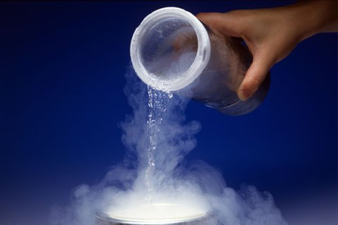
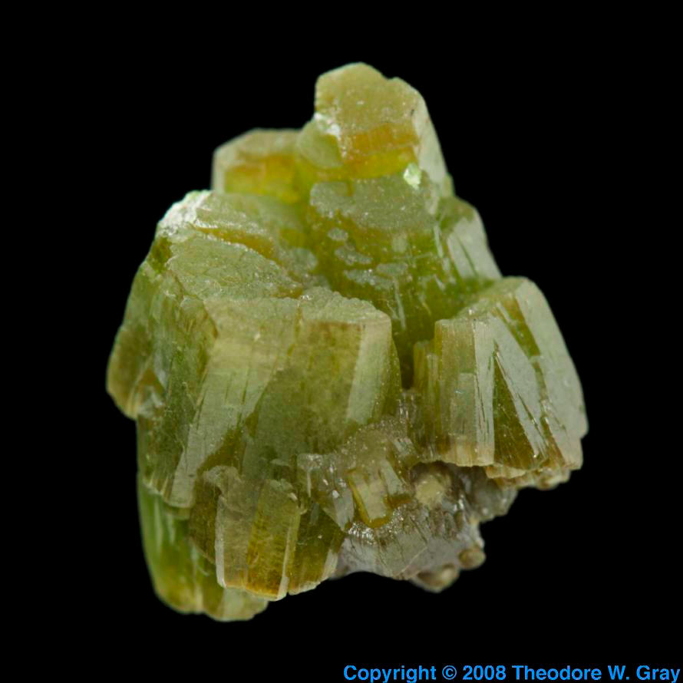
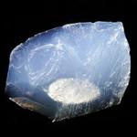
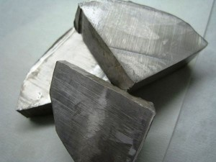
Elements which are gases at room
Temperature.
Liquid Nitrogen
Liquid Helium
Chlorine
Sodium
Solid Oxygen

Slide 16
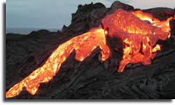
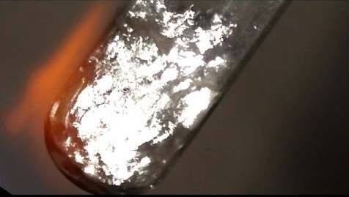
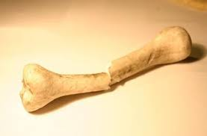
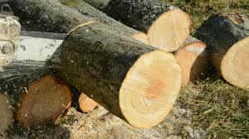
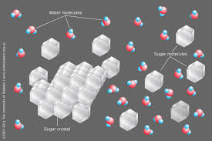
Physical Changes – appearance changes but substance does not
Melting
Boiling
Breaking
Cutting
Dissolving

Slide 17
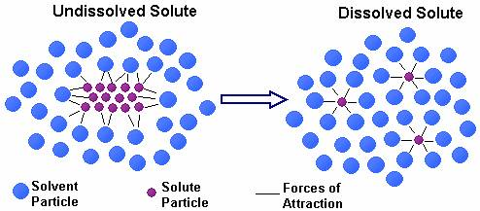
Dissolving

Slide 18
Chemical Properties

Slide 19
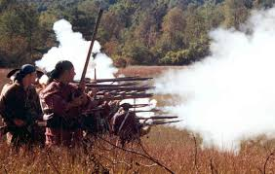
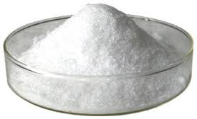
Chemical Properties
Some properties are not apparent just by looking at a sample.
The ability to burn is a chemical property. This is a property that cannot be observed without altering the substance.
Saltpeter

Slide 20
Chemical Change – change in substance
Production of an odor
Change in taste
Change in temperature (energy)
Change in color
Formation of bubbles (gas)
Formation of solid (precipitate)

Slide 21
Chemical Changes
A chemical change has occurred when a new substance has been formed.
Burning is an example of a chemical change.

Slide 22
Chemical Changes
When you burn a log of wood what happens to the total amount of carbon?
It is not always easy to tell if a change is physical or chemical.

Slide 23
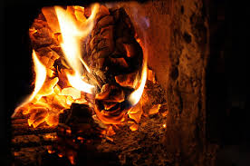
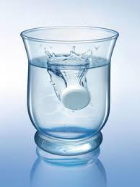
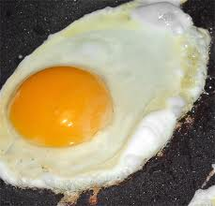
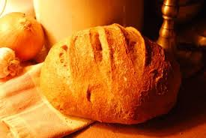
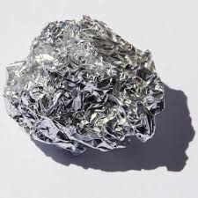
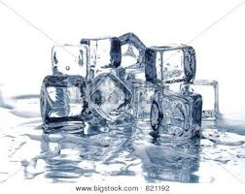
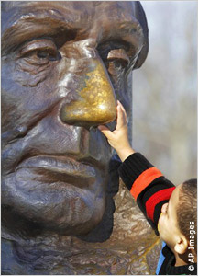
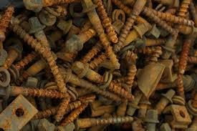
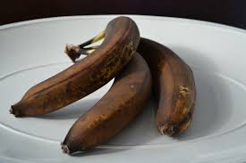
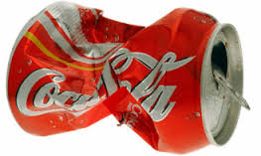
Chemical Properties
A chemical property is the ability of a substance to undergo a change that alters its identity. Which of these are chemical changes?

Slide 24
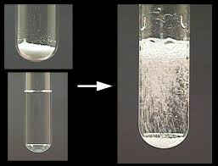
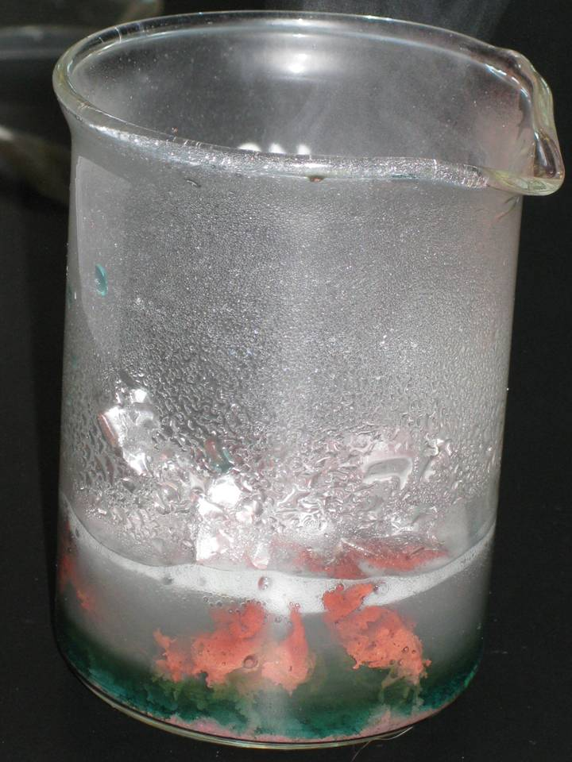
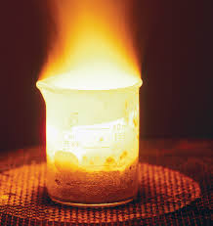
Chemical Reactions
Chemical reactions occur when substances go through chemical changes to form new substances.
Formation of gas
Formation of solid
Release of energy

Slide 25
Energy and Reactions
Chemical reactions always involve changes in energy.
However just like matter energy is never created or destroyed. It can be transferred and some may be transferred to heat which is a very hard form to capture – this is called entropy.

Slide 26
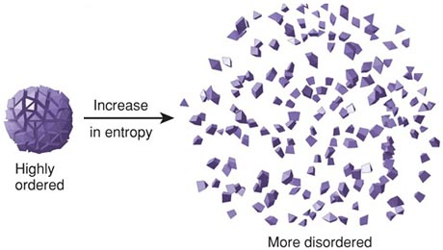
Entropy and Thermodynamics
This is the second law of thermodynamics which states that there is an increasing amount of entropy as energy moves from substance to substance.

Slide 27
First Law of Thermodynamics
The first law of thermodynamics is basically the law of conservation of energy.
The total energy of an isolated system is constant. Energy can be transformed from one form to another, but cannot be created or destroyed.

Slide 28
Energy must be added to break bonds
For the atoms in a compound to react the bonds must be broken.
In order to break all the bonds in gasoline we require an initial input of energy – if this wasn’t the case gasoline would combust whenever it came into contact with oxygen.

Slide 29
Activation Energy
This initial input of energy is known as activation energy.
When molecules collide, and enough energy is transferred to separate the atoms, bonds can break.

Slide 30
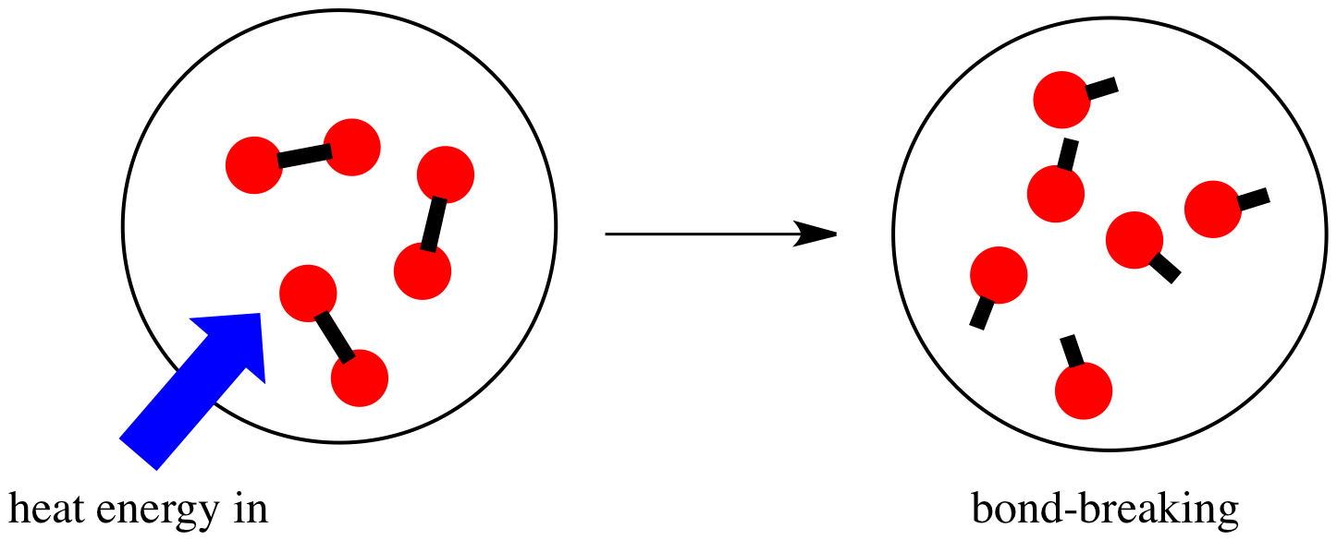
Exothermic Reactions

Slide 31
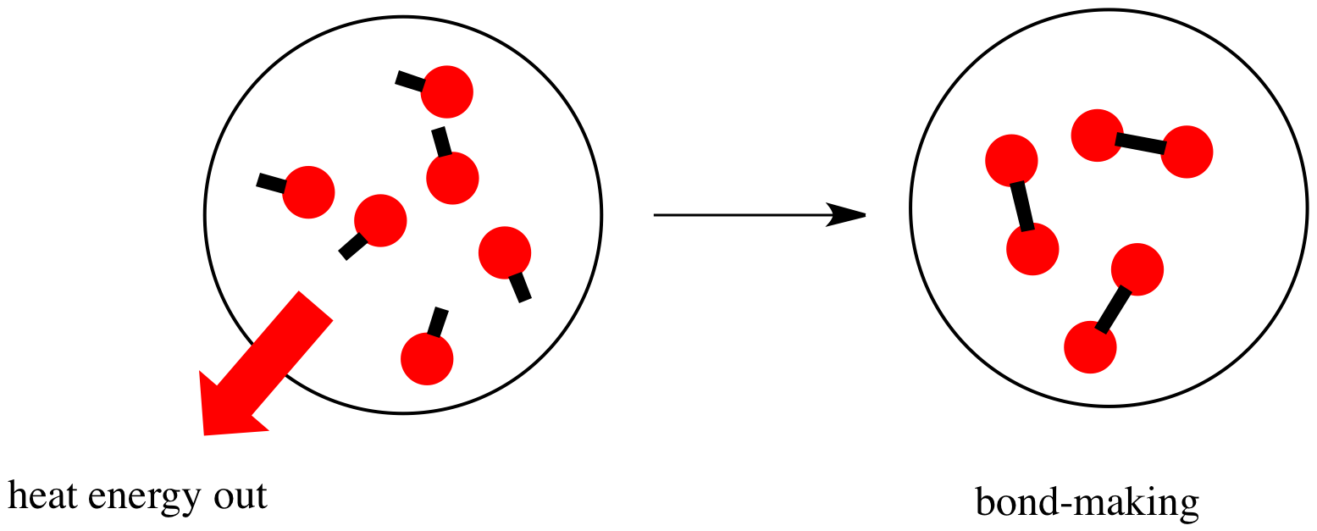
Endothermic Reactions

Slide 32
Chemical Changes
When a chemical change occurs new substances are formed.
This means bonds have been broken and new bonds have been formed.
For example plants take in CO₂. Combine this with H₂O and use energy from the sun to form glucose molecules.
6CO₂ + 6H₂O C₆H₁₂O₆ + 6O₂

Slide 33
Chemical Changes – substance changes
Formation of gases, solids, or liquids
Change in color – be careful!
Temperature change
Change in taste or smell

Slide 34
State Standards
Recognize that a substance (element or compound) has a melting point and a boiling point, both of which are independent of the amount of the sample.
Differentiate between physical and chemical changes.

