Slide 1
Physical and Chemical Changes
Chapter 3, Section 2

Slide 2
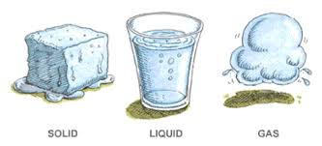
Physical Changes
During a physical change the form and appearance of matter changes.
Although water changes state due to a change in temperature it is still made up of the elements hydrogen and oxygen.

Slide 3
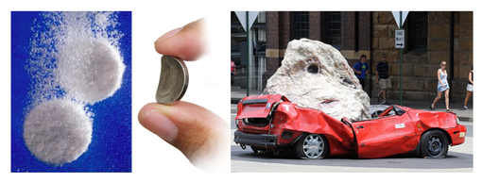
Changing Shape
Generally whenever you cut, tear, grind, or bend matter, you are causing a physical change.
Which of these changes is a physical change and which is a chemical change?

Slide 4
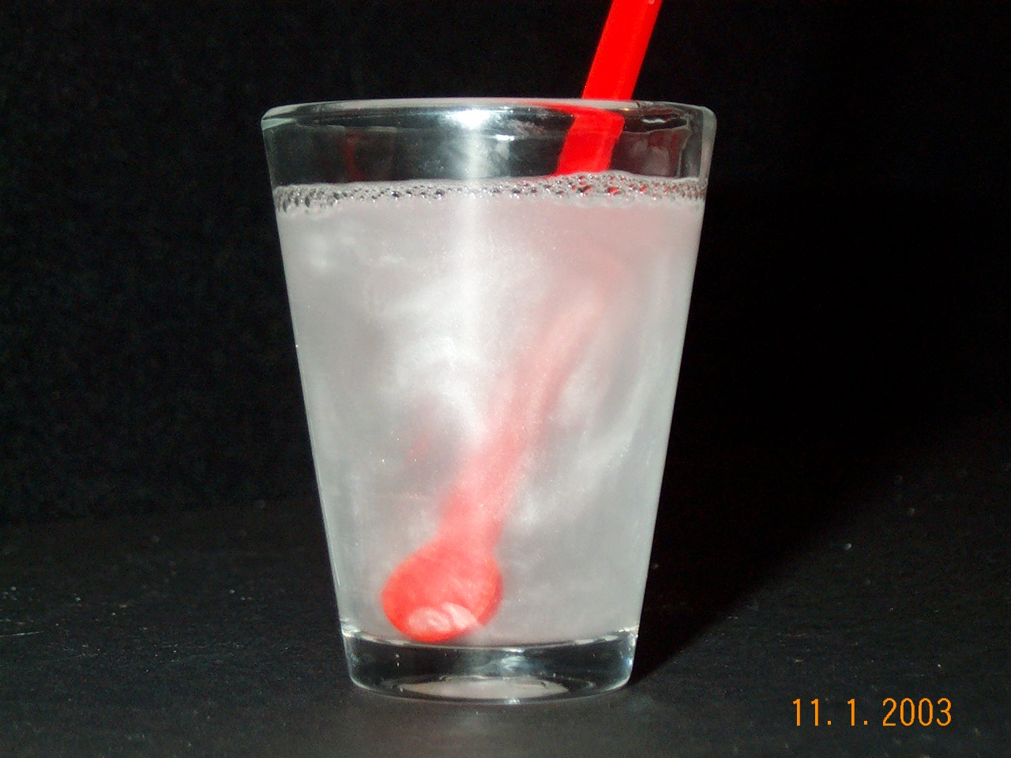
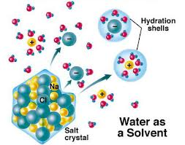
Dissolving
When you dissolve salt in water it may appear that the salt disappears but in fact the particles of salt are spreading out in the liquid.
The composition of the salt always stays the same. This is why the water will taste salty.

Slide 5
Vocab Check
Solvent – in this case the water that you are dissolving the salt into is the solvent.
Solute – the salt you are dissolving in the water is the solute
Solution – the
combination of a solvent
and a solute

Slide 6
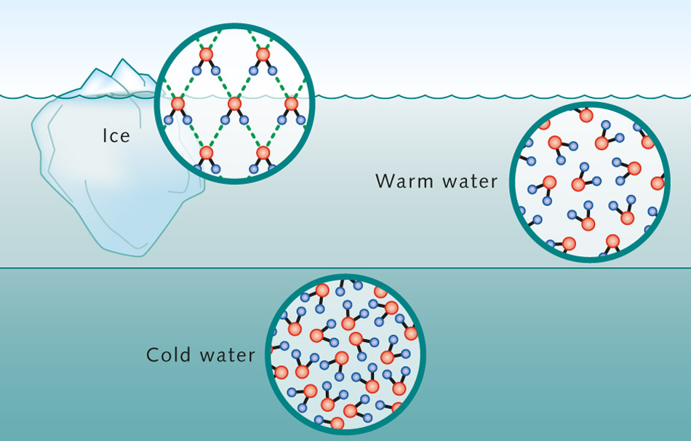
Changing State
Another physical change occurs when matter changes from one state to another.
If we were to add thermal energy to solid ice, the ice would melt and become liquid, the liquid would go through the process of vaporization and become a gas.

Slide 7
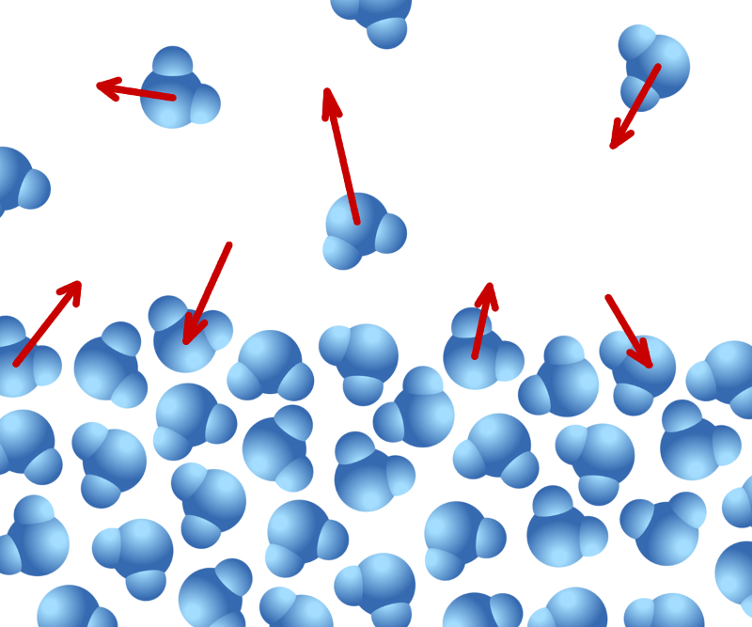
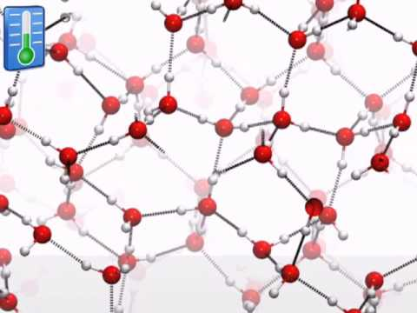
Changing State
The water vapor could go through the process of condensation and become a liquid again. Finally it could freeze and become a solid once more.

Slide 8
Changing State
Sublimation - When a solid becomes a gas without first being a liquid.
Deposition – When a gas changes directly into a solid without first being a liquid.
Question: What would deposition look like?

Slide 9
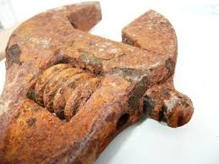
Chemical Changes
During a chemical change substances are changed in to different substances.
The composition of the substances changes.
For example when you leave an iron object out side it combines with water and oxygen to form rust.
2Fe + 2 H₂O + O₂
Fe₂O₃

Slide 10
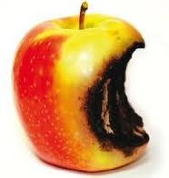
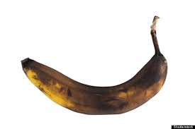
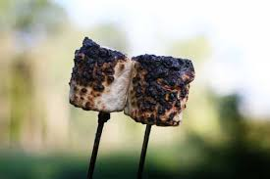
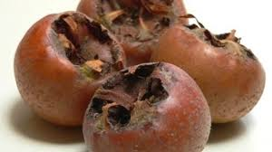
Signs of Chemical Changes

Slide 11
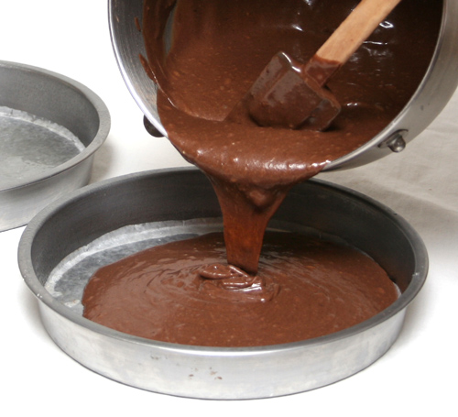
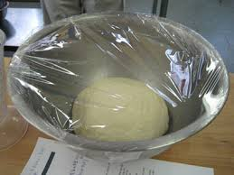
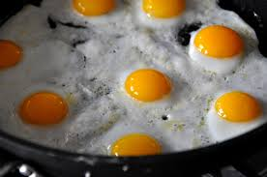
Energy
Substances must release or gain energy in order to undergo a chemical change.

Slide 12
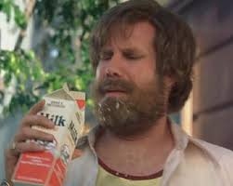
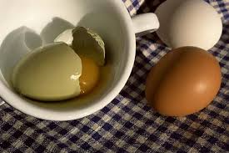
Odor
Often odor is a clue to chemical change
For example people will smell milk to see if it has gone off.
The fact that certain chemical reactions release an odor can save lives.

Slide 13
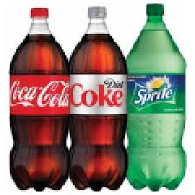
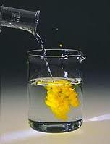
Gases or Solids
Often a gas is a clue to a chemical change.
For example there is CO₂ in a bottle of soda. This is released when the cap is opened.
A solid can form from a solution during a chemical change. This is known as a precipitate.
When sodium iodide solution is added to lead nitrate solution, a solid forms.

Slide 14
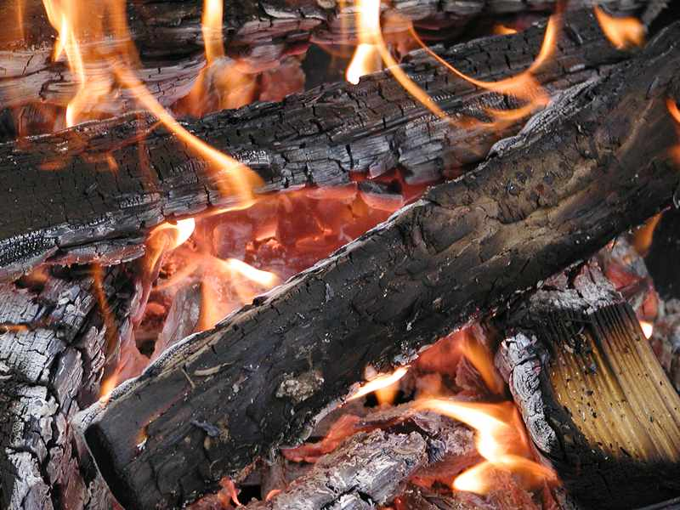
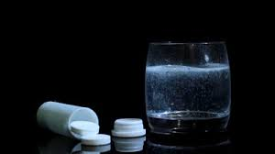
Not Easily Reversed
Often the substances changed during a chemical reaction cannot be easily changed back into the original substances.

Slide 15
Chemical vs Physical Change
In a physical change the composition of a substance does not change.
In other words only its appearance changes
In a chemical change the composition does change.
Both its form and its composition change.
Instead different substances are produced that have different chemical properties.

Slide 17
Conservation of Mass
During a chemical change the particles within the matter may rearrange to form new substances.
The number and type of particles remains the same.
Matter is never created of destroyed
This is known as the law of conservation of mass

Slide 18
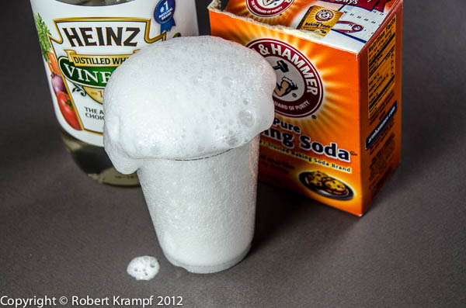
Conservation of Mass
Vinegar (HCH₃COO)
Carbon Dioxide, Water, Sodium ion, and a Acetate ion
Baking Soda (NaHCO₃)
NaHCO₃(s) + CH₃COOH(l) → CO₂(g) + H₂O(l) + Na⁺(aq) + CH₃COO⁻(aq)

Slide 19
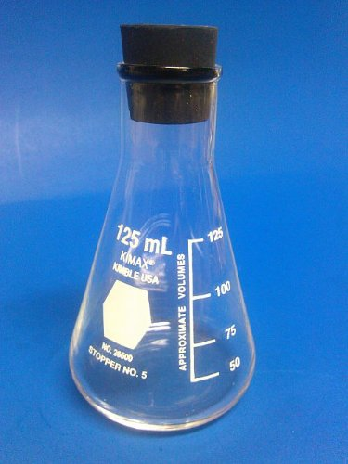
What would happen to the mass if there was no stopper?
Open system
Closed system

Slide 20
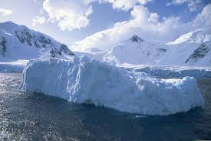
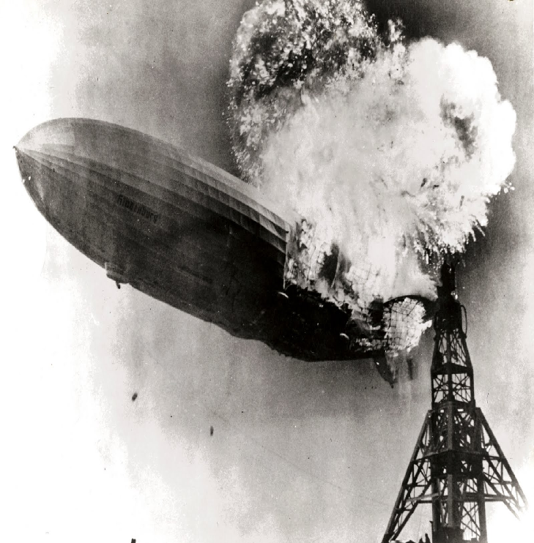
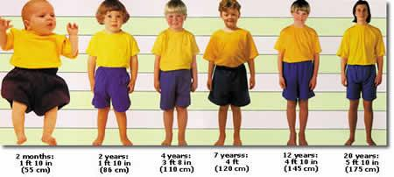
Account For The Changes in Mass

Slide 21
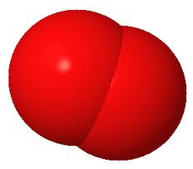
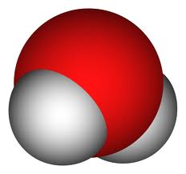
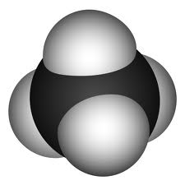
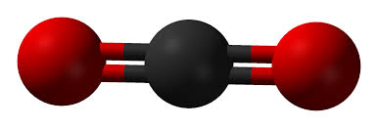
Describing Reactions
You can describe the reaction between methane and oxygen in many ways.
Word equations
Methane and oxygen yield carbon dioxide and water
Molecular models
Chemical equation
CH₄ + O₂ CO₂ + H₂0
+
+

Slide 22
Chemical Equations
We can represent chemical reaction in a shorthand system known as chemical formula.
A chemical formula tells us that a chemical reaction has occurred and that new substances have been formed.
Chemical formulas use an arrow to represent the chemical reaction.

Slide 23
Chemical equations show products and reactants
The reactants are shown on the left-hand side and the products are shown on the right. Note that the law of conservation of matter is always in effect – this is known as a balanced equation.
The arrow means “yield” or “give”.
Chemical equation:
CH₄ + O₂ CO₂ + H₂0
Reactants yield products
subscript
Coefficients

Slide 24
Understanding Chemical Equations
2H₂ + O₂ 2H₂O
Reactants
Products
Yields
Coefficient
Subscript

Slide 25
__ CO₂ + __ H₂O __C₆H₁₂O₆ + __O₂

