Slide 1
Acids and Bases
Chapter 18

Slide 2
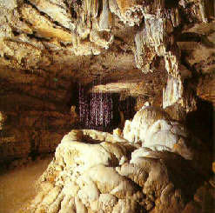
Properties of Acids
Taste Sour (Ex. Carbonic acid in soda)
Conductor of electricity
Turns blue litmus paper red
Corrosive to metals (zinc & magnesium labs)
Causes limestone erosion in caves

Slide 3
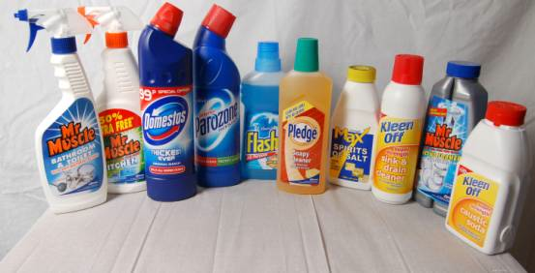
Properties of Bases
Taste bitter
Feel slippery (soap)
Conductor of electricity
Turns red litmus paper blue
Is the active ingredient in cleaning products

Slide 4
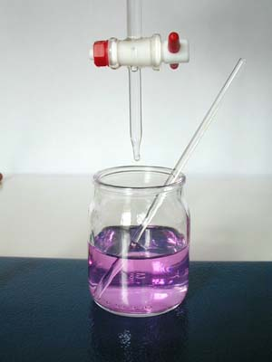
Chemical Solutions
An acidic solution contains more hydrogen ions (H⁺) than hydroxide ions (OH⁻) in a water solution
A basic solution contains more hydroxide ions than hydrogen ions
A neutral solution contains equal concentrations of both

Slide 5
Arrhenius Model
States that an acid is a substance that contains hydrogen and ionizes to produce hydrogen ions in aqueous solutions.
HCl_{(g)} → H⁺_{(aq)} + Cl⁻_{(aq)}
States that a base is a substance that contains a hydroxide group and dissociates to produce a hydroxide ion in aqueous solutions.
NaOH_{(s)} → Na⁺_{(aq)} + OH⁻_{(aq)}

Slide 6
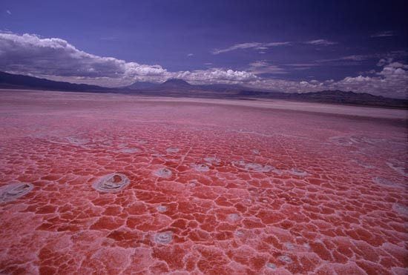
Arrhenius Model
There is a problem with the model
Ammonia (NH₃) and Sodium Carbonate (Na₂CO₃) are both well-known bases and produce OH⁻ ions, but neither contains a hydroxide group.
Lake Natron in Africa is naturally basic. Erosion of volcanic rocks carries sodium carbonate into the lake and evaporation causes the base to become concentrated and leave a white crust

Slide 7
Brønsted-Lowry Model
An acid is a hydrogen ion donor and a base is a hydrogen ion acceptor.
HX_{(aq)} + H₂O_{(l)} ←→ H₃O⁺_{(aq)} + X⁻_{(aq)}
A conjugate acid is the acid formed when a base accepts a hydrogen ion.
A conjugate base is the base formed when an acid donates a hydrogen ion
A conjugate acid-base pair consists of two substances related to each other by donating and accepting of a single hydrogen ion.

Slide 8
The pH scale
The pH level of a solution indicates the amount of H⁺ ions present within the solution.
pH = -log [H⁺]
The more H⁺ ions, the stronger the acid due to a complete ionization of the chemical
The pOH level of a solution indicates the amount of OH- ions present within the solution.
pOH = -log [OH⁻]
The more OH⁻ ions, the stronger the base due to a complete dissociation of the chemical into metal ions and OH⁻ ions

Slide 9
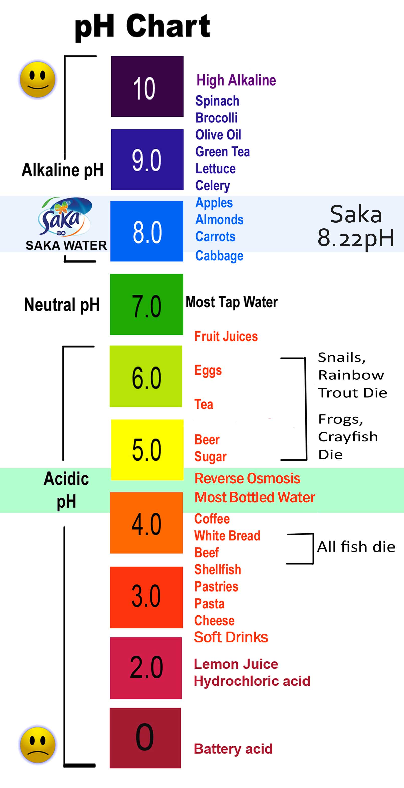
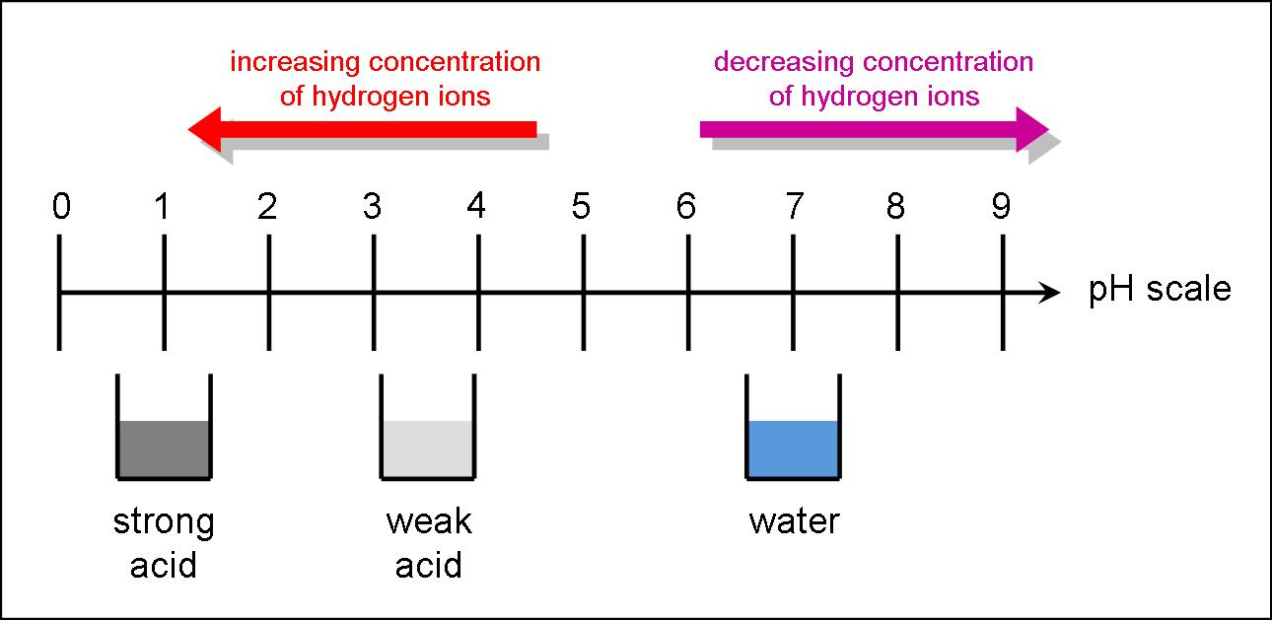
The pH scale
The higher the pH level, the lower the pH number, the stronger the acid.
The lower the pH level, the higher the pH number, the stronger the base.

Slide 10
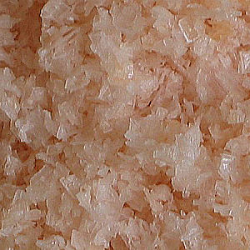
Acid and Base Titration
When an acid and a base are combined to form a salt and water, the reaction is considered a neutralizing reaction.
A salt is an ionic compound made up of a cation from a base and an anion from an acid.

Slide 11
Acid and Base Titration
Titration is a method for determining the concentration of a solution by reacting a known volume of that solution with a solution of known concentration.
The known concentration solution is called the titrant.
This process of adding acid and base continues until the equivalence point when the number of moles of H⁺ and OH⁻ are the same.

