Slide 1
Cell Growth and Division
Section 10.1

Slide 2
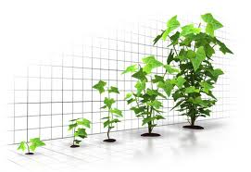
Cell Growth
When an organism grows does it get bigger because its cells divide and become more numerous or because each cell gets bigger?

Slide 3
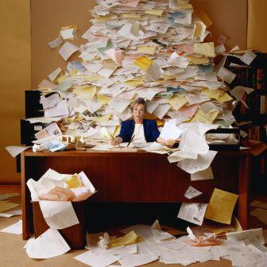
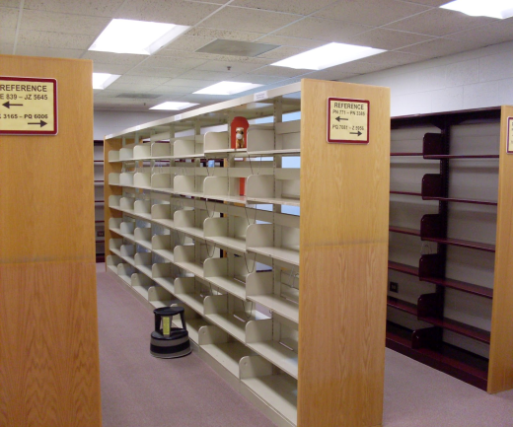
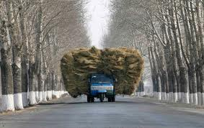
Limits to Cell Growth
The larger a cell becomes the more demands it places upon its DNA.
In addition the cell has trouble moving more and more nutrients and wastes across its cell membrane.

Slide 4
DNA “Overload”
When a cell is small its DNA is able to meet all of its needs. As it grows more and more demand is placed on its DNA.
If the cell were to grow without limit an “information” crisis would occur.
Think of a town library. As the town grows there are more people who want to borrow books. At some point if there are too many people there will not be enough books to go round.
DNA is like a genetic library.

Slide 5
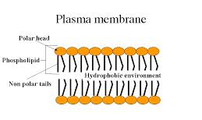
Exchanging Materials
Food, oxygen and water enter a cell and waste leaves through its cell membrane.
The rate at which this can take place depends on a cells surface area (or the total area of its cell membrane).
The rate at which food and oxygen are used up and waste products are produced depends on a cells volume.

Slide 6
Ratio of Surface Area to Volume
A square cube with a length of 1 cm would have a surface area of length x width x number of sides or;
1 cm x 1 cm x 6 = 6 cm²
The volume would be equal to length x width x height or;
1 cm x 1 cm x 1 cm = 1 cm³
or 6:1 surface area to volume ratio

Slide 7
Ratio of Surface Area to Volume
As the length of the cell increases;
Doubles:
2 cm x 2 cm x 6 cm = 24 cm² SA
2 cm x 2 cm x 2cm = 8 cm³ VOL
or 3:1 surface area to volume ratio
Triples:
3 cm x 3 cm x 6 cm = 54 cm²
3 cm x 3 cm x 3 cm = 27 cm³
or 2:1 surface area to volume ratio
The volume increases much more rapidly than the surface area causing the ratio of surface area to volume to decrease.

Slide 8
Surface Area to Volume Ratio

Slide 9
Division of the Cell
Before it gets too big the cell will divide, creating two daughter cells.
This process is called cell division
Before a cell divides it will create a copy of its DNA. This solves the problem of “information overload”
By dividing it also solves the problem of volume to surface area ratio as each daughter cell will have an increased surface area to volume, allowing efficient exchange of materials.

Slide 10
Cellular Division - Mitosis

