Slide 1
Cell Structure
Section 7.2

Slide 2
The Cell as a Factory
In order to better understand the cell we will compare it to a factory.
A factory needs walls and an entrance way to keep things out and let things in.
It needs a main office to run things and tell the workers what to do.
It needs a source of power to run machinery and workers to keep it tidy and operating effectively.
Above all else a factory needs to produce products.
Cells fulfill all these tasks…

Slide 3
The Cell as a Factory

Slide 4
Cellular Boundaries
All cells are surrounded by a cell membrane
The cell membrane protects the cell and controls what enters or leaves it
The structure of the cell membrane is called the fluid mosaic model
The cell membrane is made from a lipid bilayer – a double layered sheet
It is said to be selectively permeable
The membrane is made from phospholipids but has many proteins embedded in it.
Plant cells and some bacteria also have a cell wall

Slide 5
Fluid Mosaic Model
Mosaic - made up of a number of different things
Fluid – all of the components are moving
Although we always look at static diagrams of cell membranes they are always a dynamic moving structure. If they weren't nothing would be able to pass through
Cholesterol plays an important part in keeping a cell membrane together

Slide 6
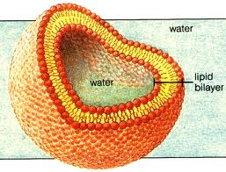
All living things have cell membranes
Phospholipids are said to be amphipathic. This means that they have a part that is hydrophilic (water loving and a part that is hydrophobic (water hating)
These qualities are created by the head being polar and the tail being non-polar
This means that charged particles (such as water) cannot easily pass through the membrane. The double layer creates a “no-fly zone” in the centre of the membrane
The proteins that are embedded in the membrane allow the cell to selectively control many of the larger molecules that go in and out of the cell

Slide 7
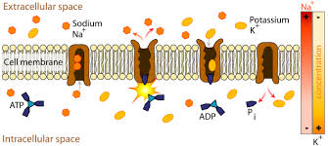
Protein Channels and pumps
Substances that are too big or carry too much of a charge must pass through a protein channel
Other substances that are vital to cell function will be actively transported into the cell via a protein pump
Active transport involves the use of ATP to physically move substances into or out of a cell that otherwise would not enter a cell due to a lack of a concentration gradient.
Other types of proteins embedded in the cell membrane include glycoproteins. These play a very important role in the immune system

Slide 8
Cell Walls
Plants and some bacteria have a cell wall but animals do not
They serve to support, shape and protect the cell
They are located outside the membrane but are porous enough to allow most substances through
In plants the cell wall also allows the plant to store more water without lysing (bursting). This adds to the stiffness and rigidity of stems
Cell walls are made from cellulose which is indigestible for humans
Some animals have symbiotic relationships with bacteria that will allow them to digest cellulose

Slide 9
Cell Organization
In this section we will primarily be discussing eukaryotic cells
Although eukaryotic cells may appear very complex and chaotic they are in fact extremely organized and structured

Slide 10
Aqueous Nature of Organisms
Cytoplasm – composed of cytosol, a gell like substance that contains all the organelles of a cell.
Interstitial fluid – between the capillary (where the blood is) and the cell (11l in of interstitial fluid in the human body).
Blood – transports oxygen, nutrients, hormones and waste products to and from cells.

Slide 11
Organelles
The many structures within a cell are called organelles
Organelles literally means “little organ”
Organelles are surrounded by a membrane
Some organelles may have been formed when the cell membrane folded in on itself
Some may have been the result of a symbiotic relationship between smaller cells that were engulfed by a bigger cell

Slide 12
Nucleus
The nucleus is like the main office of a factory. It is the area that sends out the instructions to the work force.
The Nucleus is surrounded by a double membrane that is covered in pores. These nuclear pores allow material to enter and leave the nucleus.
The nucleus contains most of the genetic information within the cell in the form of DNA and RNA. These molecules contain important instructions for making proteins and other vital materials
The nucleus contains a small dense region called the nucleolus. This is the site where ribosomes are made. Ribosomes play an important role in protein production.
DNA can be seen in the nucleus in the form of chromatin. Chromatin is DNA wrapped around special protein molecules. We are more used to seeing DNA in the condensed form of chromosomes.

Slide 13
Storage, Clean up, and Support
To function properly a factory will need workers and machines that can store goods, and clean up mess
In additon a factory will need steel supports to hold the roof up and paths or corridors for workers to move through

Slide 14
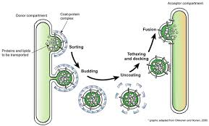
Vacuoles and Vesicles
Vacuoles – store materials such as water, salts and carbohydrates
Vacuoles also serve a another purpose in some organisms. Paramecium for example have a contractile vacuole that actively pumps out excess water.
Vesicles – store and move materials between organelles or to the surface of the cell

Slide 15
lysosomes
Lysosomes – are another membrane bound organelle that contain enzymes
The lysosomes break down larger molecules into smaller ones that can be used by the cell. They also are involved in breaking down old organelles at the end of their lives

Slide 16
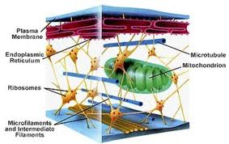
The Cytoskeleton
The cytoskeleton is found in both plant and animal cells.
It is made of protein filaments and functions to give the cell shape and aids in cell movement.
Microtubules – Are the larges fibers and often function in movement as part of a cilia or flagellum. Centrioles which play a part in cell division 9in animals) are also composed of microtubules
Intermediate filaments – help the cell keep its shape
Microfilaments – the smallest type of fiber made from actin and myosin (like in muscles). Function in cell movement (ameboid movement). Microfilaments also pinch the cell apart during cell division

Slide 17
The Cell as a Factory
Any factory has to make an end product. In our analogy this is includes organelles that make proteins and sugars. The end product may need to be packaged or assembled. These activities can be seen within the cell.
Any factory will also need access to power to run the machinery. Organelles within the cell take care of this too.

Slide 18
Mitochondria
Large organelles that are the site of cellular respiration, supplying ATP for energy.
Contain their own DNA and RNA. This suggests that they were once independent organisms that at some point entered into a symbiotic relationship with the larger cell.
Capable of reproduction by binary fission
Most of the mitochondria comes from the mothers side. This is due to the way sperm and eggs combine during inception
Contain smooth outer membrane and a folded inner membrane (cristae). These cristae provide a large surface area for cellular respiration

Slide 19
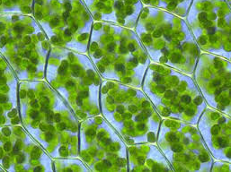
Chloroplasts
Found in plants but not animals
Similar in structure to mitochondria
Also contain their own DNA and RNA which suggests a similar lineage to mitochondria
The sight of photosynthesis
Inner membrane, called the stroma, encloses sacs called thylakoids that contain a photosynthetic pigment called chlorophyll. Chlorophyll traps energy from sunlight to generate ATP.
The generated ATP is then used in the stroma to produce carbohydrates

Slide 20
Ribosomes
The site of protein synthesis
Free floating or attached to the endoplasmic reticulum
Combine with messenger RNA and transfer RNA to produce chains of amino acids called polypeptide chains which then become proteins
composed of two parts a small functional unit and a large functional unit
Ribosomes constitute the actual production line of a factory

Slide 21
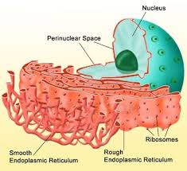
Endoplasmic Reticulum (ER)
A folded membrane that allows transport of materials within and out of the cell
Rough endoplasmic reticulum contains ribosomes which give it its name. After they are produced the polypeptide chains may be folded and/or chemically altered in the rough ER
Proteins made in the rough ER are often destined for use outside the cell or in the cell membrane
Smooth endoplasmic reticulum has no ribosomes attached and so is smooth in appearance.
The lipids found in the cell membrane are made in the smooth ER
The smooth ER also contains many enzymes involved in the detoxifying of drugs. Liver cells often contain large amounts of smooth ER

Slide 22
Golgi Apparatus
Vesicles containing proteins bud off from the rough ER and are given “molecular address tags”
They are transported to the Golgi apparatus where they may be further modified
They are then stored or released outside the cell
This is the final step before the proteins are sent to their final destinations. They constitute the packaging and distribution center of the cell
Proteins leave the cell by exocytosis

