Slide 1
Cellular Respiration and Fermentation
Chapter 9.1

Slide 2
Chemical Energy and Food
We get our energy by breaking the chemical bonds in the food that we eat.
Plants can get energy by making their own foods (autotrophy)
As heterotrophs we get our energy by eating other organisms.
Regardless of where your food comes from we need a method of breaking those bonds and releasing the energy.

Slide 3
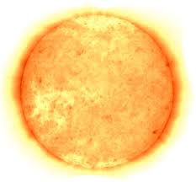
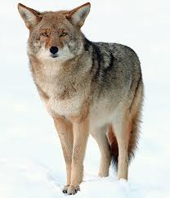
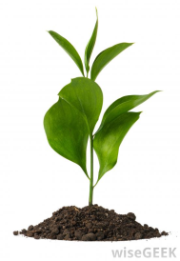
Chemical Energy and Food

Slide 4
Chemical Energy in Food
Energy in food is measured in calories. 1 calorie is the amount of energy it takes to raise 1 gram of water by 1 degree Celsius.
The calories we see on food labels is actually a kilocalorie. 1 kilocalorie is equivalent to 1000 calories.

Slide 5
Carbohydrates and Fats
1 gram of carbohydrate contains approximately 4000 calories (4 kilocalories).
1 gram of fat is approximately 9000 calories (9 kilocalories).
Cells use the energy released from breaking down food to phosphorilate ADP+P to ATP
This involves a gradual controlled breakdown where by little bits of energy are captured at any one time.

Slide 6
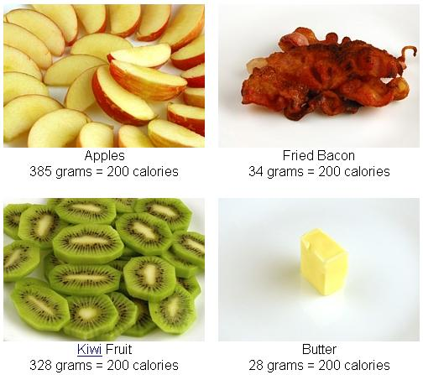
Fats v Carbohydrates

Slide 7
Overview of Cellular Respiration
When oxygen is available organisms can obtain energy from food by a process called cellular respiration.
6O₂ + C₆H₁₂O₆ >>>>>>>>> 6CO₂ + 6H₂O + energy
Oxygen + Glucose >>> Carbon Dioxide + Water + Energy
Note that this is exactly the reverse of photosynthesis.

Slide 8
Photosynthesis and Cellular Respiration

Slide 9
Oxygen, Carbon Dioxide and Photosynthesis
Photosynthesis removes CO₂ from the atmosphere and cellular respiration puts it back.
Photosynthesis releases O₂ into the atmosphere and cellular respiration uses O₂ to release energy from food.

Slide 10
Controlled Release
There is so much energy in a molecule of glucose that if it was all released at one the cell would catch fire!
Therefore our cells need a way to release this energy in a slow and controlled manner.
During cellular respiration the cells of an organism release a little energy and store it in ATP, then they release a little more and so on…

Slide 11
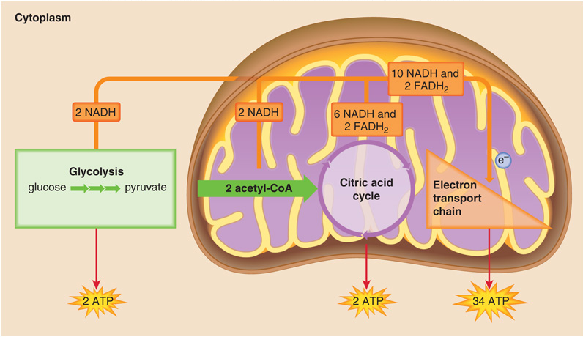
The Stages of Cellular Respiration
H₂O
CO₂

Slide 12
The Stages of Cellular Respiration
Cellular respiration can be split into 3 phases:
Glycolysis (net 2ATP)
The Krebs Cycle (Citric Acid Cycle) (2ATP – 1 per turn)
Electron Transport Chain (ETC) (34 ATP)
So for 1 molecule of glucose 38 ATP molecules are re-phosphorilated.

Slide 13
Oxygen and Energy
The final step of the breakdown of glucose, the ETC, requires oxygen.
This is why as we start to exercise our demand for oxygen increases.
2 of the 3 pathways in cellular respiration require oxygen (Krebs Cycle and ETC).
The pathways that require oxygen are said to be aerobic (“in air”) and glycolysis is said to be anaerobic (“without air”).

Slide 14
Why Do We Need Oxygen?
The energy in glucose is found in the hydrogen bonds.
Cells use oxygen to bind with the electrons of hydrogen and the resulting energy is used to turn ADP+P to ATP.
The is a huge amount of energy to be found in the pull of electrons towards oxygen
H + H + O = H₂O

Slide 15
Fermentation
The Krebs Cycle and the ETC occur in the mitochondria of cells.
Glycolysis occurs in the cytoplasm.
When O2 is not available or cannot be supplied quickly enough another pathway called fermentation makes it possible for the cell to keep producing ATP by keeping glycolysis running.

Slide 16
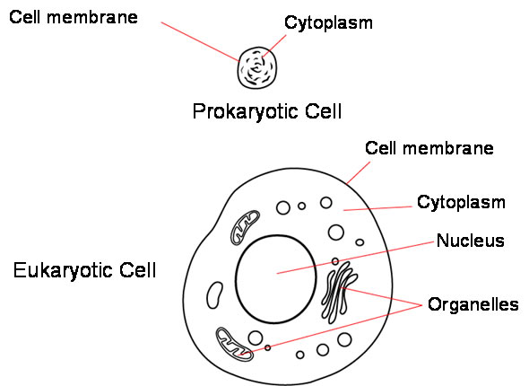
Cell Complexity
What relationship do you think a cells ability to utilize aerobic pathways have on its complexity and general development?

Slide 17
Websites
http://www.youtube.com/watch?v=Gh2P5CmCC0M
http://www.youtube.com/watch?v=5GMLIMIVUvo
http://www.youtube.com/watch?v=4S6X7qaLjvk
More complex:
http://www.youtube.com/watch?v=aA8d-tt6dII
http://www.youtube.com/watch?v=j7gPtASv0SQ

