Slide 1
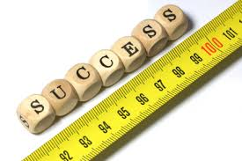
Measurement
Chapter 2 Section 1

Slide 2
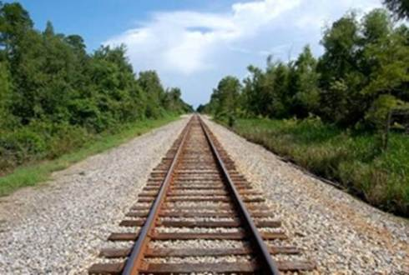
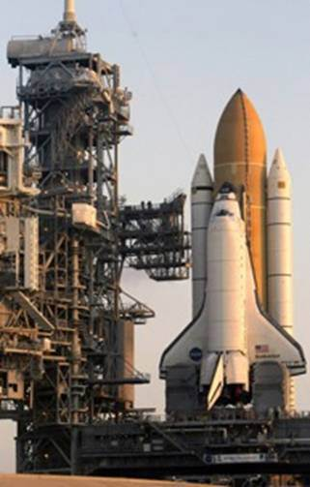
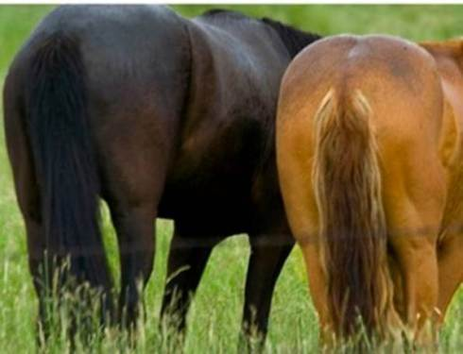
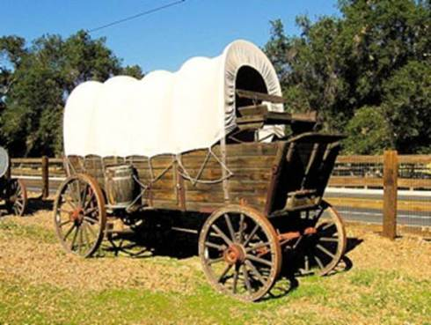
Standard measurement System
The universal system of measurement is the metric system.
The metric system is based around the number 10.
Modern scientists use a version of the metric system called the International System of Units (SI – Système International d’Unites)

Slide 3
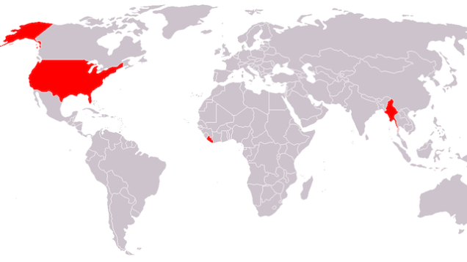
Burma
Liberia

Slide 4
Common SI Prefixes
Prefix | Symbol | Meaning
Kilo- | K | 1000
Hecto- | h | 100
Deca- | da | 10
Base Unit | e.g. m | Whatever the base unit is
Deci- | d | 0.1 (one tenth)
Centi- | c | 0.01 (one hundredth)
Milli- | m | 0.001 (one thousandth)

Slide 5
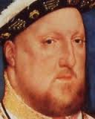
Kin
King Henry Died Unexpectedly Drinking Chocolate Milk
Kilo
1000
Hecto
100
Deca
10
Unit
e.g. m
Deci
0.1
centi
0.01
Milli
0.001
Divide to get smaller
Multiply to get bigger

Slide 6
Basic S.I. Units
The Metric System

Slide 7
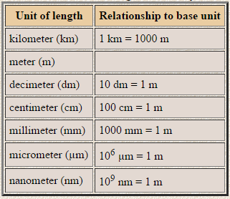
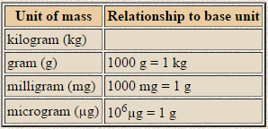
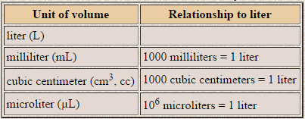
Other Units of Length
Other Units of Mass
Other Units of Volume
1000 µm in a mm
1 000 000 µm in a m
1,000,000 nm in a mm
1,000,000,000 nm in a m

Slide 8
A quick way to remember
K h d u d c m
g
L
m
Kilo-
hecto-
deca-
deci-
centi-
milli-

Slide 9
Length
The basic unit of length in the SI system is the meter (m).
- I am 1.78 m tall
Objects smaller than a meter are typically measured in centimeters (cm)
I am 178 cm tall
Objects smaller than this are measured in millimeters (mm)
- I am 1780 mm tall

Slide 10
Mass
Mass is a measure of the amount of matter an object contains.
The basic unit of mass in the SI system is the kilogram (kg).
- A wooden baseball bat has a mass of about 1kg
Smaller of objects are measured in grams (g).
- There are 1000g in one kg.
Even smaller objects are measured in milligrams (mg).

Slide 11
Measuring Mass
To measure an objects mass you first need to place it on the pan and then shift the riders until they balance the mass of the object.
In this way you are comparing the mass of an object to a known mass.
Triple Beam Balance

Slide 12
Mass vs Weight
Weight and mass are often confused but they are not the same thing.
Weight is the measure of the force of gravity acting on an object.
You can find your weight be standing on a scale. Gravity pulls you down and compresses the springs. The greater your mass the more the springs will compress.

Slide 13
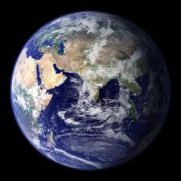
Mass v Weight – How does your weight compare?
What about your mass?

Slide 14
Weight
The SI unit for weight is actually the Newton (N).
Weight = Mass x Gravity (w=mg)
The force of Gravity is approximately 10m/s² so 1kg of mass has a weight of about 10N
The exact value of 1 kg is actually 9.81N

Slide 15
Volume
Volume is the amount of space an object takes up.
Scientists use liters (L) to measure the amount of volume of a liquid.
Smaller volumes are measured using milliliters (mL).
Volume is always measured from the bottom of the meniscus.

Slide 16
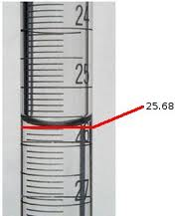
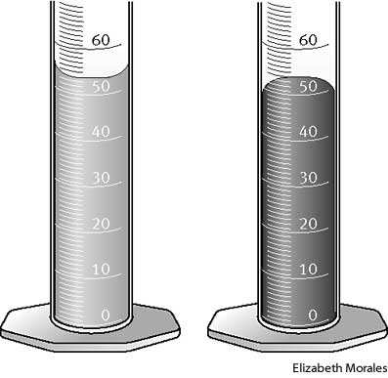
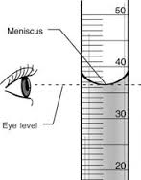
Bottom of the Meniscus
Concave
Convex

Slide 17
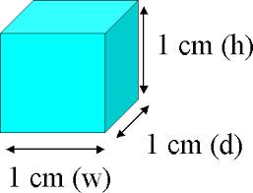
Volume of Rectangular Solids
To measure the volume of a solid object we use the cubic centimeter (cm³)
A cubic centimeter is a cube that measures 1 cm on all sides.
For solids with large volumes scientists use the SI unit of a cubic meter (m³).
The formula for volume of a rectangular shape is
Volume = Length x Width x Height

Slide 18
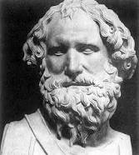
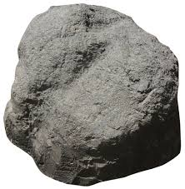
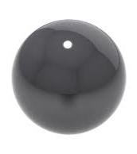
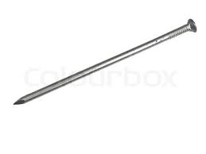
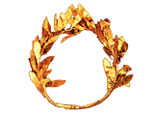
Volume of Irregular Solids
Archimedes and King Hiero’s crown
How do you measure the following objects?

Slide 19
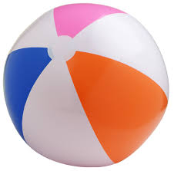
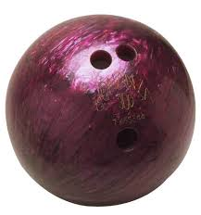
Density
Which object has the biggest volume?
Which object has the biggest mass?
Density is a measurement of how much mass an object contains in a given volume.
Density = $\frac{Mass}{Volume}$

Slide 20
Units of Density
As density is made up of two measurements (mass and volume) an objects density is expressed as a combination of two units.
Two common units of density are grams per cubic centimeter (g/cm³) and grams per milliliter (g/mL).
The numerator is a measurement of mass and the denominator is a measurement of volume.

Slide 21
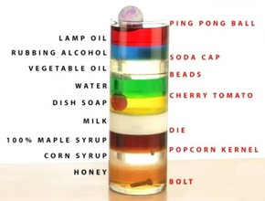
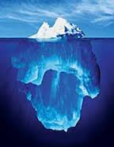
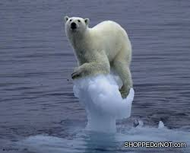
Densities of Common Substances

Slide 22
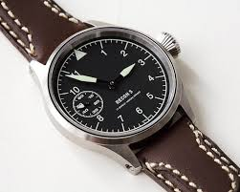
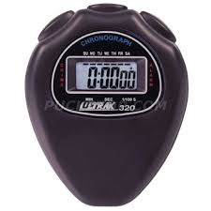
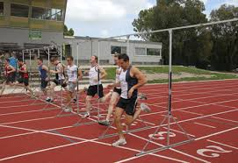
Time
The second is the SI unit used to measure time.
A millisecond is one-thousandth of a second
Longer periods of time are expressed in minutes and hours.

Slide 23
Temperature
Scientists commonly use the Celsius scale to measure temperature
Water boils at 100ºC and freezes at 0ºC
Scientists also use the Kelvin scale. The Kelvin scale is actually the official SI unit for temperature.
The kelvin scale is useful because it does not contain negative numbers.

Slide 24
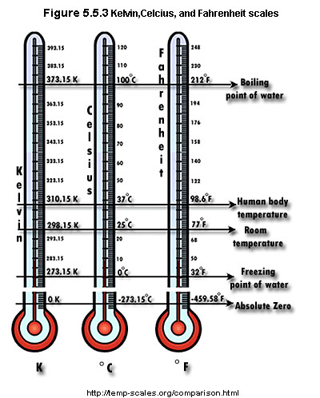
Kelvin, Celsius, and Fahrenheit Conversions

Slide 25
Converting Between Units
To convert from one measurement to another you need to know the appropriate conversion factor.
A conversion factor is the equation that shows how two units of measurement are related.

Slide 26
Conversions – multiply or divide by 10
K | h | d | U | d | c | m
1 Km | 0.1 hm | 0.01 dam | 0.001m | 0.0001 dm | 0.00001 | 0.000001 mm
56.3 cm in mm = ___________________
3.568 mL in L = ____________________
673.1 g in Kg = _____________________
0.673m in cm = ____________________
56.3 cm = 563mm
3.568 mL = .3568 L
673.1 g = .6731 Kg
0.673m = 67.3 cm

Slide 27
1.5 km = ____ m
1 km = 1000m
$\frac{1000m}{1km}$
1.5km x $\frac{1000m}{1km}$ = 1500
1.5km x $\frac{1000m}{1km}$ = 1500
1.5km = 1500m

Slide 28
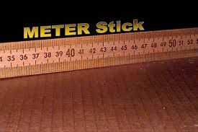
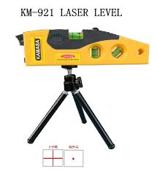
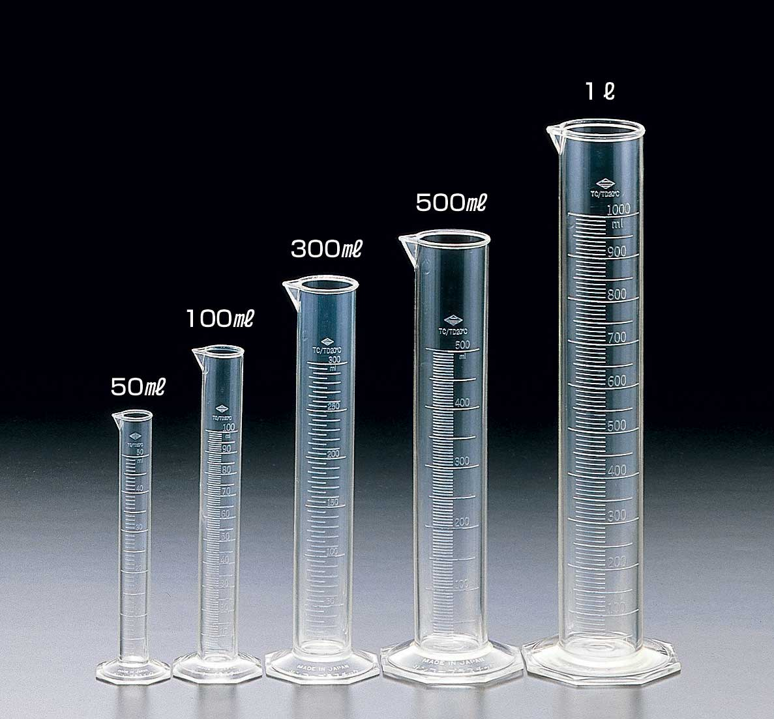
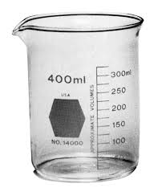
What tool to use?

Slide 29
Learning Standards
You need to be able to differentiate between weight and mass.
Recognize that weight is the amount of gravitational pull on an object.
Mass is the amount of matter in an object.

