Slide 1
Graphs in Science
Chapter 2 Section 3

Slide 2
The Importance of Graphs
Because of their visual nature graphs can reveal patterns that data and words alone cannot.
The 3 types of graph commonly used by scientists are bar graphs, circle graphs, and line graphs.

Slide 3
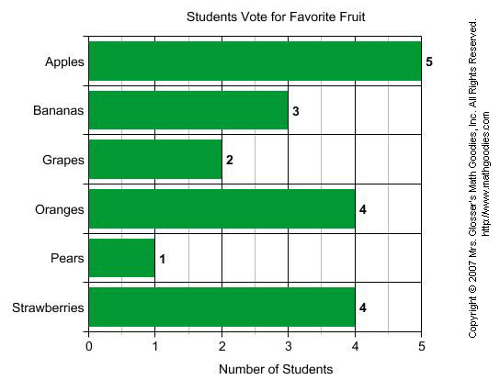
Bar Graphs
We can use bar graphs to show the relative sizes of many things, such as what type of car people have, how many customers a shop has on different days and so on.

Slide 4
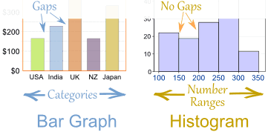
Bar Graphs vs Histograms
Bar Graphs are good when your data is in categories.
But when you have continuous data (such as a person's height) then use a Histogram.
It is best to leave gaps between the bars of a Bar Graph, so it doesn't look like a Histogram.

Slide 5
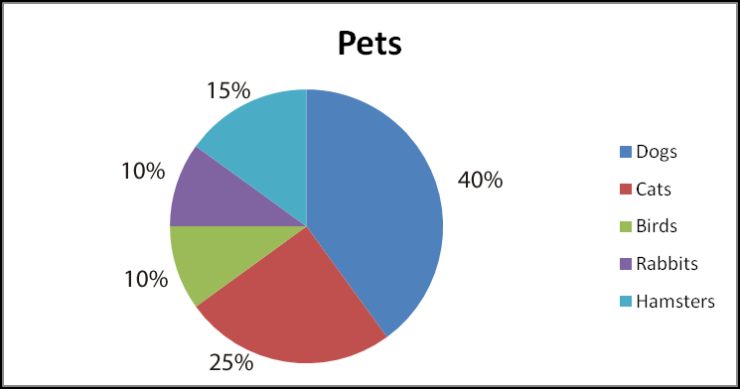
Circle Graphs or Pie Charts
Circle graphs or pie charts are a really good way to show relative sizes.
We can easily see which data is more common or how results are distributed.

Slide 6
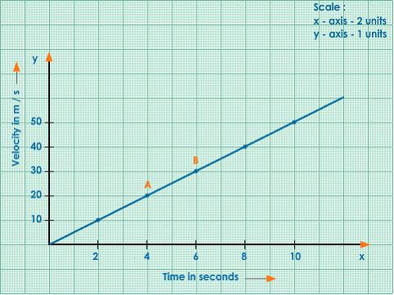
Line Graphs
Line Graph - A graph that shows information that is connected in some way (such. as change over time).
Speed vs Time
Y- axis
Y- axis title
origin
X- axis

Slide 7
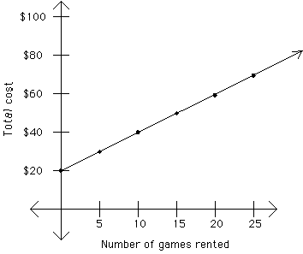
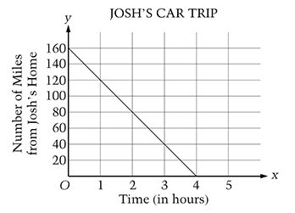
Line Graphs
Positive relationships
Line graphs are used to display data to show how one variable (the responding variable, or dependent variable) changes in responds to another variable (the manipulated or independent variable).
They are very common in science.
Negative Relationships

Slide 8
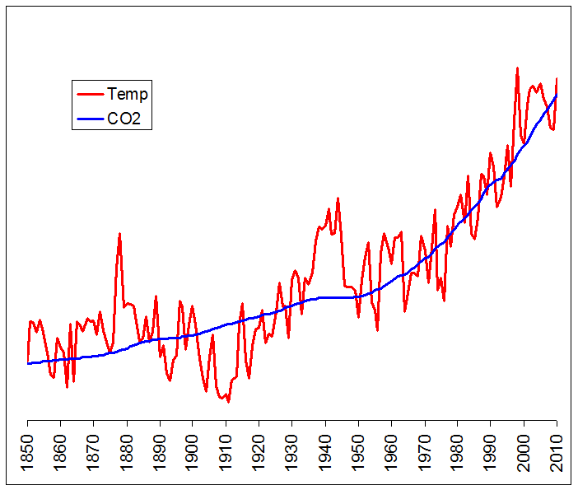
Temperature changes in response to increased carbon in the atmosphere.
What does this graph tell you about climate change?

Slide 9
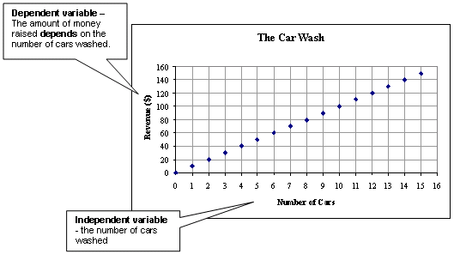

Slide 10
Plotting a Line Graph
When should we use a line graph?
When your manipulated variable (dependent variable) is continuous
1. Draw the axes
2. Label the axes
3. Create a scale
4. Plot the data
5. Draw a “line of best fit”
6. Add a title that identifies the variable or relationship shown in the graph

Slide 11
Plotting a Line Graph
Boiling times for different volumes of water
60
50
40
Boiling Time (min)
30
20
10
0
1000
1500
2000
2500
0
500
Volume of Water

