Slide 1
Thinking Like a Scientist
Chapter 1 Section 1

Slide 2
Thinking Like a Scientist
Scientists use skills like observing, inferring, predicting and classifying to learn more about the world.

Slide 3
Observing: Using one or more of your senses to gather information

Slide 4
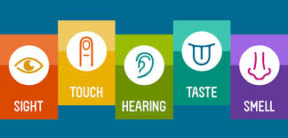
Qualitative Observations
Descriptive details about an observation. May include details about color shape, taste, feel or other subjective measures.

Slide 5
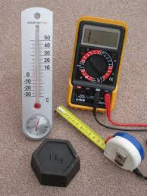
Quantitative Observations
Details about an observation that quantify the observation using numbers. For example; measurement, quantity, density.

Slide 6
Quantitative vs Qualitative

Slide 7
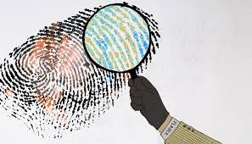
Inferring: explaining or interpreting things you observe
Inferring is like being a detective. Using what you see and what you know to understand the world.

Slide 8
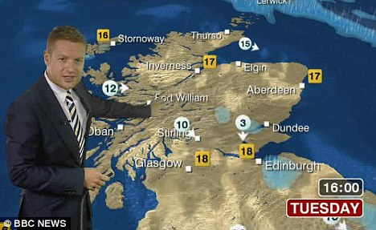
Predicting: making a forecast of what will happen in the future, based on past experience or evidence.
What is a scientific prediction and what isn’t?

Slide 9
Prediction vs Inference
Prediction and inference are similar.
A prediction is a forecast of what will happen
An inference is an explanation of what has happened.

Slide 10
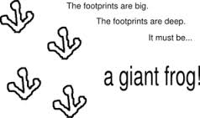
Inferences
An inference is when you use clues from data and experiments to explain a phenomenon

Slide 11
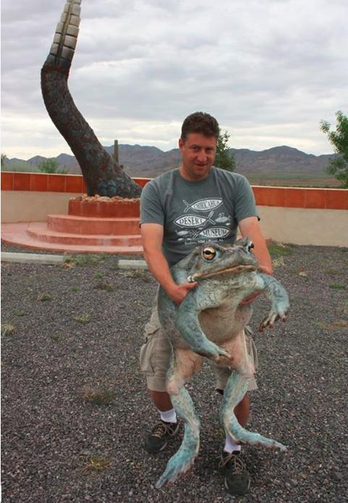
Prediction
A prediction is a forecast of what will happen.
Based on the size of its feet we predict that the giant frog will move at 3 m/s. This will be 1 m/s faster than the non-giant variety.

Slide 12
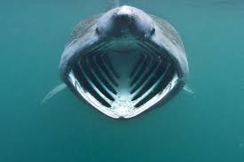
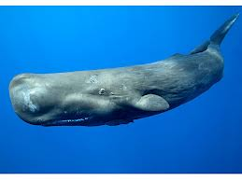
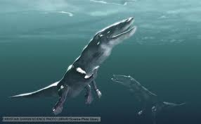
Classifying: the process of grouping together items that are alike in some way.

Slide 13
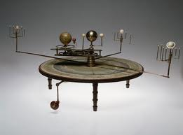
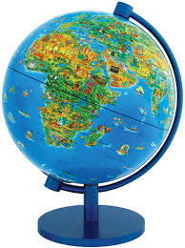
Making Models: involves creating representations of complex processes or objects

Slide 14
Scientific Attitudes: successful scientists possess certain attitudes or habits.
Curiosity
Honesty
Open-Mindedness and Skepticism
Creativity

