Slide 1
Thinking Like a Scientist
Mr. McLean

Slide 2
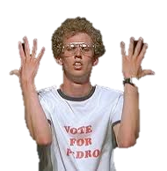
Thinking Like a Scientist
Scientists use skills like;
observing,
inferring,
predicting and
classifying
to learn more about the world.

Slide 3
Observing: Using one or more of your senses to gather information

Slide 4
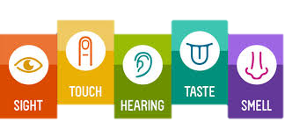
Qualitative Observations
Descriptive details about an observation.
May include details about color shape, taste, feel or other subjective measures.

Slide 5
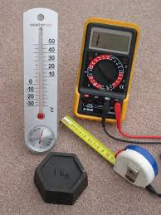
Quantitative Observations
Details about an observation that quantify the observation using numbers.
For example; measurement, quantity, density.

Slide 6
Quantitative vs Qualitative

Slide 7
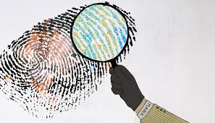
Inferring: explaining or interpreting things you observe
Inferring is like being a detective. Using what you see and what you know to understand the world.

Slide 8
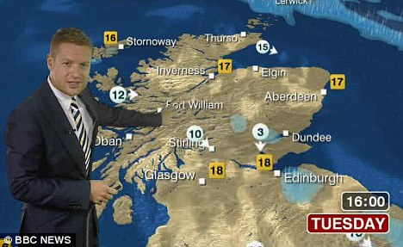
Predicting: making a forecast of what will happen in the future, based on past experience or evidence.
What is a scientific prediction and what isn’t?

Slide 9
Prediction vs Inference
Prediction and inference are similar.
A prediction is a forecast of what will happen
An inference is an explanation of what has happened.

Slide 10
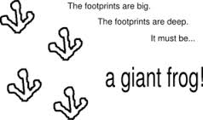
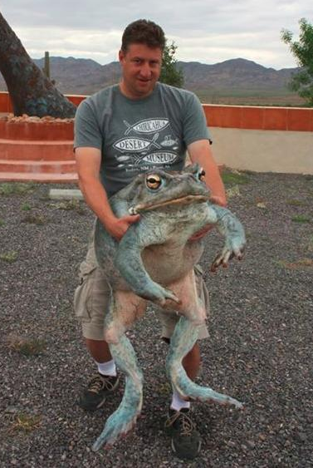
Inferences
An inference is when you use clues from data and experiments to explain a phenomenon

Slide 11
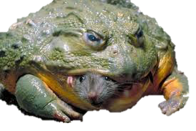
Prediction
A prediction is a forecast of what will happen.
Too many giant frogs will result in a decrease in rodent numbers.

Slide 12
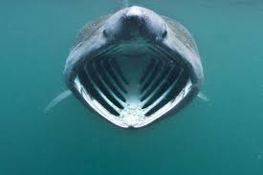
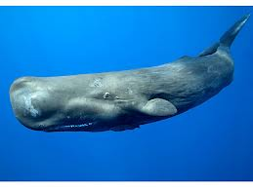
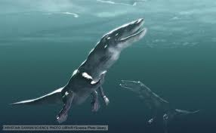
Classifying: the process of grouping together items that are alike in some way.

Slide 13
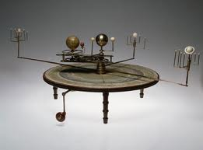
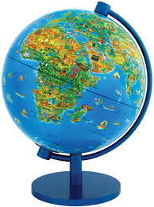
Making Models: involves creating representations of complex processes or objects
Model. (mŏd'l) A systematic description of an object or phenomenon that shares important characteristics with the object or phenomenon.
Scientific models can be material, visual, mathematical, or computational and are often used in the construction of scientific theories

Slide 14
Scientific Attitudes: successful scientists possess certain attitudes or habits.
Curiosity
Honesty
Open-Mindedness and Skepticism
Creativity

