Slide 1
Scientific Inquiry
Mr. McLean

Slide 2
Gullible vs. Skeptical
How do we reach the right amount of skepticism?
Notes:
The cynic refuses to trust.
The skeptic asks questions before trusting.
The gullible trust when there are meaningful reasons not to.
Opening question/attention grabber.

Slide 3
Opening Question
Can I prove that the tooth fairy doesn’t exist?
Warning this next section contains spoilers…..
YOU CAN’T PROVE A NEGATIVE

Slide 4
The Goal of Science
The goal of science is to investigate and understand the natural world.
To explain events in the natural world, and to use those explanations to make useful predictions.

Slide 5
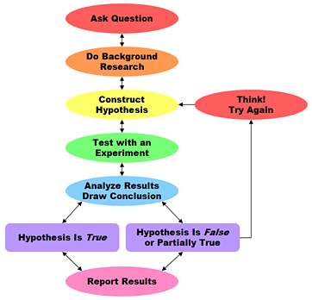
Scientific Inquiry
Observations
Observations
Scientific Inquiry refers to the diverse ways in which scientists study the natural world and propose explanations based on the evidence they gather.
Hypothesis is Accepted
Hypothesis is Rejected
Update Theory
Develop Theory

Slide 6
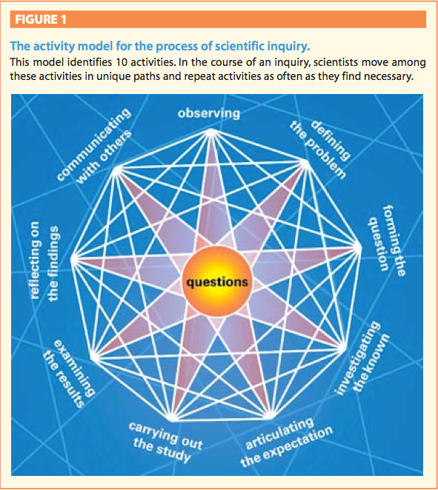
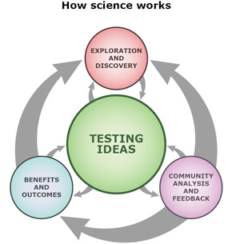

Slide 7
Posing Questions
Scientific inquiry usually begins with a problem or question about an observation.
Questions come from experience, observations and inferences that you make.
Curiosity plays a large role as well.

Slide 8
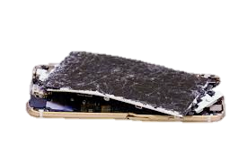
Scientific Questions vs Opinion Questions
Why has my MP3 player stopped working?
What kind of music should I listen to on my iphone?

Slide 9
Developing a Hypothesis
When we try to answer a scientific question we are in fact developing a hypothesis.
A hypothesis is a possible explanation for a set of observations or an answer to a scientific question.
In science a hypothesis must be testable. This means that researchers must be able to carry out investigations and gather evidence that will support (accept) or disprove (reject) the hypothesis.

Slide 10
Designing an Experiment
After you state your hypothesis you need to design an experiment to test it.
To do this you need to control all variables or factors that might change in an experiment.

Slide 11
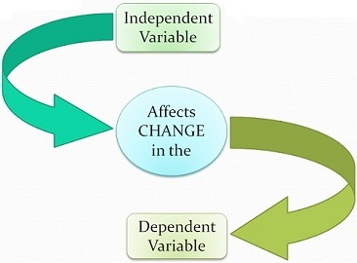
Designing an Experiment
In any experiment one variable will be purposefully changed. This is known as the manipulated variable or independent variable.

Slide 12
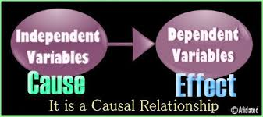
Dependent Variable
The factor that may change in response to the independent variable is known as the responding variable or the dependent variable.

Slide 13
Controlled Variables
Controlled variables are variables that must be kept constant in order to make an accurate comparison and to determine the affect of the independent variable.
Variables that are not properly controlled are known as extraneous variables.

Slide 14
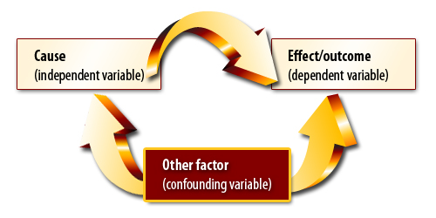
Why Control Variables?
We control experiments so that we know which variable is responsible for certain changes.
This way we can eliminate factors that to not affect the outcome or which may alter the outcome of an experiment in unexpected ways.

Slide 16
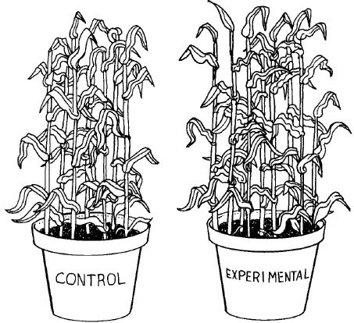
Setting Up a Controlled Experiment.
A controlled experiment is when only one variable (the independent variable) is manipulated at a time.
A control group can help scientists fully identify the effects of the independent variable.

Slide 18
Forming Operational Definitions
An operational definition is a statement that describes how to measure a particular variable or define a particular term.
Sometimes this is easy for example when measuring weight or height.
Other variables need more defining for example counting the “chirps” from a cricket – what constitutes a chirp.

Slide 19
Collecting and Interpreting Data
Organizing data: before you begin experimenting it is important to create a table to collect your data. Data are the facts, figures, and other evidence gathered through your observations.
Graphing your results: We will discuss graphing in more detail later but graphs can help us make sense of data and reveal patterns.

Slide 20
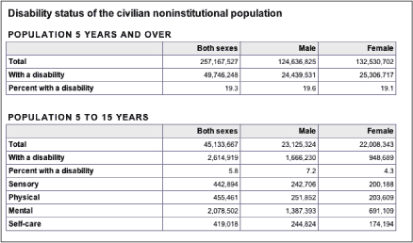
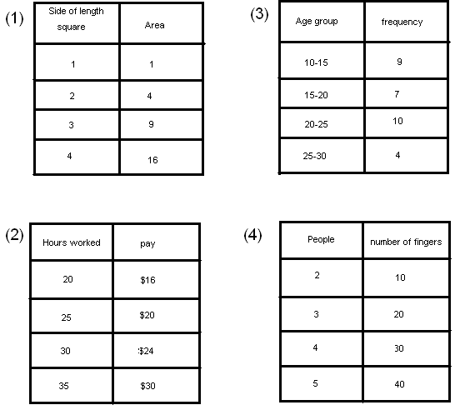
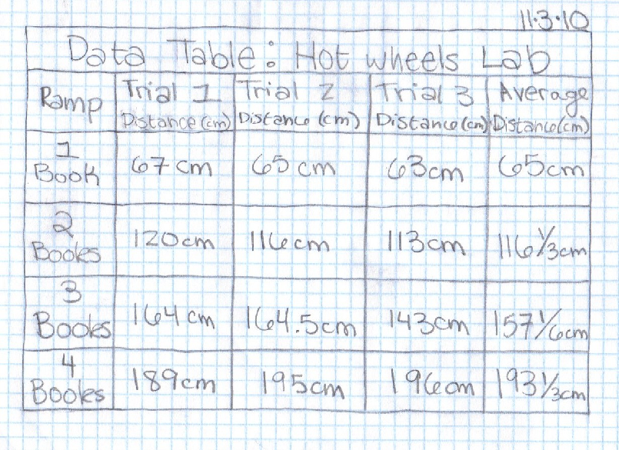

Slide 21
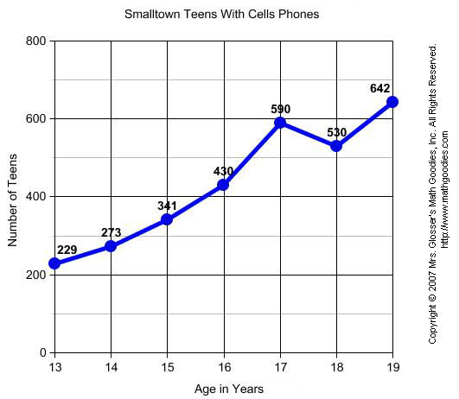
Dependent variable Y axis
Independent variable X axis

Slide 22
Drawing a Conclusions
Once you have gathered and interpreted data you are free to draw conclusions about your hypothesis.
Does the data support your hypothesis?
Did you collect enough data?
Did anything happen that might have affected your results?
These questions should be addressed in your summary which should state whether your hypothesis is accepted or rejected?

Slide 23
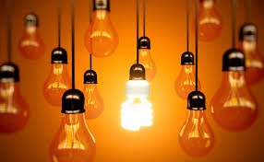
Inquiry leads to Inquiry
Once an experiment is done scientific inquiry usually doesn’t end.
Often scientific enquiry leads to more scientific inquiry
What other variables effect the experiment?
Was the experiment just a fluke?
These questions can lead to new hypotheses and new experiments. Some questions may require different approaches. Scientific inquiry has many paths and is not a rigid set of steps.

Slide 24
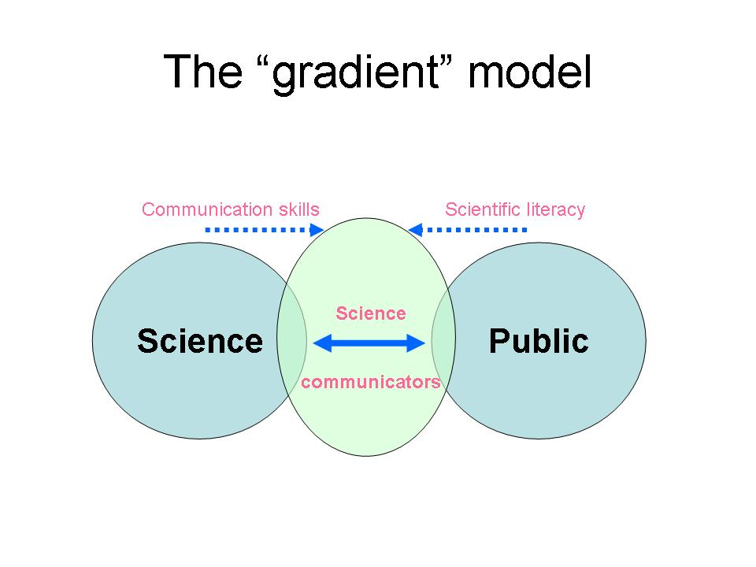
There is a disconnect between scientists and the general public. Scientists are very bad at communicating their ideas and results. This leads to confusion and misconceptions of important concepts.

Slide 25
Communicating
Communicating is the sharing of ideas and experimental findings through writing and speaking.
Scientists share their ideas in many ways:
Scientific talks
Exchange of information on the internet
Published articles in scientific journals.
When scientists communicate their research they describe their procedures in full detail so that others can replicate their experiments.

Slide 26
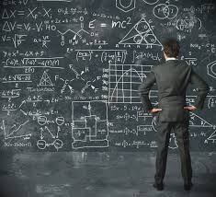
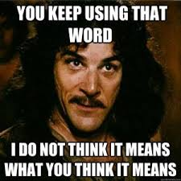
Scientific Theories and Laws
The body of knowledge is built up slowly and cautiously. A hypothesis is not just accepted after one successful experiment. It is repeated many times as other scientists try to apply it to their own work.

Slide 27
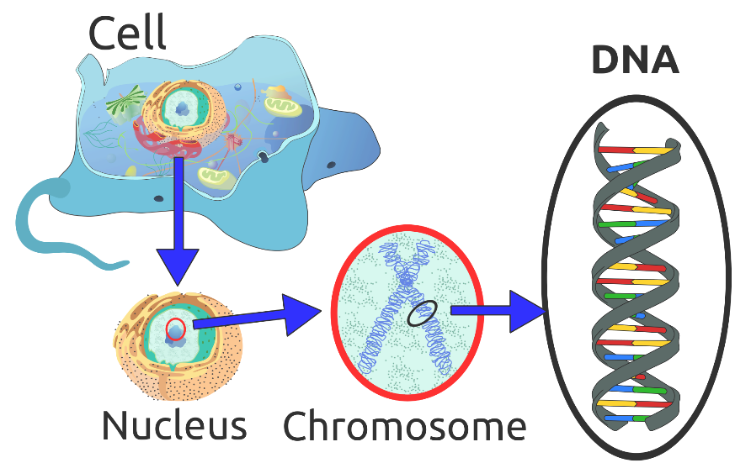
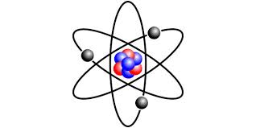
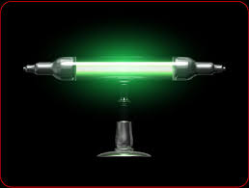
Scientific Theories and Laws
Sometimes a large set of related observations can be connected by a single explanation. This leads to the development of a scientific theory.
A scientific theory is a well-tested explanation for a wide range of observations or experimental results.
Atomic Theory
Evolutionary Theory

Slide 28
What makes a hypothesis or theory?
A theory or even a single hypothesis must be falsifiable
A statement is called falsifiable if it is possible to conceive an observation or an argument which proves the statement in question to be false.
In this sense, falsify is synonymous with nullify, meaning not "to commit fraud" but "show to be false".

Slide 30
Scientific Theories
The Theory of Evolution: all life on earth has evolved from a common ancestor. This draws on scientific knowledge form many areas including the age of the Earth, the fossil record, radioactive carbon dating, anatomy and physiology and DNA technology.
Atomic Theory: all substances are composed of tiny particles called atoms. This theory helps us explain many observations, such as why ice melts at a particular temperature and why nails rust.

Slide 31
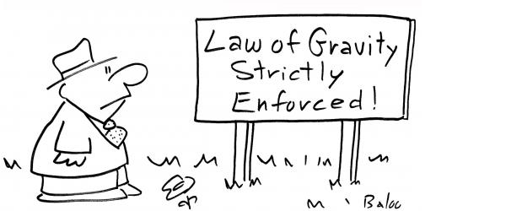
Scientific Laws
When scientists achieve the same results in specific circumstances they arrive at a scientific law.
A scientific law is a statement that describes what scientists expect to happen every time under a particular set of conditions.

Slide 32
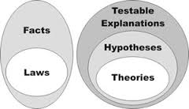
What’s the Difference
Unlike a theory a scientific law describes an observed pattern in nature without attempting to explain it.
For example the law of gravity states that all objects in the universe attract each other.

Slide 33
Theories and Laws
A Theory explains
Evolution explains how life evolved from a single common ancestor through mutations to organisms DNA.
A Law describes
The law of gravity describes how matter is attracted to other matter. It describes the velocity with which objects move together but not why.

Slide 34
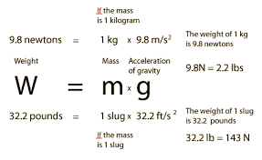
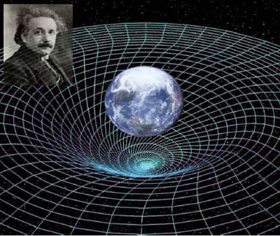
Theory vs Law
A law describes (summarizes) what happens.
A Theory (model) tries to explain why something happens.

Slide 35
Knowledge and Understanding
Do you think it is better to have an experiment that accepts or rejects a hypothesis?
Should it matter to a scientist if their hypothesis is rejected or accepted? Give reasons for your answers.
Scientists can gain as much insight from an experiment with a positive result as they can from a negative result.
If scientists are being truly objective they should not care in what direction a result goes.

Slide 36
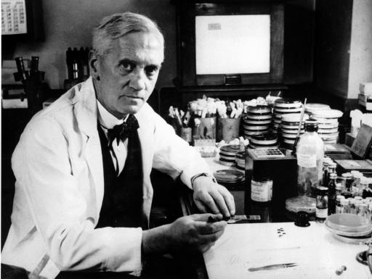
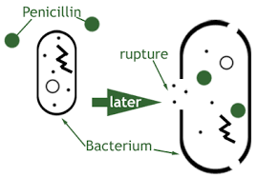
Penicillin
Alexander Flemming

Slide 37
Knowledge and Understanding
Define Observation:
Things you see, hear, touch, or smell using all your senses
Define Inference:
An inference is an attempt to explain observations or experimental results
What must scientists construct before formulating a hypothesis but after making observations?
A question that can produce a quantifiable answer – a testable question

Slide 38
Knowledge and Understanding
How is the term theory used differently in science than in regular conversations?
In science a theory means a concept that is well established and understood. Conversationally we tend to use theory as a way of saying a guess.
What is the difference between a scientific theory and a scientific law?
A scientific theory explains how something works.
A Scientific law describes an observable phenomena.

