Slide 1
Modern Evolutionary Classification
Chapter 18.2

Slide 2
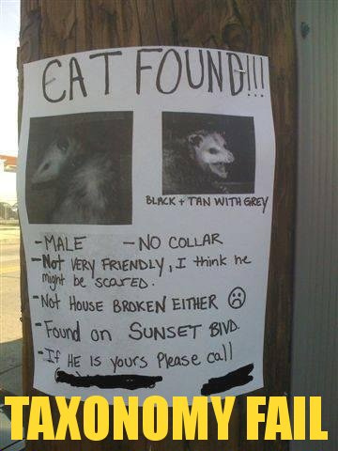
The Problem with the Linnaeus System
Linnaeus classified organisms based on overall similarities and differences – he did this more than a century before Darwin formulated his theory on evolution.
But there were problems. Many organisms were classified in the same family even though they had no real evolutionary relationship.

Slide 3
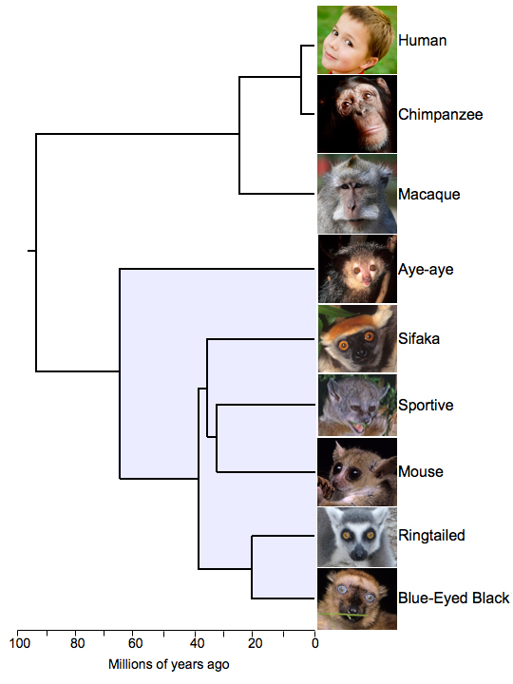
The Problem with the Linnaeus System
Darwin’s ideas suggested a new way of classifying organisms based on their interrelatedness and a ‘tree of life’ idea – how recently they shared a common ancestor.
This lead to the study of phylogeny – the study of how living and extinct organisms are related to one another.

Slide 4
Phylogenic Systematics
This in turn lead to a branch of study called phylogenic systematics.
The goal of phylogenic systematics, or evolutionary classification is to group species into larger categories based on evolutionary descent, rather than overall similarities and differences.
To do this scientists often utilize modern techniques in DNA and RNA to make more accurate measurements of lines of descent.

Slide 5
Common Ancestors.
Phylogenic systematics places organisms into higher taxa whose members are more closely related to one another than they are to members of any other group.
Species in one genus are more closely related to each other than they are to species in another genus.
That is to say they share a more recent common ancestor than species in another genus.

Slide 6
Clades
By classifying organisms in this manner we can place them into groups called clades.
A clade is a group of species that share a single common ancestor and all descendants of that ancestor – living or extinct.
A clade must be monophyletic. A monophyletic group must include all species that are descended from a common ancestor and cannot include any species that are not descended from that ancestor.

Slide 7
Cladograms
A cladogram shows how species are related to one another by showing how evolutionary lines, or lineages, evolved and branched off from common ancestors over time.
To understand cladograms think back to the process of speciation we studied earlier.
The point where the lineage branches is called a fork, or node. Each node represents the last point which the new lineages shared a common ancestor.

Slide 8
Cladograms are tree diagrams that show how different evolutionary lineages branched off over time.
Speciation event
Ancestral lineage
The bottom of the tree represents the ancestors and the descendants are represented by the top of the tree
1
2
3
4
5
6
The Red branch numbered 1 represents a clade that descended from a common ancestor.
The blue branches represent another more complicated clade descended from the same ancestor.

Slide 9
Cladograms track the lineage of an organism. They represent a hypothesis as to the way in which an organism has evolved and where certain traits emerged.

Slide 10
Mohawk
Nose
Mouth
Eyes

Slide 11
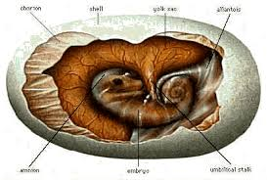
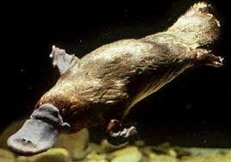
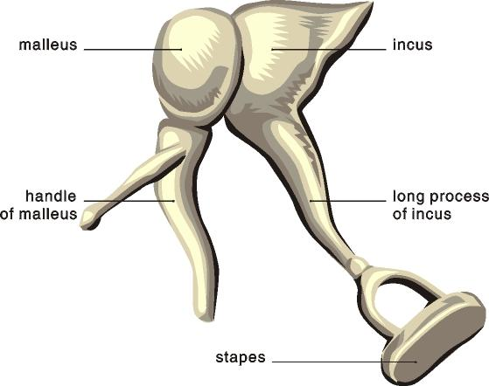
Derived Characters
A derived character is a trait that emerged from a common ancestor and was passed along to its descendants.
All organisms that share that derived character are descended from an ancestor that had that characteristic.

Slide 12
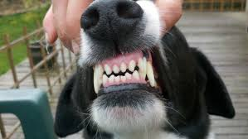
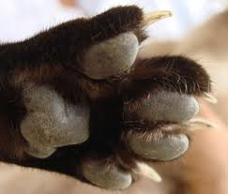
Derived Characters
For example all members of the clade carnivora have specialized sheering teeth – as these were inherited from a common ancestor.
Retractable claws are found in Lions but not coyotes – retractable claws are a derived character in the lineage leading to the cat family.

Slide 13
Reading Cladograms
The lowest node on a cladogram represents the last common ancestor.
The forks represent the order in which various groups branched off from the largest clade over the course of evolution.
A series of derived characteristics is listed along the main trunk of the cladogram – showing the order in which they arose.
Notice how the smaller clades are nestled within the bigger ones.

Slide 14
Reading Cladograms
The chicken or the egg, which came first?
Clade Tetrapoda
Clade Amniota
Clade Mammalia
Clade Carnivora
Clade Felidae
Amphibians
Reptiles
Marsupials
Dogs
Cats
Retractable claws
Specialized shearing teath
Hair
Amniotic egg
Four Limbs

Slide 15
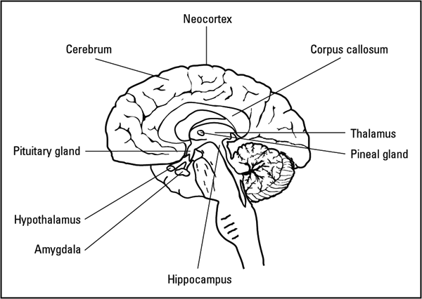
Clades and Traditional Taxonomic Groups
Sometimes the clades used in phylogeny correspond to the taxonomic system.
For example the clade Mammalia corresponds to class Mammalia in Linnaeus’s system – they are all vertebrates with hair, 3 middle ear bones, mammary glands and a neo cortex.

Slide 16
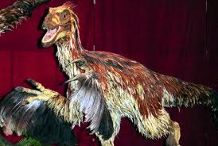
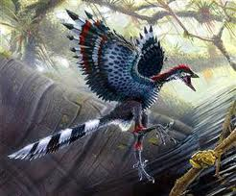
Clades and Traditional Taxonomic Groups
Sometimes however it has lead to a revised classification. For example according to the cladistics system we can see that birds are descended from a group of dinosaurs.
Birds are then viewed as a clade within the larger clade that includes dinosaurs.

Slide 17
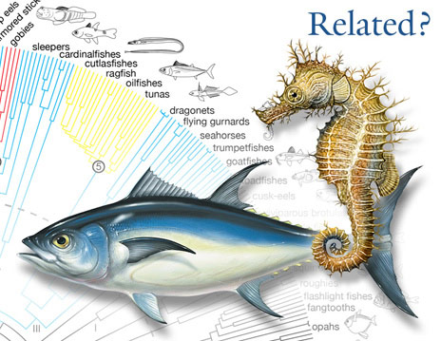
DNA in Classification
So far we have examined cladistics analysis based on physical characteristics.
The goal of modern systematics is to understand the evolutionary relationships of all life on Earth.

Slide 18
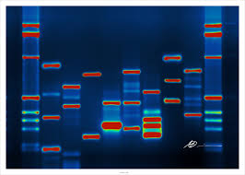
DNA in Classification
Our new understanding of DNA and RNA has allowed scientists to study specific genes as derived characters.
The more similar the DNA sequences of two species, the more derived characters they share, the more recently they shared a common ancestor.

Slide 19
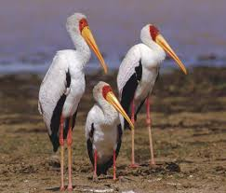
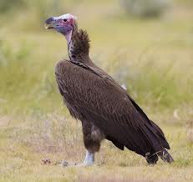
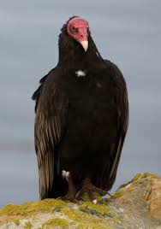
New Techniques Redraw Old Trees
Family Accipitridae
Family Ciconiidae
Both the American vulture and the African vulture were traditionally classified in the same family due to their similar appearances
Storks
African vulture
American vulture

Slide 20
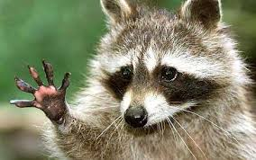
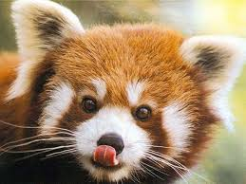
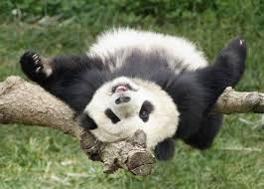
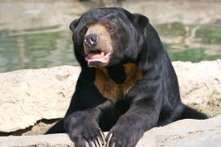
We used to think that giant pandas were more closely linked to raccoons and red pandas. DNA analysis showed that giant pandas were more closely related to bears in the family Ursidae.

Slide 22
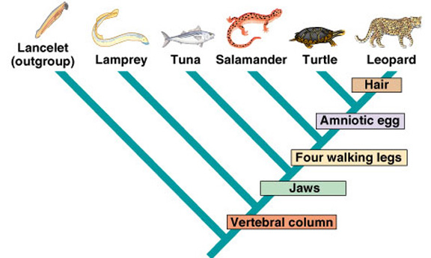

Slide 23
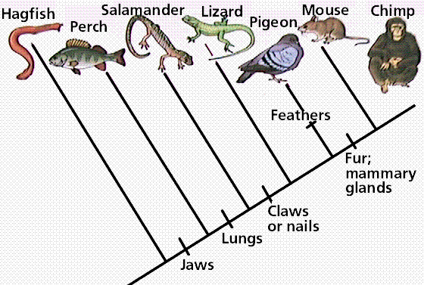

Slide 24
Building the Tree of Life
Chapter 18.3

Slide 25
Changing Ideas about Kingdoms
In Linnaeus's initial system the only known differences were between animals and plants.
Classification systems have changed dramatically since Linnaeus’s time.
First introduced | Names of Kingdoms
1700s | Plantae |  |  |  |  | Animalia
Late 1800s | Protista |  |  | Plantae |  | Animalia
1950s | Monera |  | Protista | Fungi | Plantae | Animalia
1990s | Eubacteria | Archaebacteria | Protista | Fungi | Plantae | Animalia

Slide 26
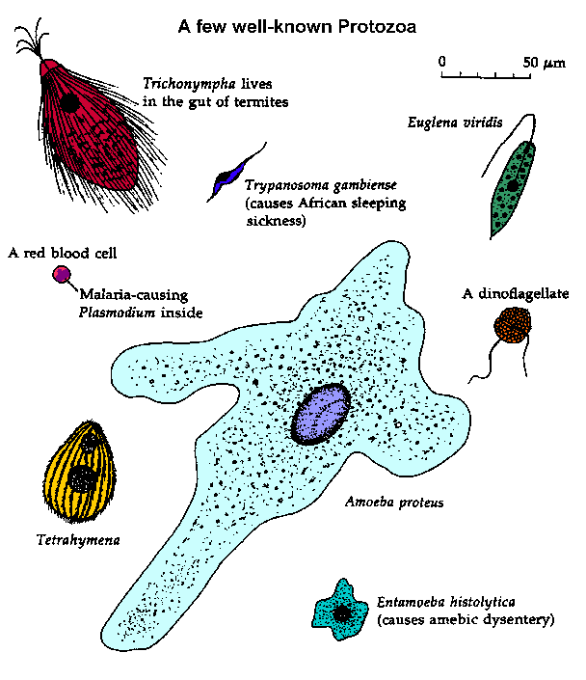
2 then 3 then 5 then 6 Kingdoms
As researchers studies life they realized that single cell organisms were significantly different from plants and animals and so created a 3rd kingdom – Protista.
Then researchers realized that some of these single celled organisms such as yeasts and molds were similar to other plant-like organisms so they were placed in their own kingdom – Fungi.

Slide 27
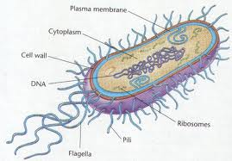
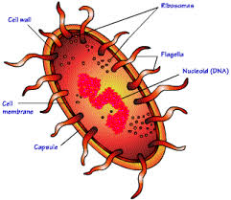
2 then 3 then 5 then 6 Kingdoms
Later still scientists started to recognize bacteria and placed them in another kingdom – Monnera.
Later scientists recognized that these bacteria were in fact two distinct kingdoms – Eubacteria and Archebacteria

Slide 28
Tree of Life
Scientists now use a three-domain system to describe life.
Domain | Bacteria | Archea | Eukarya
Kingdom | Eubacteria | Archaebacteria | Protista | Fungi | Plantae | Animalia
Cell type | Prokaryote | Prokaryote | Eukaryote
Number of Cells | Unicellular | Unicellular | Most unicellular | Most multicellular | Multicellular | Multicellular
Examples | E.Coli | Holophiles | Amoeba | Yeasts | Mosses, flowering plants | Sponges, fishes, mammals

Slide 30
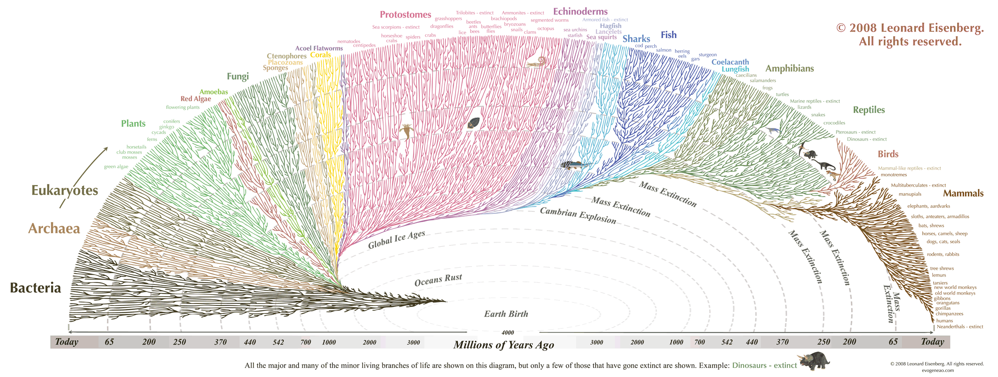
Tree of Life

