Slide 1
Finding Order in Diversity
Chapter 18.1

Slide 2
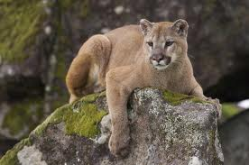
Why Classify?
To study the diversity of life, biologists use a classification system to name organisms and group them in a logical manner.
In the scientific discipline of taxonomy, scientists classify organisms and assign them a universally accepted name.
WRONG! WRONG! WRONG!
Mountain lion or cougar?
What animal is this?
I would have accepted puma or panther

Slide 3
Linnaeus’s System of Classification
Carolus Linnaeus (1707-1778) brought order to the process of naming species and classifying them into groups.
His hierarchical system of classification includes seven levels.
The different levels are:
Kingdom, phylum, class, order, family, genus, and species. Each level is known as a taxon.

Slide 4
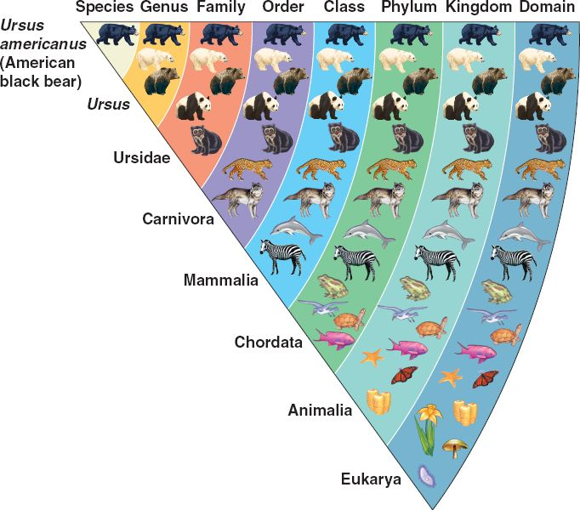

Slide 5
Keep Pond Clean or Froggy Gets Sick
I
N
G
D
O
M
H
Y
L
U
M
L
A
S
S
A
M
I
L
Y
E
N
U
S
P
E
C
I
E
S

Slide 6
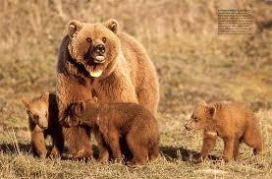
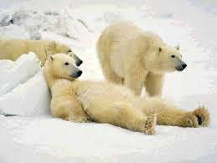
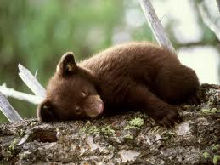
How the system works
Species is the smallest category and includes all individuals who are capable of mating and producing viable offspring that can reproduce.
For example grizzly bears
The level above species is genus. This would include all bear like creatures who resemble the grizzly bear.
Ursus arctos
Genus Ursus

Slide 7
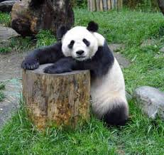
The Family
Genera that share many characteristics are then grouped into the next taxon up – the family
Family - Ursidae

Slide 8
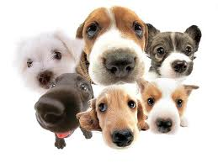
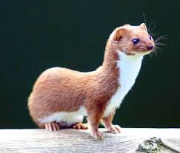
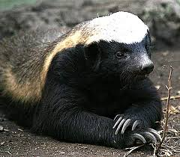
The Order
The next level up is the order. An order is a broad taxonomic category composed of similar families.
Order Carnivora

Slide 9
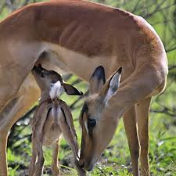
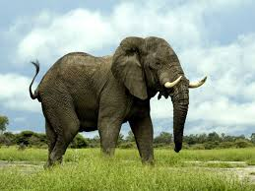
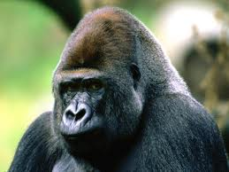
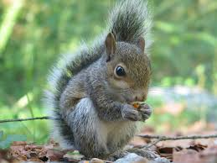
Class
The next level up is class. In the case of our example, order carnivore is placed in the Mammalia class.
Class Mammalia

Slide 10
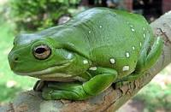
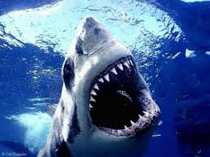
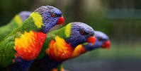
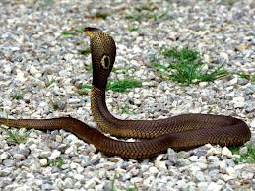
Phylum
Several different classes make up the phylum. A phylum includes several different orders and classes that share important characteristics. In this case the phylum chordata all share similar body plans.
Phylum Chordata
Birds – class Aves
Amphibians – class Amphibia
Reptiles – class Reptilia
All classes of fish

Slide 11
Kingdom
The kingdom is the largest and most inclusive of Linnaeus’s taxonomic categories. Laneus named 2 kingdoms – plants and animals.
We now have six – bacteria, archea, protista, plants, fungi and animals.

Slide 12
The 6 Kingdom Model

Slide 13
The Problem With Taxonomy
Although this system took many years to develop scientists have now discovered that it is fundamentally flawed and we are in the process of updating and improving it.
However it continues to be in common use today.
The problem with this system is that it is based on assumptions and the reality is that two organisms who may look similar could have completely different evolutionary histories.

Slide 14
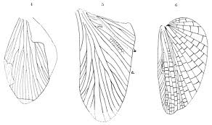
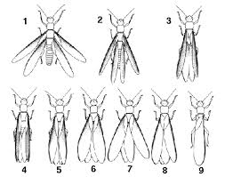
How do we classify wings?

