Slide 2
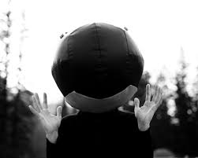
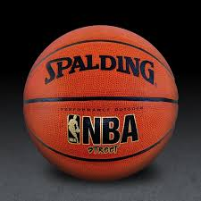
What is Density?
Density is the amount of matter per unit of volume.
Which has more mass medicine ball or a basketball?
Which has more volume?

Slide 3
Mathematical Formula

Slide 4
Units of Density
The units of measurement for density are a combination of mass and volume.
For example if you have a 5 gram (g) mass and a 10 cubic centimeter (cm³) volume your units would be g/cm³

Slide 5
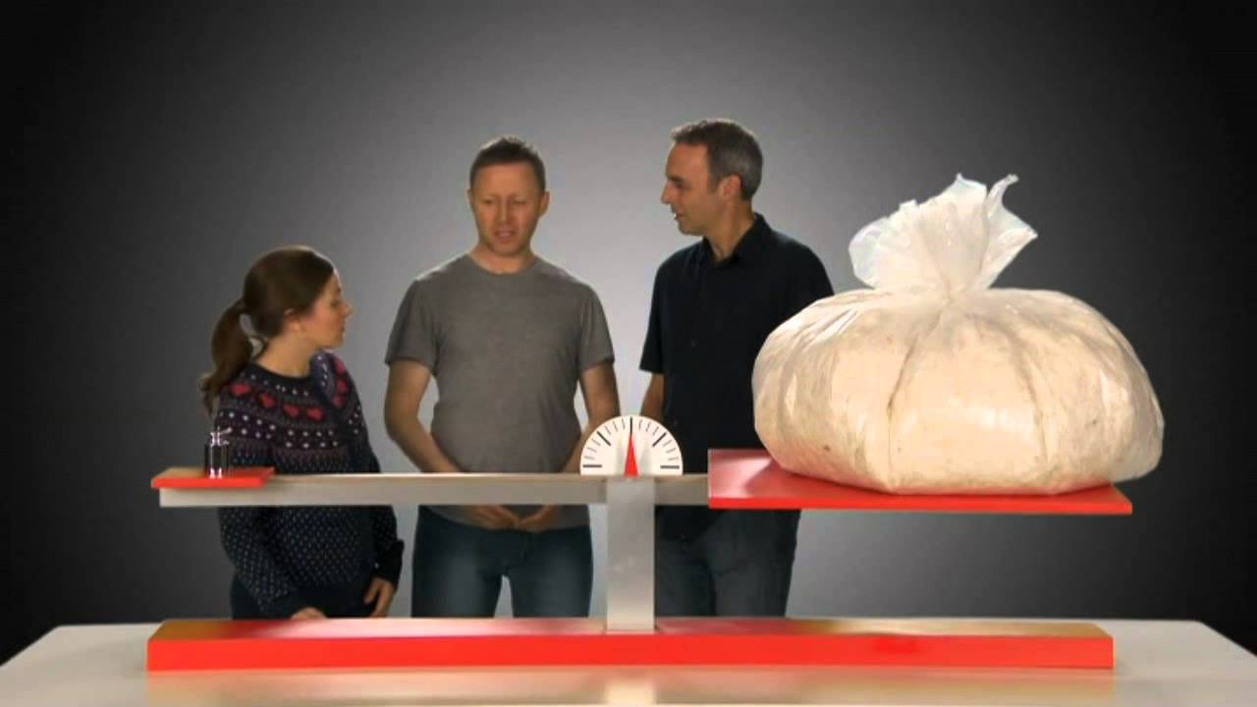
Common Misconceptions
Bigger things are not always heavier or contain more mass
An objects density will determine how much mass it has

