Slide 1
Distance vs Time A Review
Mr. McLean – Physical Science

Slide 2
What does a distance-time graph show us?
How far an object has moved in a period of time.
A distance time graph does not plot speed but you can calculate speed from the graph.
The shape of the graph can tell us if an object is moving at a constant speed or if it is accelerating

Slide 4
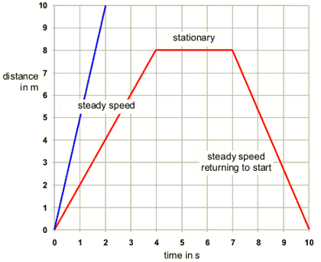
Graph to show distance traveled and time

Slide 5
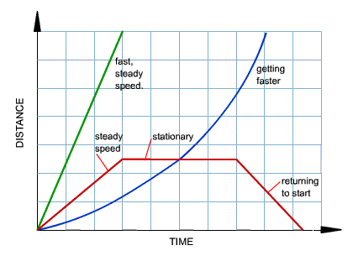
Graph to show distance traveled and time
Distance

Slide 6
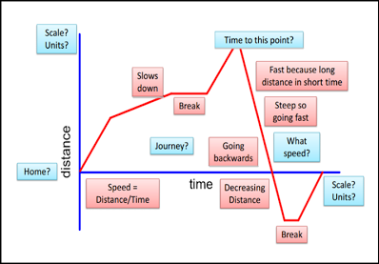
Graph to show distance traveled and time

Slide 7
